Slide 1
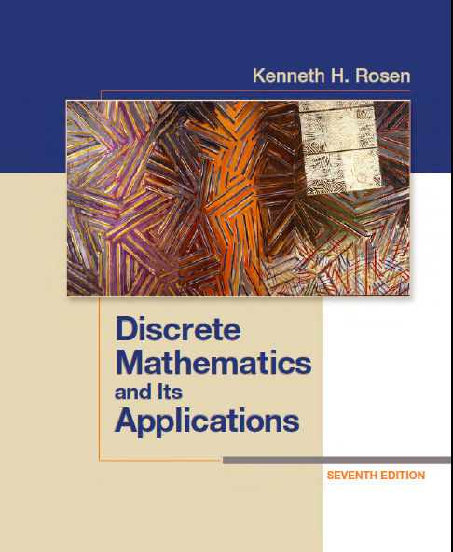
Discrete Math
Haiming Chen
Associate Professor, PhD
Department of Computer Science,
Ningbo University
http://www.chenhaiming.cn

Slide 2
Curriculum Progress
Part I：Logic （Thinking in Mathematics）
Propositional Logic, Predicates and Quantifiers
Definition, Theorem, Corollary and Proofs (Induction)
Part II：Combinatorial Counting
The Basic of Counting
The Pigeonhole Principle
Permutation and Combination
Binomial Coefficients and Combinations
Lists and Sequences (Recursive Definition /Recurrence Relations)
Part III: Discrete Structure
Sets
Functions
Relations
Graphs
Trees
Part IV: Algebra
Algebra (Groups) *
Boolean Algebra

Slide 3
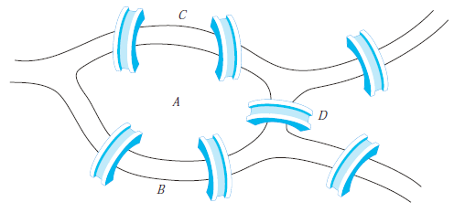
Euler Paths and Circuits
The problem of traveling across every bridge without crossing any bridge more than once

Slide 4
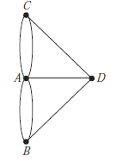
Euler Paths and Circuits
Is there a simple circuit in this multigraph that contains every edge?
Euler circuit
An Euler path in G is a simple path containing every edge of G.

Slide 5
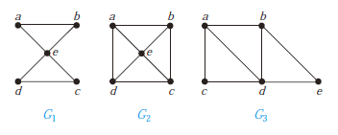
Euler Paths and Circuits
Which of the undirected graphs have an Euler circuit? Of those that do not, which have an Euler path?

Slide 6
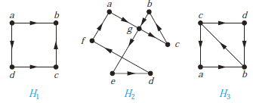
Euler Paths and Circuits
Which of the undirected graphs have an Euler circuit? Of those that do not, which have an Euler path?

Slide 7
Necessary and Sufficient Conditions
A connected multigraph with at least two vertices has an Euler circuit if and only if each of its vertices has even degree.

Slide 8
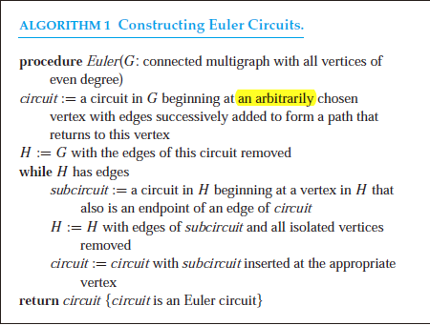
Constructing Euler Circuits

Slide 9
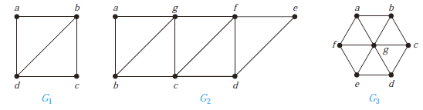
Necessary and Sufficient Conditions
A connected multigraph has an Euler path but not an Euler circuit if and only if it has exactly two vertices of odd degree.

Slide 10
Applications
Chinese postman problem
finding a circuit in a graph with the fewest edges that traverses every edge at least once

Slide 11
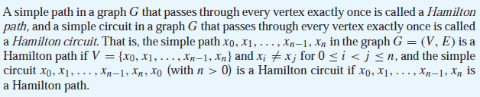
Hamilton Paths and Circuits
simple paths and circuits that contain every vertex of the graph exactly once

Slide 12
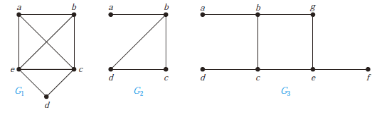
Hamilton Paths and Circuits

Slide 13
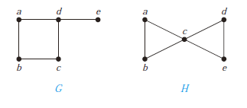
Conditions of the existence of Hamilton Circuit
no known simple necessary and sufficient criteria for the existence of Hamilton circuits

Slide 14


Conditions of the existence of Hamilton Circuit

Slide 15
Traveling Salesperson Problem or TSP
examine all possible Hamilton circuits and select one of minimum total length
approximation algorithm

Slide 16
Homework
Chapter 10.5
6, 10, 20, 32, 47(b)(d)
Chapter 10.6
26

