Slide 1
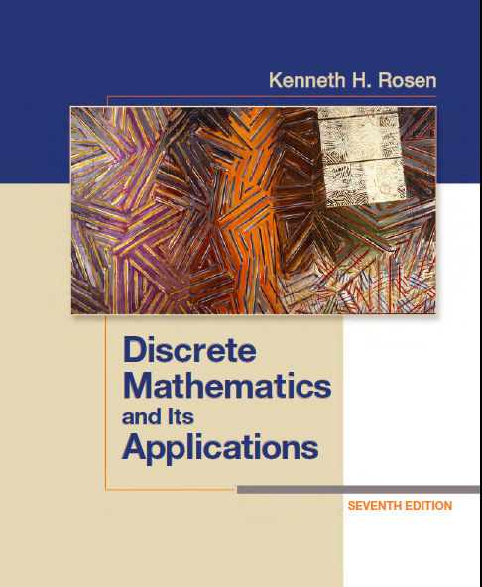
Discrete Math
Haiming Chen
Associate Professor, PhD
Department of Computer Science,
Ningbo University
http://www.chenhaiming.cn

Slide 2
Curriculum Progress
Part I：Logic （Thinking in Mathematics）
Propositional Logic, Predicates and Quantifiers
Definition, Theorem, Corollary and Proofs (Induction)
Part II：Combinatorial Counting
The Basic of Counting
The Pigeonhole Principle
Permutation and Combination
Binomial Coefficients and Combinations
Lists and Sequences (Recursive Definition /Recurrence Relations)
Part III: Discrete Structure
Sets
Functions
Relations
Graphs
Trees
Part IV: Algebra
Algebra (Groups) *
Boolean Algebra

Slide 3
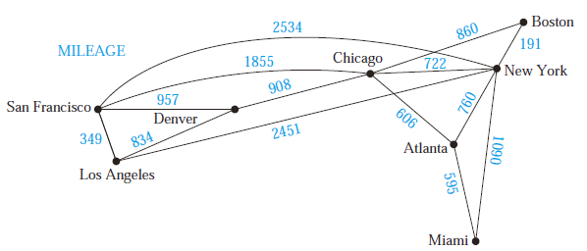
Shortest-Path Problems
Weighted Graphs

Slide 4
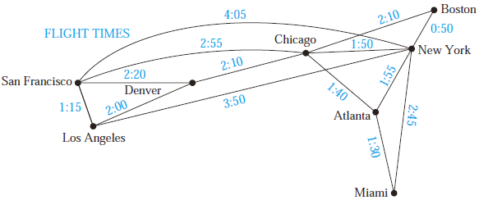
Shortest-Path Problems
Weighted Graphs

Slide 5
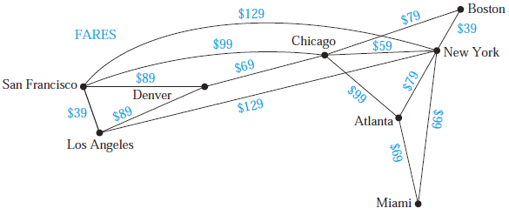
Shortest-Path Problems
Weighted Graphs

Slide 6
Shortest-Path Problems
What is a shortest path, that is, a path of least length, between two given vertices?

Slide 7
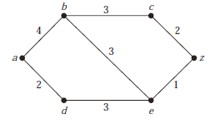
Shortest-Path Problems
What is the length of a shortest path between a and z ?

Slide 8
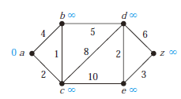
Dijkstra’s algorithm

Slide 9
Dijkstra’s algorithm
L_{k}(a, v) =
min{L_{k−1}(a, v), L_{k−1}(a, u) + w(u, v)},
S_{k} is the distinguished set
v be a vertex not in S_{k}
u is the vertex chosen to be added to S_{k} at each step

Slide 10
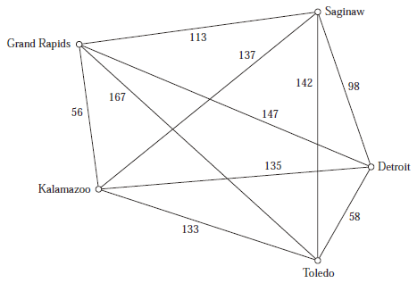
Dijkstra’s algorithm

Slide 11
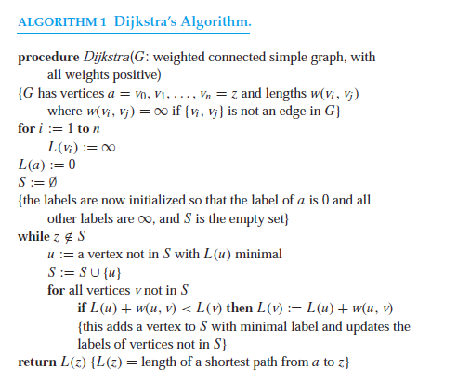
Dijkstra’s algorithm

Slide 12
Dijkstra’s algorithm
Dijkstra’s algorithm uses O(n²) operations (additions and comparisons) to find the length of a shortest path between two vertices in a connected simple undirected weighted graph with n vertices.

Slide 13
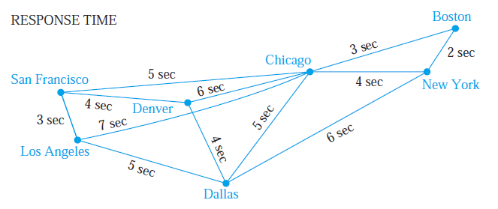
Example

Slide 14
Extended Study
Show that Dijkstra’s algorithm may not work if edges can have negative weights.
Floyd’s algorithm
Exercise 21-24

Slide 15
Homework
Chapter 10.6
2, 28

