Slide 1
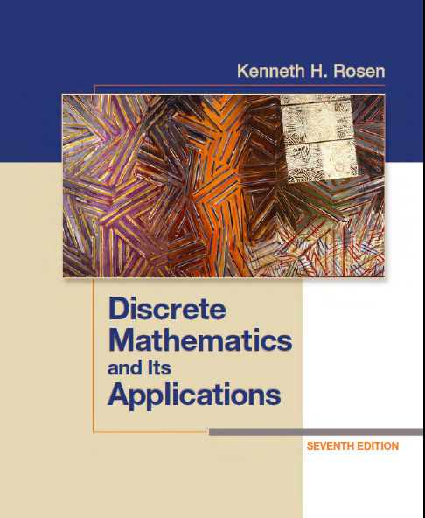
Discrete Math
Haiming Chen
Associate Professor, PhD
Department of Computer Science,
Ningbo University
http://www.chenhaiming.cn

Slide 2
Curriculum Progress
Part I：Logic （Thinking in Mathematics）
Propositional Logic, Predicates and Quantifiers
Definition, Theorem, Corollary and Proofs (Induction)
Part II：Combinatorial Counting
The Basic of Counting
The Pigeonhole Principle
Permutation and Combination
Binomial Coefficients and Combinations
Lists and Sequences (Recursive Definition /Recurrence Relations)
Part III: Discrete Structure
Sets
Functions
Relations
Graphs
Trees
Part IV: Algebra
Algebra (Groups) *
Boolean Algebra

Slide 3

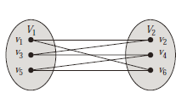
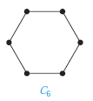
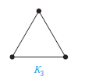
Bipartite Graphs
C₆

Slide 4
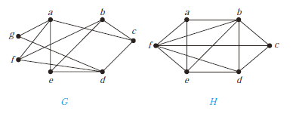
Example 1
How to determine whether a graph is bipartite?

Slide 5
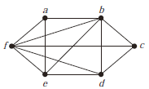
Bipartite Graphs
A simple graph is bipartite if and only if it is possible to assign one of two different colors to each vertex of the graph so that no two adjacent vertices are assigned the same color.

Slide 6
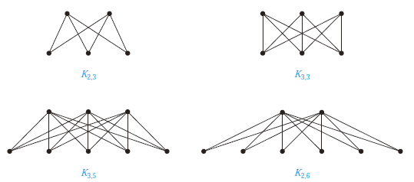
Complete Bipartite Graphs
K_{m,n} is a graph that has its vertex set partitioned into two subsets of m and n vertices, respectively with an edge between two vertices if and only if one vertex is in the first subset and the other vertex is in the second subset.

Slide 7
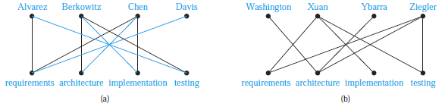
Bipartite Graphs and Matchings
Job Assignments
Matching M
Unmatched

Slide 8
Matching
a matching M in a simple graph G = (V ,E) is a subset of the set E of edges of the graph such that no two edges are incident with the same vertex.
A maximum matching is a matching with the largest number of edges.
A complete matching from V₁ to V₂ if every vertex in V₁ is the endpoint of an edge in the matching, or equivalently, if |M| = |V₁|.

Slide 9

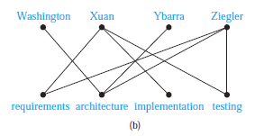
Matching
How to determine whether a complete matching from V₁ to V₂ exists when (V₁, V₂) is a bipartition of a bipartite graph G = (V ,E).

Slide 10
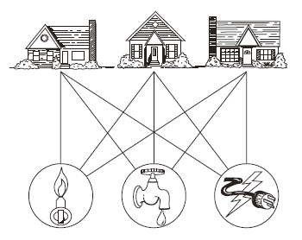
Planar Graphs
Is it possible to find at least one
way to represent this graph in a plane without any edges crossing?
complete bipartite graph K_{3,3}

Slide 11

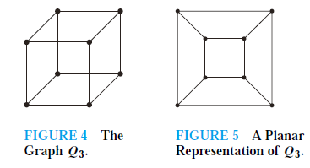
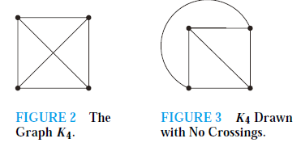
Planar Graphs

Slide 12
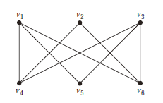
Planar Graphs

Slide 13

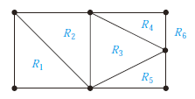
Euler’s Formula
A planar representation of a graph splits the plane into regions, including an unbounded region

Slide 14
COROLLARY
If G is a connected planar simple graph with e edges and v vertices, where v ≥ 3, then e ≤ 3v − 6.
If G is a connected planar simple graph, then G has a vertex of degree not exceeding five.
If a connected planar simple graph has e edges and v vertices with v ≥ 3 and no circuits of length three, then e ≤ 2v − 4.

Slide 15
Kuratowski’s Theorem
Elementary subdivision (初等细分)If a graph is planar, so will be any graph obtained by removing an edge {u, v} and adding a new vertex w together with edges {u, w} and {w, v}. Such an operation is called an.
The graphs G1 = (V1,E1) and G2 = (V2,E2) are called homeomorphic （同胚）if they can be obtained from the same graph by a sequence of elementary subdivisions.

Slide 16
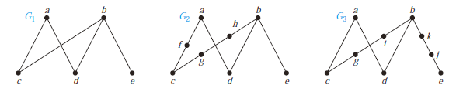
Kuratowski’s Theorem

Slide 17
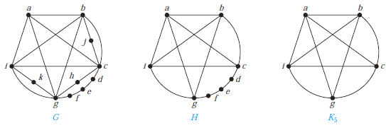
Kuratowski’s Theorem

Slide 18
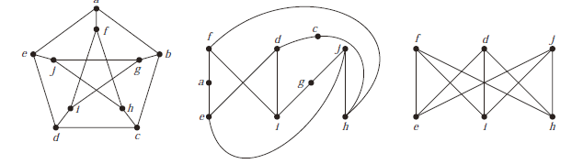
Kuratowski’s Theorem

Slide 19
Homework
Chapter 10.2
24, 26, 30
Chapter 10.7
4, 6, 12, 14, 18, 22, 24

