Slide 1
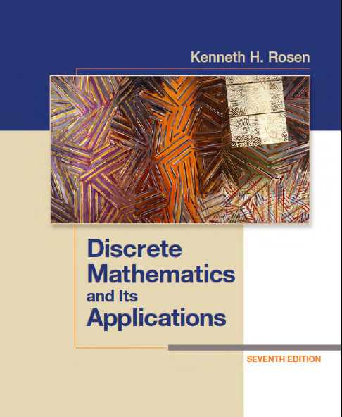
Discrete Math
Haiming Chen
Associate Professor, PhD
Department of Computer Science,
Ningbo University
http://www.chenhaiming.cn

Slide 2
Curriculum Progress
Part I：Logic （Thinking in Mathematics）
Propositional Logic, Predicates and Quantifiers
Definition, Theorem, Corollary and Proofs (Induction)
Part II：Combinatorial Counting
The Basic of Counting
The Pigeonhole Principle
Permutation and Combination
Binomial Coefficients and Combinations
Lists and Sequences (Recursive Definition /Recurrence Relations)
Part III: Discrete Structure
Sets
Functions
Relations
Graphs
Trees
Part IV: Algebra
Algebra (Groups) *
Boolean Algebra

Slide 3
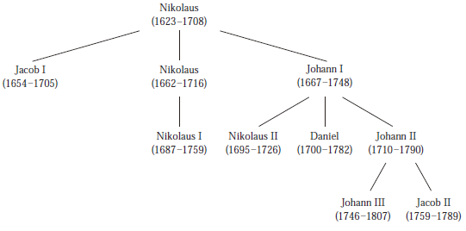
Introduction to Trees

Slide 4
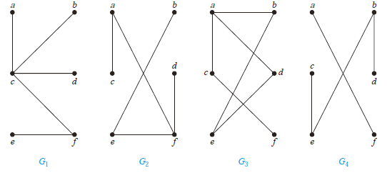
Introduction to Trees

Slide 5
Introduction to Trees
A tree is a connected undirected graph with no simple circuits.
A tree cannot contain multiple edges or loops.
Any tree must be a simple graph.

Slide 6
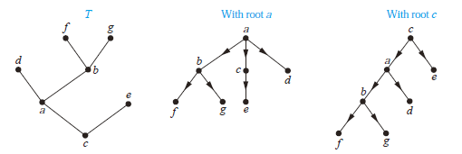
Rooted Trees
A rooted tree is a tree in which one vertex has been designated as the root and every edge is directed away from the root.
defined recursively

Slide 7
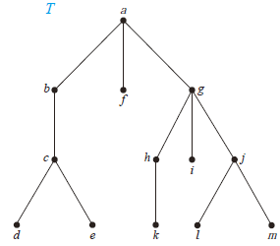
Rooted Trees
Parent
Child
Siblings
Ancestors
Descendants
Leaf
Internal vertices
Subtree

Slide 8
m-ary tree
m-ary tree if every internal vertex has no more than m children
full m-ary tree if every internal vertex has exactly m children
binary tree: an m-ary tree with m = 2

Slide 9
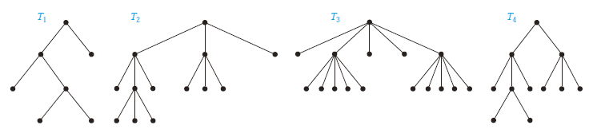
m-ary tree

Slide 10
ordered rooted tree
a rooted tree where the children of each internal vertex are ordered
from left to right

Slide 11
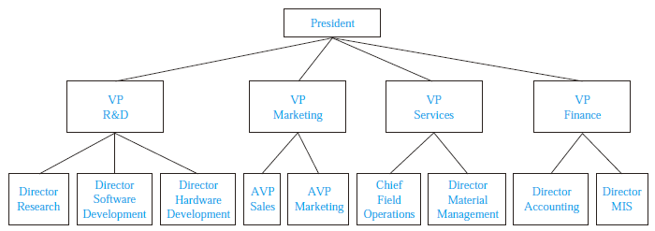
Trees as Models
Representing Organizations
Computer File Systems

Slide 12
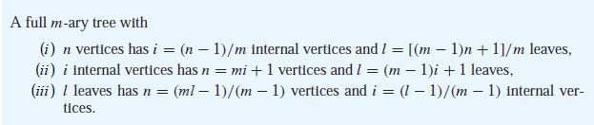
Properties of Trees
A tree with n vertices has n − 1 edges.
A full m-ary tree with i internal vertices contains n = mi + 1 vertices.

Slide 13
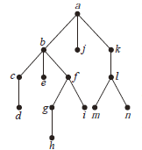
Properties of Trees
level of a vertex v in a rooted tree
height of a rooted tree
balanced if all leaves are at levels h or h − 1

Slide 14
Properties of Trees
There are at most m^{h} leaves in an m-ary tree of height h.
If the m-ary tree is full and balanced, then h = ┌log_{m} l ┐.

Slide 15
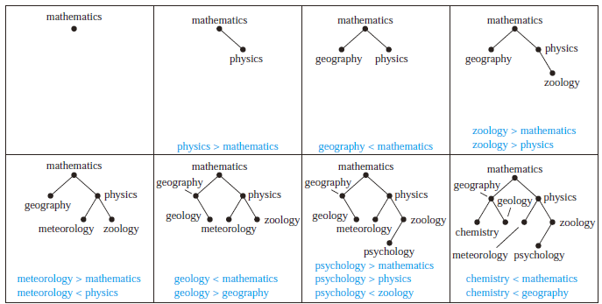
Applications of Trees
Binary Search

Slide 16
Applications of Trees
Huffman coding
Use Huffman coding to encode the following symbols with the frequencies listed: A: 0.08, B: 0.10, C: 0.12, D: 0.15, E: 0.20, F: 0.35. What is the average number of bits used to encode a character?

Slide 17
Homework
Chapter 11.1
4, 6, 18, 20
Chapter 11.2
24, 30

