Slide 1
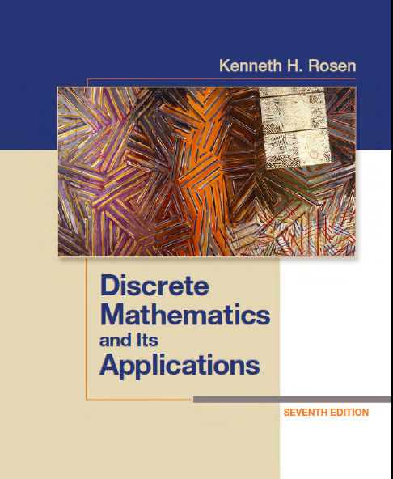
Discrete Math
Haiming Chen
Associate Professor, PhD
Department of Computer Science,
Ningbo University
http://www.chenhaiming.cn

Slide 2
Logic and Proofs
Propositional Logic
Predicates and Quantifiers
Inference/Reasoning (Logic Argument)
Proof (Mathematical Argument )
Notes:
Mathematical argument 数学论证 proof
Conjecture 推测

Slide 3
Introduction
“It is not sunny this afternoon and it is colder than yesterday,”
“We will go swimming only if it is sunny,”
“If we do not go swimming, then we will take a canoe trip,”
“If we take a canoe trip, then we will be home by sunset”
“We will be home by sunset.”

Slide 4
Argument
Premise
The truth of the preceding statements
Conclusion
The final statement
Valid Argument
Rules of inference: the truth of all the premises implies that the conclusion is true
Invalid Argument
Incorrect reasoning: fallacies

Slide 5

Valid Argument
“If you have a current password, then you can log onto the network.”
“You have a current password.”
“You can log onto the network.”
((p → q) ∧ p) → q

Slide 6
Invalid Argument
“If you have access to the network, then you can change your grade.”
“You can log onto the network.”
“You can change your grade.”

Slide 7
Definition
the argument form with premises p₁, p₂, . . . , p_{n} and conclusion q is valid, when (p₁ ∧ p₂ ∧ · · · ∧ p_{n}) → q is a tautology.

Slide 8

Rules of Inference
modus ponens (law of detachment)

Slide 9
Example 1
“If it snows today, then we will go skiing”
“It is snowing today ,”
“We will go skiing,”

Slide 10

Example 2

Slide 11
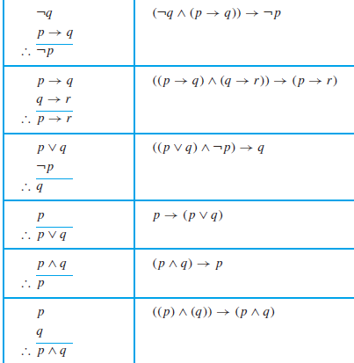

Rules of Inference
Resolution
Resolvent
r = F

Slide 12
Example 3
“Jasmine is skiing or it is not snowing”
“It is snowing or Bart is playing hockey”
“Jasmine is skiing or Bart is playing hockey.”

Slide 13
Example 4
Show that the premises (p ∧ q) ∨ r and r → s imply the conclusion p ∨ s.
p ∨ r
q∨ r
￢r ∨s
p ∨ s
q ∨ s
(p ∧ q) ∨ r
￢r ∨s
(p ∧ q) ∨ s
(p ∨ s) ∧ (q ∨ s)
(p ∨ s)

Slide 14
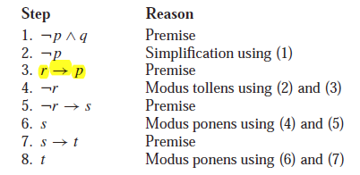
Example 5
“It is not sunny this afternoon and it is colder than yesterday,”
“We will go swimming only if it is sunny,”
“If we do not go swimming, then we will take a canoe trip,”
“If we take a canoe trip, then we will be home by sunset”
“We will be home by sunset.”
p : It is sunny this afternoon,
q : It is colder than yesterday,
r :We will go swimming,
s :We will take a canoe trip,
t :We will be home by sunset.

Slide 15
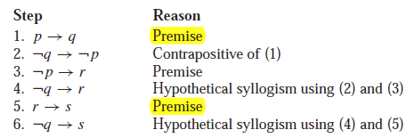
Example 6
“If you send me an e-mail message, then I will finish writing the program,”
“If you do not send me an e-mail message, then I will go to sleep early,”
“If I go to sleep early, then I will wake up feeling refreshed ,”
“If I do not finish writing the program, then I will wake up feeling refreshed.”
p : You send me an e-mail message,
q : I will finish writing the program,
r: I will go to sleep early,
s: I will wake up feeling refreshed.

Slide 16
Fallacies (1)
If you do every problem in this book, then you will learn discrete mathematics.
You learned discrete mathematics.
Therefore, you did every problem in this book.
fallacy of affirming the conclusion
((p → q) ∧ q) → p is not a tautology

Slide 17
Fallacies (2)
If you do every problem in this book, then you will learn discrete mathematics.
You don’t do every problem in this book.
Therefore, you don’t learn discrete mathematics.
fallacy of denying the hypothesis
((p → q)∧￢p)→￢q is not a tautology

Slide 18

Examples from Lewis Carroll
“All lions are fierce.”
“Some lions do not drink coffee.”
“Some fierce creatures do not drink coffee.”
P(x), “x is a lion,”
Q(x), “x is fierce,”
R(x) ,“x drinks coffee,”
domain consists of all creatures
Notes:
Chapter 1.4

Slide 19
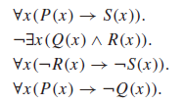
Examples from Lewis Carroll
“All hummingbirds are richly colored.”
“No large birds live on honey.”
“Birds that do not live on honey are dull in color.”
“Hummingbirds are small.”
P(x), “x is a hummingbird,”
Q(x), “x is large,”
R(x), “x lives on honey,”
S(x),“x is richly colored,”
domain consists of all birds

Slide 20
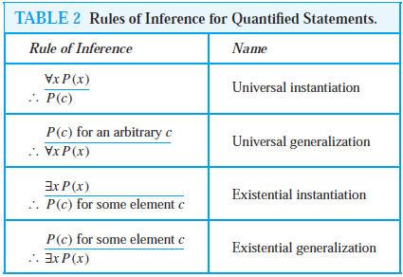
Rules of Inference for Quantified Statements

Slide 21
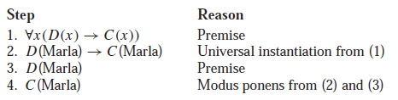
Example 7
“Everyone in this discrete mathematics class has taken a course in computer science”
“Marla is a student in this class”
“Marla has taken a course in computer science.”
D(x) :“x is in this discrete mathematics class,”
C(x) :“x has taken a course in computer science.”

Slide 22
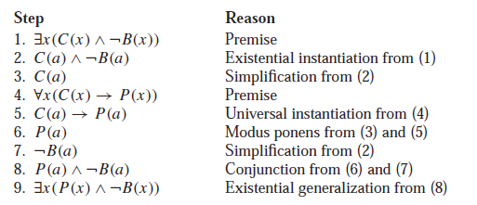
Example 8
“A student in this class has not read the book,”
“Everyone in this class passed the first exam”
“Someone who passed the first exam has not read the book.”
C(x) :“x is in this class,”
B(x) :“x has read the book,”
P(x) :“x passed the first exam.”

Slide 23

Example 9
“For all positive integers n, if n is greater than 4, then n² is less than 2^{n}”
100² < 2¹⁰⁰
P(n) :“n > 4”
Q(n) :“n² < 2^{n}”
domain consists of all positive integers

Slide 24
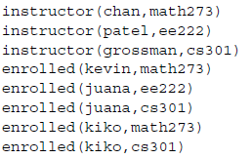
Logic Programming
Prolog (from Programming in Logic)
Prolog facts define predicates
Prolog rules are used to define new predicates
Example
instructor(p, c)
enrolled(s, c)
Prolog facts
Prolog rules
Notes:
Chapter 1.4

Slide 25
Logic Programming
?enrolled(kevin,math273)
yes
?enrolled(X,math273)
kevin
kiko
?teaches(X,juana)
patel
grossman

Slide 26
Homework
Review the Chapter 1.6
Chapter 1.4 Exercise 56;
Chapter 1.6 Exercise 8, 12, 18, 26, 30，32

