Slide 1
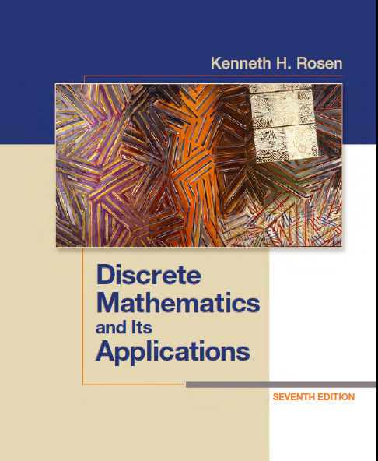
Discrete Math
Haiming Chen
Associate Professor, PhD
Department of Computer Science,
Ningbo University
http://www.chenhaiming.cn

Slide 2
Logic and Proofs
Propositional Logic
Predicates and Quantifiers
Inference/Reasoning (Logic Argument)
Proof (Mathematical Argument )
Notes:
Mathematical argument 数学论证 proof
Conjecture 推测

Slide 3
Some Terminology
Theorem
Mathematical statement that is proven to be true
Proof
A valid argument that establishes the truth of a theorem
Axiom
A statement we assume to be true
Lemma
A less important theorem that is helpful in the proof of other results
Corollary
A theorem that can be established directly from a theorem that has been proved
Conjecture
A statement that is being proposed to be a true statement, usually on the basis of some partial evidence, a heuristic argument, or the intuition of an expert

Slide 4
Methods of Proving Theorems
Direct Proofs
Proof by Contraposition
Proofs by Contradiction

Slide 5
Direct Proofs
a conditional statement p → q is true by showing that if p is true, then q must also be true, so that the combination p true and q false never occurs.

Slide 6
Example 1
Give a direct proof of the theorem “If n is an odd integer, then n² is odd.”

Slide 7
Example 2
Give a direct proof that“if m and n are both perfect squares, then nm is also a perfect square.”

Slide 8
Methods of Proving Theorems
Direct Proofs
Proof by Contraposition
Proofs by Contradiction

Slide 9
Proof by Contraposition
The conditional statement p → q can be proved by showing that its contrapositive, ￢q →￢p, is true.

Slide 10
Example 3
Prove that if n is an integer and 3n + 2 is odd, then n is odd.

Slide 11
Example 4
Prove that if n = ab, where a and b are positive integers, then a ≤ or b ≤ .

Slide 12
Direct or Indirect?
Prove that the sum of two rational numbers is rational.

Slide 13
Direct or Indirect?
Prove that if n is an integer and n² is odd, then n is odd.

Slide 14
Methods of Proving Theorems
Direct Proofs
Proof by Contraposition
Proofs by Contradiction

Slide 15
Proofs by Contradiction
Prove that p is true if we can show that ￢p → (r ∧￢r) is true for some proposition r.

Slide 16
Example 5
Show that at least four of any 22 days must fall on the same day of the week.
￢p: at most three of the 22 days fall on the same day of the week
￢p → r: at most 21 days could have been chosen
￢p → (r ∧￢r)
￢p is false
So p is true

Slide 17
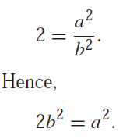
Example 6
Prove that is irrational by giving a proof by contradiction.
Suppose ￢p : is rational is true
there exist integers a and b with = a/b, where b = 0 and a and b have no common factors
a² is even, a must also be even, a = 2c
2b² = 4c², b² = 2c²
both a and b are even, that is, 2 divides both a and b
￢p → (r ∧￢r), so p is true

Slide 18
Proofs by Contradiction
contraposition of a conditional statement can be rewritten as a proof by contradiction
p → q
￢(p → q)
p ∧ ￢ q

Slide 19
Proofs by Contradiction
Give a proof by contradiction of the theorem “If 3n + 2 is odd, then n is odd.”
Assume that 3n + 2 is odd and that n is not odd.
Because n is even, there is an integer k such that n = 2k. This implies that 3n + 2 = 3(2k) + 2 = 6k + 2 = 2(3k + 1).
3n + 2 is even.
p ∧ ￢ q → p ∧ ￢p
p ∧ ￢ q is false, so ￢ (p ∧ ￢ q) is true
p → q is true

Slide 20

Others
Exhaustive Proof and Proof by Cases
Existence Proof
Uniqueness Proofs
Formulate a conjecture about the final decimal digit of the square of an integer and prove your result.
without loss of generality
Show that there exist irrational numbers x and y such that x^{y} is rational.
Constructive or Nonconstructive

Slide 21
Proof Strategies
Forward reasoning
Backward reasoning
Looking for Counterexamples
Given two positive real numbers x and y, the arithmetic mean is always greater than the geometric mean.

Slide 22
Homework
Review the Chapter 1.7, 1.8
Chapter 1.7 Exercise 18, 32;
Chapter 1.8 Exercise 6, 10, 22, 28, 36

