Slide 1
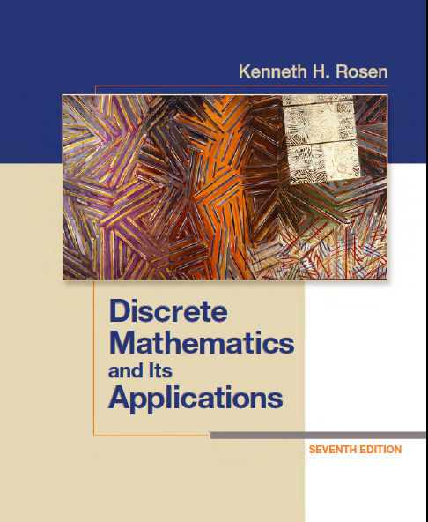
Discrete Math
Haiming Chen
Associate Professor, PhD
Department of Computer Science,
Ningbo University
http://www.chenhaiming.cn

Slide 2
Logic and Proofs
Propositional Logic
Predicates and Quantifiers
Inference/Reasoning (Logic Argument)
Proof (Mathematical Argument )
Notes:
Mathematical argument 数学论证 proof
Conjecture 推测

Slide 3
Proof
Mathematical Induction
Strong Induction and Well-Ordering

Slide 4
Mathematical Induction
mathematical induction can be used to prove statements that assert that P(n) is true for all positive integers n, where P(n) is a propositional function.
if P(1) and ∀k(P(k) → P(k + 1)) are true for the domain of positive integers, then ∀nP (n) is true.

Slide 5
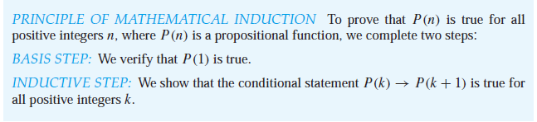
Mathematical Induction
Inductive Hypothesis
Why Mathematical Induction is Valid
An axiom for the set of positive integers: every nonempty subset of the set of positive integers has a least element
The well ordering property

Slide 6
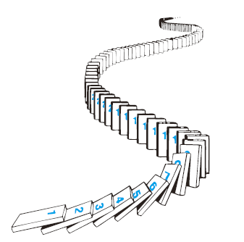
Mathematical Induction
Cannot be used to find new theorems
do not provide insights as to why theorems are true

Slide 7
Mathematical Induction
summation formulae
inequalities
identities for combinations of sets
divisibility results
theorems about algorithms
some other creative results

Slide 8
Example 1
for every positive integer n, n³ − n is divisible by 3.

Slide 9

Example 2
Show that if n is a positive integer, then

Slide 10
Example 3
Conjecture a formula for the sum of the first n positive odd integers. Then prove your conjecture using mathematical induction.

Slide 11
Mathematical Induction
summation formulae
inequalities
identities for combinations of sets
divisibility results
theorems about algorithms
some other creative results

Slide 12


Example 4
Use mathematical induction to prove the inequality

Slide 13
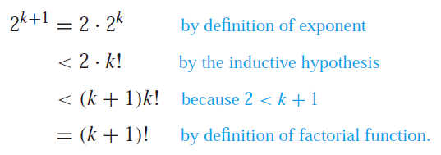
Example 5
Use mathematical induction to prove that 2^{n} < n! for every integer n with n ≥ 4.

Slide 14
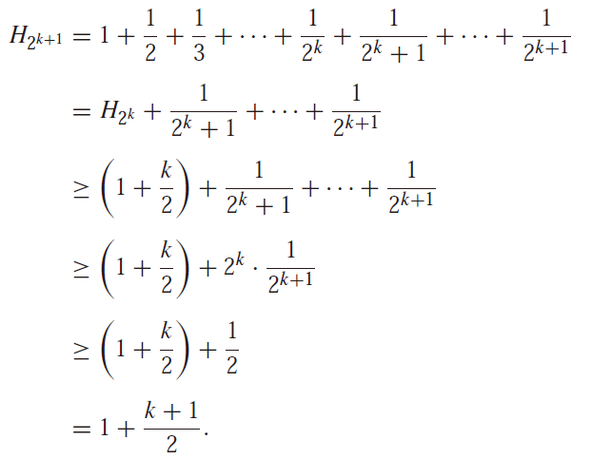


Example 6
Prove an Inequality for Harmonic Numbers

Slide 15
Mathematical Induction
summation formulae
inequalities
identities for combinations of sets
divisibility results
theorems about algorithms
some other creative results

Slide 16
Example 7
Use mathematical induction to prove that n³ − n is divisible by 3 whenever n is a positive integer.

Slide 17
Mathematical Induction
summation formulae
inequalities
identities for combinations of sets
divisibility results
theorems about algorithms
some other creative results

Slide 18
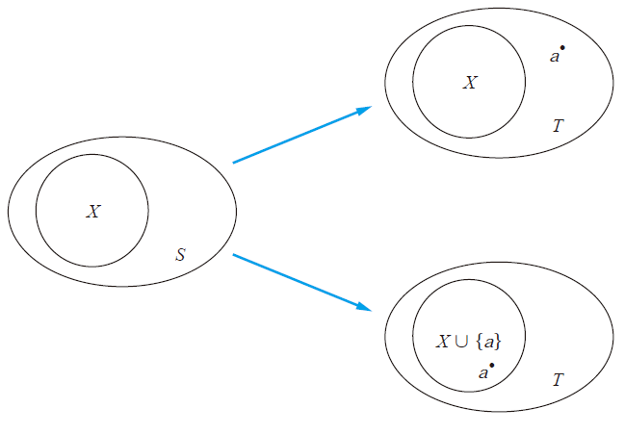
Example 8
Use mathematical induction to show that if S is a finite set with n elements, where n is a nonnegative integer, then S has 2^{n} subsets.

Slide 19
Mathematical Induction
summation formulae
inequalities
identities for combinations of sets
divisibility results
theorems about algorithms
some other creative results

Slide 20
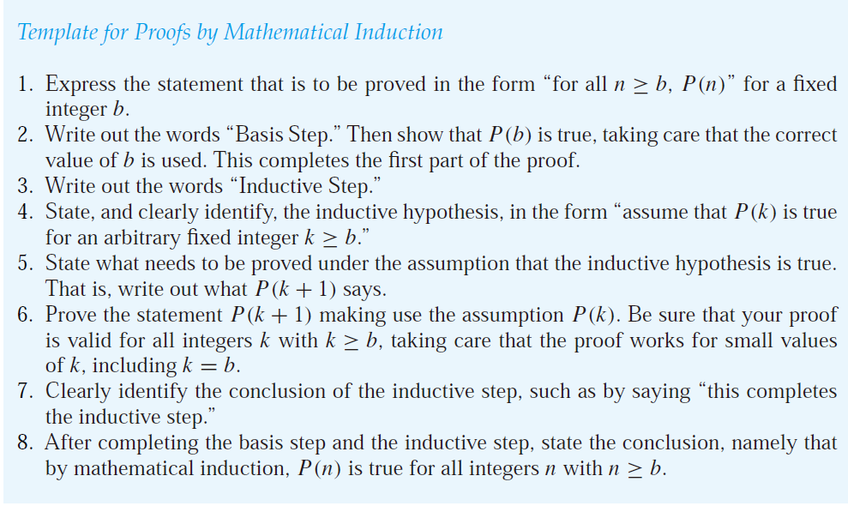
Guidelines for Proofs by Mathematical Induction

Slide 21
Proof
Mathematical Induction
Strong Induction and Well-Ordering

Slide 22
Strong Induction
if P(j) is true for all positive integers not exceeding k, then P(k + 1) is true.
Why Strong Induction is Valid
An axiom for the set of positive integers: every nonempty subset of the set of positive integers has a least element
The well ordering property

Slide 23
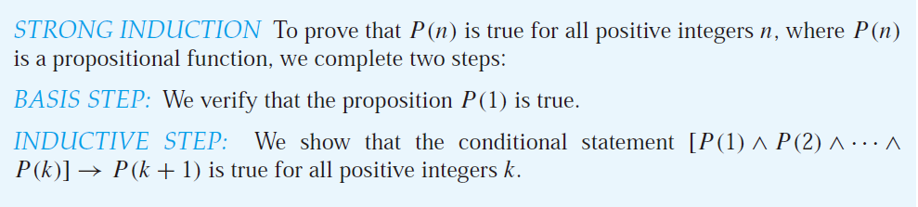
Strong Induction

Slide 24
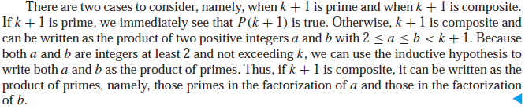
Example 9
Show that if n is an integer greater than 1, then n can be written as the product of primes.
BASIS STEP: P(2) is true, because 2 can be written as the product of one prime, itself.
INDUCTIVE STEP: The inductive hypothesis is the assumption that P(j) is true for all integers j with 2 ≤ j ≤ k, that is, the assumption that j can be written as the product of primes whenever j is a positive integer at least 2 and not exceeding k.
Then to show that P(k + 1) is true under this assumption.

Slide 25
Example 10
Prove that every amount of postage of 12 cents or more can be formed using just 4-cent and 5-cent stamps.

Slide 26
Proofs Using the Well-Ordering Property
how the well-ordering property can be used directly in proofs?
THE WELL-ORDERING PROPERTY Every nonempty set of nonnegative integers has a least element.

Slide 27
Example 11
if a is an integer and d is a positive integer, then there are unique integers q and r with 0 ≤ r < d and a = dq + r.
Let S be the set of nonnegative integers of the form a − dq, where q is an integer.
S is not empty. By the well-ordering property, S has a least element r = a − dq₀.
Suppose that r ≥ d. let r=(a − dq₀) − d = a − d(q₀ + 1) =r − d ≥ 0.
Consequently, there are integers q and r with 0 ≤ r < d.
Then prove that q and r are unique.

Slide 28
Homework
Review the Chapter 5.1, 5.2
Chapter 5.1 Exercise 12, 24;
Chapter 5.2 Exercise 12, 32, 40

