Slide 1
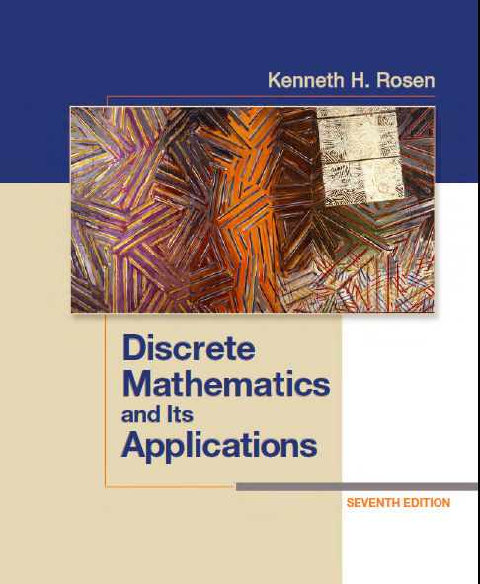
Discrete Math
Haiming Chen
Associate Professor, PhD
Department of Computer Science,
Ningbo University
http://www.chenhaiming.cn

Slide 2
Content
Part I：Logic （Thinking in Mathematics）
Propositional Logic, Predicates and Quantifiers
Definition, Theorem, Corollary and Proofs (Induction)
Part II：Combinatorial Counting
The Basic of Counting
The Pigeonhole Principle
Permutation and Combination
Binomial Coefficients and Combinations
Lists and Sequences (Recursive Definition /Recurrence Relations)
Part III: Discrete Structure
Sets
Relations
Functions
Trees
Graphs
Part IV: Algebra
Algebra (Groups) *
Boolean Algebra

Slide 3
Logic and Proofs
Propositional Logic
Predicates and Quantifiers
Inference/Reasoning (Logic Argument)
Proof (Mathematical Argument )
Mathematical Induction
Strong Induction and Well-Ordering
Translating from English into Logical Expressions
Notes:
Mathematical argument 数学论证 proof
Conjecture 推测

Slide 4
Logic Expression
You can access the Internet from campus only if you are a computer science major or you are not a freshman
Express the statements “Some student in this class has visited Mexico” and “Every student in this class has visited either Canada or Mexico” using predicates and quantifiers.

Slide 5
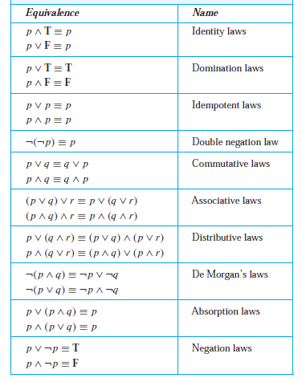
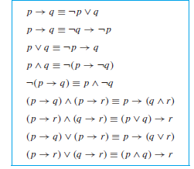
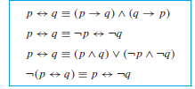
Logic Equivalences

Slide 6
Logic and Bit Operations_{P11}
A bit can be used to represent a truth value, because there are two truth values, namely, true and false.
1 represents T (true), 0 represents F (false).
A variable is called a Boolean variable if its value is either true or false.

Slide 7
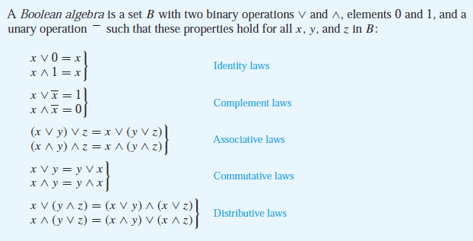
The Abstract Definition of a Boolean Algebra

Slide 8
Boolean Algebra
Chapter 12
Boolean Operators
Complement
Boolean sum
Boolean product
Precedence for boolean operators
Complement > Boolean product > sum

Slide 9
Example

Slide 10

Example

Slide 11
Boolean Function
Represented using expressions made up from variables and Boolean operations.
Every Boolean function can be represented by a Boolean expression

Slide 12
Boolean Function
Complement of the Boolean function F
Boolean sum F + G
Boolean product FG

Slide 13
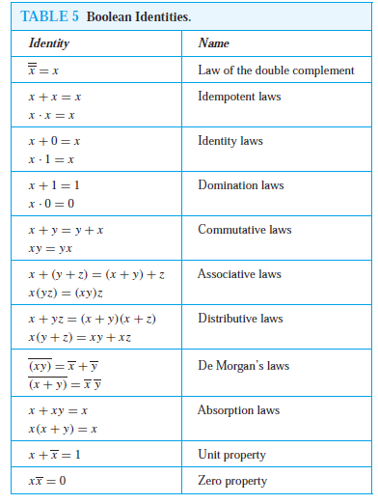
Identities of Boolean Algebra

Slide 14
Duality
The dual of a Boolean expression is obtained by interchanging Boolean sums and Boolean products and interchanging 0s and 1s.

Slide 15
Duality principle
An identity between functions represented by Boolean expressions remains valid when the duals of both sides of the identity are taken

Slide 16
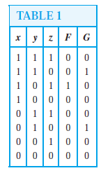
Boolean Expression
Given the values of a Boolean function, how can a Boolean expression that represents this function be found?
What’s F(x,y,z) and G(x,y,z)?

Slide 17
Sum-of-Products Expansions
Any Boolean function can be represented by a Boolean sum of Boolean products of the variables and their complements
minterm

Slide 18
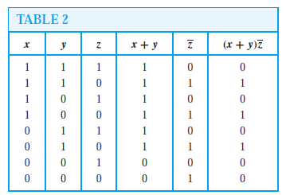
Sum-of-Products Expansions
Another way

Slide 19


Functional Completeness
Every Boolean function can be represented using these operators
{・,+, − }
{・, − }
{+, − }
| or NAND operator
↓ or NOR operator

Slide 20


Logic Gates
Basic Types of Gates

Slide 21
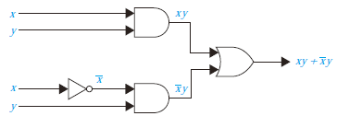
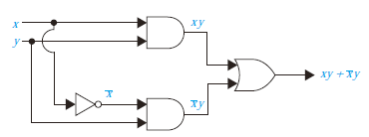
Combinations of Gates

Slide 22

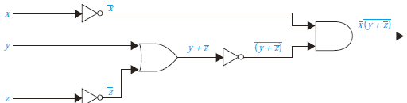
Combinations of Gates

Slide 23
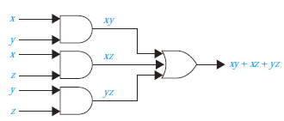
Example
Boolean Function
Boolean Expression
Logic Gates

Slide 24
Homework
Review 12.1, 12.2, 12.3
Chapter 12.1, Exercise 6(c)(d), 28
Chapter 12.2, Exercise 2(a)(b), 4(b)(c), 12(b)(d), 15,16
Chapter 12.3, Exercise 4, 6(d)

