Slide 1
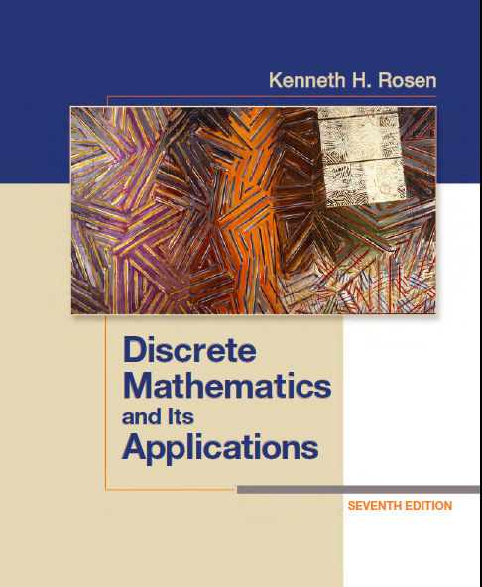
Discrete Math
Haiming Chen
Associate Professor, PhD
Department of Computer Science,
Ningbo University
http://www.chenhaiming.cn

Slide 2
Example
Boolean Function
Boolean Expression
Logic Gates
x | y | z | F
0 | 0 | 0 | 0
0 | 0 | 1 | 0
0 | 1 | 0 | 0
0 | 1 | 1 | 1
1 | 0 | 0 | 0
x | y | z | F
1 | 0 | 1 | 1
1 | 1 | 0 | 1
1 | 1 | 1 | 1

Slide 3
Minimization of Circuits
Produce Boolean sums of Boolean products that represent a Boolean function with the fewest products of literals
To construct a circuit for this function that uses the fewest gates and fewest inputs

Slide 4
Minimization of Circuits
Karnaugh Maps
Quine–MCCluskey Method
Notes:
奎因–麦克拉斯基法

Slide 5
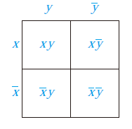
Karnaugh maps
K-maps give us a visual method for simplifying sum-of-products expansions
useful in minimizing circuits with up to six variables
minterm
Adjacent minterms, which differ in exactly one literal.

Slide 6
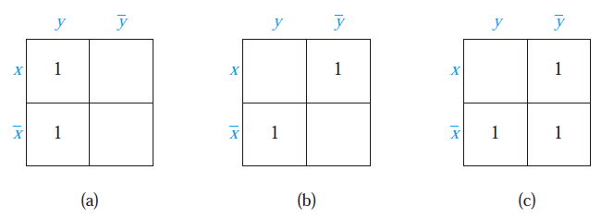
Example
Include a 1 in a cell when the minterm represented by this cell is present in the sum-of-products expansion

Slide 7
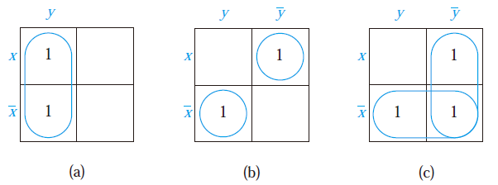
Karnaugh maps
Circle 1s in two adjacent cells in the K-map
adjacent cells can be combined into a product involving just one of the variables

Slide 8
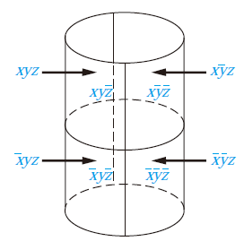
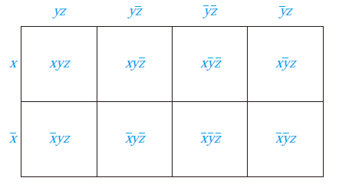
Karnaugh maps
Include a 1 in a cell when the minterm represented by this cell is present in the sum-of-products expansion
1
1
1
1
Circle 1s in two adjacent cells in the K-map

Slide 9
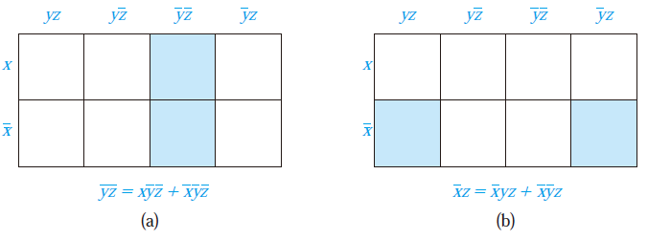
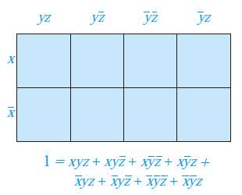
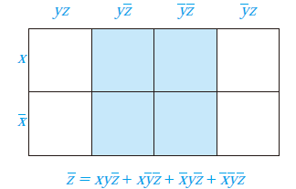
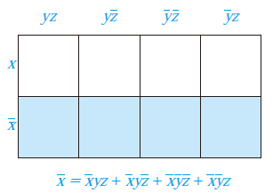
Karnaugh maps

Slide 10
Karnaugh maps
identify the largest possible blocks in the map
cover all the 1s in the map with the least number of blocks
using the largest blocks first

Slide 11
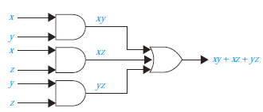
Karnaugh maps
1
1
1
1

Slide 12

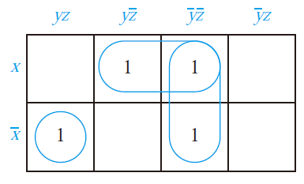

Examples

Slide 13
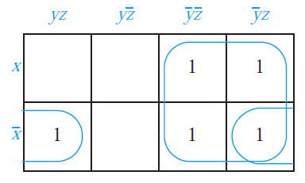

Examples

Slide 14
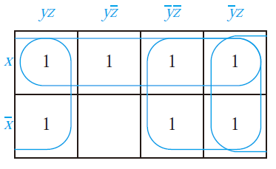

Examples

Slide 15

Examples

Slide 16
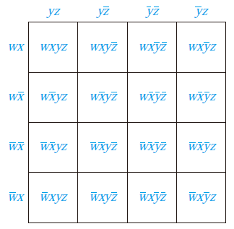
Karnaugh maps
Include a 1 in a cell when the minterm represented by this cell is present in the sum-of-products expansion
Circle 1s in two adjacent cells in the K-map

Slide 17
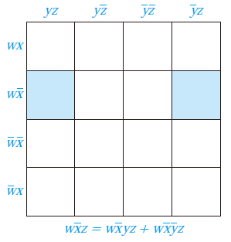
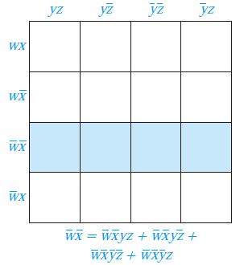
Karnaugh maps

Slide 18
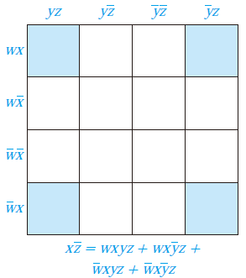
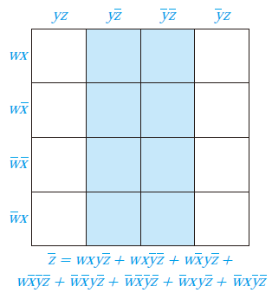
Karnaugh maps

Slide 19
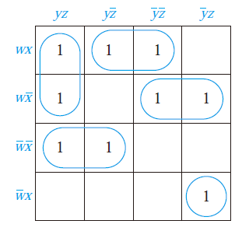
Examples

Slide 20
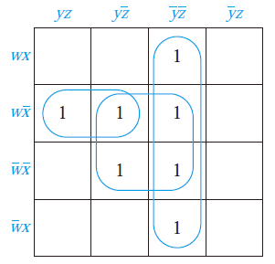

Examples

Slide 21
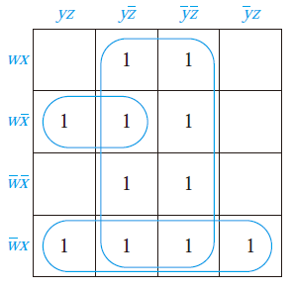
Examples

Slide 22

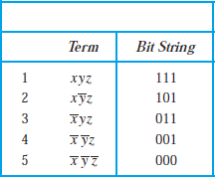
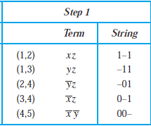
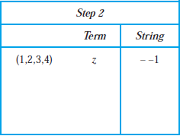
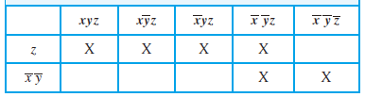
Quine–MCCluskey Method
essential prime implicants
Notes:
奎因–麦克拉斯基法

Slide 23
Quine–MCCluskey Method
Express each minterm in n variables by a bit string of length n with a 1 in the i^{th} position if x_{i} occurs and a 0 in this position if occurs.
Group the bit strings according to the number of 1s in them.
Determine all products in n − 1 variables that can be formed by taking the Boolean sum of minterms in the expansion.
Determine all products in n − 2 variables that can be formed by taking the Boolean sum of the products in n − 1 variables found in the previous step.
Continue combining Boolean products into products in fewer variables as long as possible.
Find all the Boolean products that arose that were not used to form a Boolean product in one fewer literal.
Find the smallest set of these Boolean products such that the sum of these products represents the Boolean function

Slide 24

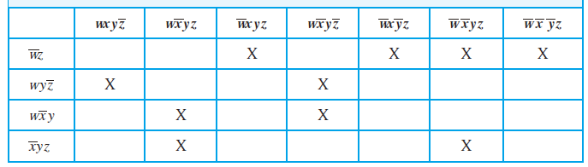
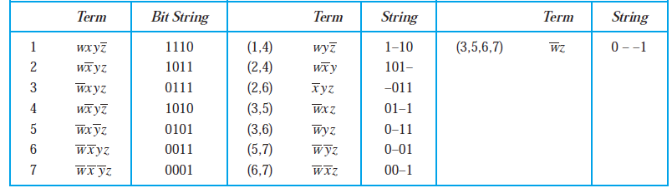

Quine–MCCluskey Method
OR

Slide 25
Homework
Review Chapter 12.4
Chapter 12.4, Exercise 6(c), 12(d), 14(b)
Use the Quine–McCluskey method to simplify the sum-of-products expansions in Exercise 6(c), 12(d), 14(b)

