Slide 1
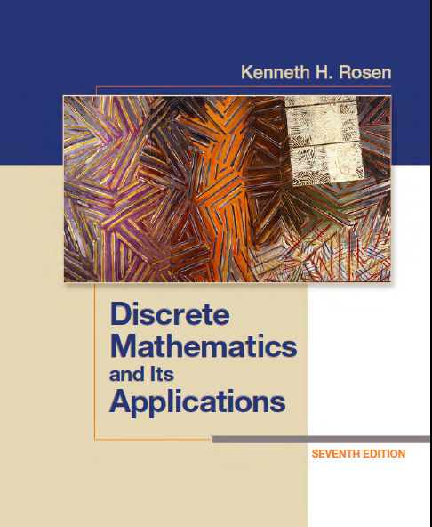
Discrete Math
Haiming Chen
Associate Professor, PhD
Department of Computer Science,
Ningbo University
http://www.chenhaiming.cn

Slide 2
Content
Part I：Logic （Thinking in Mathematics）
Propositional Logic, Predicates and Quantifiers
Definition, Theorem, Corollary and Proofs (Induction)
Part II：Combinatorial Counting
The Basic of Counting
The Pigeonhole Principle
Permutation and Combination
Binomial Coefficients and Combinations
Lists and Sequences (Recursive Definition /Recurrence Relations)
Part III: Discrete Structure
Sets and Functions
Relations
Trees
Graphs
Part IV: Algebra
Algebra (Groups) *
Boolean Algebra

Slide 3
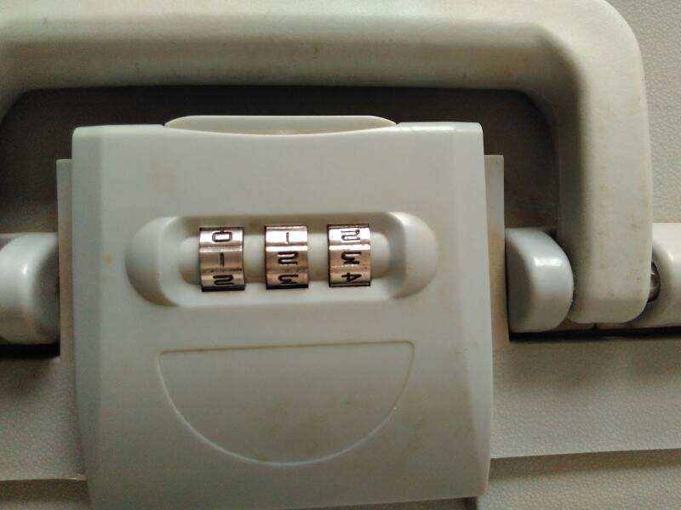
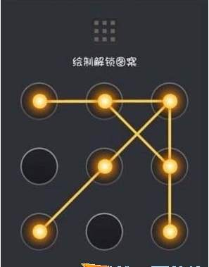
The Basic of Counting

Slide 4
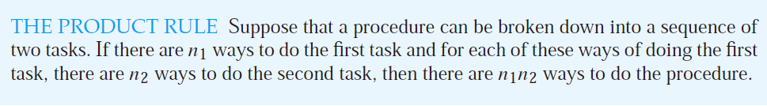
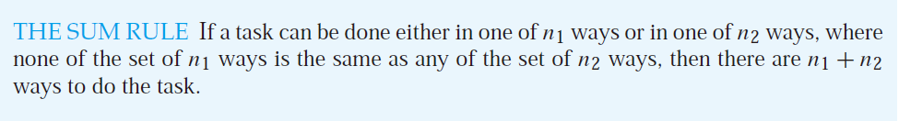
Basic Counting Principles

Slide 5
Examples of Product Rule
How many functions are there from a set with m elements to a set with n elements?
How many one-to-one functions are there from a set with m elements to one with n elements?
Use the product rule to show that the number of different subsets of a finite set S is 2^{|S|}.
n · n · · · · · n = n^{m}
m > n, no one-to-one function
m ≤ n, n(n − 1)(n − 2) · · · (n − m + 1)

Slide 6
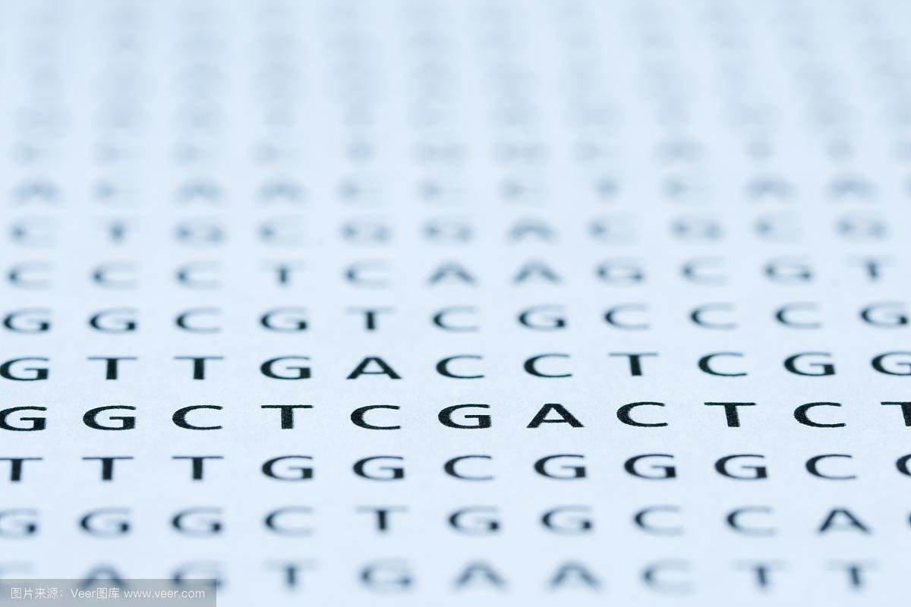
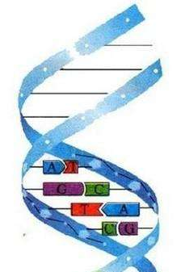
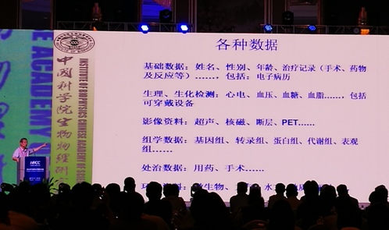
Examples of Product Rules
A gene is a segment of a DNA molecule that encodes a particular protein
DNA molecules consist of two strands consisting of blocks known as nucleotides(核苷酸)
Each nucleotide contains subcomponents called bases, each of which is adenine (A), cytosine (C), guanine (G), or thymine (T).
RNA is single stranded, with uracil (U) replacing thymine as a base.
DNA: A-T, C-G
RNA: A-U, C-G
Sequences of bases in DNA and RNA encode long chains of proteins
simple living creatures such as algae and bacteria have between 10⁵ and 10⁷ links
at least 4^{10^5} different sequences of bases in the DNA of simple organisms
mammals have between 10⁸ and 10¹⁰ links in their DNA
At least 4^{10^8} different sequences of bases in the DNA of more complex organisms.
locate each gene in the DNA of an organism, approximately 23,000 genes
determination of the sequence of links on each gene, 1,000 or more links

Slide 7
Examples of Sum Rule
Use the sum rule to show that the number of different subsets of a finite set S is 2^{|S|}.

Slide 8
Examples of using both rules
In a version of the computer language BASIC, the name of a variable is a string of one or two alphanumeric characters, where uppercase and lowercase letters are not distinguished. Moreover, a variable name must begin with a letter and must be different from the five strings of two characters that are reserved for programming use. How many different variable names are there in this version of BASIC?
26 + 931 = 957

Slide 9
Examples of using both rules
Each user on a computer system has a password, which is six to eight characters long, where each character is an uppercase letter or a digit. Each password must contain at least one digit. How many possible passwords are there?
P₆ = 36⁶ − 26⁶
P₇ = 36⁷ − 36⁷
P₈ = 36⁸ − 26⁸
P₆+P₇+P₈

Slide 10
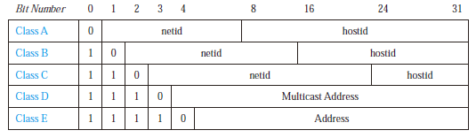
Examples of using both rules
How many different IPv4 addresses are available for computers on the Internet?
Class A: (2⁷-1)*(2²⁴-2)
Class B: 2¹⁴*(2¹⁶-2)
Class C: 2²¹*(2⁸-2)
3,737,091,842
1111111 is not available as the netid of a Class A network, and the host ids consisting of all 0s and all 1s are not available for use in any network.

Slide 11

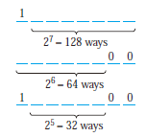
The Subtraction Rule
How many bit strings of length eight either start with a 1 bit or end with the two bits 00?
principle of inclusion–exclusion

Slide 12

The Division Rule
How many different ways are there to seat four people around a circular table, where two seatings are considered the same when each person has the same left neighbor and the same right neighbor?

Slide 13
Tree Diagrams
Use a branch to represent each possible choice
Represent the possible outcomes by the leaves

Slide 14
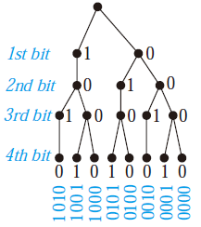
Examples
How many bit strings of length four do not have two consecutive 1s?

Slide 15
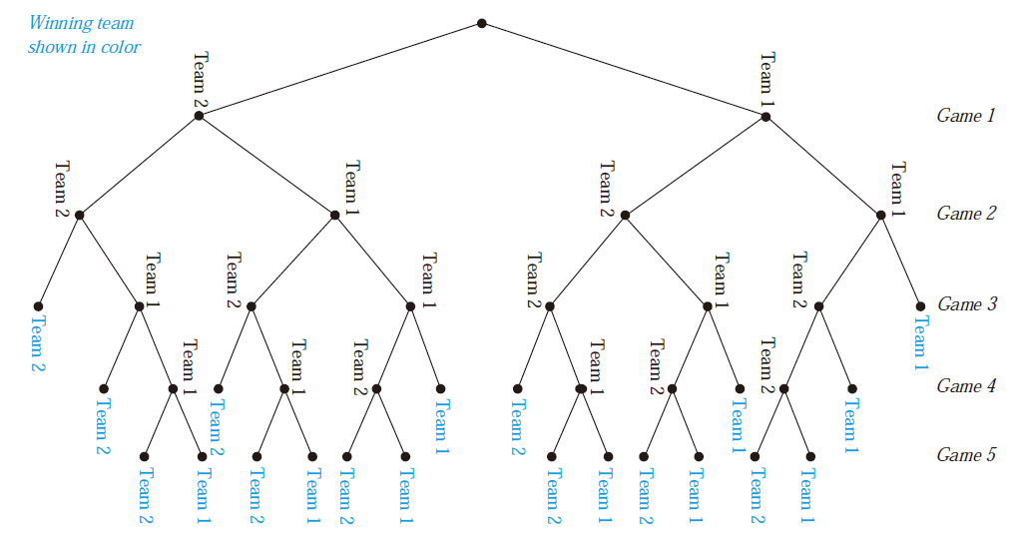
Examples
A playoff between two teams consists of at most five games. The first team that wins three games wins the playoff. In how many different ways can the playoff occur?

Slide 16
Homework
Review Chapter 6.1
Exercise 24, 42, 62,64

