Slide 1
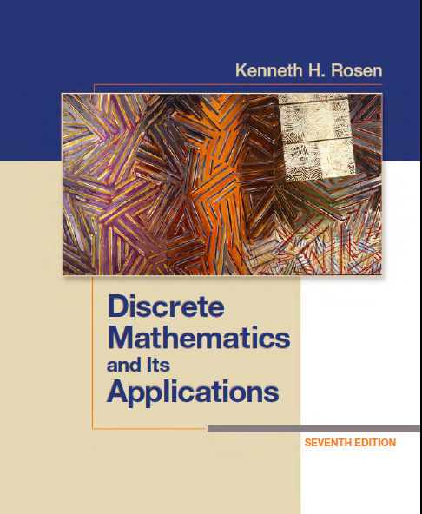
Discrete Math
Haiming Chen
Associate Professor, PhD
Department of Computer Science,
Ningbo University
http://www.chenhaiming.cn

Slide 2
Content
Part I：Logic （Thinking in Mathematics）
Propositional Logic, Predicates and Quantifiers
Definition, Theorem, Corollary and Proofs (Induction)
Part II：Combinatorial Counting
The Basic of Counting
The Pigeonhole Principle
Permutation and Combination
Binomial Coefficients and Combinations
Lists and Sequences (Recursive Definition /Recurrence Relations)
Part III: Discrete Structure
Sets
Relations
Functions
Trees
Graphs
Part IV: Algebra
Algebra (Groups) *
Boolean Algebra

Slide 3
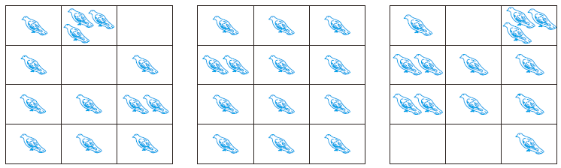

The Pigeonhole Principle

Slide 4
The Pigeonhole Principle
Proof: We prove the pigeonhole principle using a proof by contradiction. Suppose that none of the k boxes contains more than one object. Then the total number of objects would be at most k. This is a contradiction, because there are at least k + 1 objects.

Slide 5
COROLLARY 1
A function f from a set with k + 1 or more elements to a set with k elements is not one-to-one.

Slide 6
Examples
Among any group of 367 people, there must be at least two with the same birthday, because there are only 366 possible birthdays.
In any group of 27 English words, there must be at least two that begin with the same letter, because there are 26 letters in the English alphabet.
How many students must be in a class to guarantee that at least two students receive the same score on the final exam, if the exam is graded on a scale from 0 to 100 points?

Slide 7

The Generalized Pigeonhole Principle
Suppose that none of the boxes contains more than − 1 objects. Then, the total number of objects is at most
This is a contradiction because there are a total of N objects.

Slide 8
Examples
Among 100 people there are at least = 9 who were born in the same month.
What is the minimum number of students required in a discrete mathematics class to be sure that at least six will receive the same grade, if there are five possible grades, A, B, C, D, and F?
a) How many cards must be selected from a standard deck of 52 cards to guarantee that at least three cards of the same suit are chosen?
b) How many must be selected to guarantee that at least three hearts are selected?

Slide 9
Some Elegant Applications of the Pigeonhole Principle
During a month with 30 days, a baseball team plays at least one game a day, but no more than 45 games. Show that there must be a period of some number of consecutive days during which the team must play exactly 14 games.
Let a_{j} be the number of games played on or before the j^{th} day of the month.

Slide 10
Some Elegant Applications of the Pigeonhole Principle
Show that among any n + 1 positive integers not exceeding 2n there must be an integer that divides one of the other integers.
a_{j} = 2^{kj} q_{j}
The integers q₁, q₂, . . . , q_{n+1} are all odd positive integers less than 2n.

Slide 11

Some Elegant Applications of the Pigeonhole Principle
8, 11, 9, 1, 4, 6, 12, 10, 5, 7

Slide 12
Homework
Review 6.2
Exercise 14,18, 20

