Slide 1
Projects of DataBase System
Lecturer: Shuai Wang
TA: Hao Gong

Slide 2
Projects Outline
0 - Project Preparation
1 - Project One
2 - Project Two
3 - Project Three
Every 2 Week
4 - Project Four
5 - Project Five
6 - Project Six
Notes:
我们这学期数据库实验有7个，除去第0个也就是本次实验的Preparation给大家简要介绍一下实验的主要要求和背景以外，你们要做的实验是下面6个。
然后每两个实验发布间隔一般是2个星期，也就是每两次课会有一次实验。

Slide 3
0 - Project Preparation
Project Rules
Software Preparation
Some Common DBMS
Frontend Technology
Project One Preview

Slide 4
Project Rules
【Grading Criteria】
Mid Exam + Lab Work + Others : 30%
Final Exam: 70%

Slide 5
Project Rules
【DeadLine】
Before 23:59 of the next Project.
Notes:
也就是下周日（包括下周日这一天）之前提交，下一周的周一（0：00）之前
给大家完成实验的时间是两个周末。

Slide 6
Project Rules
【Grace Day Policy】
If you have a Grace Day Policy, you can ask for a project to delay a day’s acceptance.
You can only use Grace Day Policy once in a project.
Earn them from the class.
Notes:
困难、身体问题、生病

Slide 7
Project Rules
【Submitt Assignment】
Send the lab report and experimental results required by the project to the email address “seudatabaseqa@gmail.com” with the title “StudentNumber-Name-Project-X” and the lab report will be used as the basis for the rating.
For Example：“71117315-凌泰炜-Project-1“
Notes:
具体实验报告的模板会在群里发布，不一定要根据实验报告模板
双语、英语撰写，对英语水平不作要求，表达清楚、逻辑清晰、图文并茂

Slide 8
0-Project Preparation
Project Rules
Software Preparation
Some Common DBMS
Frontend Technology
Project One Preview

Slide 9

About Access
A database management system (DBMS) from Microsoft
Combines the relational Access Database Engine (ACE) with a graphical user interface and software-development tools.
A member of the Microsoft Office and Microsoft 365 suite of application.
Microsoft Access
Notes:
ACCESS是由微软发布的关系数据库管理系统，本课程实验主要使用这个工具完成。
它是 Microsoft Office 和Microsoft 365 应用程序套件的成员。所以和大多数office软件一样需要付费激活。
下载过Offiice全家桶的话不需要再下载。

Slide 10
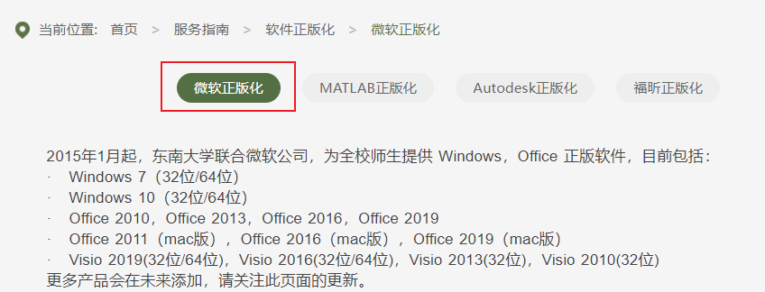
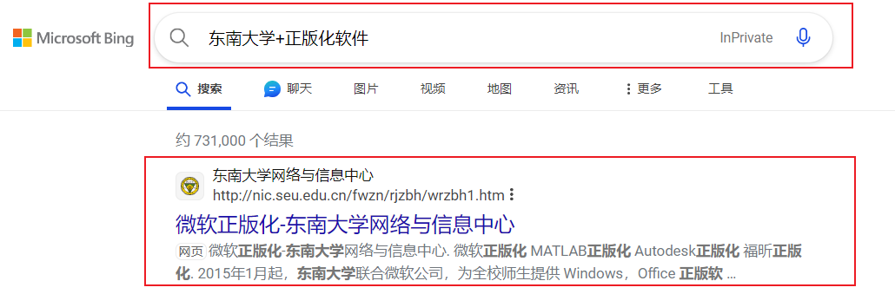
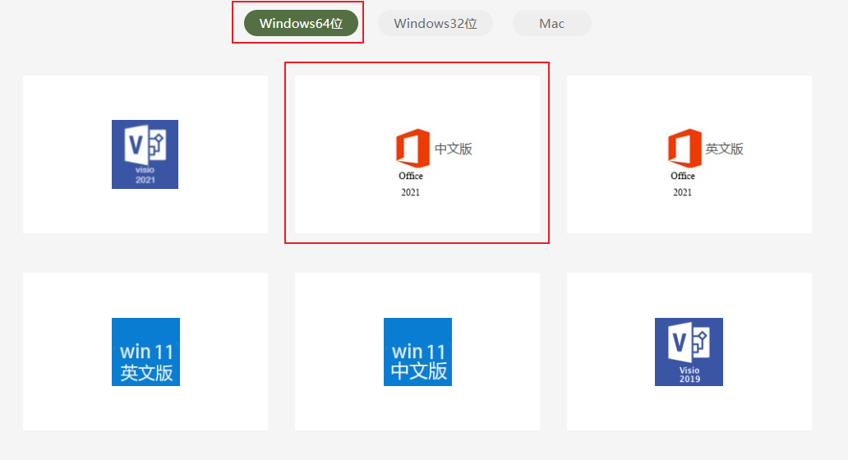
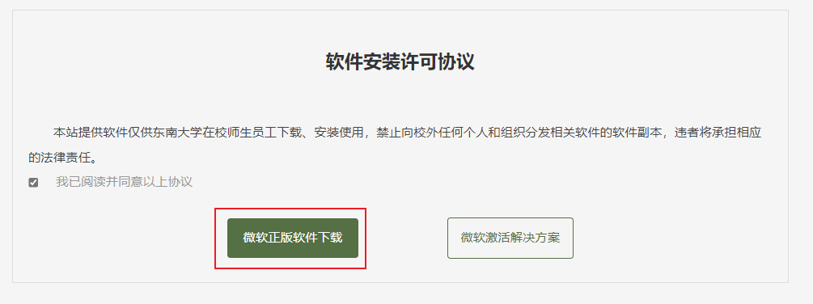
Download MS Access from SEU
微软正版化-东南大学网络与信息中心 (seu.edu.cn)

Slide 11
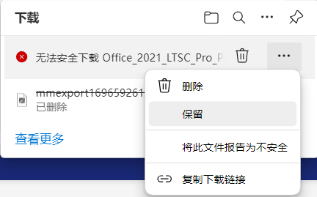
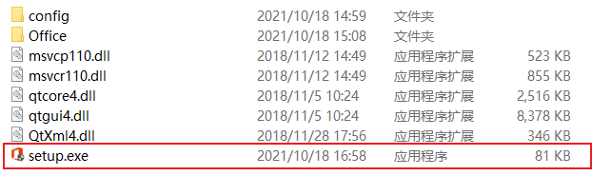

Download MS Access from SEU

Slide 12
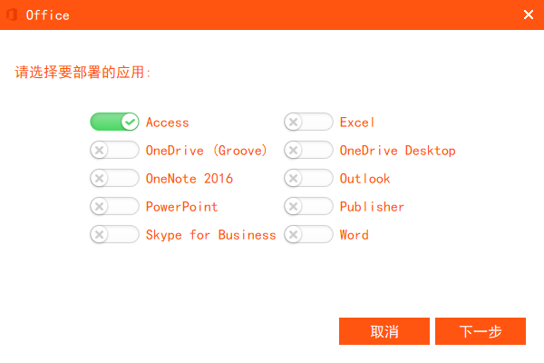

Download MS Access from SEU

Slide 13
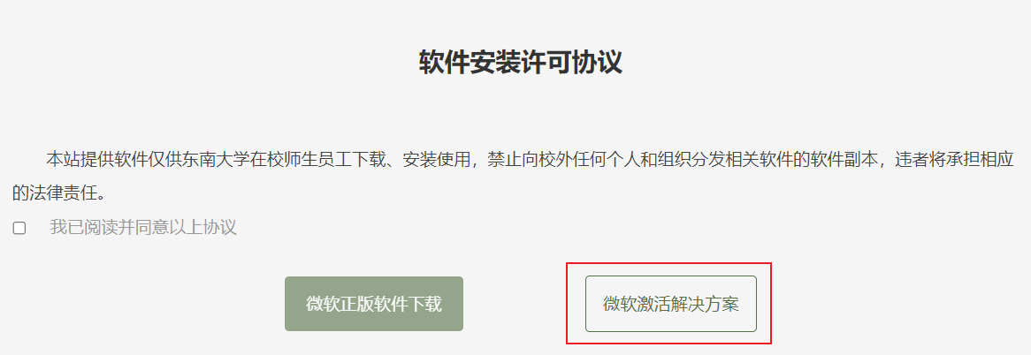
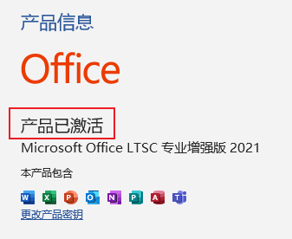
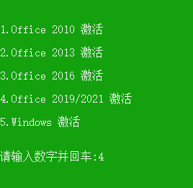
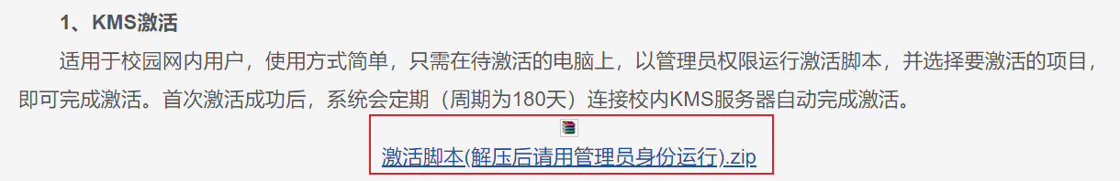
Activate MS Access from SEU
激活解决方案-东南大学网络与信息中心 (seu.edu.cn)

Slide 14
0-Project Preparation
Project Rules
Software Preparation
Some Common DBMS
Frontend Technology
Project One Preview

Slide 15

1. MySQL
Latest version 8.0. The language used is C and C++.
Relational database. Works on many different platforms : Linux /Windows /Solaris…
Few features of this tool are:
(1)High-speed data processing;
(2)Use of triggers increases productivity, with rollback and commit helps in data recovery if required.
Costs: Open-source and free for Community Server.
      Commercial fees for Enterprise Edition
Website: MySQL
“LAMP”
Notes:
高速的数据处理以及触发器的使用提高了工作效率
回滚和commit进行数据恢复。
LAMP是指一组通常一起使用来运行动态网站或者服务器的自由软件名称首字母缩写。这种方式不用花一分钱（除开人工成本）就可以建立起一个稳定、免费的网站系统。
Linux作为操作系统，Apache 作为 Web 服务器，MySQL 作为数据库，PHP/Perl/Python作为服务器端脚本解释器。

Slide 16

2. SQLite
The latest release version is 3.39.3. Coded in C language.
It is mainly used as a database system for mobiles. It can work on Linux, Windows, and Mac operating systems.
Few features of this tool are:
(1) Concise functionality, small size.
(2) Don’t need much space
(3) Fast and don’t need to set up.
Costs: It’s an open-source tool.
Website: SQLite
Notes:
SQLite 是一个 C 语言库，它实现了一个小型、快速、自包含、高可靠性、全功能的 SQL 数据库引擎。
SQLite 内置于所有手机和大多数计算机中，并捆绑在人们每天使用的无数其他应用程序中。
SQLITE功能简约，小型化，不需要太多的空间，因此，它可以用于存储小型到中型网站。
同时它免设置和部署，能快速上手使用
和MYSQL相比，功能全面，综合化，追求最大并发效率。而SQLite追求最大磁盘效率

Slide 17

3. Redis
The latest stable release is 7.0.4.
NoSQL, work on Windows and Linux operating systems. It is coded in ANSI C language.
Few features of this tool are:
(1) supports distributed systems.
(2) key-value storage system
(3) high processing speed. data types like hashes and strings are also supported.
Costs: It’s an open-source tool.
Website: Redis
Notes:
Redis是现在最受欢迎的NoSQL数据库之一
因为是NoSQL ，支持分布式，并发处理的效率很高
使用了key-value这种键值对数据存储，而关系型数据库使用表格结构。
它的数据库速度非常快，将数据存储在内存中。由于内存的读写速度远快于硬盘，因此Redis在性能上对比其他基于硬盘存储的数据库有非常明显的优势。
还支持哈希和字符串等数据类型，查询的性能也很高

Slide 18

4. Neo4j
The latest stable version is 5.12. Coded in Java
Graph database(NoSQL), used on Windows and Linux/Unix operating systems.
Few features of this tool are:
(1)Stores data in the form of graphs (nodes, edges, and attributes of nodes and edges).
(2)Using Cypher query language (CQL), easy to learn.
(3) easy to represent and manage data in connected relationships.
Costs: Open-source and free for Community Server.
      Commercial fees for Enterprise Edition
Website: Neo4j
Notes:
图数据库(Graph database)指的是以图数据结构的形式来存储和查询数据的数据库，有大容量服务器
图形数据库存储节点和关系而不是表或文档。
Neo4j使用了它自己的 CQL 图形查询语言，允许用户从图形数据库存储和检索数据。
容易表示连接关系的数据

Slide 19

5. OrientDB
The latest stable version is 3.2.23. It is coded in Java language
NoSQL , used on Windows and Linux platforms.
Few features of this tool are:
(1) A graphical database.
(2) Widely used across big data market and in real-time web-based applications.
Costs: It’s an open-source tool.
Website: OrientDB
Notes:
OrientDB 是一个多模型开源 NoSQL DBMS，它将图形的强大功能和文档的灵活性结合到一个可扩展的高性能操作数据库中。

Slide 20

6. phpMyAdmin
The latest stable release is 5.2.1. It is coded primarily in PHP.
It can work on Windows and Linux operating systems.
Few features of this tool are:
(1) Use the web interface to manage MySQL databases.
(2) Interface is user-friendly, data can be exported in CSV, SQL, XML files and it can be imported from both CSV and SQL file formats.
Costs: It’s an open-source tool.
Website: phpMyAdmin
Notes:
phpMyAdmin 是一个用PHP编写的免费软件工具，旨在 通过 Web处理MySQL的管理。phpMyAdmin 支持对 MySQL 和 MariaDB 的广泛操作.

Slide 21

7. SQL Developer
The latest stable release is 23.1. It is coded in Java.
It can work on Windows and Linux operating systems.
Few features of this tool are:
(1) Graphical interface.
(2) Less execution time.
(3) Queries can be run and generated in many formats such as HTML, PDF, XML, and Excel.
Costs: It’s an open-source tool.
Website: SQL Developer
Notes:
Oracle SQL Developer 有简洁明了的图形化界面。
查询所需的执行时间更短。
查询可以以多种格式运行和生成，如HTML、PDF、XML和Excel。

Slide 22
0-Project Preparation
Project Rules
Software Preparation
Some Common DBMS
Frontend Technology
Project One Preview

Slide 23
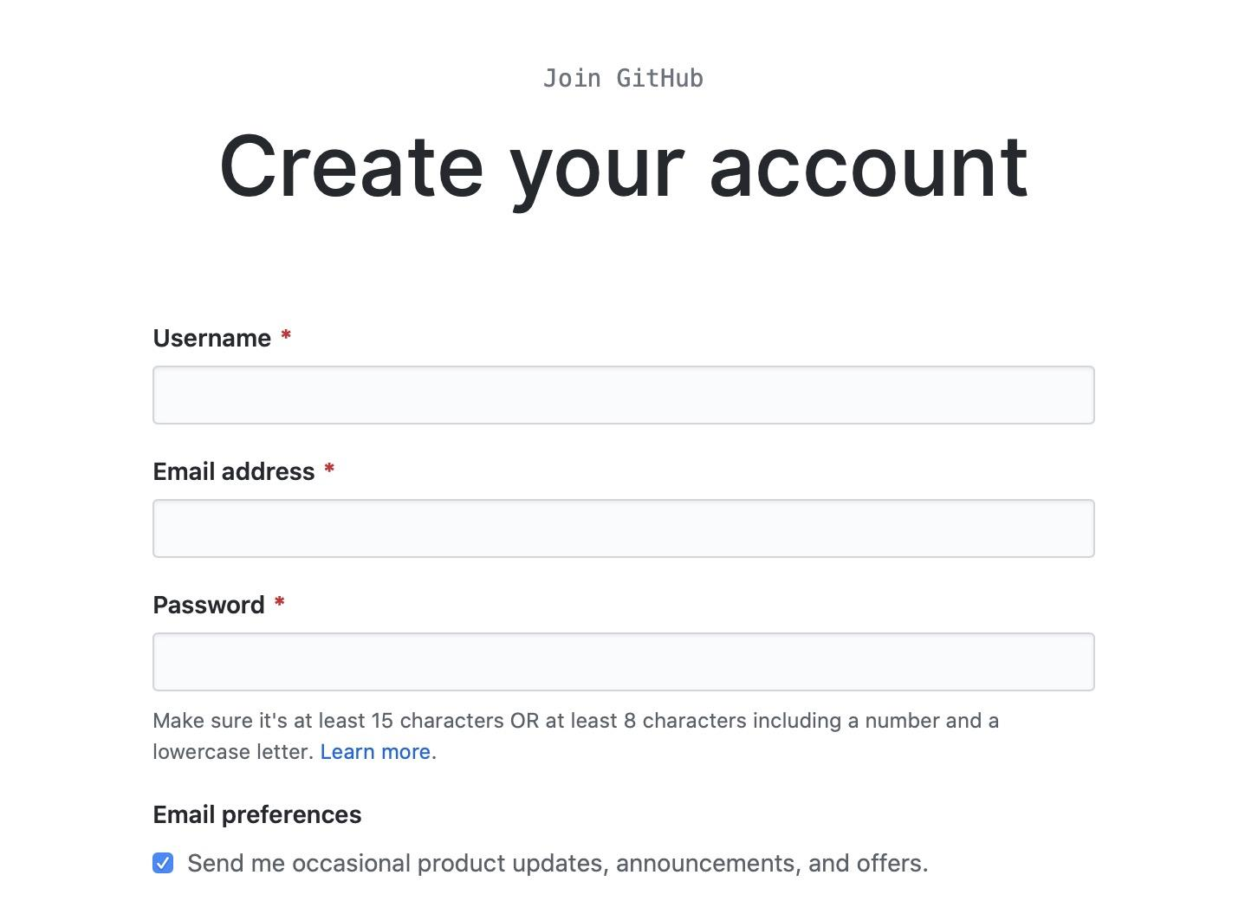
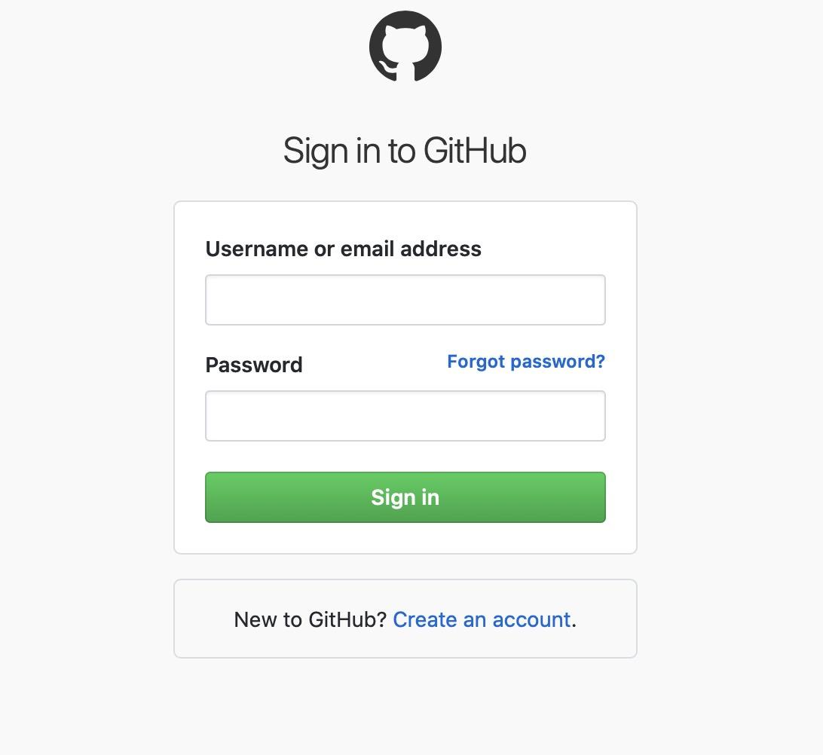
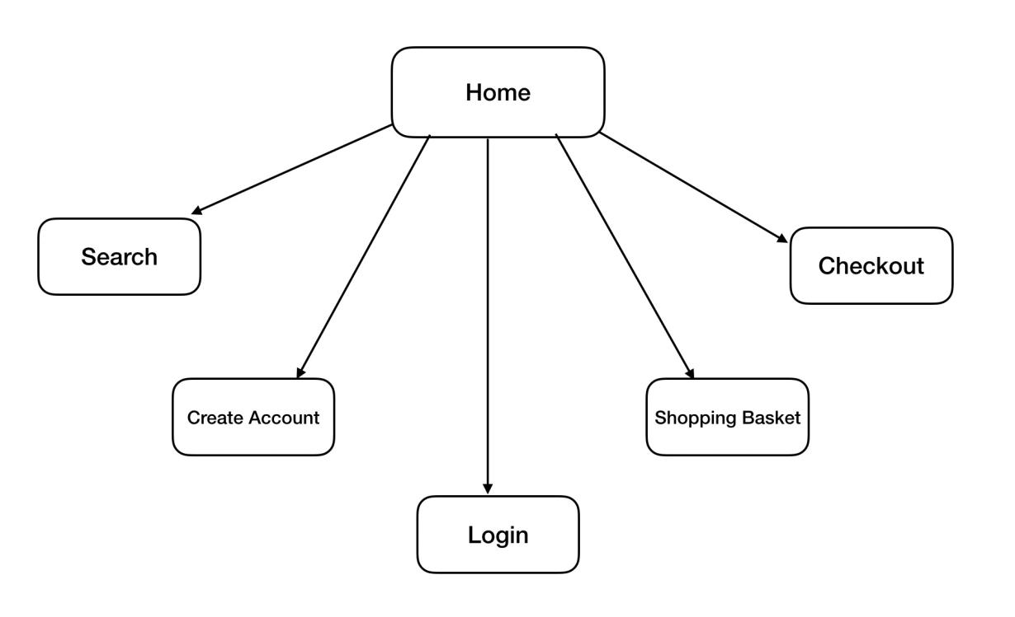
About Project Six
Unlike Project One-Five, Project Six is a TEAM project
In Project Six, you need to use Frontend Technology
Notes:
3-4人组队，提前组队，确定好分工

Slide 24
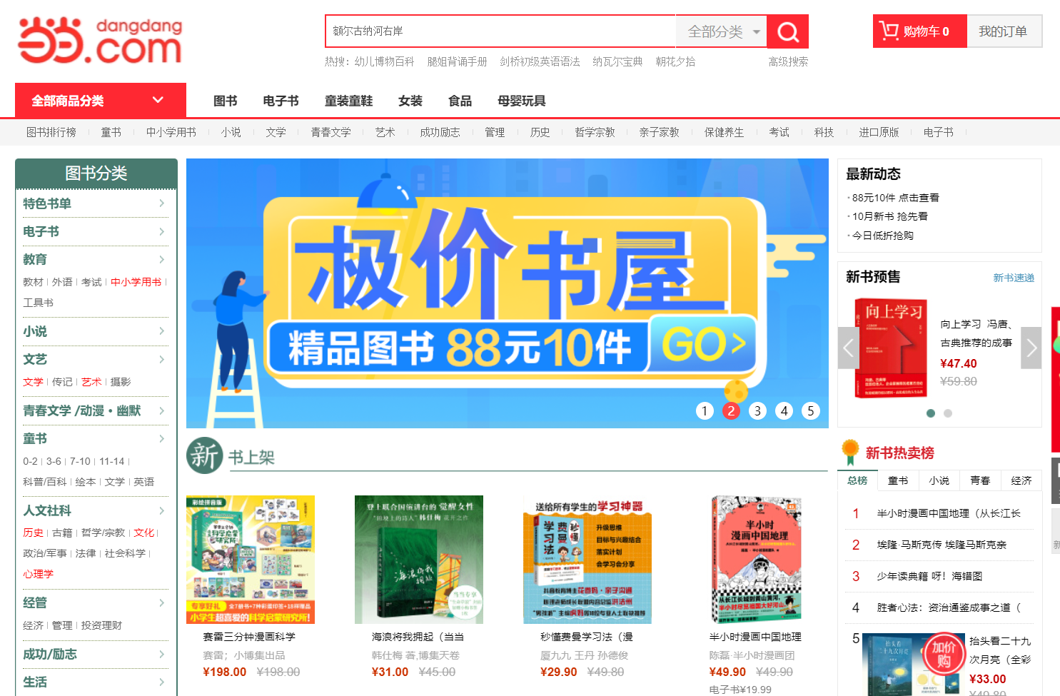
About Project Six
“ Internet Bookstore ”
  B/S or C/S
  Database: Access , MySQL , …
Notes:
3-4人组队，提前组队，确定好分工

Slide 25
Frontend Technology
HTML
HTML provides the basic structure of sites, which is enhanced and modified by other technologies like CSS and JavaScript.
CSS
  CSS is used to control presentation, formatting, and layout.
JavaScript
JavaScript is used to control the behavior of different elements.
Notes:
HTML: 代表超文本标记语言，是浏览器显示内容的代码结构。更具体地说是内容的载体。然后通过CSS和JavaScript等技术进行了增强和修改网页结构。
CSS：是表现，相当于网页的外衣。用于控制html内容的样式和布局。比如字体大小、颜色变化、标题加入花里胡哨的背景和边框。
JavaScript：用于控制不同元素的行为。Javascript处理网页设计和开发的逻辑。比如按钮被点击后执行什么工作（进入新页面？退出页面）、鼠标滑过弹出菜单、动画等交互。
JavaScript 和Java没有关系，Java是一种程序设计语言，JavaScript是客户端的脚本语言。

Slide 26
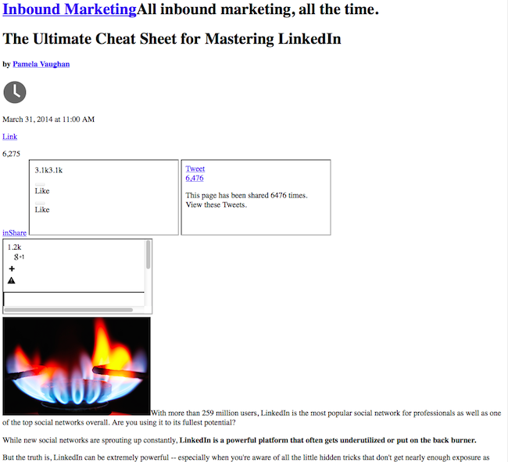

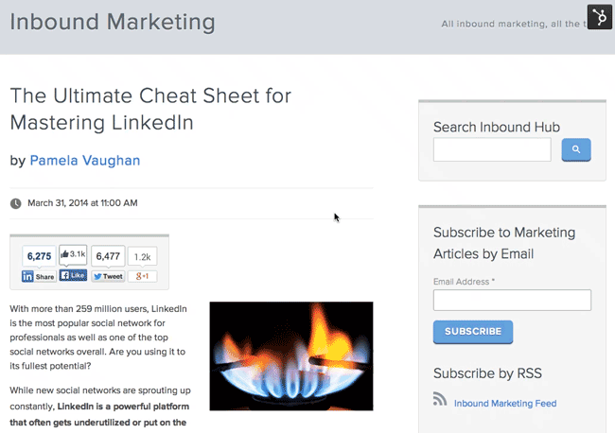
Frontend Technology
Only HTML
Enhanced by
CSS
Enhanced by
CSS and JavaScript
Notes:
很经典的例子是说HTML就像 一个人的骨骼、器官，而CSS就是人的皮肤，有了这两样也就构成了一个植物人了，加上javascript这个植物人就可以对外界刺激做出反应，可以思考、运动。

Slide 27
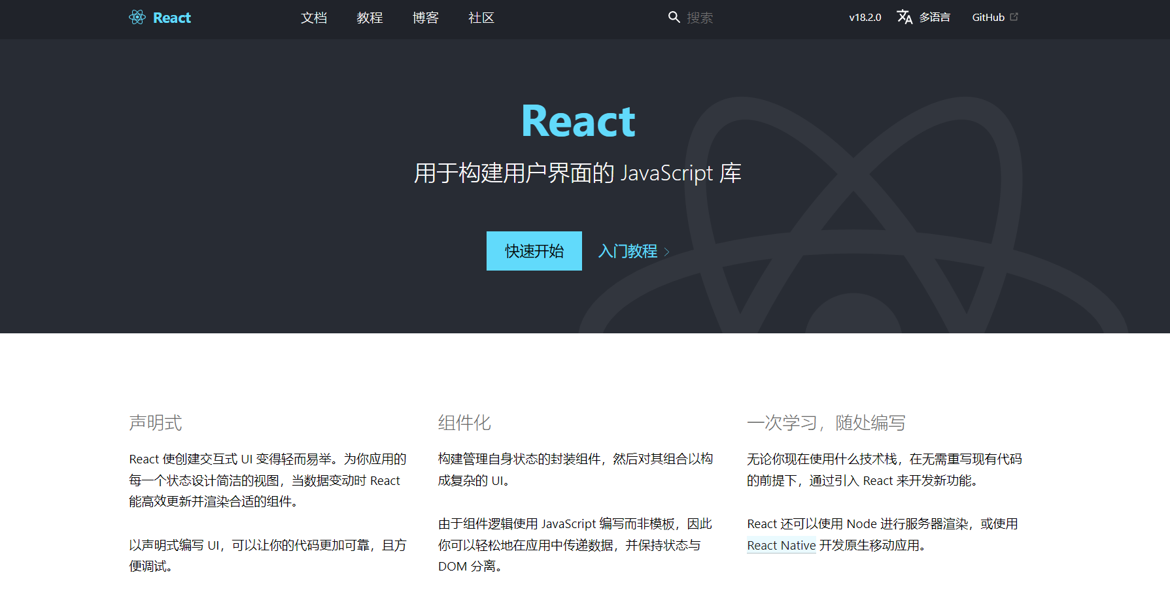
Framework Tools
React
React's reusable components ensure that developers don’t have to rewrite the same code over and over again.
Notes:
React:的可重用组件确保了开发人员不必一遍又一遍地重写相同的代码。由于它的受欢迎程度，在网上有大量来自同行开发者的免费帮助。

Slide 28
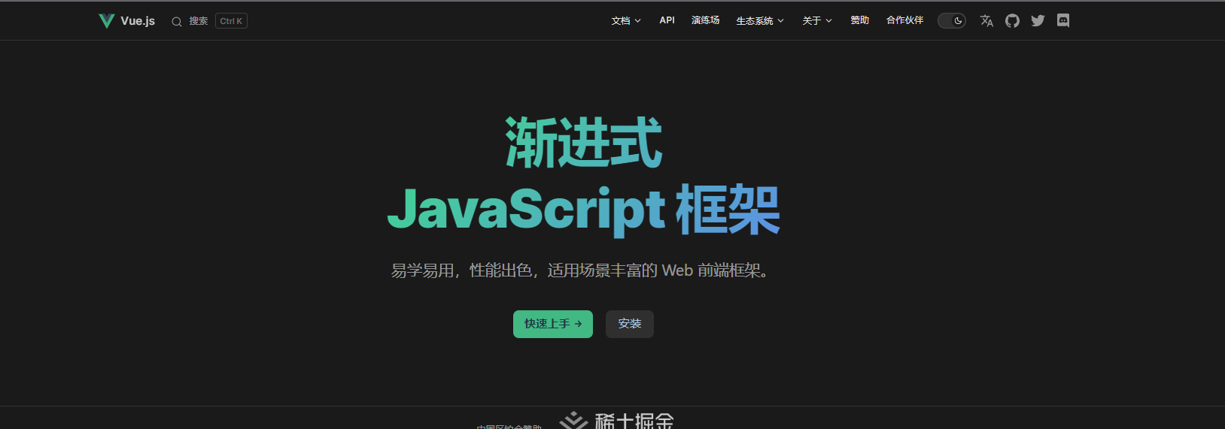
Framework Tools
Vue
Excellent documentation and intended for beginners and seasoned developers alike; An extensive tooling ecosystem that has grown over the years.
Notes:
Vue:优秀的文档，适合初学者和经验丰富的开发人员。多年来发展起来的庞大工具生态系统。框架体积小，易学。

Slide 29
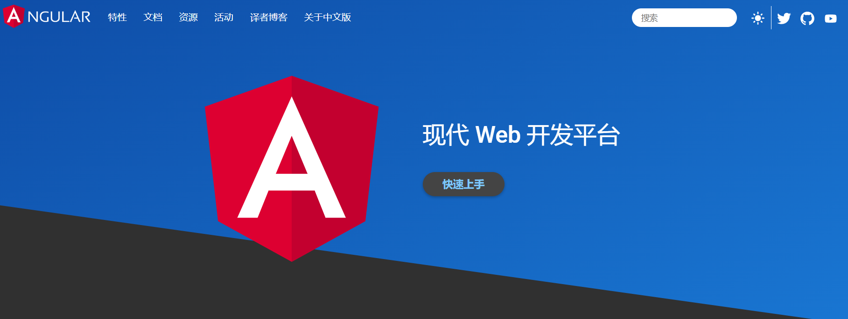
Framework Tools
Angular
Extremely complex web apps can be developed on the enterprise scale that rival desktop-based applications.
Notes:
Angular:极其复杂的web应用程序可以在企业规模上开发，可以与基于桌面的应用程序相匹敌。谷歌保证了对这个开源项目的长期支持，开发人员可以放心，它不会很快被放弃。

Slide 30
Development Tools
Frontend
WebStorm, Visual Studio Code, Adobe Dreamweaver
Backend
  IDEA
Collaboration
GitHub

Slide 31
0-Project Preparation
Introduce Myself and Rules
Software Preparation
Some Common DBMS
Frontend Technology
Project One Preview

Slide 32
Project One Preview
Create a Database
Create a Table
Set the Field Properties for an Existing Table
Add Data to a Table
Import Data into Access

Slide 33
Project 1
Lecturer: Shuai Wang
TA: Hao Gong

Slide 34

Requirements for submitting the assignment
Email address : seudatabaseqa@gmail.com
File name format : StudentNumber-Name-Project-X
  example : 71121000-张三-Project-1.zip
Including :
report_A1.doc / report_A1.docx
university_A1.mdb / university_A1.accdb
Deadline: Beijing time, 10.18, 24:00:00

Slide 35
Project 1
Tutorial with Project Examples
Assignment

Slide 36

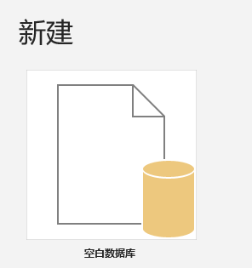
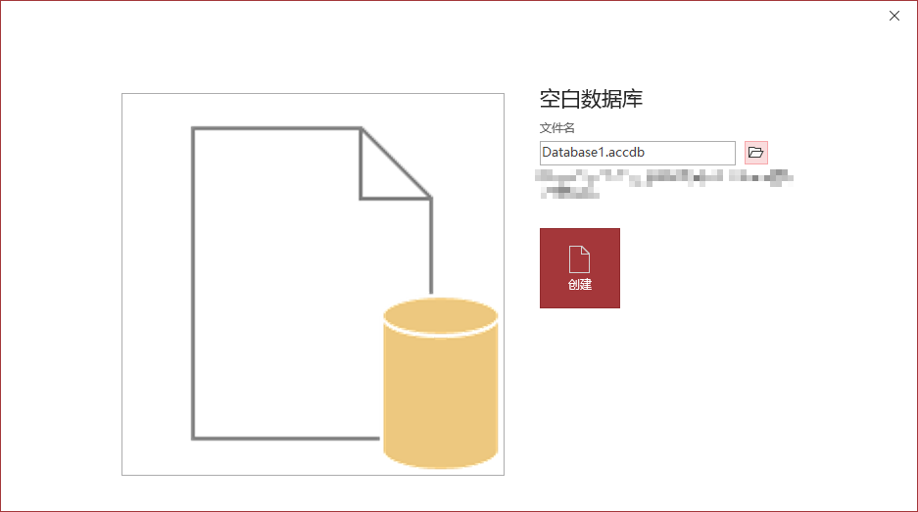
Tutorial with Project Examples
1. Create a Database
Microsoft Access 2016 Tutorial (quackit.com)
1.1 Select a Blank Database
1.1.1 From the File > Open > Choose One Database
1.1.2 From the File > New Folder > Blank Database
1.2 Name the Database
Easy Job

Slide 37
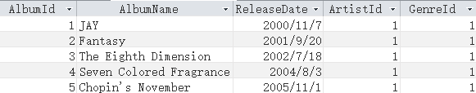
Tutorial with Project Examples
2. Create a Table
Field Name | Data Type
AlbumId | Auto-Coding
AlbumName | Short Text
ReleaseDate | Date & Time
ArtistId | Number
GenreId | Number
2.1 Customize the Blank Table
2.1.1 Select a Data Type for the New Field
2.1.2 Name the Field
2.1.3 Save the Table
2.1.4 Name the Table
Easy Job

Slide 38
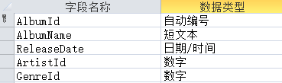
Tutorial with Project Examples
2. Create a Table
2.2 Create a Table in Design View
2.2.1 Create the Table
2.2.2 Switch to Design View
2.2.3 Add Fields in Design View
2.2.4 Set a Primary Key
2.2.5 Save the Table
Easy Job
Notes:
设计视图是 Access 中用于创建和修改表结构的专业界面，它比直接在数据表视图中工作提供了更精细的控制。通过设计视图，你可以：
定义每个字段的精确数据类型、设置详细的字段属性、指定主键和索引、添加字段说明文档、控制数据验证规则

Slide 39
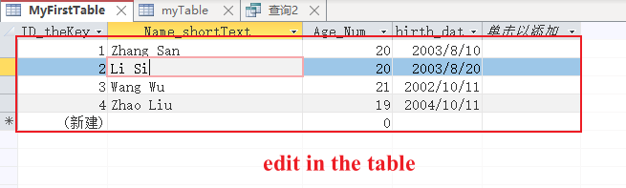
Tutorial with Project Examples
3. Add Data to Table
3.1 Add Data Directly in Datasheet View
Little Hard

Slide 40
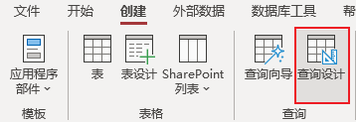
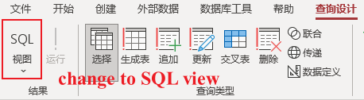
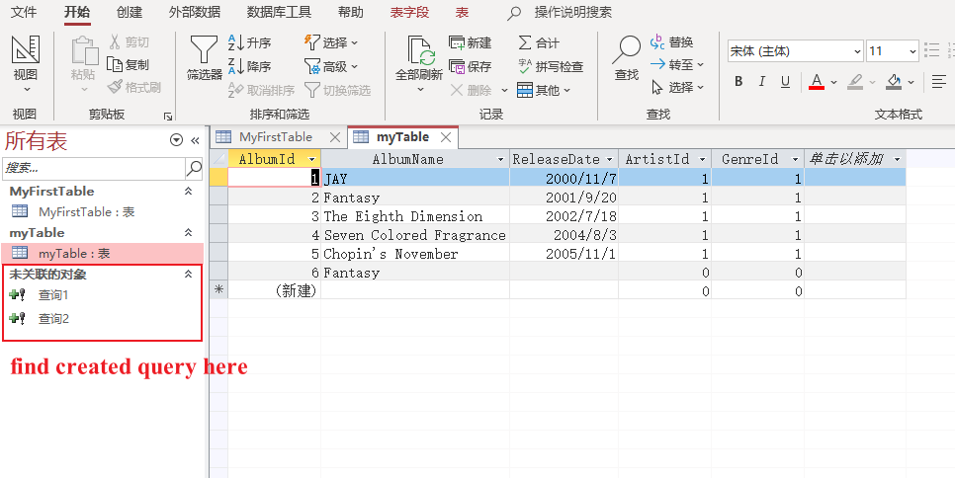
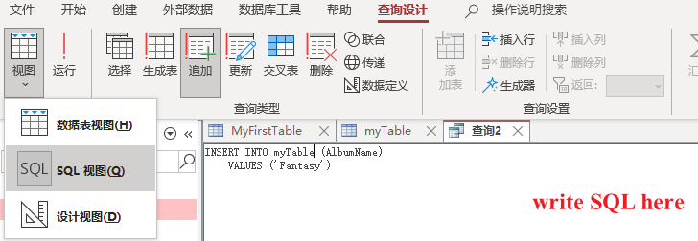

Tutorial with Project Examples
3. Add Data to Table
3.2 Add Data using SQL
Little Hard

Slide 41
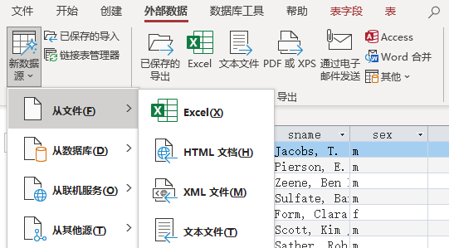
Tutorial with Project Examples
3. Add Data to Table
3.3 Add Data from External Resource
Follow the guides of Access to complete step by step.
Little Hard

Slide 42
Project 1
Tutorial with Project Examples
Assignment

Slide 43
Assignment
1. Assignment Content
1.1 Familiar with MS Access
1.2 Create a university database
1.2.1 university.mdb
  1.2.2 Load data into the database
  1.2.3 Use SQL to insert one record
1.3 Open the university database
  1.3.1 Use C++/Python to generate more than 5000 random tuples for student table
  1.3.2 Use SQL to insert those random tuples into database
Notes:
随机生成元组，并用sql插入到数据库中

Slide 44
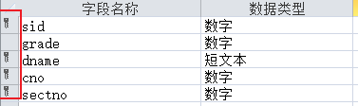
Assignment
2. Schema and Sample Data
The schema of the database is provided below (keys are red, field types are omitted):
    student(sid, sname, sex, age, year, gpa)
    dept(dname, numphds)
    prof(pname, dname)
    course(cno, cname, dname)
    major(dname, sid)
    section(dname, cno, sectno, pname)
    enroll(sid, grade, dname, cno, sectno)
Multiple keys

Slide 45
Assignment
2. Schema and Sample Data
Before you start writing SQL, it is a good idea to take a look at the database and familiarize yourself with its contents.
Write down as many details of your experiment as possible, and combining TEXT and PICTURE will get better grades.

Slide 46
Assignment
3. Data Files
Download the following data files from WeChat Group
    course.txt
    dept.txt
    enroll.txt
    major.txt
    prof.txt
    section.txt
    student.txt

