Slide 1
Project 2
Lecturer: Shuai Wang
TA: Jiawei Liu

Slide 2
Requirements for submitting the assignment
Email address : liujoy@seu.edu.cn
Format of Email subject and File name: StudentNumber-Name-Project-X
  example : 71121000-张三-Project-1.zip
Including :
①report_A2.doc / report_A2.docx / report_A2.pdf
②university_A2.mdb / university_A2.accdb
Deadline: Beijing time, 11.06, 23:59:59

Slide 3
Requirements for submitting the assignment
Note:
Name and submit the files according to the prescribed format!
Include the required files (docx, accdb, pdf..). Each one is indispensable!
Submit all the files in a compressed format (zip, rar…)!
Ensure the accuracy of your name, student ID, and even the subject you are submitting for!!!
Submit your report on time!! Late submissions will not be accepted now!

Slide 4
Project 2
Tutorial with Project Examples
Assignment

Slide 5
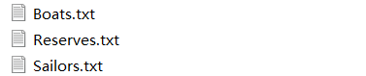
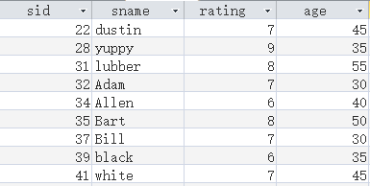
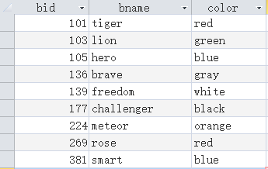
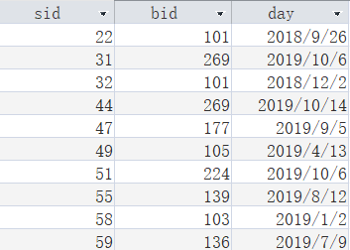
Tutorial with Project Examples
1. Preparation Work
It is solely used for demonstrating the operational process and is not part of the experimental requirements.
①Download the following data files
②Import the txt into the lab2.accdb and create three tables
Sailor
Boats
Reserves

Slide 6
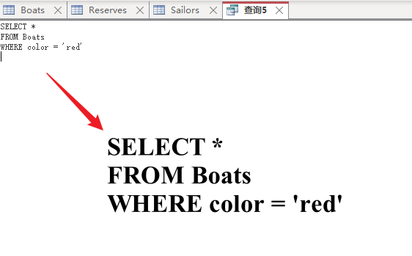
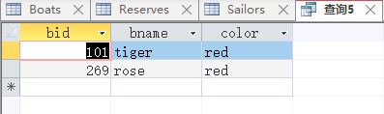
Tutorial with Project Examples
2. Simple Example of Using SQL
Print records in Boats Table that Boat’s color is red
Result

Slide 7
Tutorial with Project Examples
3. Simple tests
Names of sailors who have booked red boats (1)

Slide 8
Tutorial with Project Examples
3. Simple tests
Names of sailors who have booked red boats (2)

Slide 9
Tutorial with Project Examples
3. Simple tests
Names of sailors who have booked boats within 2019 (1)

Slide 10
Tutorial with Project Examples
3. Simple tests
Names of sailors who have booked boats within 2019 (2)

Slide 11
Tutorial with Project Examples
3. Simple tests
Boat names booked by at least 2 different sailors

Slide 12
Project 2
Tutorial with Project Examples
Assignment

Slide 13
Assignment
1. Assignment Content
Use SQL queries on university database.
Write SQL queries that answer the questions below (one query per question) and run them on the Microsoft ACCESS Database System using its SQL interpreter.

Slide 14
Assignment
1. Assignment Content
Questions
Print the names of professors who work in departments that have fewer than 50 PhD students.
Print the name(s) of student(s) with the lowest gpa.
For each Computer Sciences class, print the cno, sectno, and the average gpa of the students enrolled in the class.
Print the course names, course numbers and section numbers of all classes with more than six students enrolled in them.
Print the name(s) and sid(s) of the student(s) enrolled in the most classes.
Print the names of departments that have one or more majors who are under 18 years old.

Slide 15
Assignment
1. Assignment Content
Questions
Print the names and majors of students who are taking one of the College Geometry courses. (Hint: You'll need to use the "like" predicate and the string matching character in your query).
For those departments that have no majors taking a College Geometry course, print the department name and the number of PhD students in the department.
Print the names of students who are taking both a Computer Sciences course and a Mathematics course.
Print the age difference between the oldest and youngest Computer Sciences major(s).
For each department that has one or more majors with a GPA under 1.0, print the name of the department and the average GPA of its majors.
Print the ids, names, and GPAs of the students who are currently taking all of the Civil Engineering courses.

Slide 16
Assignment
1. Assignment Content
Schema and Sample Data
The schema of the database is provided below (keys are red, field types are omitted):
    student(sid, sname, sex, age, year, gpa)
    dept(dname, numphds)
    prof(pname, dname)
    course(cno, cname, dname)
    major(dname, sid)
    section(dname, cno, sectno, pname)
    enroll(sid, grade, dname, cno, sectno)

Slide 17
Assignment
1. Assignment Content
Data Files
Download the following data files from WeChat Group(The imports you made in Project 1).
        course.txt
        dept.txt
        enroll.txt
        major.txt
        prof.txt
        section.txt
        student.txt
It is recommended to use the original student.txt for better communication and comparison of correctness among classmates.

Slide 18
Assignment
2. A Few Points to Note
The query answers must not contain duplicates, and the SQL keyword distinct should only be used when necessary.
The SQL interpreter in ACCESS is not quite the same as the one described in the textbook. If the query you write is not accepted by ACCESS (usually it gives you some strange errors), try different ways until you get one that works with ACCESS.
For this assignment, creation of temporary tables is not allowed, i.e., for each question you have to write exactly one SQL statement.
Notes:
distinct不像mysql那样方便，所以

Slide 19
Assignment
2. A Few Points to Note
This is an individual assignment – no group submissions are allowed.
Hand in an ACCESS database that contains the answers to the 12 questions. The database should contain 12 queries, named as follows:
  Query1 ：
  Query2 ：
  …
  Query12：
Test the function of index with query related with student table.
Hand in a report which outlines your answers and the process by which you arrived at them.

Slide 20
How to improve your
SQL capability？
nowcoder
LeetCode

