Slide 1
Project 3
Lecturer: Shuai Wang
TA: Jiawei Liu

Slide 2
Requirements for submitting the assignment
Email address : liujoy@seu.edu.cn
Format of Email subject and File name: StudentNumber-Name-Project-X
  example : 71121000-张三-Project-1.zip
Including :
①report_A3.doc / report_A3.docx / report_A3.pdf
② code.zip
Submit only necessary code files such as java/xml etc. Other files that you think are important can also be included (such as README). The remaining project files do not need to be submitted.
Please limit the size of your code package.
Deadline: Beijing time, 11.20, 23:59:59

Slide 3
Project 3
Tutorial with Project Examples
Assignment

Slide 4

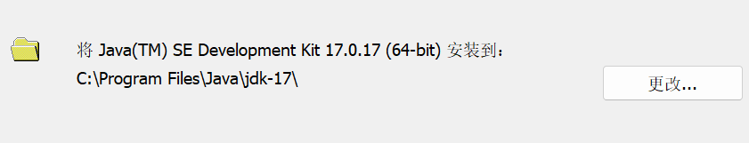
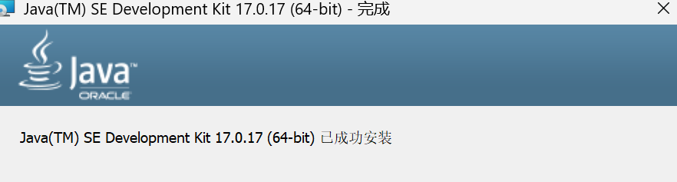
Tutorial with Project Examples
1. Preparation Work
Download JDK17 for Microsoft Windows
Install JDK17
Change path (default path contains spaces, not recommended)
Installation completed

Slide 5
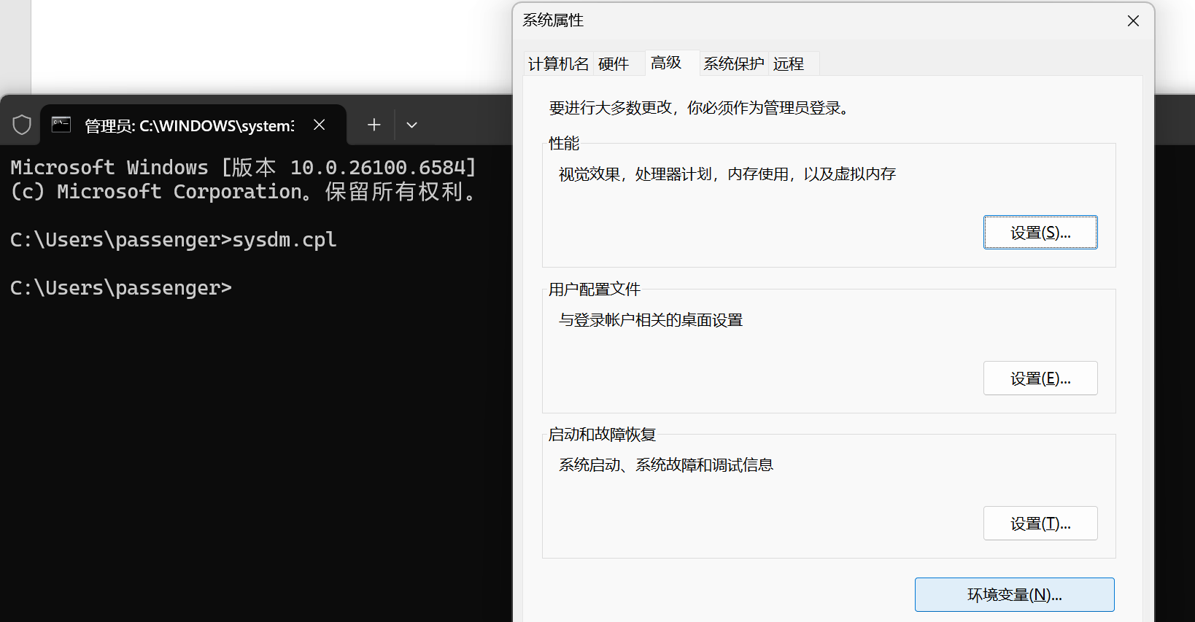
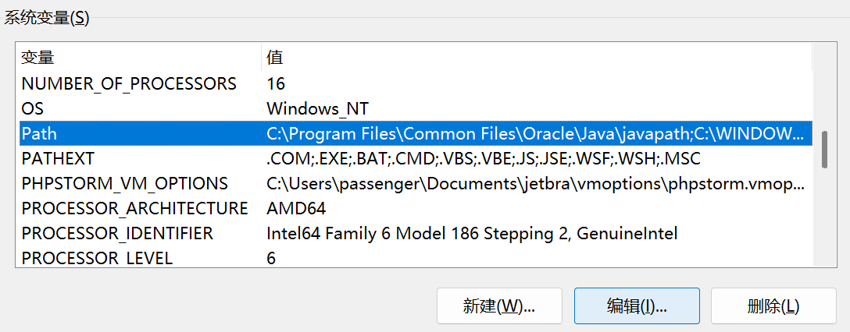
Tutorial with Project Examples
Press Win+R, enter sysdm.cpl → Advanced → Environment Variables
Edit system variables

Slide 6
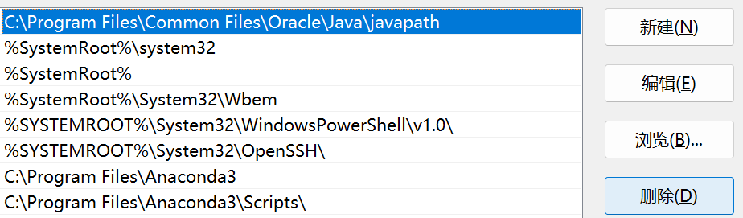
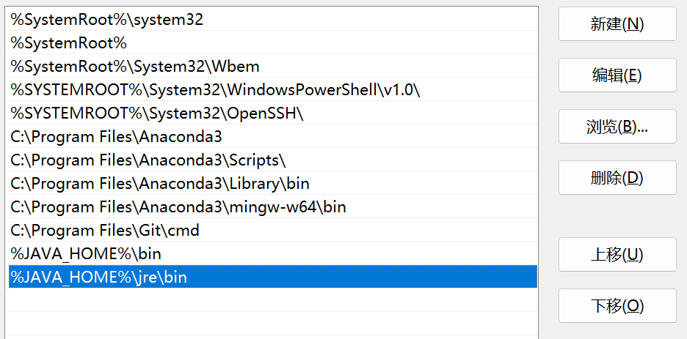
Tutorial with Project Examples
Delete
Add two variables in Path %JAVA_HOME%\bin and %JAVA_HOME%\jre\bin

Slide 7
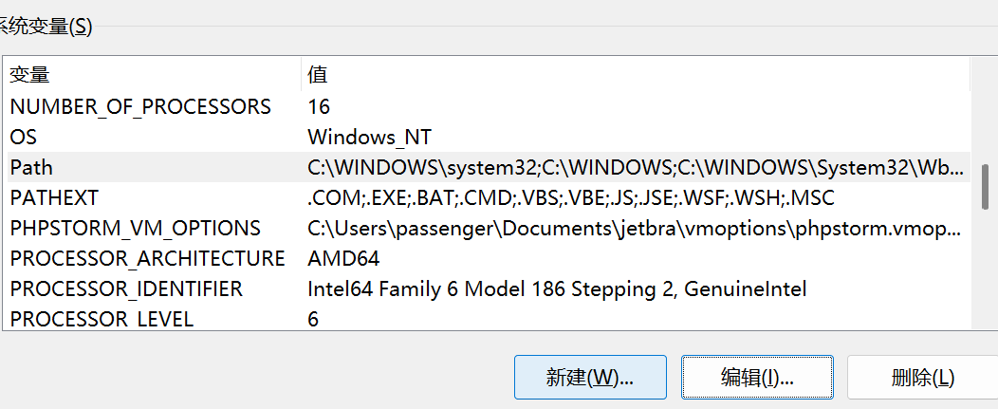
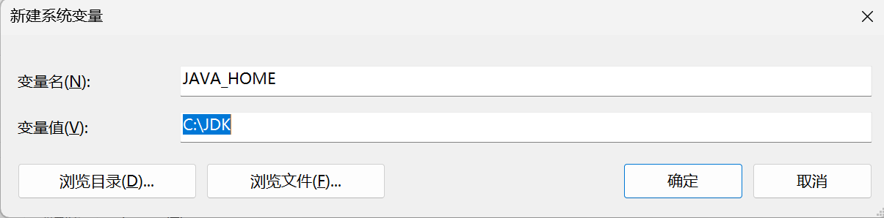
Tutorial with Project Examples
Add the JAVA_SOME variable with the value of the jdk installation address
Confirm all the way until all the windows are closed

Slide 8
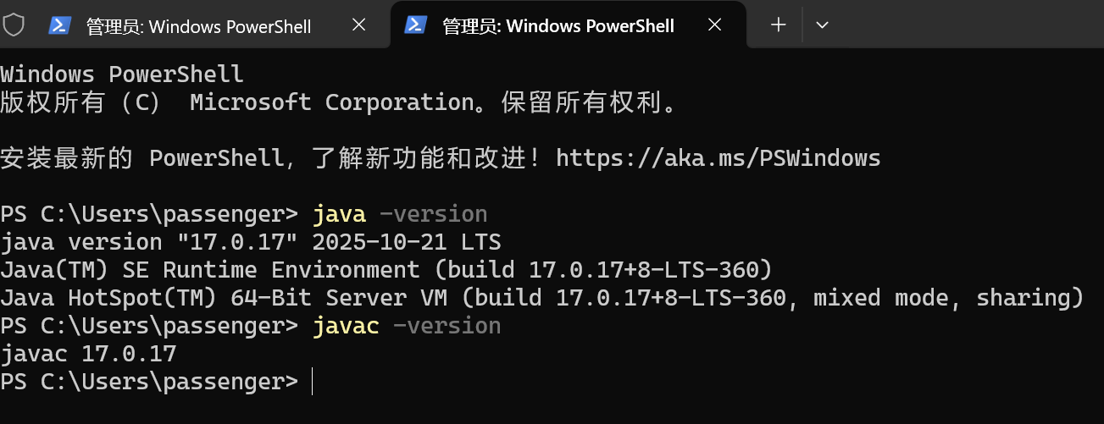
Tutorial with Project Examples
Verify installation
Press Win + R， enter cmd
java -version
javac -version

Slide 9
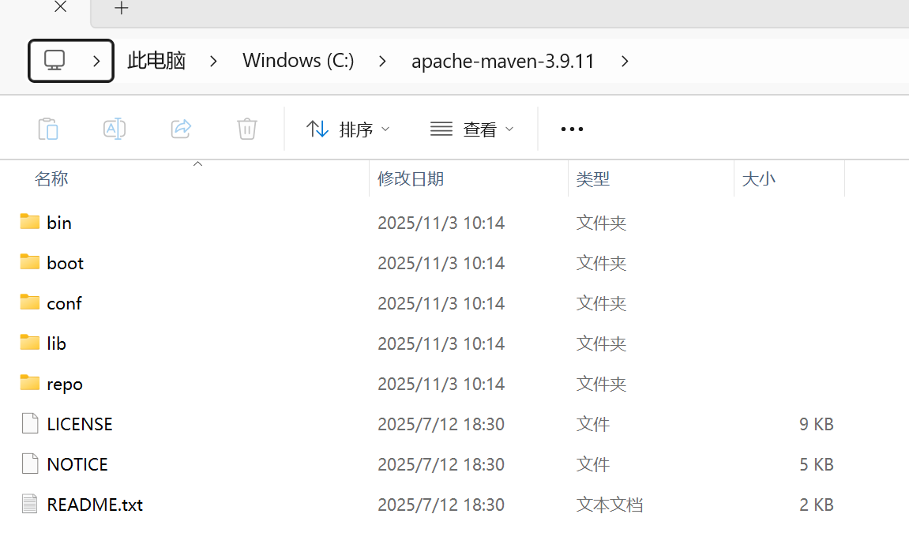
Tutorial with Project Examples
Download Apache Maven – Maven
Extract the downloaded Maven compressed file
Enter the folder and create a repo folder to store Maven local repository dependencies

Slide 10
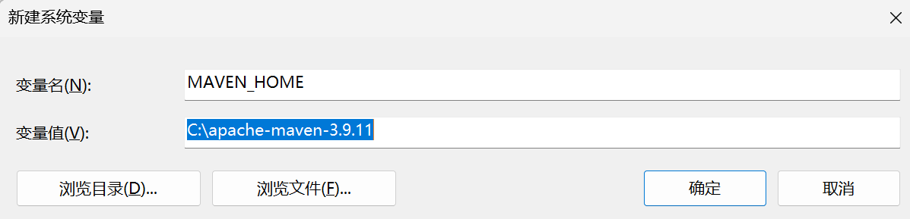
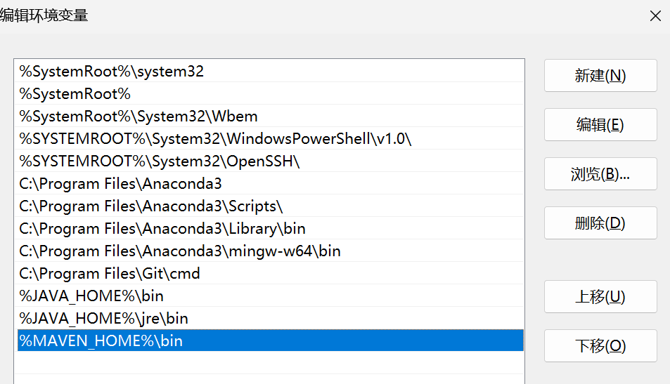
Tutorial with Project Examples
Create a new system variable MAVEN_SOME with the value of the Maven installation address
Create a new environment variable %MAVEN_HOME%\bin

Slide 11
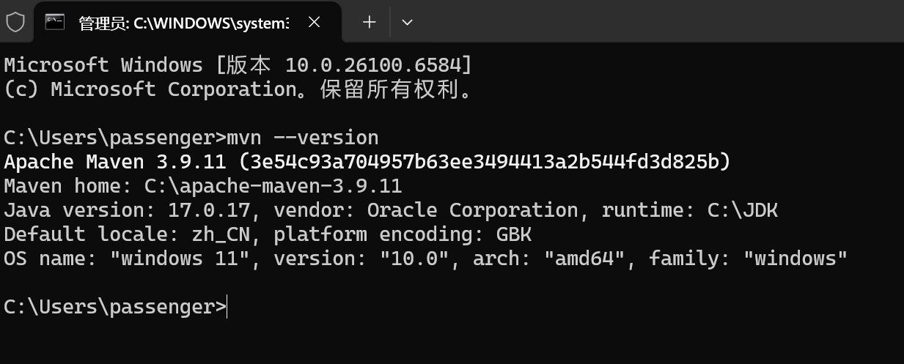
Tutorial with Project Examples
Win + R -> CMD ，enter mvn --version (View Maven version)

Slide 12
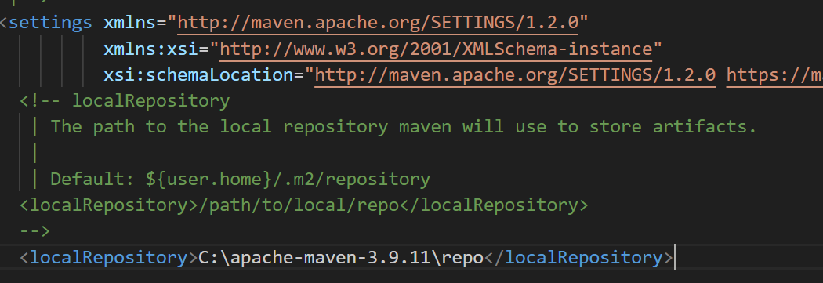
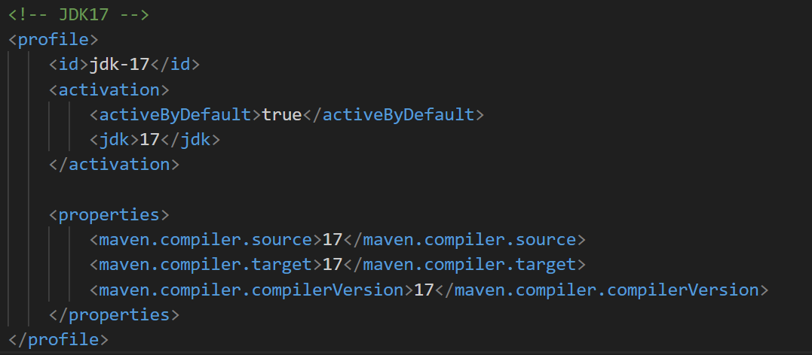
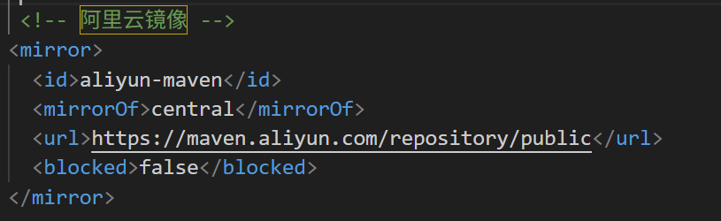
Tutorial with Project Examples
Go to the config folder and edit the settings. xml file
Specify repo address
Configure mirrors
Configure JDK version
The file sent to everyone is an edited version that does not require any changes except for the repo address
Notes:
Maven 的默认服务器在国外所以下载依赖会很慢，所以我们需要将其改为国内的镜像，一般使用的是阿里云的镜像。
在 Maven 中配置 JDK 版本，可以确保项目在正确的 JDK 环境下进行构建和运行，避免因 JDK 版本不兼容而导致的编译错误或运行时问题。

Slide 13
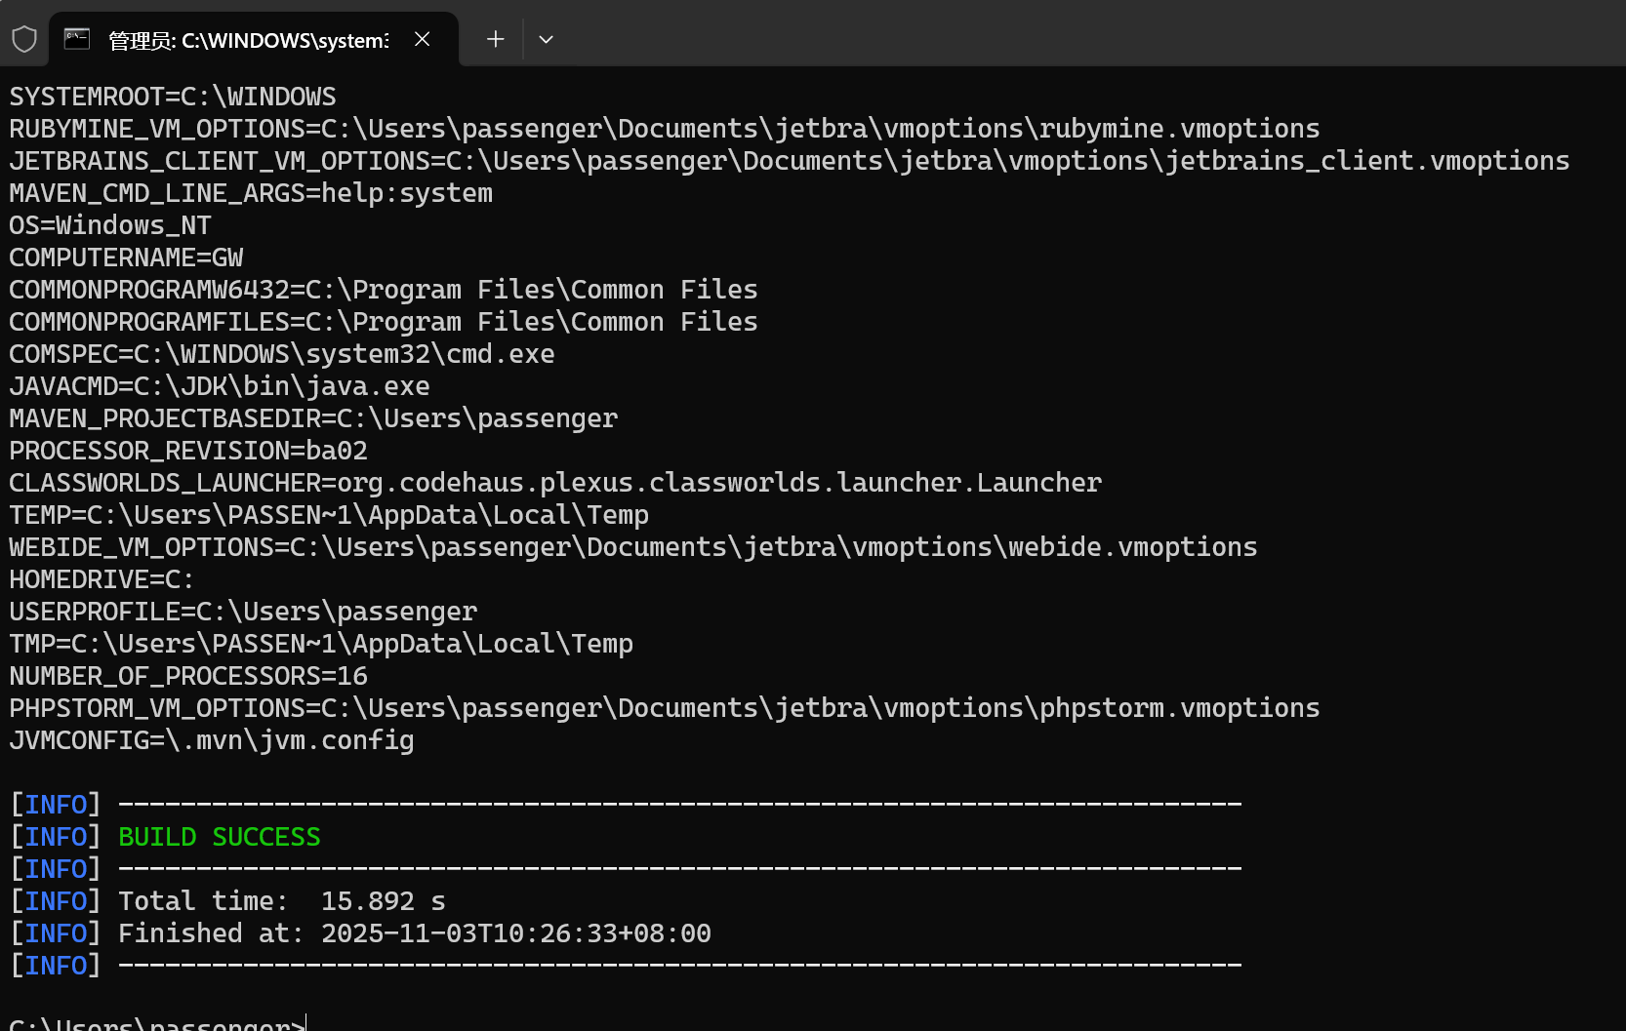
Tutorial with Project Examples
Check if the configuration is successful
Win + R -> CMD , enter mvn help:system (Print Maven information)

Slide 14
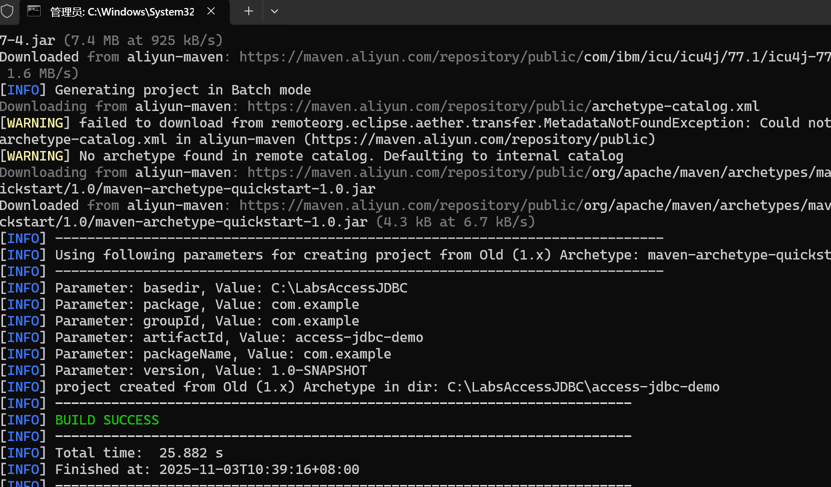
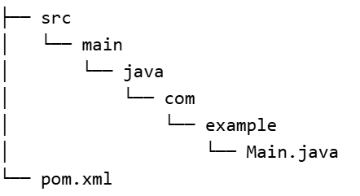
Tutorial with Project Examples
Create a new folder named LabsAccess JDBC as the project address
Enter the folder, enter cmd in the address bar, and open the command line
Enter at the command line:
mvn archetype:generate -DgroupId=com.example -DartifactId=access-jdbc-demo -DarchetypeArtifactId=maven-archetype-quickstart -DinteractiveMode=false

Slide 15
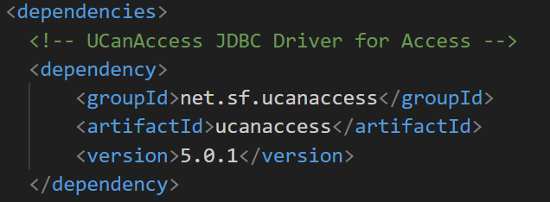
Tutorial with Project Examples
Edit pom.xml

Slide 16
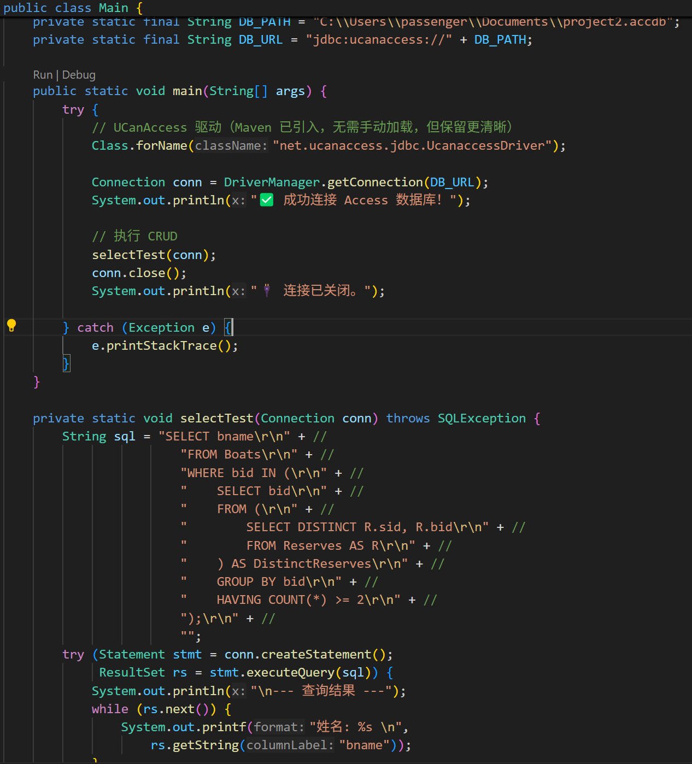
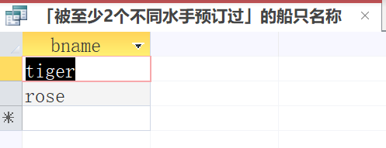
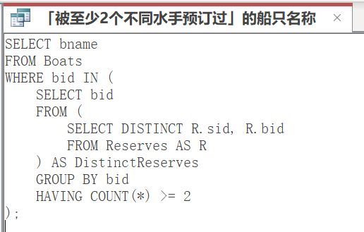
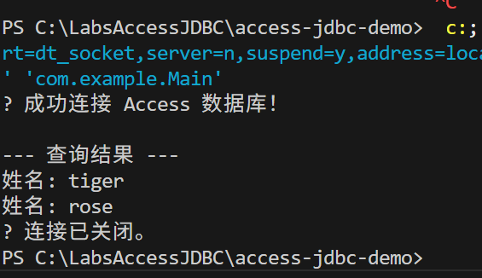
Tutorial with Project Examples
Operate the database by writing Java code

Slide 17
Project 3
Tutorial with Project Examples
Assignment

Slide 18
Assignment
1. Assignment Content
Connect to the universities database using Java
Implement adding, deleting, updating, and querying database tables using Java

Slide 19
Assignment
1. Assignment Content
Questions
This assignment requires everyone to exercise their subjective initiative:
Based on existing tables in the database, create a new table and design the fields and primary keys for the created table. The report needs to explain the reasons for establishing this table.
Delete the newly created table.
Insert a row of record in the student table.
Delete the newly inserted record.
Update a record in the student table.
Restore the modified records to their original state.
Execute all the SQL statements in Project 2.

Slide 20
Assignment
1. Assignment Content
Schema and Sample Data
The schema of the database is provided below (keys are red, field types are omitted):
    student(sid, sname, sex, age, year, gpa)
    dept(dname, numphds)
    prof(pname, dname)
    course(cno, cname, dname)
    major(dname, sid)
    section(dname, cno, sectno, pname)
    enroll(sid, grade, dname, cno, sectno)

Slide 21
Assignment
1. Assignment Content
Data Files
Download the following data files from WeChat Group(The imports you made in Project 1).
        course.txt
        dept.txt
        enroll.txt
        major.txt
        prof.txt
        section.txt
        student.txt
It is recommended to use the original student.txt for better communication and comparison of correctness among classmates.

Slide 22
Assignment
2. A Few Points to Note
Pay attention to the address of the database connection, a single slash is an escape character.
This is an individual assignment – no group submissions are allowed.
Hand in a report which outlines your answers and the process by which you arrived at them.

