Slide 1
Project 5
Lecturer: Shuai Wang
TA: Jiawei Liu

Slide 2
Requirements for submitting the assignment
Email address : liujoy@seu.edu.cn
Format of Email subject and File name: StudentNumber-Name-Project-X
  example : 71121000-张三-Project-5.zip
Including :
①report_A5.doc / report_A5.docx / report_A5.pdf
②university_A5.mdb / university_A5.accdb
Deadline: Beijing time, 12.18, 23:59:59

Slide 3
Project 5
Tutorial on Integrity Constraint
Assignment

Slide 4
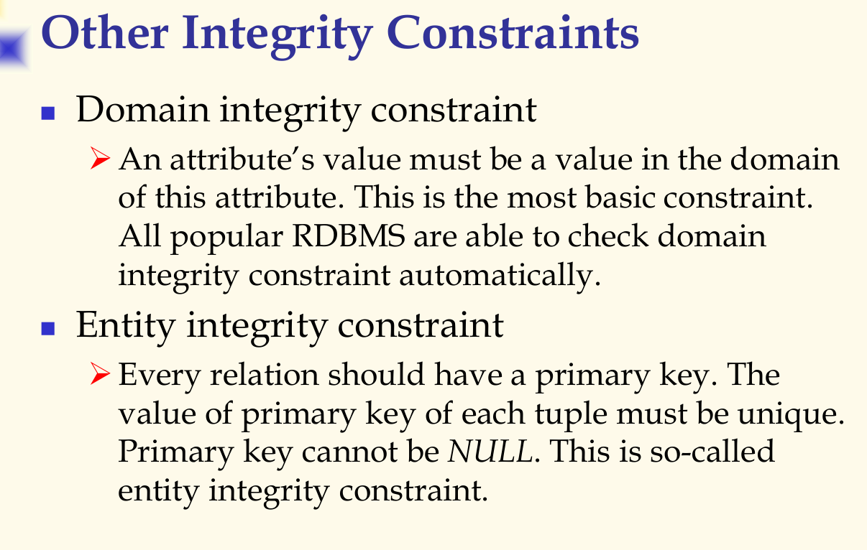
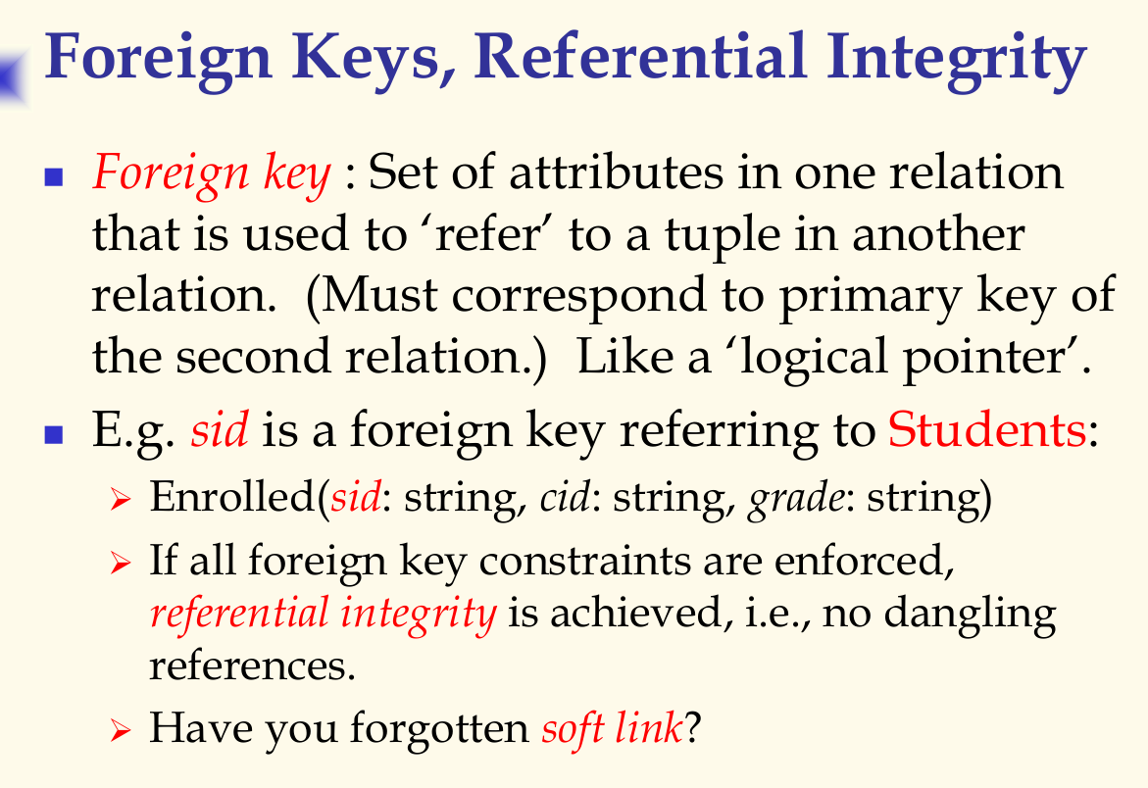
Integrity Constraint
DB_Ch2_1 P15-P17
Notes:
慢点讲，先将实体完整性。然后域完整性。
最后参照完整性。那么为什么要有参照完整性？
A表C表的主键构成了B表的主键。
假设没有参照完整性。
问题1：如果更新或者删除了表A的主键，他也在B里面。会发生什么问题？
让大家思考。。。很显然，B里面的东西没修改或者没删除！数据库里的内容不一致了！
问题2：反过来如果更新或者删除了表B的主键，他也在A、C里面。会发生什么问题？
让大家思考。。。很显然，A、C里面的东西没修改或者没删除！数据库里的内容也不一致了！
那么，有了这个参照完整性约束啊，我们在操作B的时候，才不会破坏数据库的一致性。

Slide 5
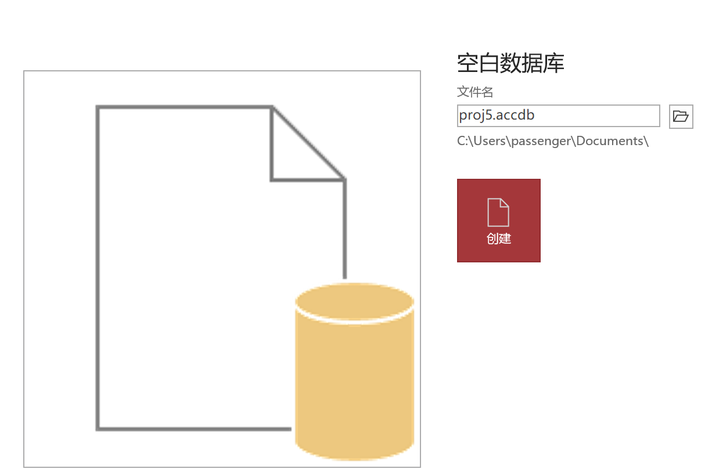
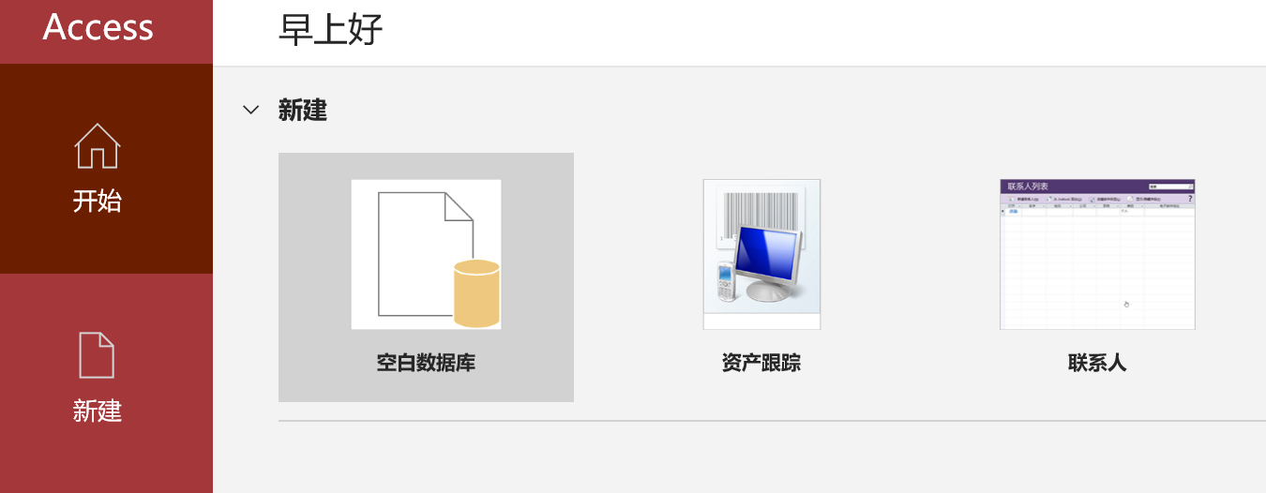
Integrity Constraint
1. Preparation
1) Create Database

Slide 6
2) Create Table
学生表（students）
  学号（StudentID）
  姓名（Name）
  年龄（Age）
  性别（Gender）
课程表（courses）
  课程号（CourseID）
  课程名（CourseName）
  学分（Credits）
选课表（enrollments）
  学号（StudentID）
  课程号（CourseID）
  成绩（Grade）

Slide 7
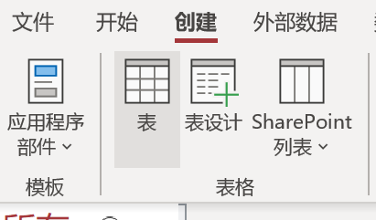
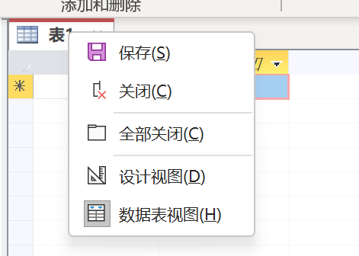
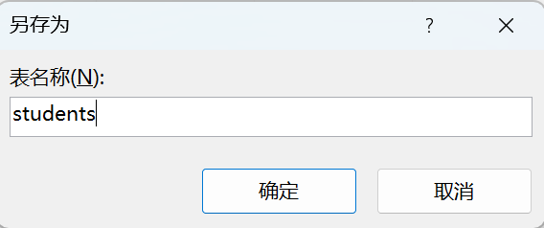
Create “students” Table

Slide 8
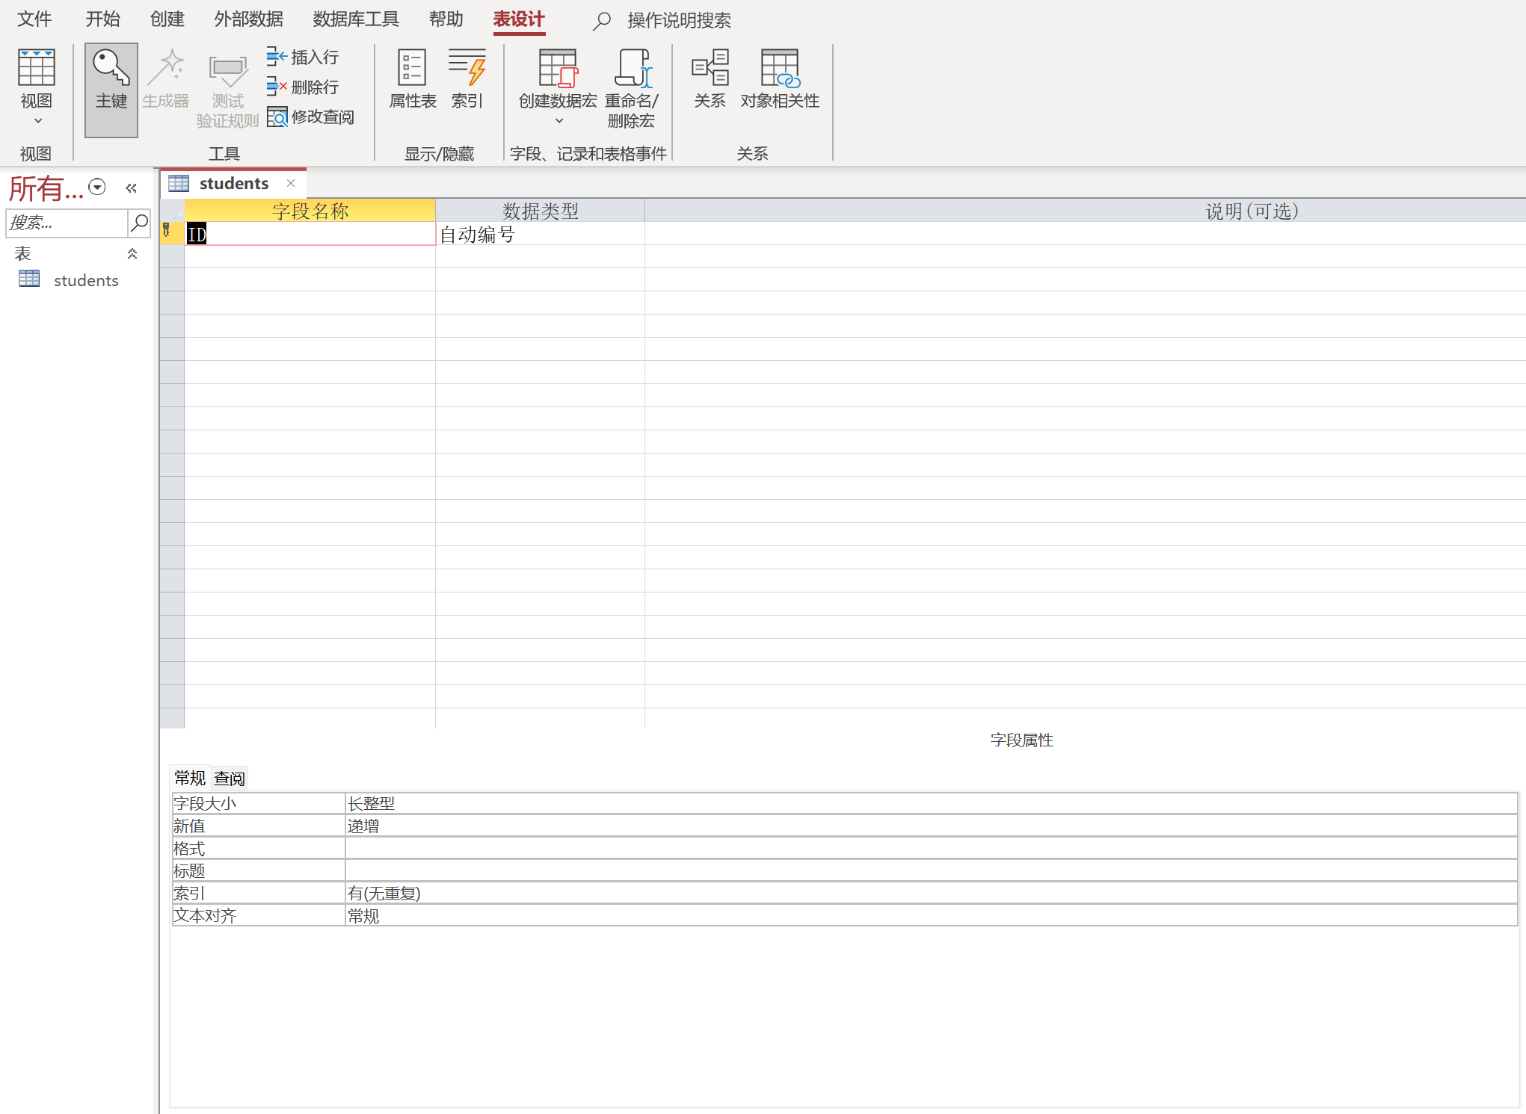
Create “students” Table
3) Rename Field

Slide 9
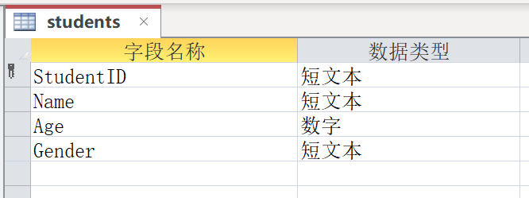
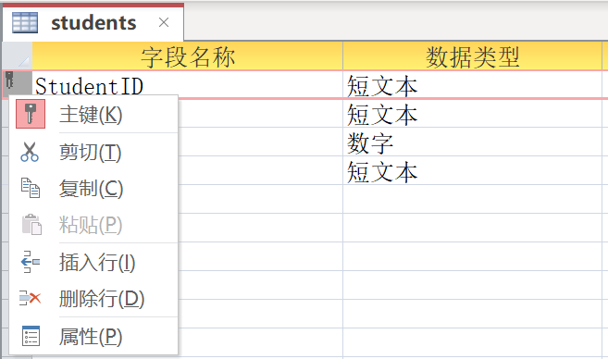
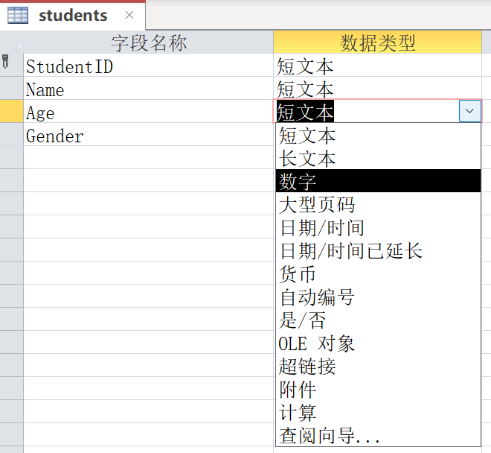
学生表（students）
  学号（StudentID）
  姓名（Name）
  年龄（Age）
  性别（Gender）
Not “自动编号”
[Optional]: Set Primary Key
4) Add New Fields
5) Set Data Type

Slide 10
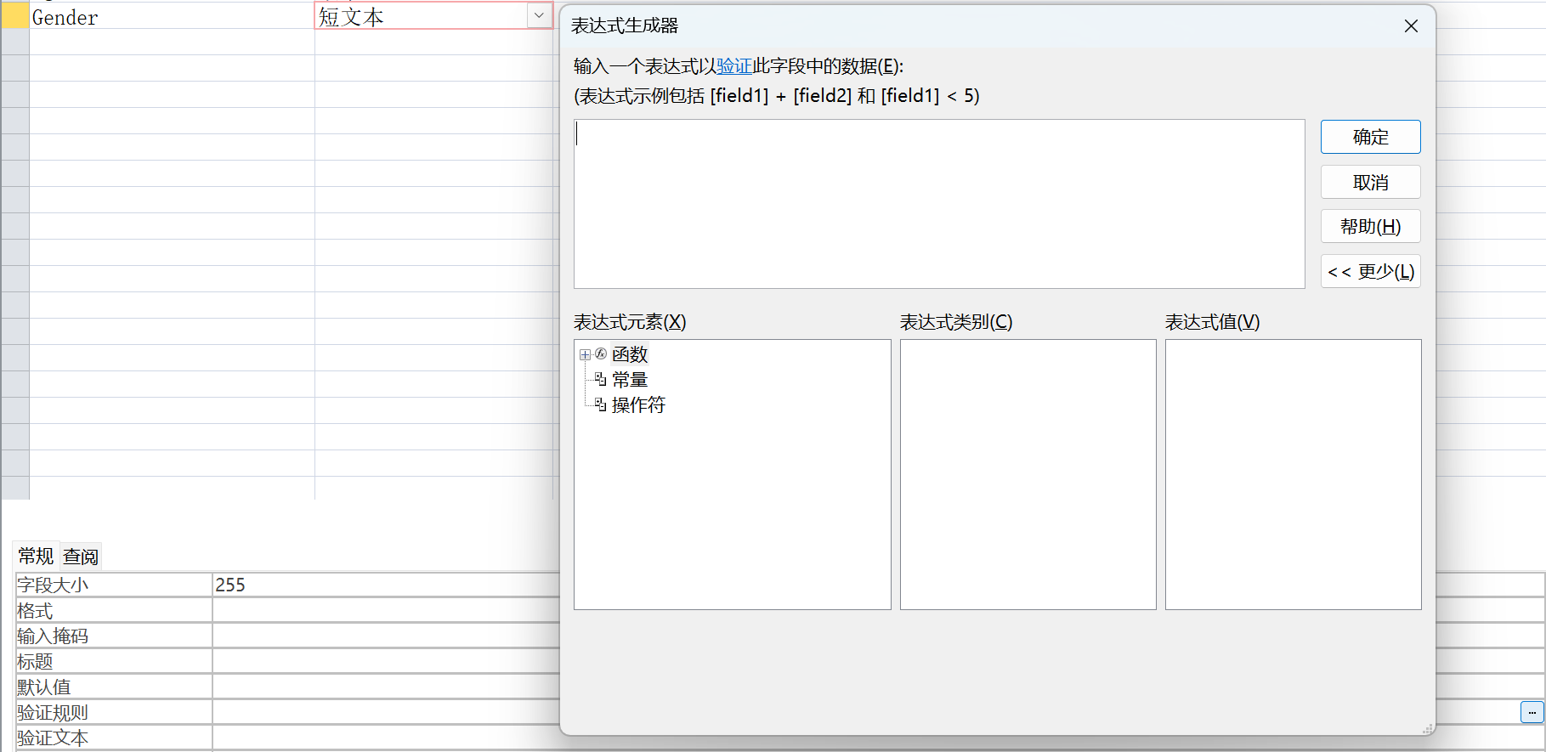
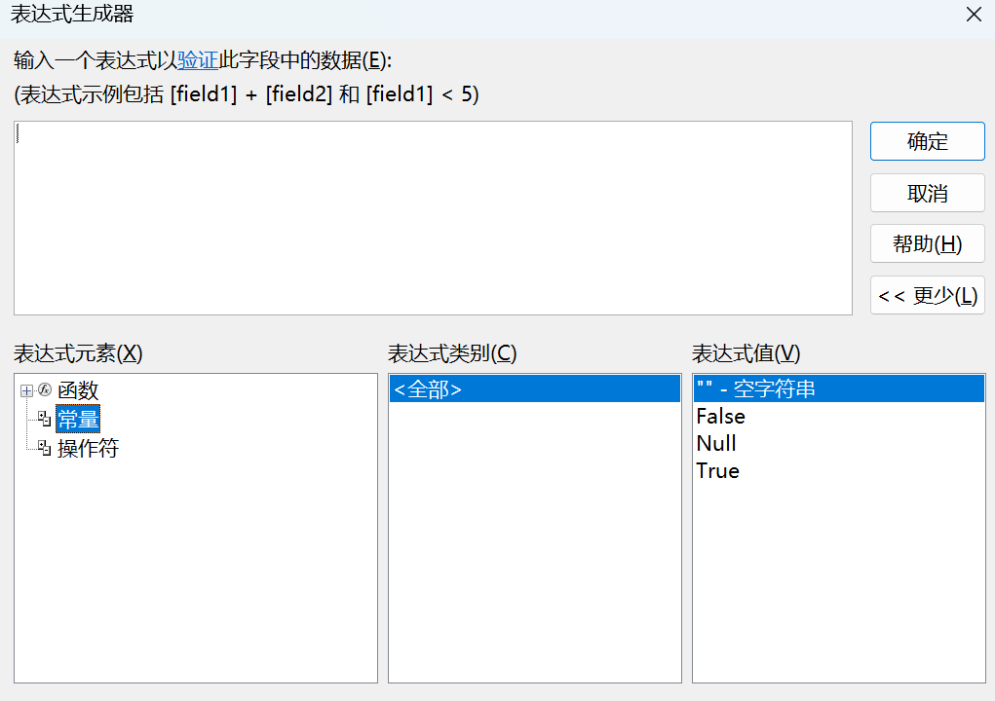
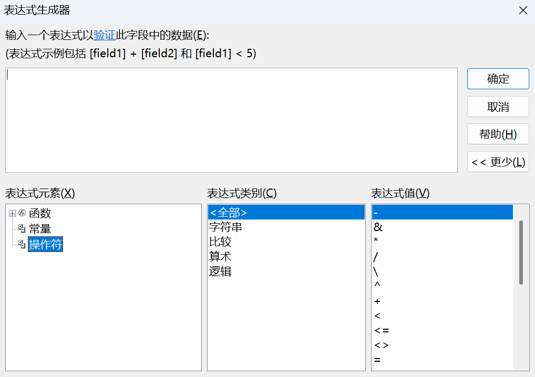
6) Set Constraints

Slide 11
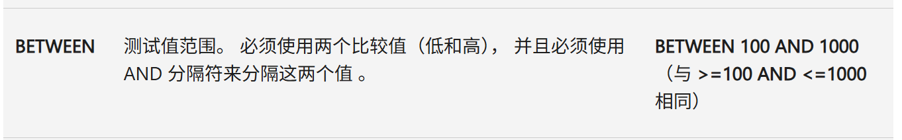
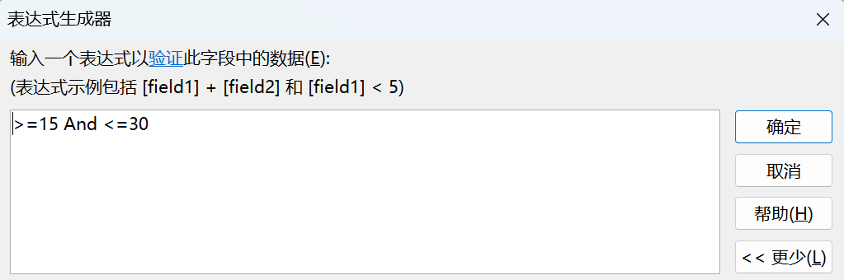
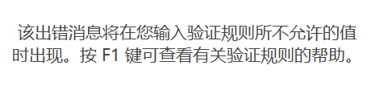
6) Set Constraints [Age]
使用有效性规则限制数据输入 - Microsoft 支持

Slide 12
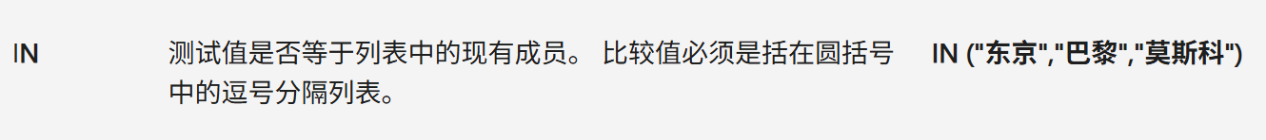
6) Set Constraints [Gender]
使用有效性规则限制数据输入 - Microsoft 支持

Slide 13
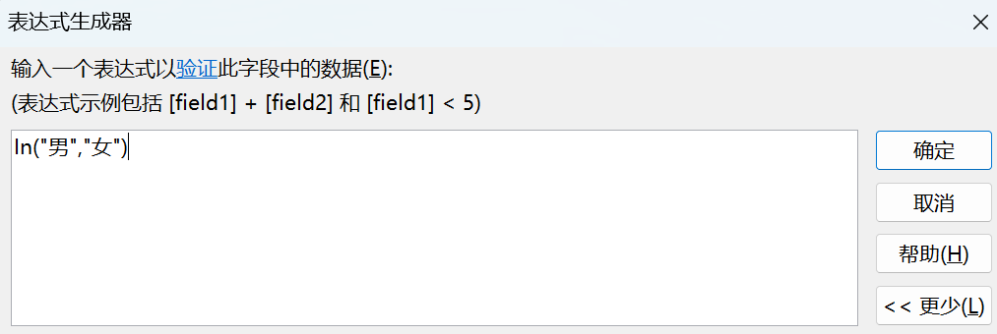

6) Set Constraints [Gender]

Slide 14
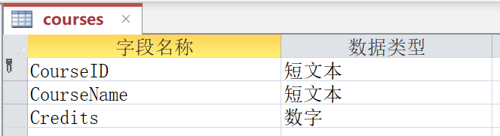
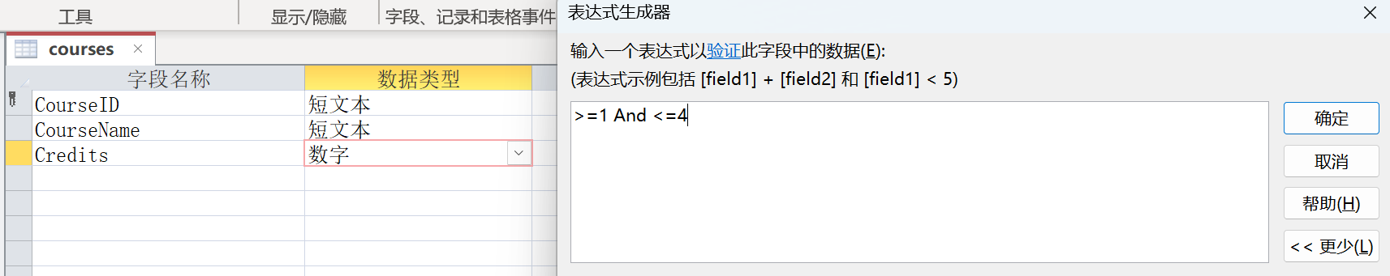

7) Similar processes for “courses” Table
课程表（courses）
  课程号（CourseID）
  课程名（CourseName）
  学分（Credits）

Slide 15
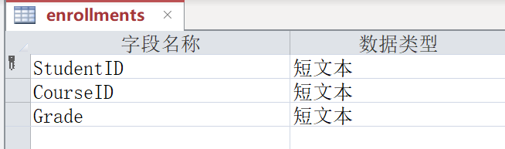
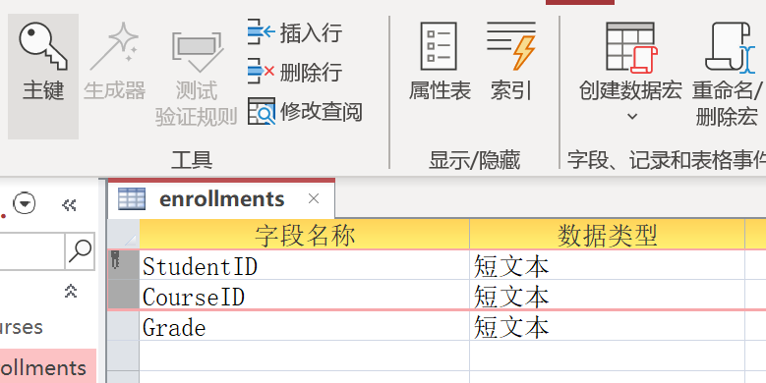
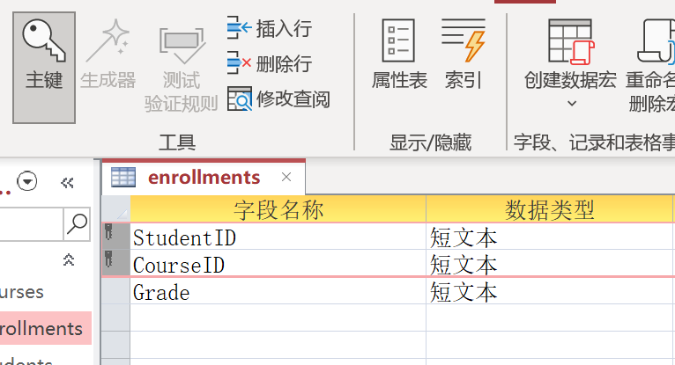
8) Similar processes for “enrollments” Table
选课表（enrollments）
  学号（StudentID）
  课程号（CourseID）
  成绩（Grade）

Slide 16
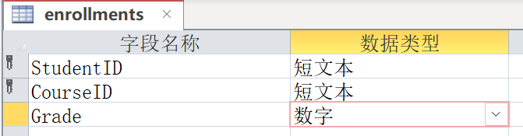

8) Similar processes for “enrollments” Table

Slide 17
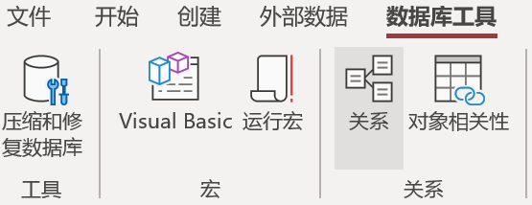
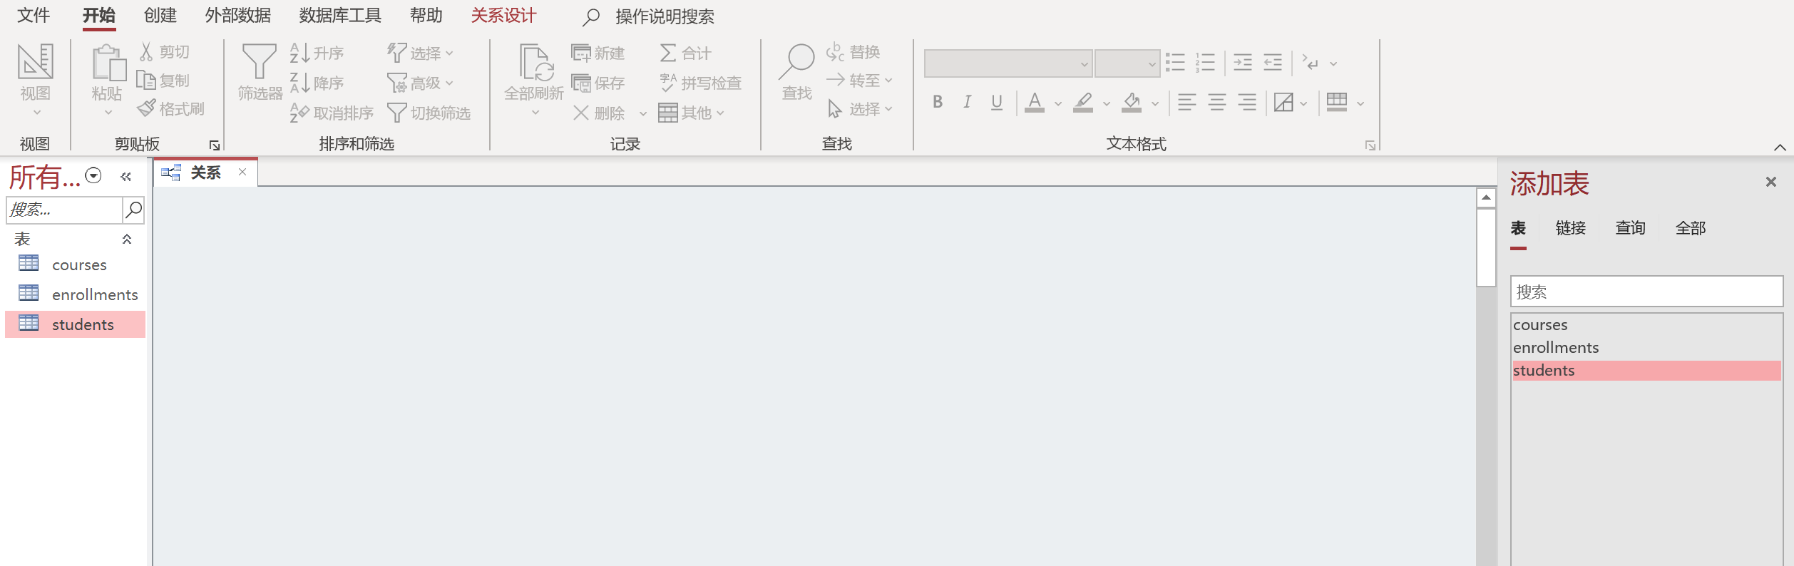
9) Set Relationships Between Tables

Slide 18
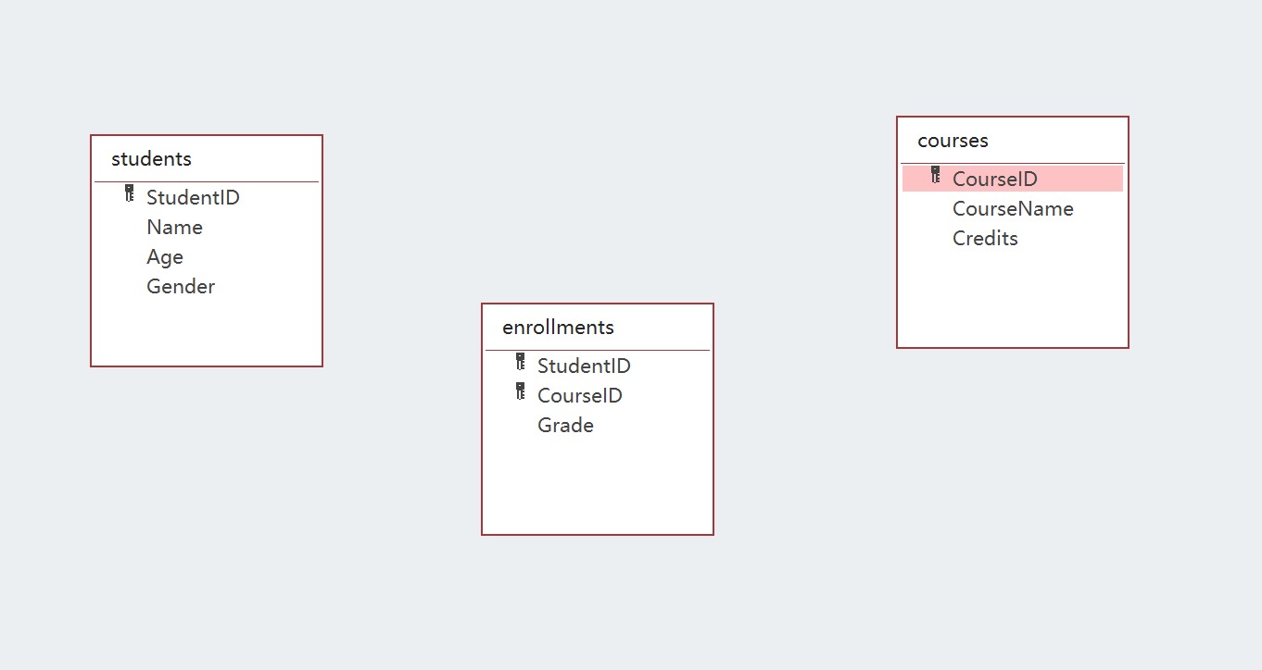
9) Set Relationships Between Tables
Drag the tables to the operation area

Slide 19
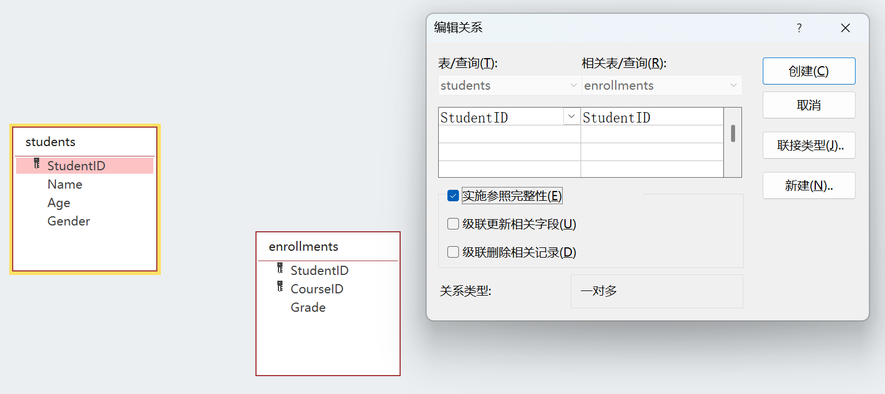
9) Set Relationships Between Tables
Establish the relationship between the “students” table and the “enrollments” table

Slide 20
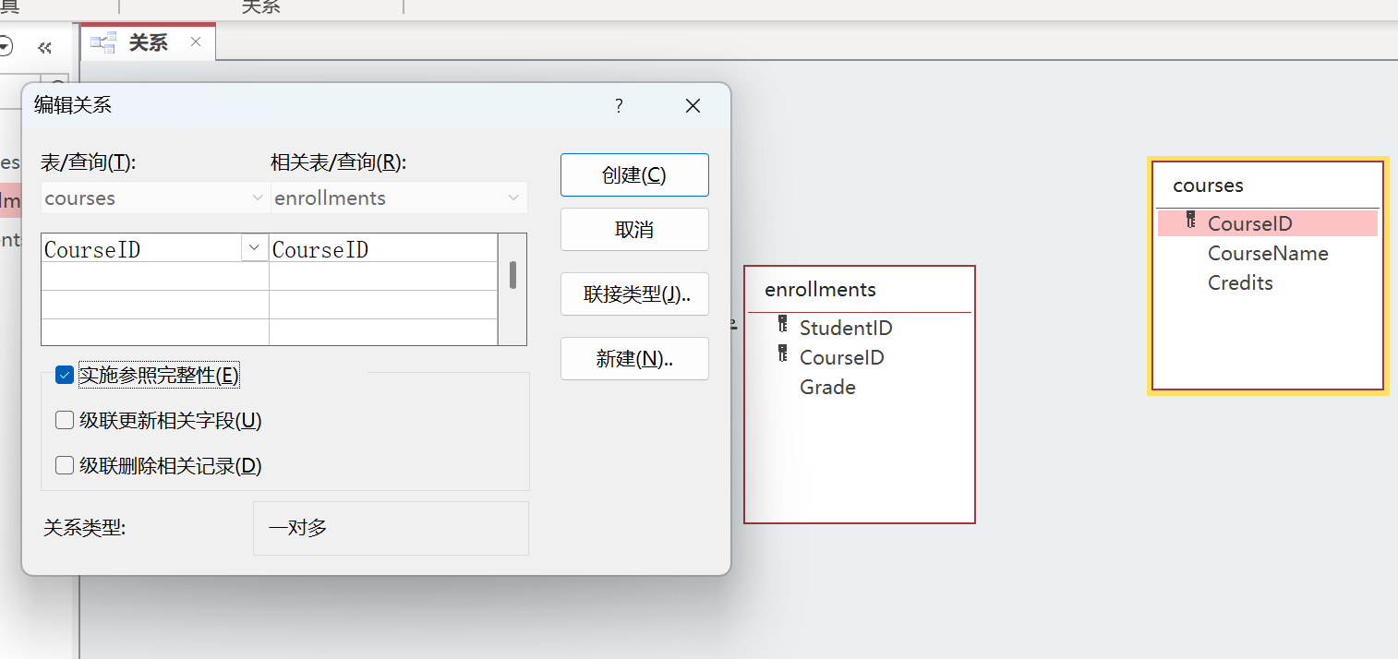
9) Set Relationships Between Tables
Establish the relationship between the “courses” table and the “enrollments” table

Slide 21
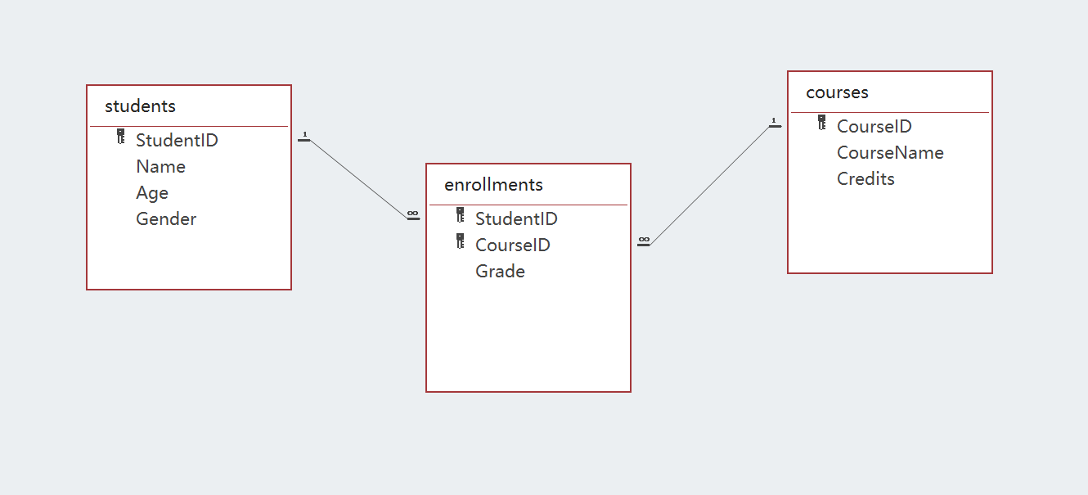
9) Set Relationships Between Tables

Slide 22
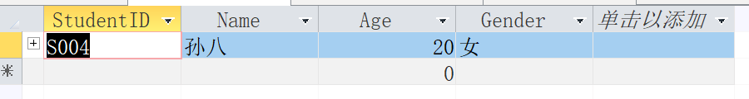
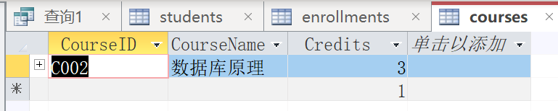
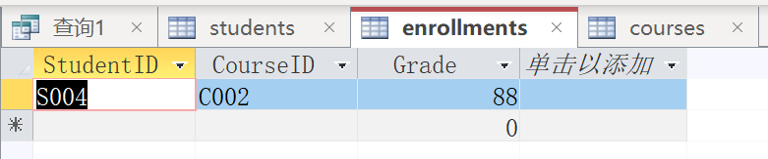
Integrity Constraint
2. Experiments
Correctly insert new student
INSERT INTO Students (StudentID, Name, Age, Gender) VALUES ('S004', '孙八', 20, '女’);
Correctly insert new course
INSERT INTO Courses (CourseID, CourseName, Credits) VALUES ('C002', '数据库原理', 3);
Correct enrollment (premise: both S004 and C002 exist)
INSERT INTO Enrollments (StudentID, CourseID, Grade) VALUES ('S004', 'C002', 88);

Slide 23
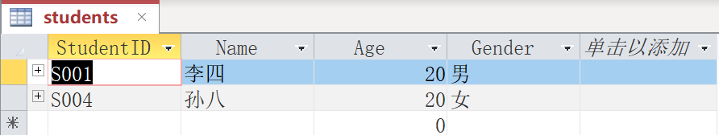
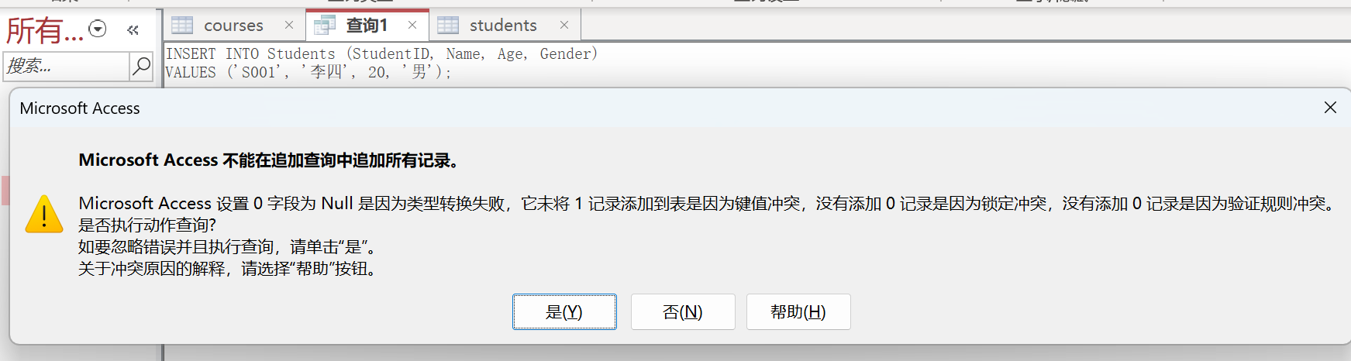
1) Verify Entity Integrity (unique and non empty primary key)
Add new data to “sutdents”
INSERT INTO Students (StudentID, Name, Age, Gender)
VALUES ('S001', '李四', 20, '男');
Insert duplicate data again (i.e. run the SQL statement again)
INSERT INTO Students (StudentID, Name, Age, Gender)
VALUES ('S001', '李四', 20, '男');

Slide 24
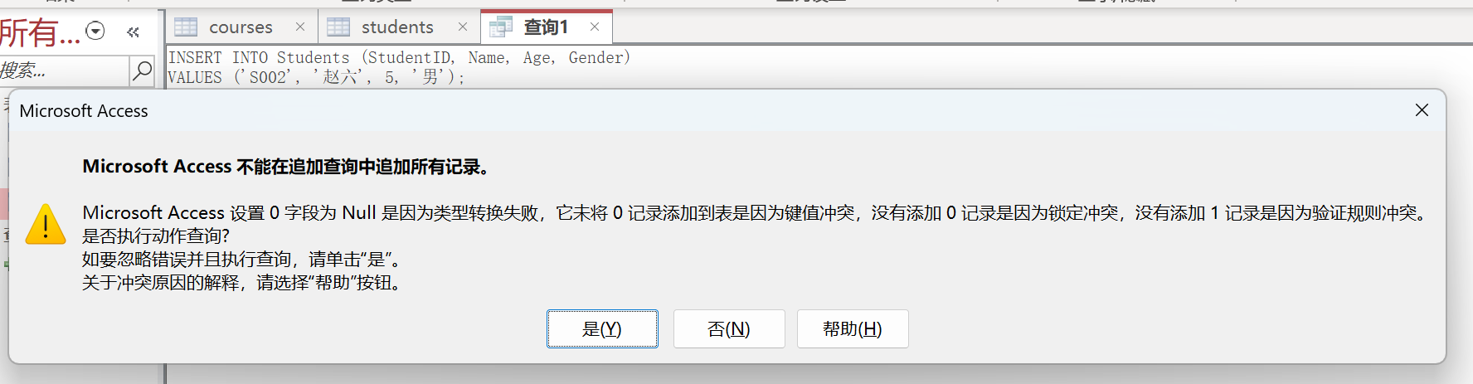
2) Verify Domain Integrity
Inserting data beyond the age range
INSERT INTO Students (StudentID, Name, Age, Gender)
VALUES ('S002', '赵六', 5, '男');

Slide 25
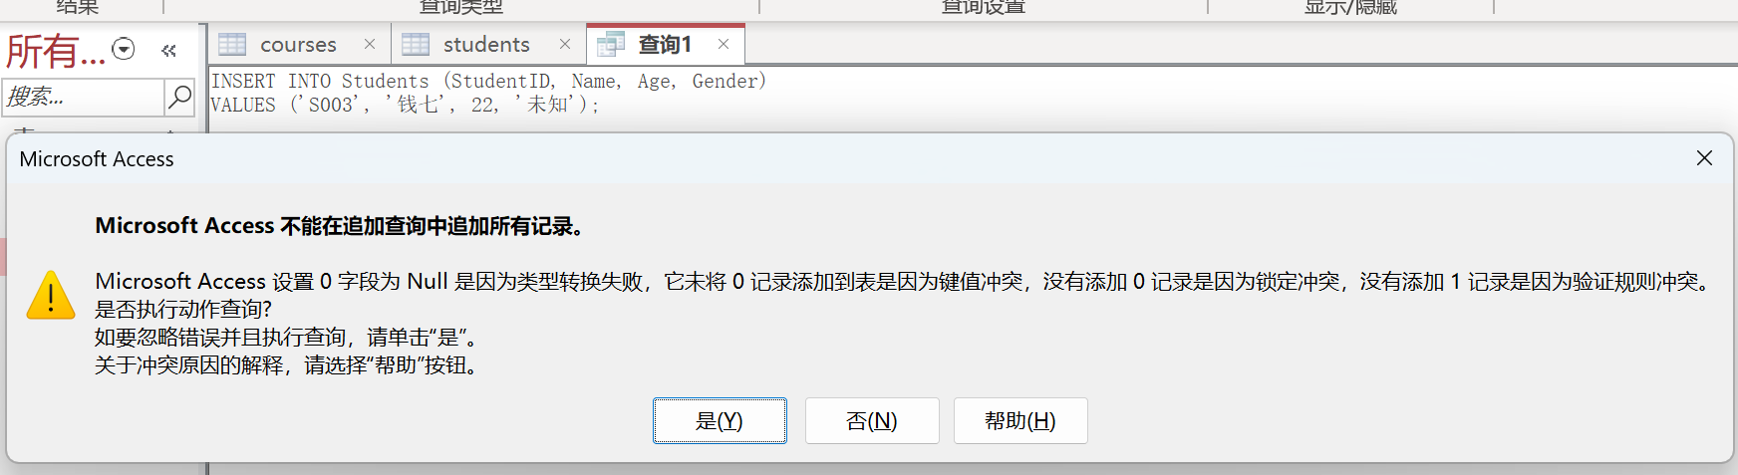
2) Verify Domain Integrity
Inserting data of invalid gender
INSERT INTO Students (StudentID, Name, Age, Gender)
VALUES ('S003', '钱七', 22, '未知');

Slide 26
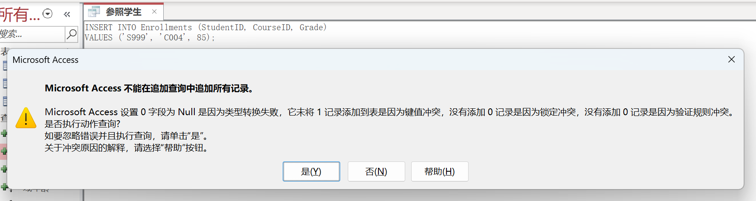
3) Verify Reference Integrity
Insert a non-existent student course selection record
INSERT INTO Enrollments (StudentID, CourseID, Grade)
VALUES ('S999', 'C004', 85);

Slide 27
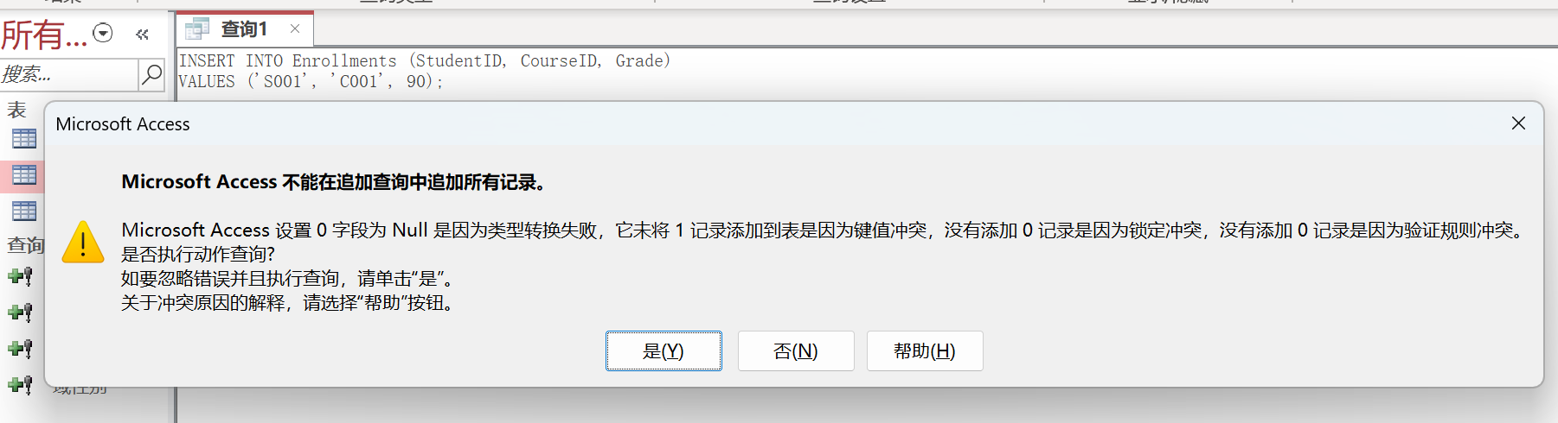
3) Verify Reference Integrity
Insert a non-existent course
INSERT INTO Enrollments (StudentID, CourseID, Grade)
VALUES ('S001', ‘C001', 90);

Slide 28
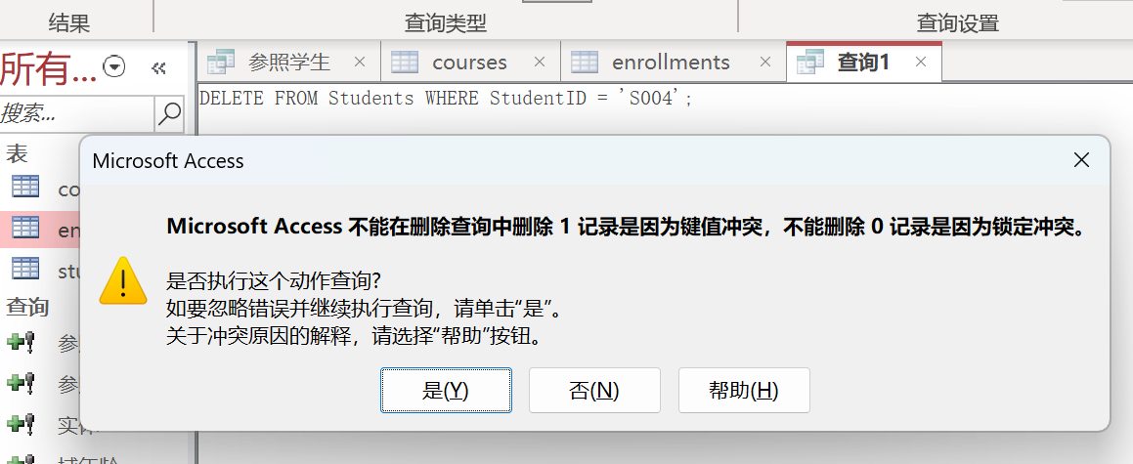
3) Verify Reference Integrity
Delete referenced students (recorded in Enrollments)
DELETE * FROM Students
WHERE StudentID = 'S004';
未启用“级联删除”，Access 会阻止删除，因为相关记录存在于另一个表中。

Slide 29
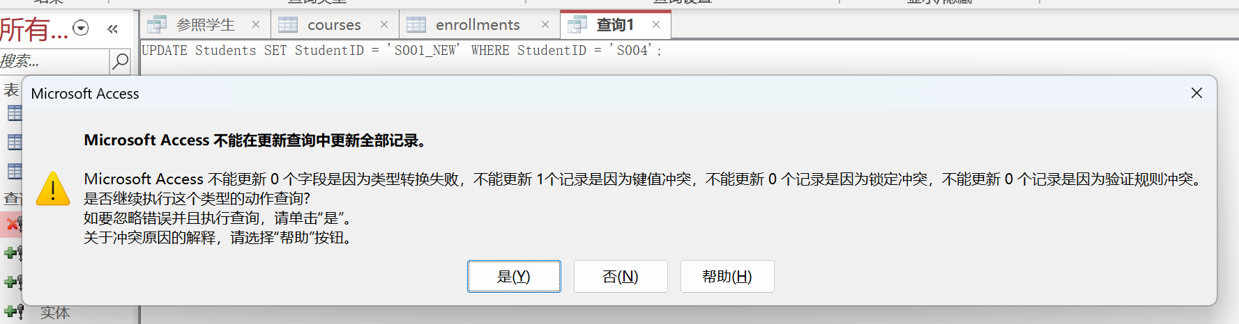
3) Verify Reference Integrity
Update primary key of main table (referenced by foreign key)
UPDATE Students SET StudentID = 'S001_NEW'
WHERE StudentID = 'S004';
未启用“级联更新”，会报错，因为存在相关记录。

Slide 30
Project 5
Tutorial on Integrity Constraint
Assignment

Slide 31
Assignment after Class
1. Content
For Domain integrity constraint, Entity integrity constraint and Referential integrity constraint, you should give each integrity constraint “INSERT”,”DELETE” and ”UPDATE” SQL statements to prove it.
(At least 9 statements totally)

Slide 32
Assignment after Class
2. Data Schema
The schema of the database is provided below (keys are red, field types are omitted):
    student(sid, sname, sex, age, year, gpa)
    dept(dname, numphds)
    prof(pname, dname)
    course(cno, cname, dname)
    major(dname, sid)
    section(dname, cno, sectno, pname)
    enroll(sid, grade, dname, cno, sectno)

Slide 33
Assignment after Class
3. Data Files
Download the following data files from WeChat Group
    course.txt
    dept.txt
    enroll.txt
    major.txt
    prof.txt
    section.txt
    student.txt

Slide 34
Assignment after Class
4. Demand
Hand in an ACCESS database that contains at least nine statements. The database should contain nine queries, named as follows:
Insert1
Insert2
…
Delete1
…
Update3
Hand in a report which indicates your answers.(Figure is important. You should give your analysis about your sql statements.)

