Slide 1
Project 4
Lecturer: Shuai Wang
TA: Jiawei Liu

Slide 2
Requirements for submitting the assignment
Email address : liujoy@seu.edu.cn
Format of Email subject and File name: StudentNumber-Name-Project-X
  example : 71121000-张三-Project-4.zip
Including :
①report_A4.doc / report_A4.docx / report_A4.pdf
②university_A4.mdb / university_A4.accdb
Deadline: Beijing time, 12.04, 23:59:59

Slide 3
Project 4
Tutorial on ER Diagram
Assignment

Slide 4
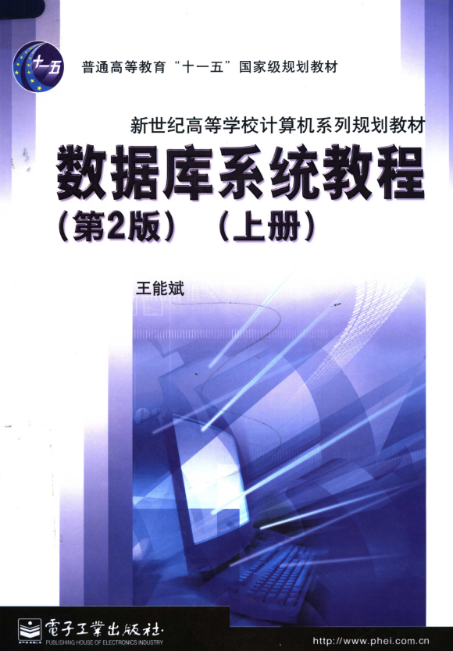
Tutorial on ER Diagram
1. A Good Database design
P223
①Design a schema logically based on business requirements.
  You should first identify your current business scenario and requirements.
  University system? Logistics inventory? E-commerce platform? Library management? Student information system?
  There are many channels available to learn about database design techniques. It is well-established and mature .
  Through tutorials or online resources.
②Reduce redundant data.
  Redundant information will lead to wasted space, difficulties in updating, inefficient querying, and challenges in maintaining data consistency. Divide your information into tables based on themes to minimize redundant data (so you must know your business well) .
Notes:
基于业务需求逻辑的设计模式（书p223
减少冗余：重复信息(也称为冗余数据)是不好的，因为它浪费空间，增加错误和不一致的可能性。把你的信息分成以主题为基础的表格，减少冗余数据
）

Slide 5
Tutorial on ER Diagram
1. A Good Database design
③Ensure data accuracy and integrity.
  If a table contains incorrect or inconsistent information, any reports extracted from the database will also contain erroneous information.
④Define and use the appropriate naming conventions.
  Use appropriate naming conventions, as well as carefully consider the selection of primary keys.
  You may have noticed that in our previous projects, some tables in the university database had inappropriate primary key definitions, and some tables had unclear content definitions. Now it is time to improve it and create a more reasonable database system.
Notes:
确保数据的正确性和完整性：如果数据库包含不正确的信息，从数据库提取信息的任何报告（单位：工资计算）也将包含不正确的
定义并使用适当的命名约定（规范化

Slide 6
Tutorial on ER Diagram
2. Design Process
Define the application scenarios and specific business logic of this database by ER Diagram
Gather data, Organize in tables and Specify the primary keys.
Create relationships among tables.
Refine & Normalize the Design.
Notes:
定义应用的用途
收集数据，组织在表格和指定主键
创建表之间的关系（1-1 1-n n-m 多元）
优化和规范设计

Slide 7
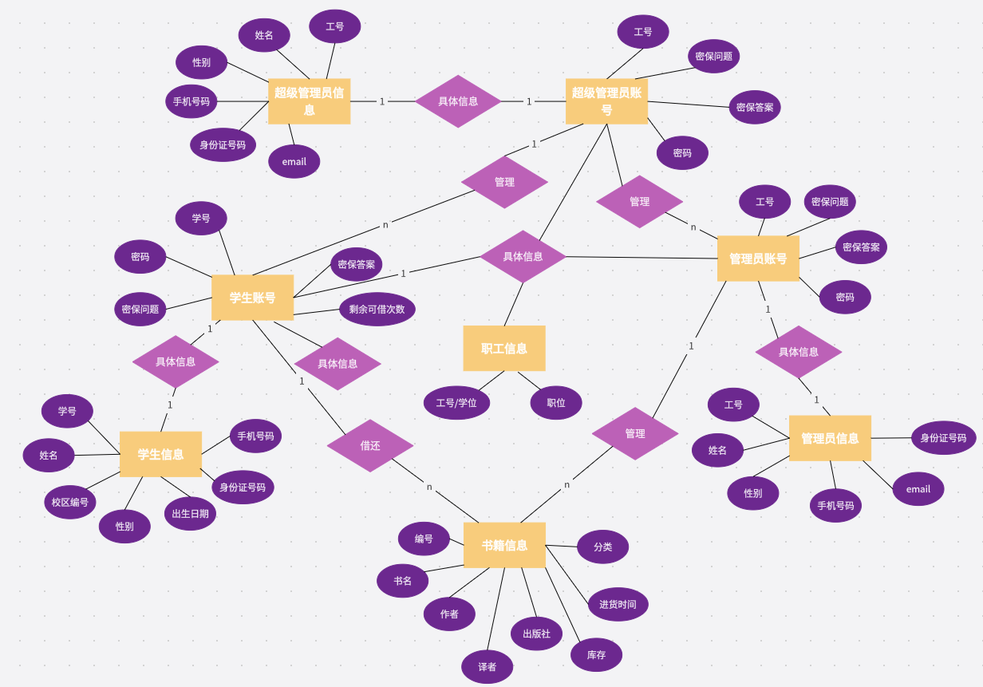
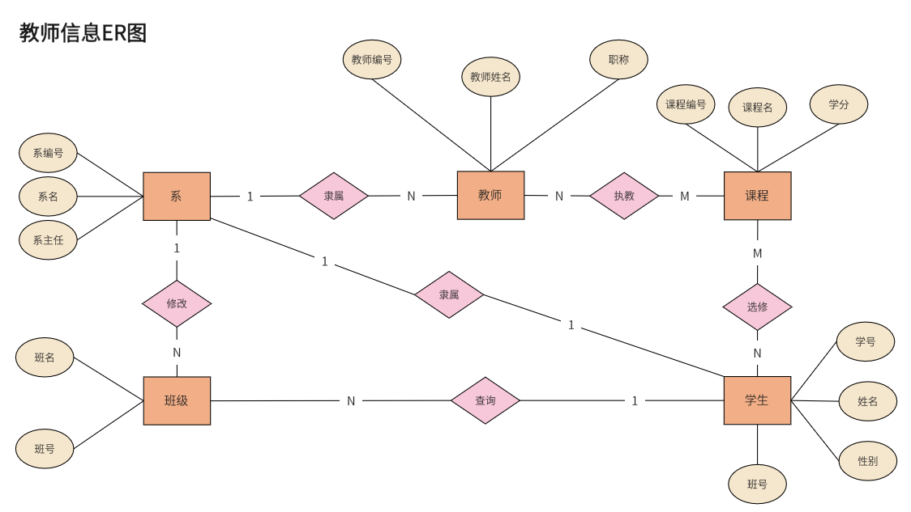
Tutorial on ER Diagram
3. ER example
Notes:
左边的简单讲讲，右边的记得提一下，为什么学生账号和学生信息都是严格1对1，却还要分开。
这涉及到业界的一个概念，叫做冷热数据分离。
对于那些查询频率比较高的字段，单独放张表，以减轻查询开销。

Slide 8
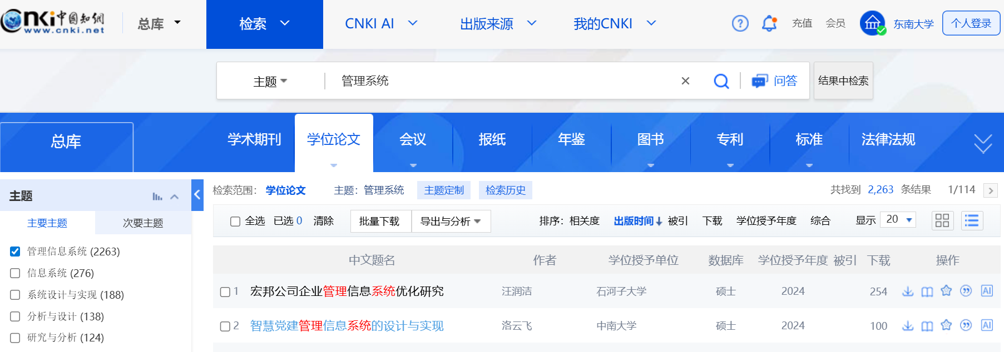
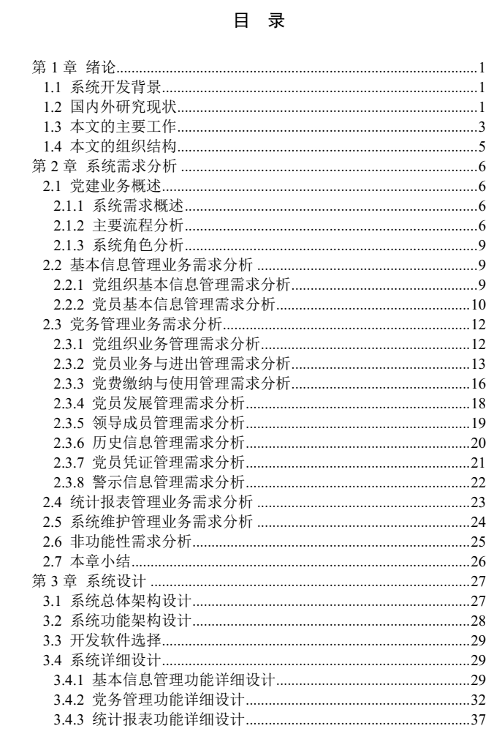
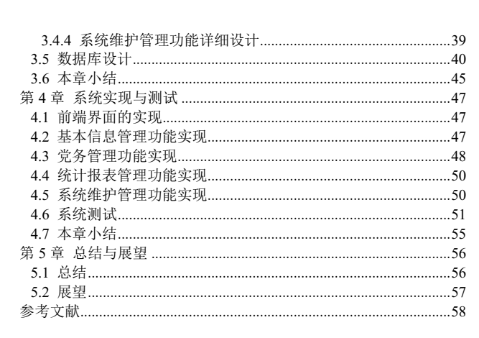
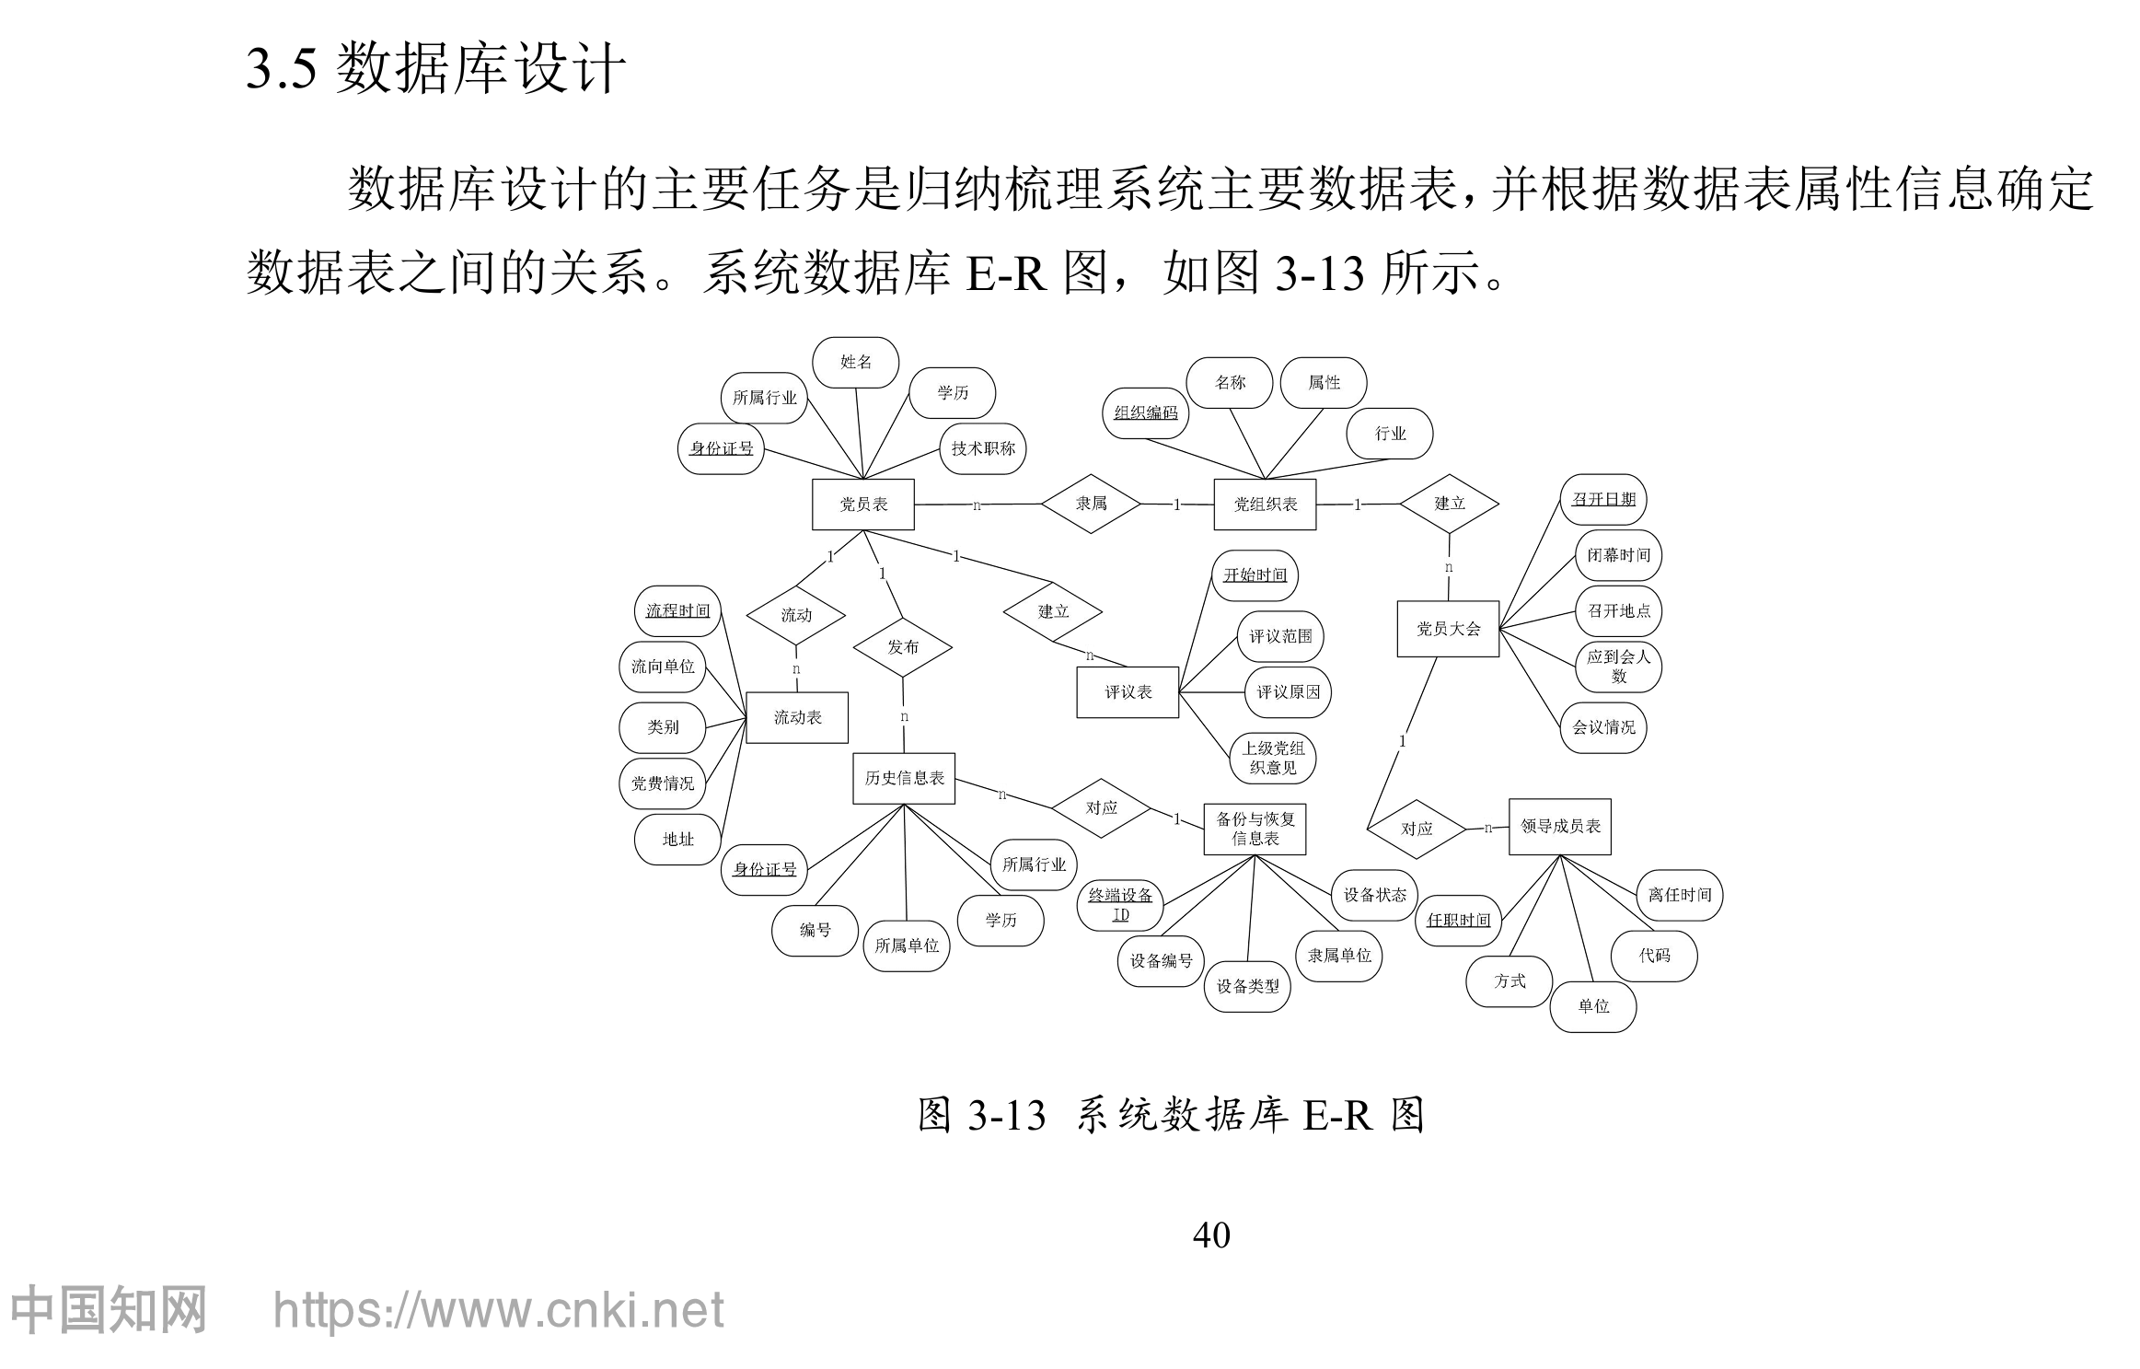
Tutorial on ER Diagram
3. ER example

Slide 9
Project 4
Tutorial on ER Diagram
Assignment

Slide 10
Assignment
The University database is the most basic.
You can also try to design your own database, such as the mentioned business scenarios.
You can also design an online bookstore database (which was mentioned in the first class), familiarize yourself with the design process of a major project.
1. Assignment Content
① Design a simple application based on the university database
  Design a student grade management
  Include at least 3~4 tables in your design database
  Try to design an application background for it
② Use the tools directly offered by Access to implement the interface, queries, report, etc.
Notes:
例如，基于大学数据库的非常简单的应用程序(不需要编程)
进行数据库设计
学生成绩管理
涉及大学数据库中至少3~4个表
能自己设计应用背景吗？
直接使用Access提供的工具实现接口、查询、报表

Slide 11
Assignment
1. Assignment Content
③ Hand in a report about the assignment
  Main contents
  E-R diagram design
  Function design (Describe the function you designed)
  Database query (Not be too simple)
④ Hand in your .mdb database
Notes:
交一份关于任务的报告
Main çontentse – r
图设计功能设计(描述你想设计什么功能)
数据库查询(不要设计地太简单)

