Slide 1
Project 6
Lecturer: Shuai Wang
TA: Jiawei Liu

Slide 2
Assignment
1. Content
  You are required to complete a comprehensive database system, including the implementation of both front-end and back-end processes.
  Below are the specific requirements for the content.
  Presentation: You can construct the Web system or App (desktop app, mobile app, WeChat app) using either B/S or C/S architecture.
  Framework: No restrictions. You can utilize any architecture or framework that you have researched and are familiar with to implement the front-end and back-end.
  Database: No restrictions. You can use databases such as Access, MySQL, or others as the storage medium for data.
  Task Type: Team work. 3~4 students per group.

Slide 3
Assignment
1. Content
  Scenario: You can use real-world database scenarios as the context for this experiment, including but not limited to the given example: Internet Bookstore .
  Note: Internet Bookstore is a classic example, providing a reference and defining the scope of the task. But it also has some mandatory:
  Internet Bookstore is the most basic requirement. The complexity and difficulty of the database scenario you customize should not be lower than this example.
  Internet Bookstore is not the minimum standard, and choosing it does not mean a lower score. We provide this example to guide everyone in understanding the scope and process of the required task. There is no good or bad in the database scenario; everything depends on your effort and completeness.

Slide 4
Assignment
1. Content
  Function Requirements:
  Implement possible functions and interfaces for the scenario you have defined. The interface will be presented as web pages for the Web system ,or as new windows or UI in the Apps.
  To provide a unified technical path for everyone to experiment with, we take Internet Bookstore as an example. The following pages must be implemented (All pages needed):
  Home Page
  Search Page
  Book Information Page
  Account Creation Page
  Shopping Basket Page
  Login Page
  Checkout Page

Slide 5
Assignment
1. Content
  Function Framework : The relationship between the above pages is as follows. The following relationships are provided as a reference only. You can design a more flexible framework and presentation method.
Home Page
Menu Bar
Account Creation Page
Search Page
Login Page
Book Information Page
Shopping Basket Page
Checkout Page

Slide 6
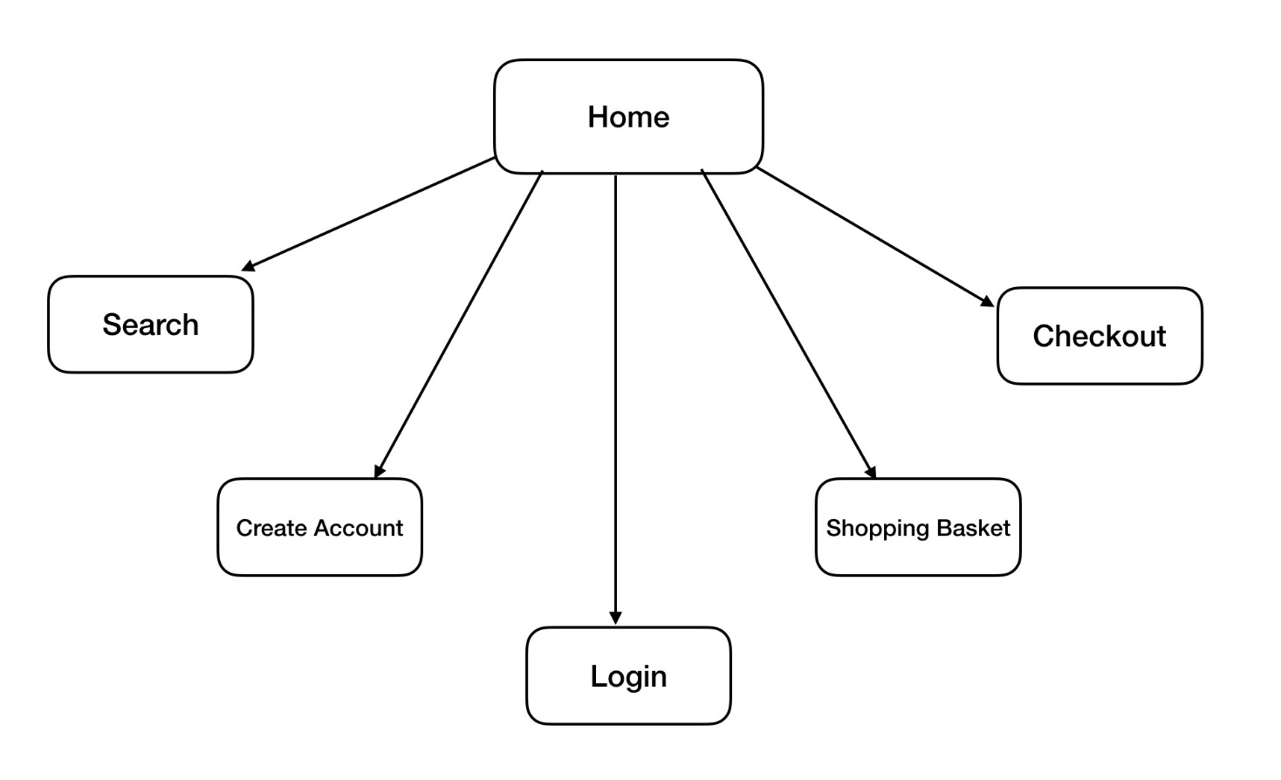
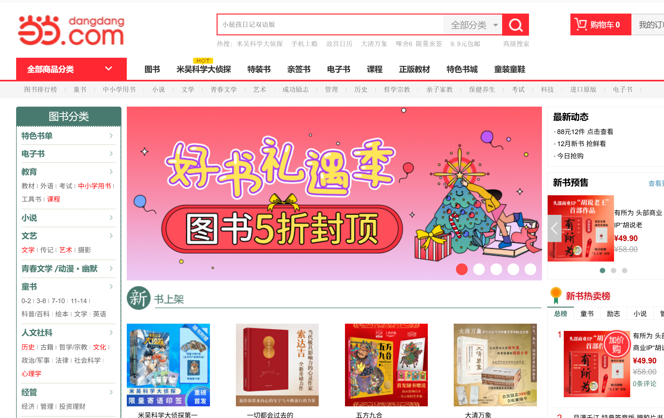
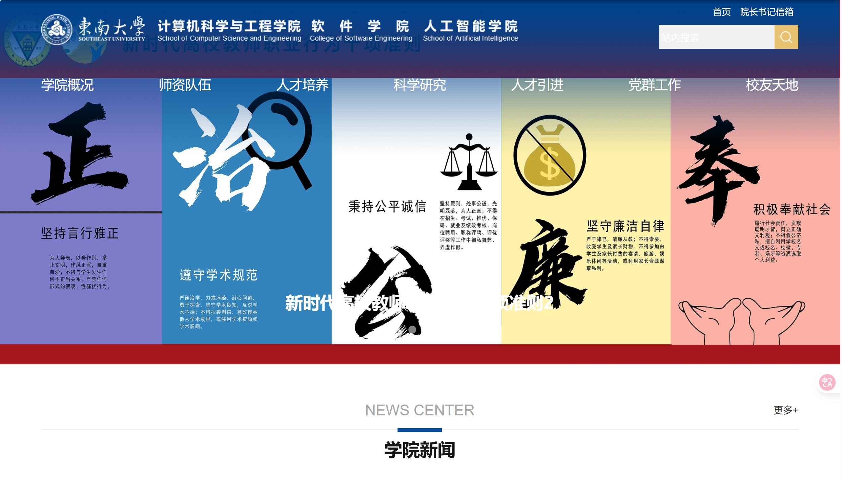
Assignment
2. Pages Requirements
  Home Page: The home page will be the first page users see when they connect to the website or use the application. Users will be greeted by a welcome message for our web site or application, or they can quickly understand what kind of system this is.

Slide 7
Assignment
2. Pages Requirements
  Home Page: We suggest every page will have a menu bar at the top (other methods to display navigation information is ok, such as sidebars, tables of contents, etc.) which allow users to move fluidly around our system from any page.

Slide 8
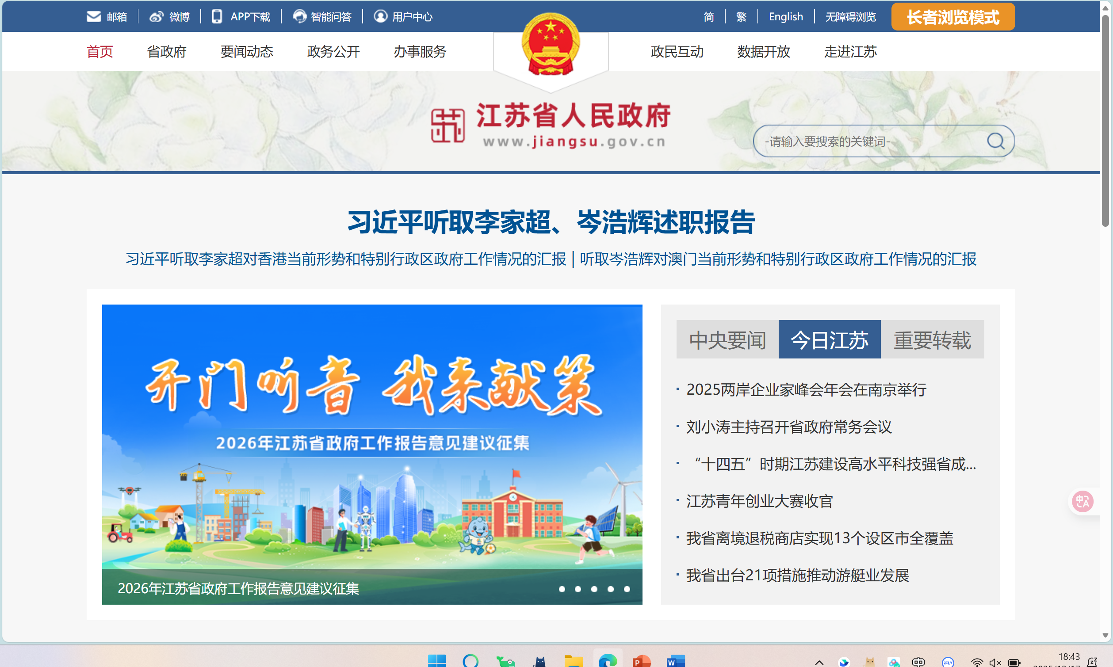
Assignment
2. Pages Requirements
  Home Page

Slide 9
Assignment
2. Pages Requirements
  Home Page

Slide 10
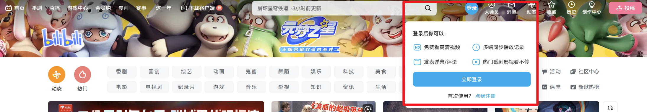
Assignment
2. Pages Requirements
  Home Page: They will also be presented with the following list of options:
Action | Directed to
Creat new Account | Page-Account Creation
Login | Page-Login

Slide 11
Assignment
2. Pages Requirements
  Search Page: This page will consist of a series of questions that will assist a user in searching our database. A User selects whether they would like to search for a book by author, title, or ISBN number. They then enter a non-case sensitive text string used to search for their book. Some examples of possible queries are:
    Author = Charles Dickens
    Title = American Pastoral
    ISBN = 1829853333
  Users will be presented with a list of books and have the ability to view individual books book information pages, Page Book Information, for each book in the database.

Slide 12
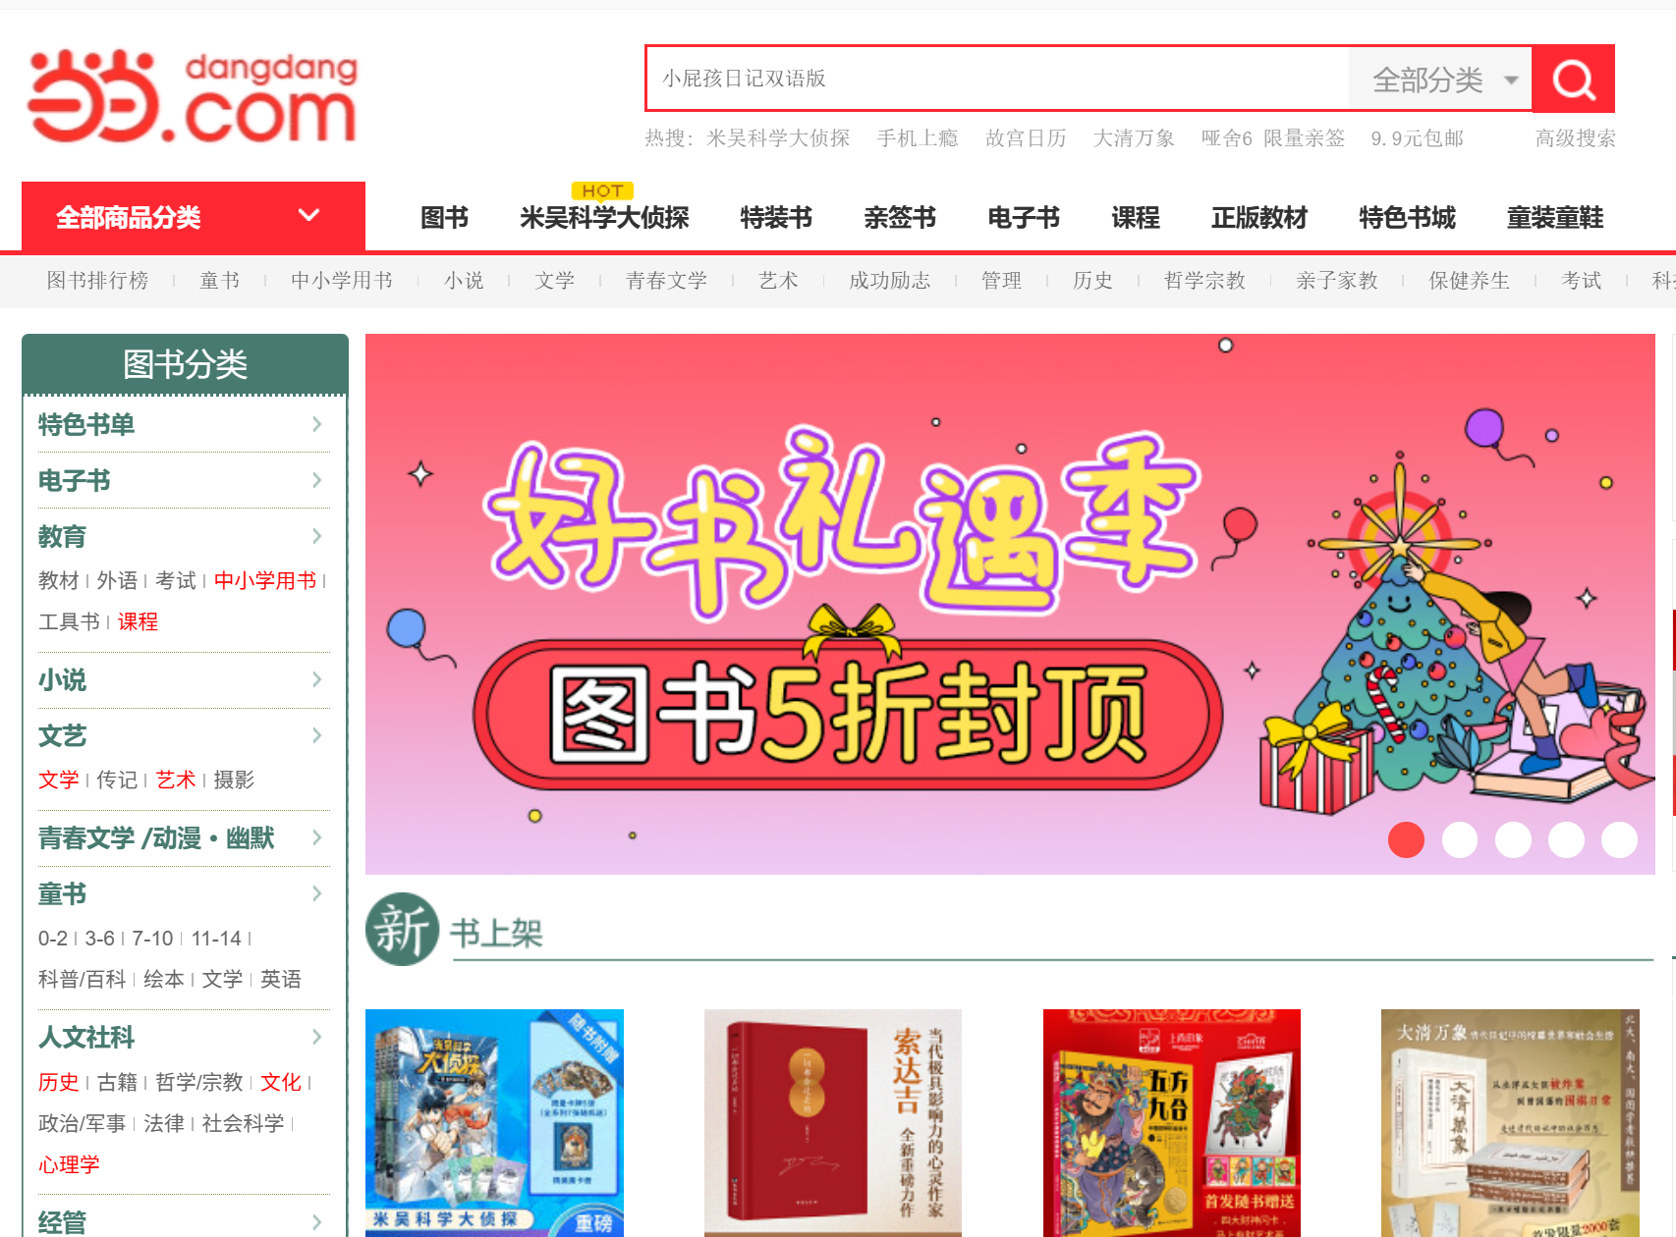
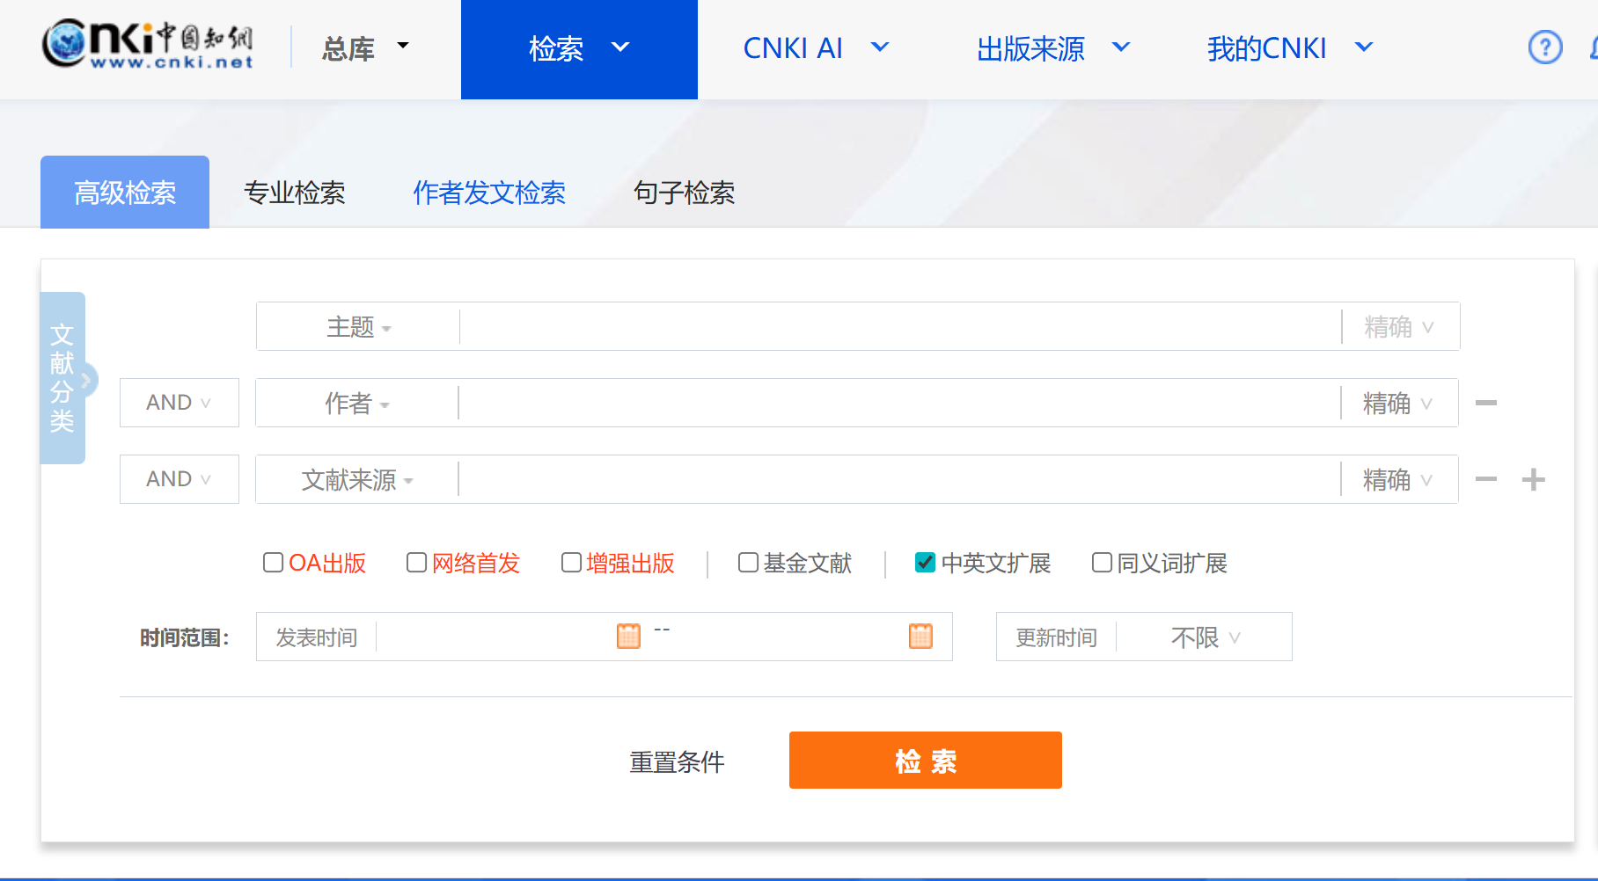
Assignment
2. Pages Requirements
  Search Page

Slide 13
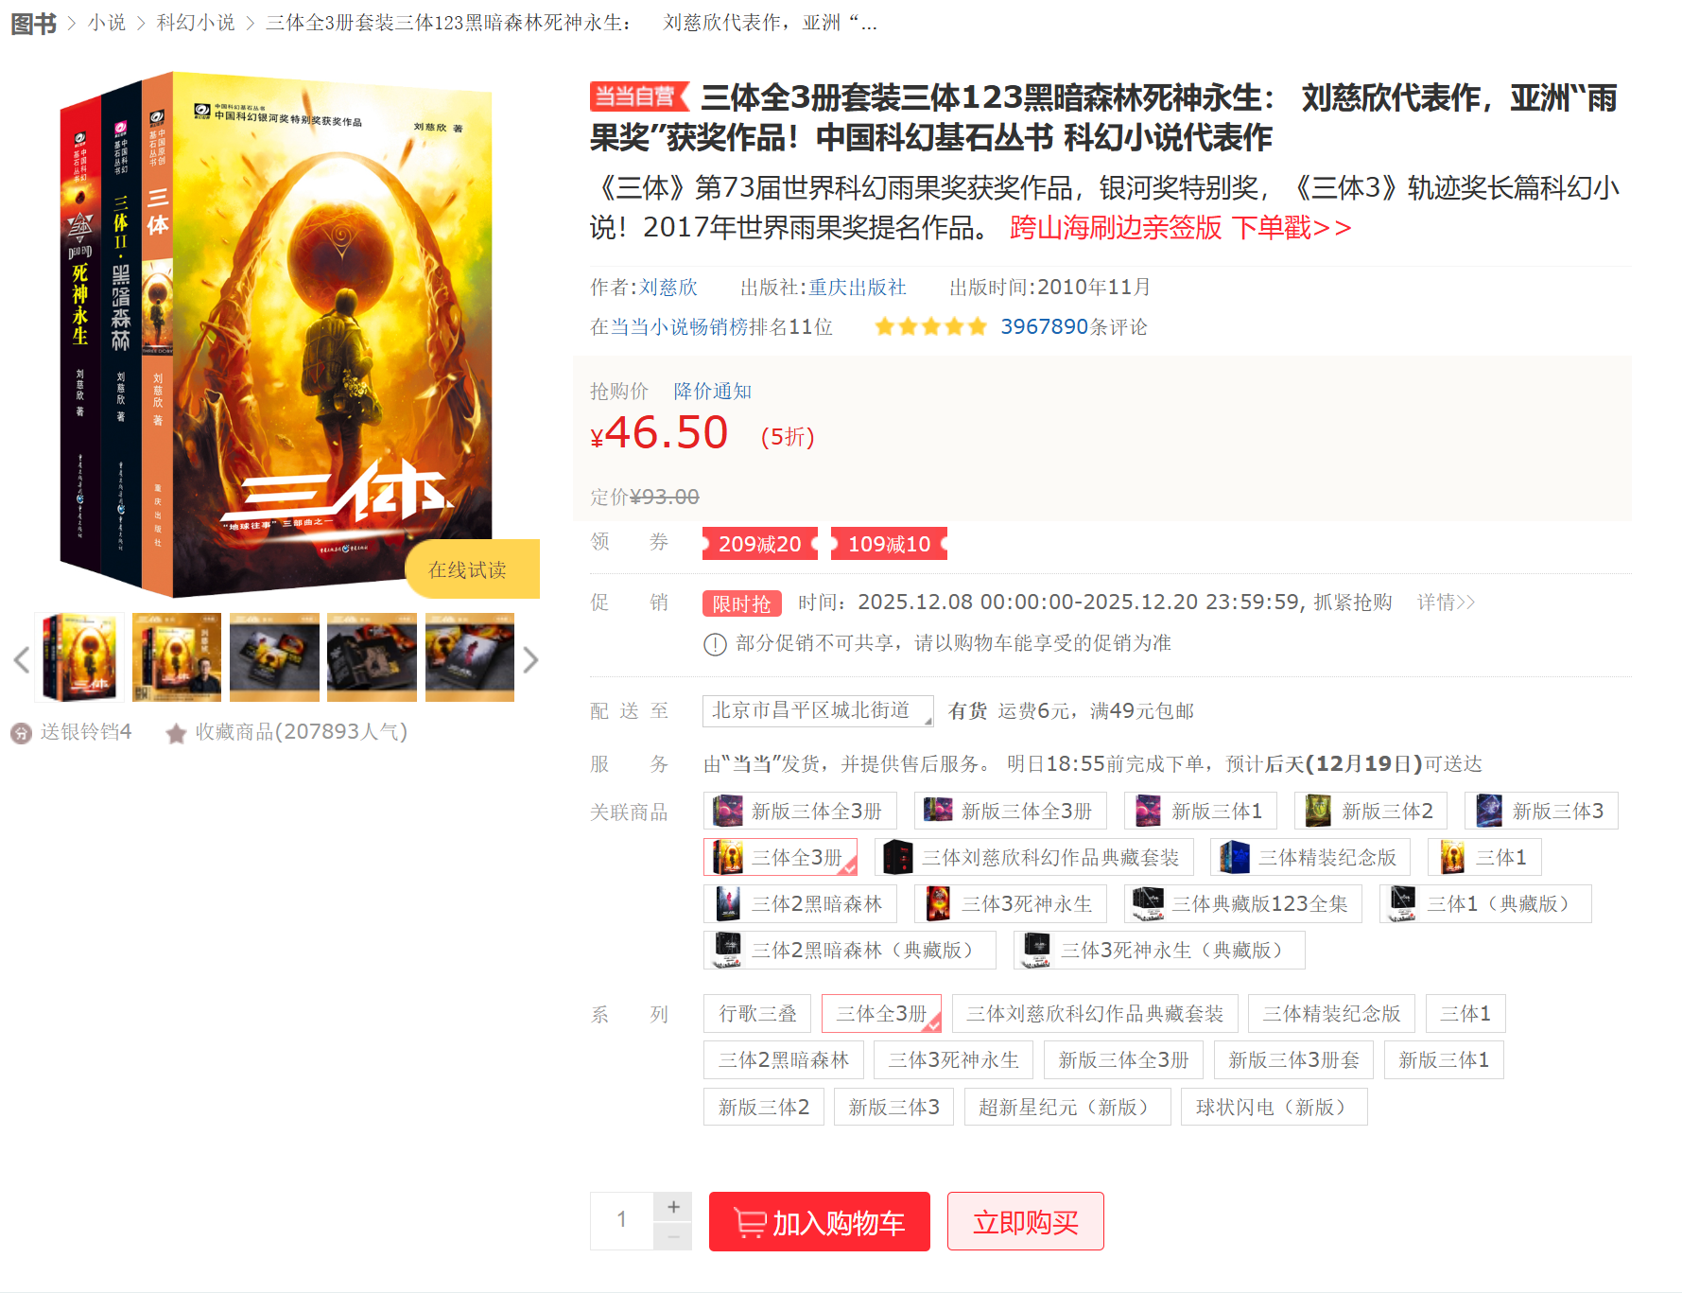
Assignment
2. Pages Requirements
  Book Information Page: For each book in system, users will be presented with information such as the books title, author, and price.

Slide 14
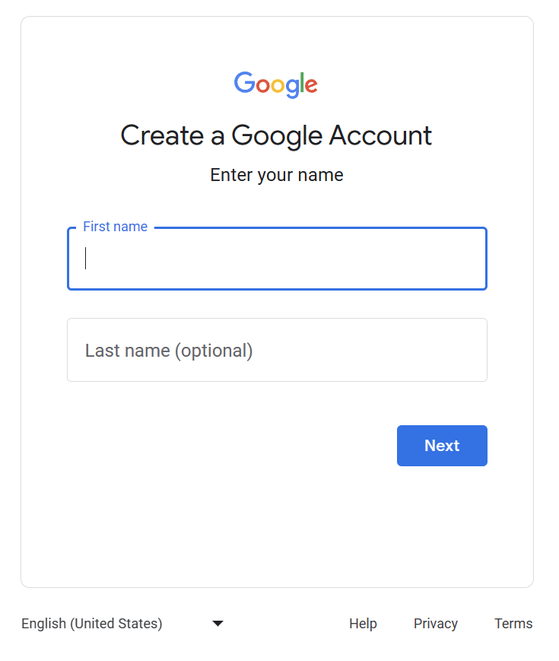
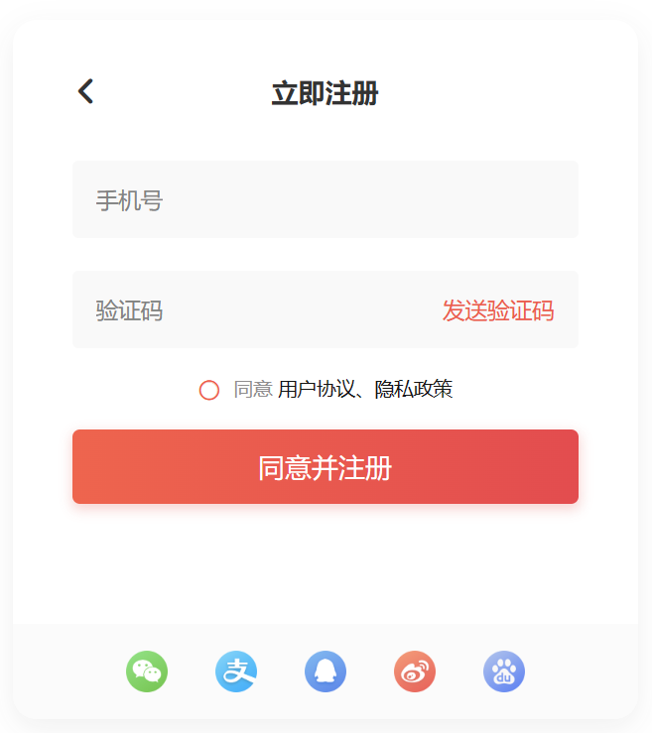
Assignment
2. Pages Requirements
  Account Creation Page: Users without accounts or those wishing to create new ones can do so by choosing to create a new account from the system Page Home. They will be asked a series of personal questions including choosing a new username for the system as well as a password. If any of the information they provide is incorrect, missing, or invalid, they will be asked to enter it again.
Character count limit
Character type restriction
Uniqueness constraint

Slide 15
Assignment
2. Pages Requirements
  Account Creation Page: The application layer will check the information the user enters thoroughly each time they submit it before attempting to create the account. If all the data passes, the server will attempt to make the account and check for account creation errors.
  After the account information has been entered correctly, the account will be created by the system, and the user will be automatically logged in and directed to Page Shopping Basket (or Page Search, decided by you).
  Usually it is directed to the page before login, and the page is in login status. Anyway, it is decided by you.

Slide 16
Assignment
2. Pages Requirements
  Shopping Basket Page: The shopping basket is a temporary state page that shows the user which items they have added to their order during their current visit. In addition, users can change their shopping cart by both modifying the quantities of books in their baskets, as well as deleting books from their basket.
  Note: No information contained in the shopping basket is maintained by the system permanently. So a user’s shopping basket is erased each time they connect to our server.

Slide 17
Assignment
2. Pages Requirements
  Login Page: The login page will ask a user for their username and password to use to log into the system. In addition, they will have the following options based on the information they provided:
  The application layer will query the database with the information the user has provided and if it is valid for a user in the system, it will log a user in by creating a cookie on the user’s machine.
Action | Directed to
Forgot Password | E-mail Message to Administrator
Login: Incorrect Information | Login page
Login: Correct Information | Search page

Slide 18
Assignment
2. Pages Requirements
  Checkout Page : Only when a user has at least one item in their shopping basket and has logged into our system will they be able to proceed to the checkout page.
  First, they will be asked to confirm the items in their order.
  Next, they will be asked to provide a valid credit card for the order as well as shown their shipping address for the order.
  Finally, they will be shown the information for their entire order and asked to confirm it.
  Once they confirm the order, it is sent to the database for processing.
  When the quantity of the items is insufficient, the operation will fail and the corresponding prompt message will be returned.
  If the operation is successful, the quantities of the books in stock will be decremented by the quantities of books the user purchased for each book.

Slide 19
Assignment
3. Document requirements
Hand in a report about the TEAM PROJECT (Each group only needs to submit one report) :
  Information of Team Members and Responsibilities
  Database Scenario
  Requirements Analysis
  ER Diagram Design
  Technical Framework
  Functional Design & Software Implementation
  Results Display
code.zip: Source code and README
PPT/Video/Website Link/Executable Program Package: The medium of presenting the project. You can choose to use a PPT to showcase the website or program, or dynamically showcase the content through a recorded video. You can even present the final project as an accessible website link or executable program package.

Slide 20
Requirements for submitting the assignment
Email address : liujoy@seu.edu.cn
File name format : StudentNumber-Name-Project-X
  example : 71121000-王五-Project-6.zip
The zip includes 3 files:
① report_A6.doc / report_A6.docx / report_A6.pdf
② code.zip
③ PPT/Video/Website Link/Executable Program Package
The team leader's student ID and name. Each group only needs to submit one.
Deadline: Beijing time, 01.25, 23:59:59

