Slide 1
Dade membership software
User manual Version 1.1
Created by Gong Jiaji

Slide 2
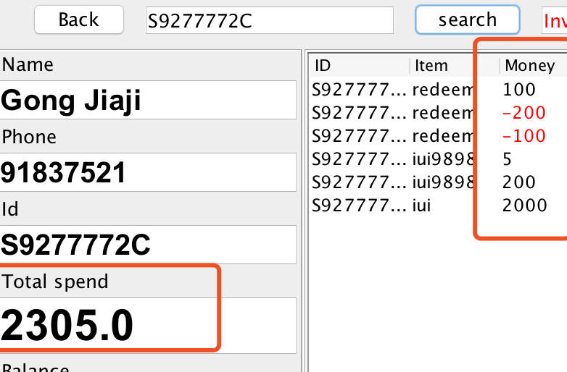
The Updates of 1.1
User (the cashier) can no longer allowed to change the total spend of customer manually, since the software is used in multiple stores and I have concerns of financial security issue. In stead, the software calculates the money according to purchase history, in the other word, all money transactions are now clearly reflected by purchase logs and hence increases manageability.
Only the sales money will count into accumulated total spend, in the case above. The total spend should be 100+5+200+200 = 2305

Slide 3
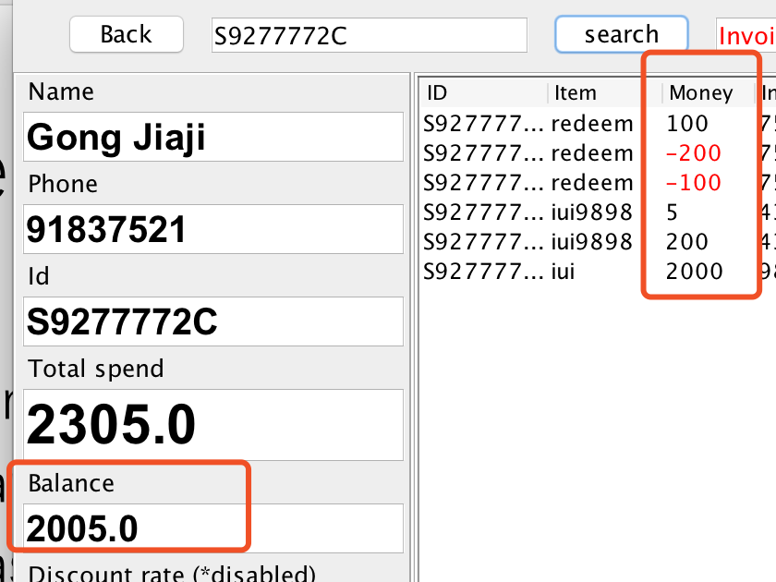
The Updates of 1.1
The customer now has a field called “Balance”, which indicates the money left in his account.
Balance = Total spend – all the redeem cost
Please note: The redeem cost are flexible and totally controlled by user. Key in -1000 if the cost set to $1000.
In the case above, the total spend is 2305.
So the balance should be
2305 – 200 - 100 = 2005

Slide 4
The Updates of 1.1
Now multiple stores can use this software at same time, but, some technical disability must be point out:
If 2 stores add purchase log for same customer at the same time, most likely not possible though, only the latest purchase will be recorded. Technically say, the first purchase was recorded but rewrote by latest purchase.
In rare cases, a conflict database.csv will be generated by Dropbox, it is either caused by multiple stores creating users at the same time(rare case), or store A create some users without open Dropbox, during that time, store B also create users and synchronized in Dropbox, when next time store A open Dropbox, the file will be conflict, store B holds the data of original database.csv and the data of store A will be in conflict file. Similarly, one of the record will be replaced.
The solution is simple, 1. Always open Dropbox 2. close the program immediately after usage. 3. Manually merge and amend the database.csv file.

Slide 5
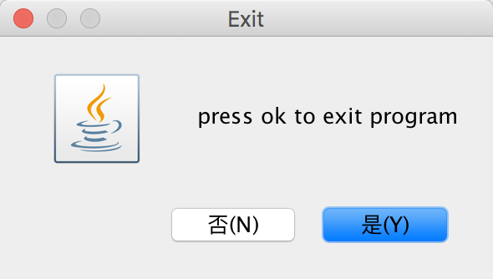
The Updates of 1.1
Minor bug fix
User are not allowed to type non-numbers in Money field. Warning message will pop out.
Fixed decimal round up issue.
Increase font size of new user window
A logic mistake about customer csv file has been corrected.
A 90 seconds count down is added. A diagram pop out to ask whether exit the program, click YES to exit. No to continue.
I suggest exit the program when job is done
It helps preventing conflict files

Slide 6
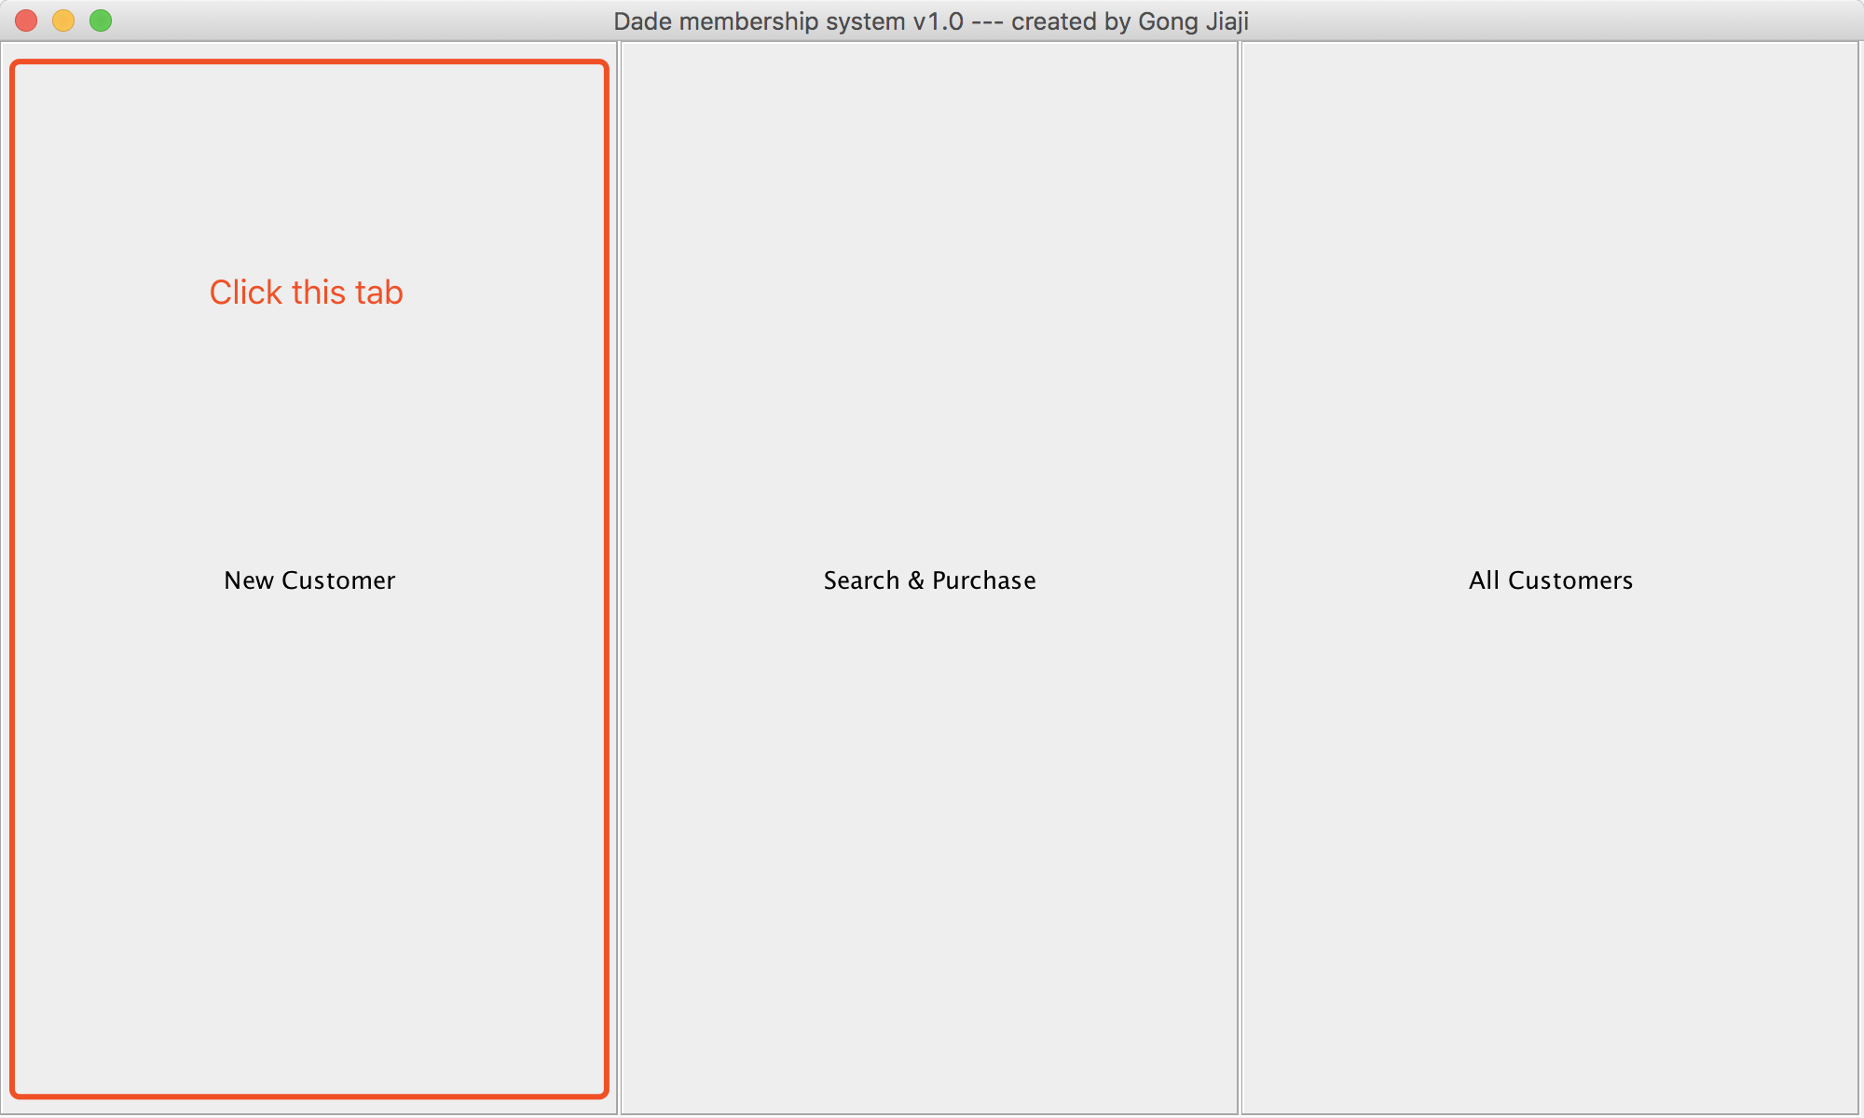
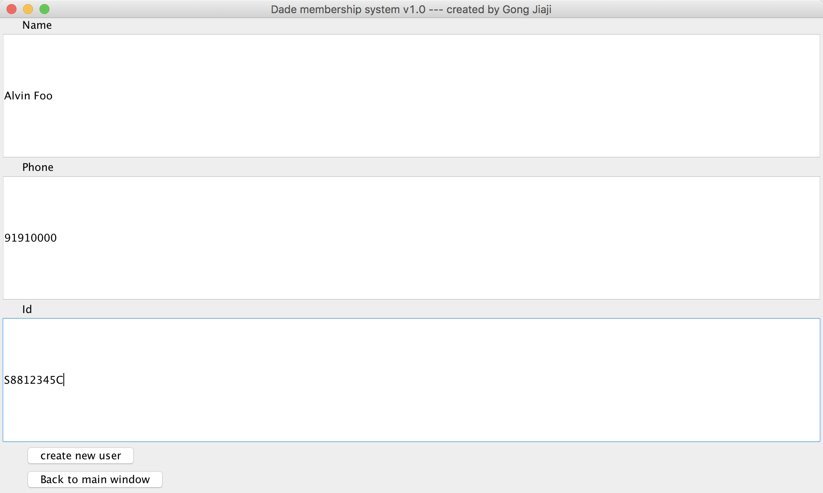
Create new Customer
Open software
Click first tab “New Customer”
Fill in customer’s Name, Phone and NRIC. Please note: NRIC is the search keyword throughout the software, make sure you record correct ID.
Click “Create new user ”button below to confirm creation.
For example, a customer whose name is Alvin Foo, phone number 91910000, Id number S8812345C has created.

Slide 7
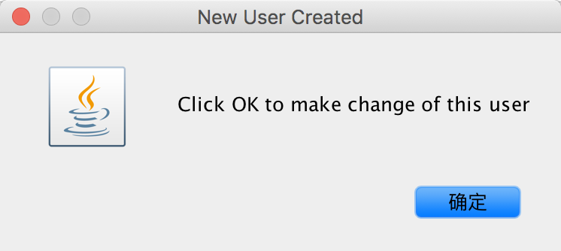
A dialog will pop out to confirm creation. Click “Ok” to Edit this customer. You can now go purchase item for this customer.
Then software goes to search window, which handles most of the operations. Normally, you should open the software, click “search and purchase” button in the middle.

Slide 8
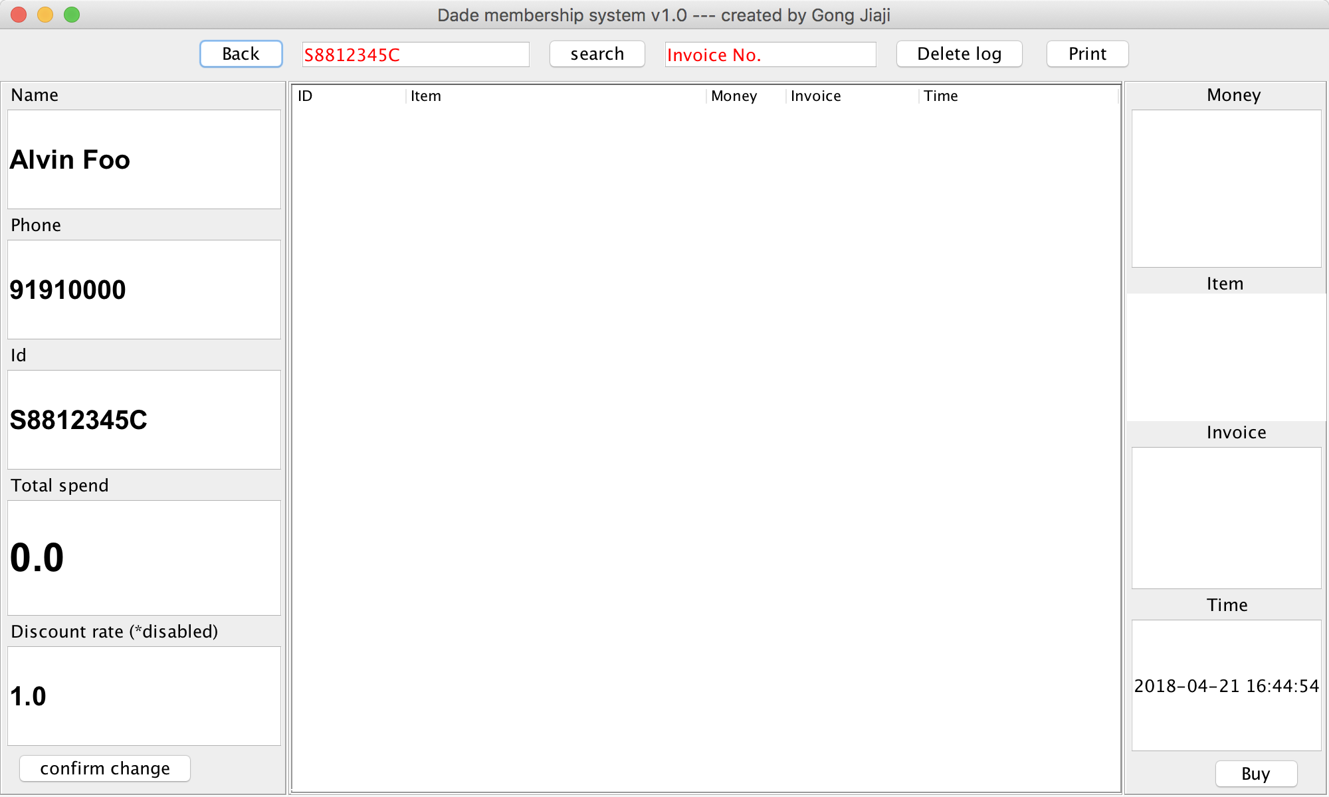
Search
Enter customer NRIC (case insensitive) and click Search
The left panel shows the basic information of customer. You can modify them easily. Remember Clicking “Confirm change”
Total spend indicates the accumulated SG dollars, 100.00 equals to S$100 total purchase. Please note, if customer redeems product, 1000 will be deducted from the Total spend
Please also note: The software DO NOT allow duplicate NRIC, so if you create 2 customers with same NRIC, the latest one will be removed silently.
Search window
The discount rate was designed for discount system, since it is not necessary, I set the rate always be 1.0, which means original price. Let me know if this function needs to be enabled.

Slide 9
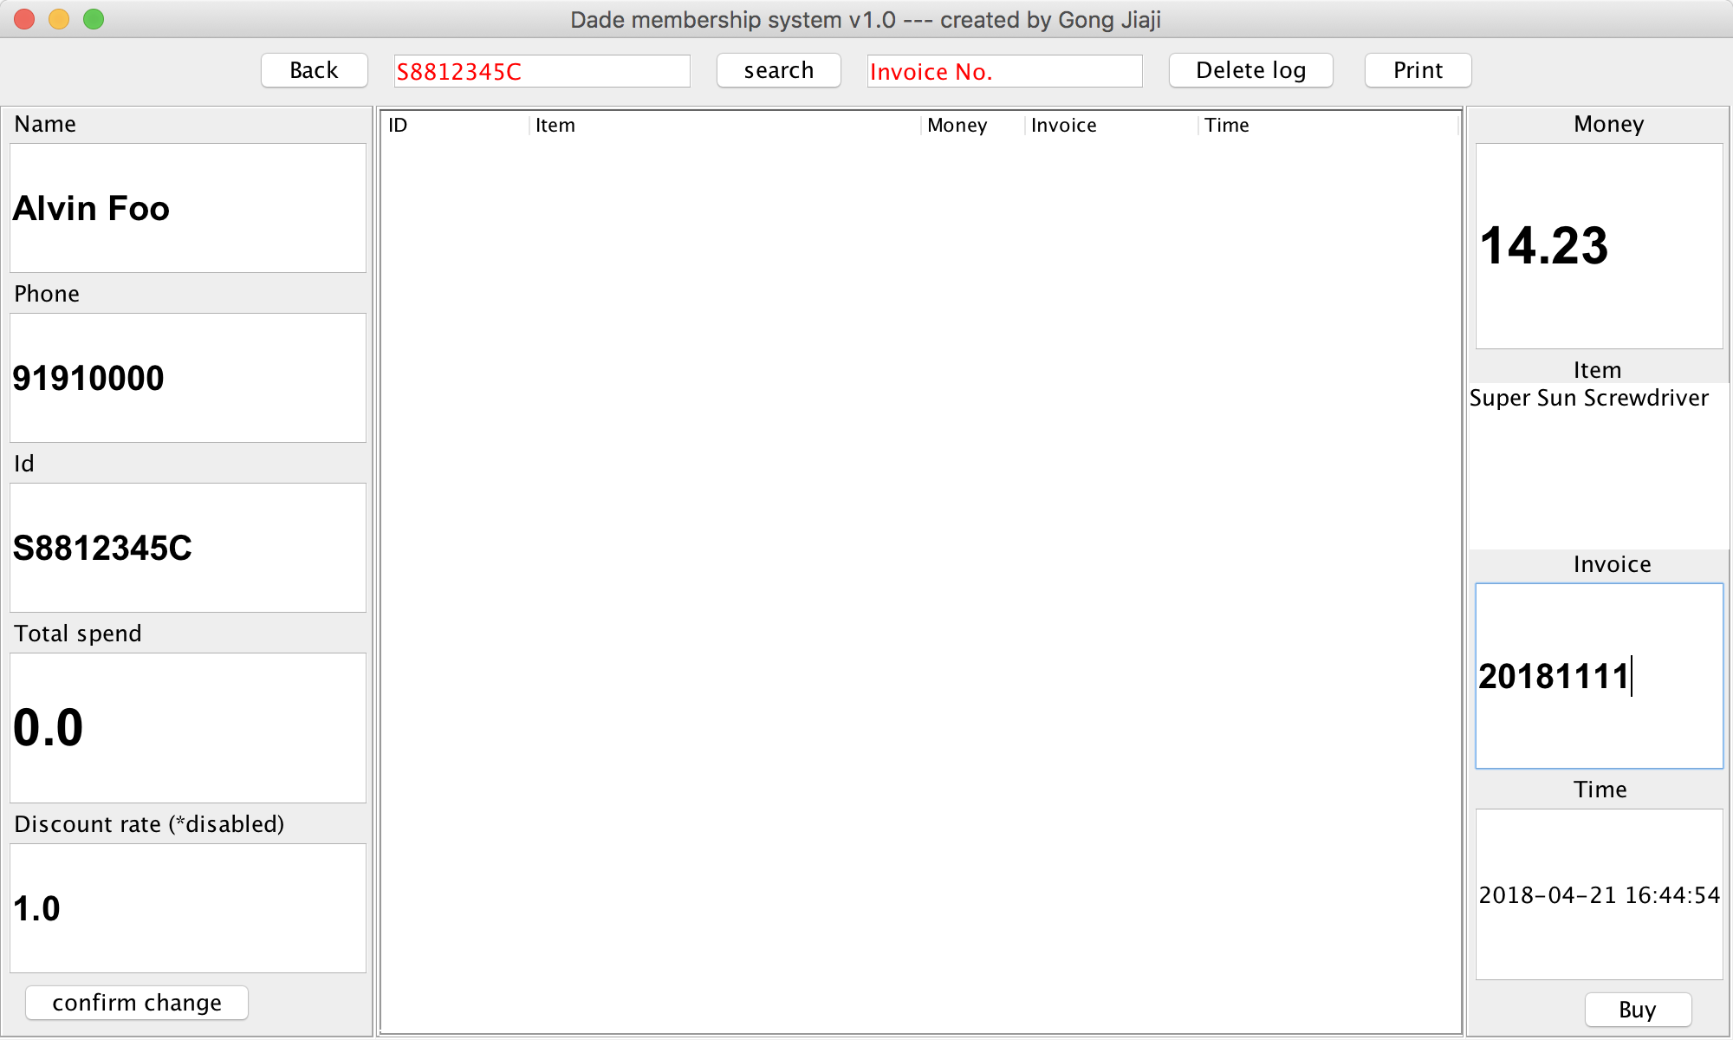
Purchase
Fill in the Money, Item and Invoice field to create a new sales log.
Time is automatically generated by checking computer time. amend it if necessary.

Slide 10
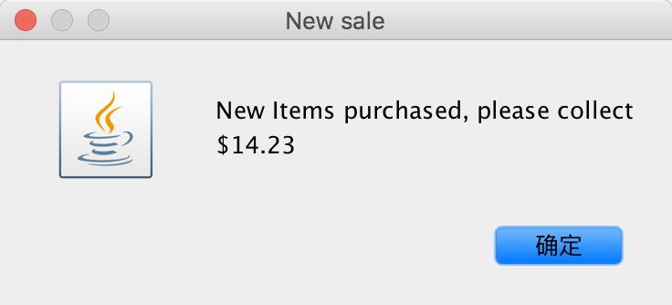
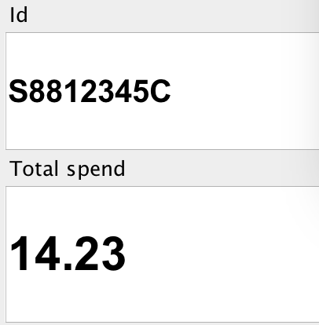
After Purchase
Dialog pop out, remind you collect correct money from customer.
(if discount system is enabled, the amount will be automatically calculated by multiply with discount rate. )
Also, the Total spend will be accumulated. Please note these 2 conditions:
Total spend > 1000
in this case, a dialog will pop out to remind you that customer has enough spend to redeem product.
Total spend < 0
something wrong happened, Check purchase log and find out the reason, then amend this slot manually.

Slide 11
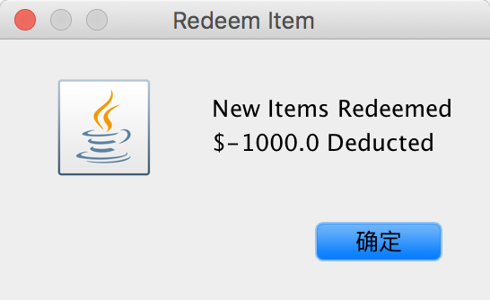
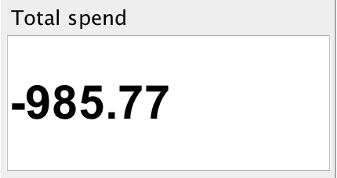
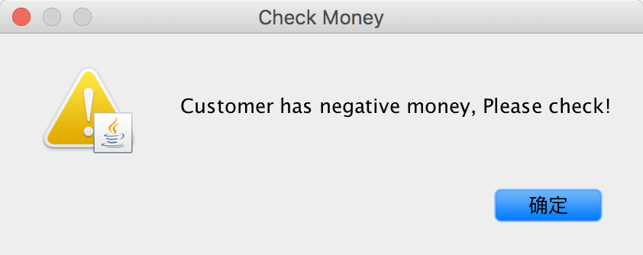
Redeem Item
Similar to purchase, redeem is an action of “buying product with negative money”, you should enter “-1000”in money slot instead of positive amount.
1. Confirm message of redeem process.
2. $1000 will be deducted from total spend
(14.23 – 1000 = -985.77)
3. Warning message. Because user has suspicious balance.

Slide 12
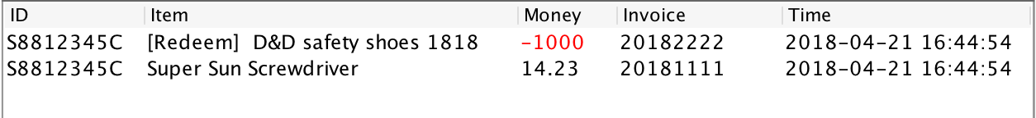
Purchase log ( records )
I have made 2 deals earlier. One is ordinary purchase , the other is redeem.
You can find this table in the center panel after enter customer’s NRIC and click search.
IF an incorrect ID been searched, a warning message will pop out says no such customer, Please check carefully in this case. And I strongly suggest you restart the software to avoid any unpredictable results.
The table is easy to read and all necessary information has been recorded. For redeem products, the money slot will be red color.
Please note:
You can put multiple items in one log, but it decreases the readability. Try Resize the software.
You CANNOT Edit the content of his table by simply double click the column then amend it. It’s different from edit customer’s basic information. I will let you know how in the last page.
The software allows same Invoice number exist at the same time, although I strongly DONOT suggest to do so ,Because if you want to delete this invoice number, only the older (earliest) log will be deleted. (Introduce later)

Slide 13
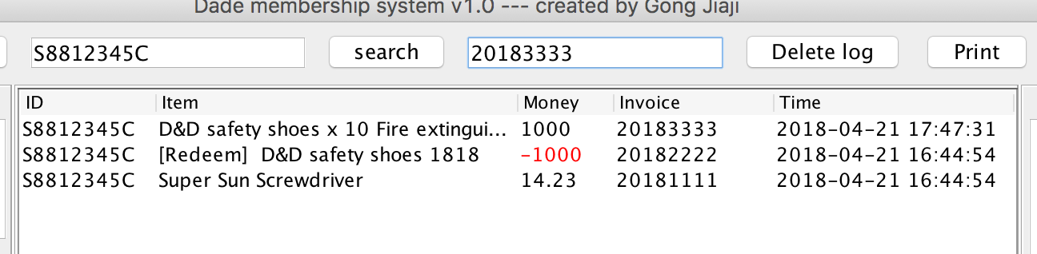
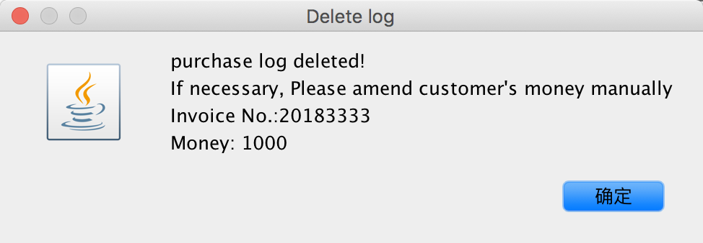
Delete Log
Enter Invoice number in Invoice No. slot, then Click “Delete log” button.
Message dialog will pop out and let you confirm the delete action, Please note the effected money will NOT go back to Total Spend so please amend customer’s money manually .
If invoice number is invalid, a warning message will pop out.

Slide 14
Print
Click “Print” button on the right upper
It prints the purchase logs for searched customer
I can’t guarantee this function works well.
I will let you know the alternative way of printing later.

Slide 15
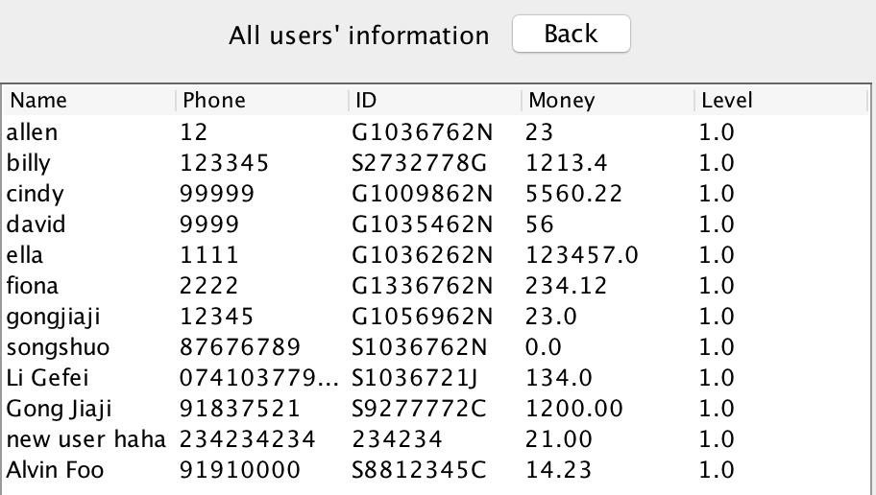
All Customers
Click the “All users” Tab on main window.
All customer’s information will be listed in table. You CANNOT edit this table directly.
Level tab is made for discount function. It is disabled right now.
You can see Alvin Foo, I created earlier, is on the bottom of the list. Ignore the rest testers.

Slide 16
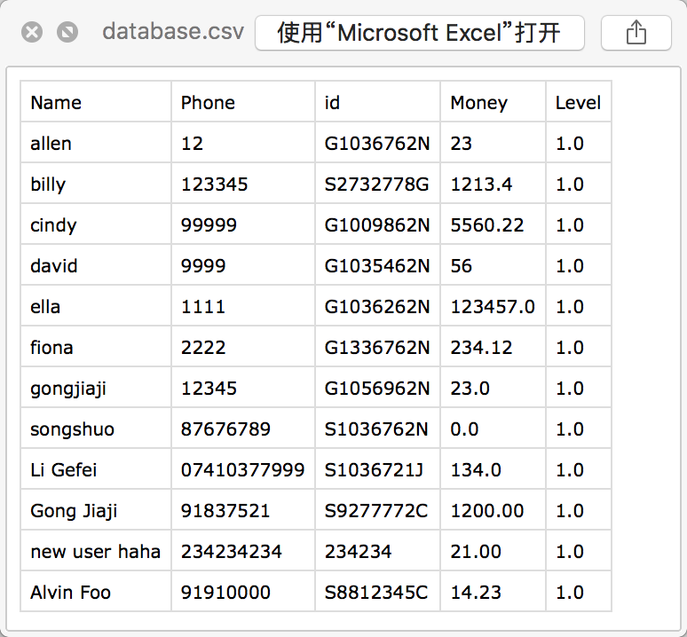
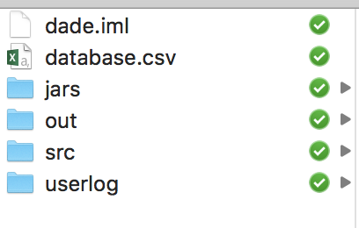
Where are the data stored ?
This is what you should see in the software folder.
Database.csv stores all customers’information. Which generates the “All users”table.

Slide 17
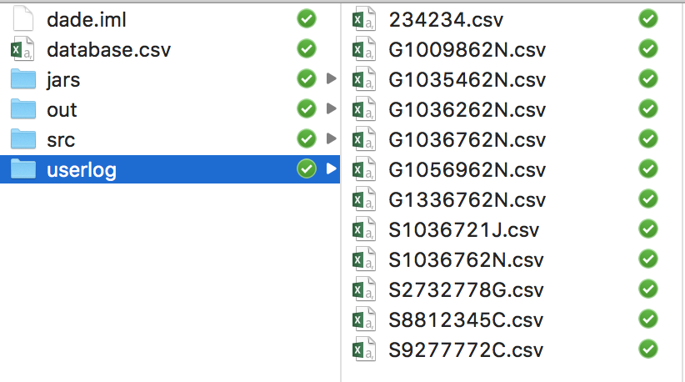
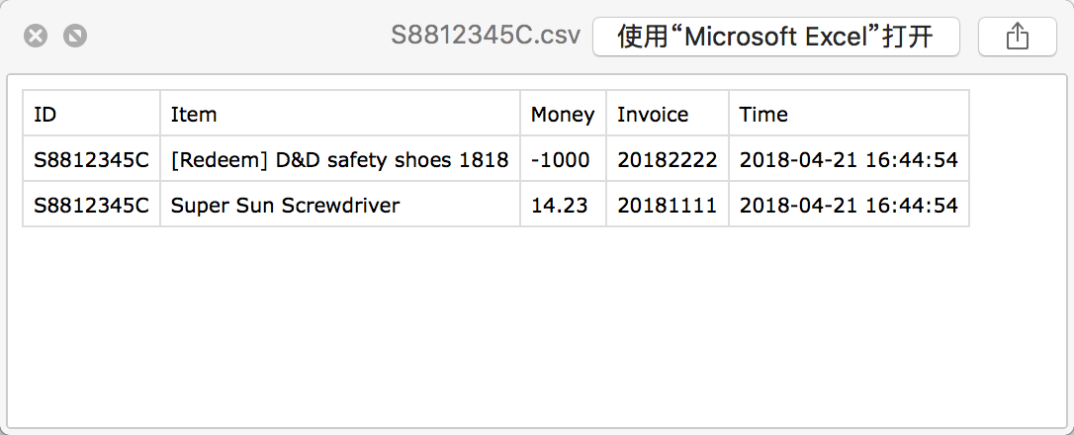
Individual purchase log
All the logs are stored under “userlog”folder. The files are automatically generates for each customer.
It looks like this:

Slide 18
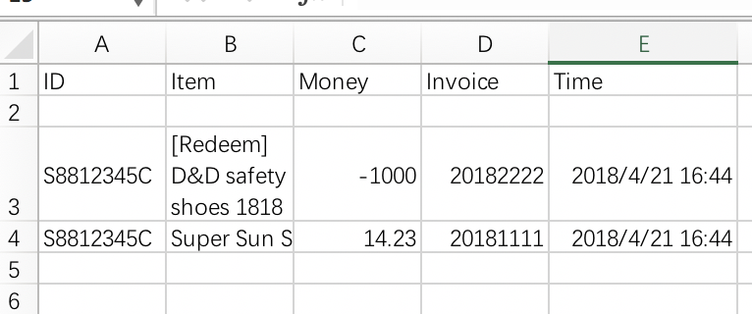
Amend customer’s purchase logs by editing files I DONNOT suggest you edit customer information in this way. But if you do, follow the instruction :
Close the software.
Go to software folder, open “CustomerNRIC.csv”in excel. (e.g. S8812345C.csv)
Warning message will display, click ok/process to open the file anyway.
Delete the 2nd row, the empty row. Or the purchase log table (all customers table) will not display.
Save and close the file. Restart the software. Do not modify any files when software is running.
This is what the table should be look like, let me know if anything wrong here.
Please note, the Time columns might display a string of #, you should double click here and resize the width.
You can print this file same as printing ordinary Excel file.

Slide 19
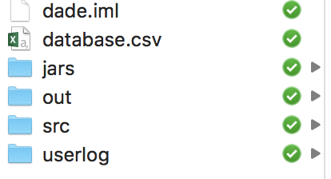
How is the data synchronized
The data are stored in the csv files, and the whole folder are synchronized by Dropbox.
What you made to the files will record and upload to cloud server, it helps you back up the data whenever you make changes, for example, create new user or new sales. So, always ensure Dropbox is running on your computer. In case of you forget to do so, the data is securely stored in your computer, once you open the Dropbox, the data will back up automatically.
If you see green icons beside the file, it means the files have uploaded to the cloud server. If icons in blue, they are uploading. Can’t see anything then you are not open Dropbox yet.
The further development and maintenance work will go through Dropbox as well so I can do my work silently without you doing anything.

