Slide 1
CagA-Dependent Gut Microbiome Restructuring
and Functional Redundancy
PC047 vCagAepitope Microbiome Analysis Progress
2026-01-26
Presenter: Yuhang Gong
1

Slide 2
Background: CagA and Intestinal Tumors
H. pylori CagA Pathogenesis
Key Literature Support
H. pylori
Infection
CagA Injection
into Host Cell
• Jones et al. 2017, PLoS Pathog
Drosophila: CagA alone induces
dysbiosis and epithelial proliferation
Disrupt Wnt/
NF-κB Pathways
Gut Microbiota
Dysbiosis
• Cui et al. 2025, BMC Gastro
Clinical: CagA+ strains affect
colorectal lesions via gut microbiota
Tumor Promotion
• Ding et al. 2025, Cell Host
Phage can eliminate tumor-
promoting bacteria
Central Question: What maintains CD8+ T-cell activation after CagA clearance?
2
Notes:
Research background. (30s)
CagA protein disrupts Wnt and NF-κB pathways, causes gut microbiota dysbiosis, promoting tumor development.
Central question: What maintains CD8+ T-cell activation after CagA clearance?

Slide 3
Background: Apc Mutation and Genetic Susceptibility
Apc Mutation → Constitutive Wnt Activation
G×E Interaction Hypothesis
Normal
ApcWT
ApcMUT
APC
β-catenin
Degradation
Homeostasis
CagA-
Normal
Microbiota
Mild
Dysbiosis
Apc Mutant
APC ✗
β-catenin
Accumulation
Tumor
CagA+
No Effect
P=0.387
Significant
P=0.039
Experimental Design: 2×3 Factorial
→ CagA effect requires Apc-mutant susceptible background
ApcWT
ApcMUT
Ctrl
HpKO
HpWT
Core Comparison
3
Notes:
Apc mutation and G×E interaction. (30s)
CagA effect is highly dependent on host genetics. No effect in wild-type (P=0.387), but significant restructuring in Apc-mutant (P=0.039).
Core comparison: CagA+ vs CagA- under Apc-mutant background.

Slide 4
Central Hypothesis: Functional Footprint
1
2
3
4
CagA Infection
Restructures Microbiota
Microbiota Produces
Specific Molecules
Persistent CD8+
T-cell Activation
Tumor
Promotion
Scope of This Study
✓ Verified
○ Pending
• Microbiota restructured (P=0.012)
• G×E interaction confirmed (9/9 verified)
• Functional redundancy (GO/PFAM verified)
• Network collapse (Modularity -62%)
• Metabolomics: Specific metabolite ID
• Transcriptomics: Gene expression validation
• Integration with tumor/T-cell phenotypes
4
Notes:
Central hypothesis - Functional Footprint. (30s)
Logical chain: CagA restructures microbiota → produces specific molecules → persistent T-cell activation → tumor promotion.
Verified: microbiota restructuring, G×E interaction, functional redundancy (GO/PFAM verified), network collapse (modularity -62%).

Slide 5
Analysis Pipeline Overview
Cecum Samples (n=27)
01 Species Analysis
02 Functional Analysis
03 Network/Phage
Kraken2/Bracken
HUMAnN4
igraph/Lyrebird
Community
G×E Interaction
Pathway→KO
→GO→PFAM
Co-occurrence
Bacteria-Phage
5/9 Sig.
Redundancy
Mod -62%
Integration: CagA restructures bacteria → Functional redundancy (all levels) → Network collapse → Phage coordination
5
Notes:
Analysis pipeline overview. (30s)
Three modules: species composition (5/9 significant), functional potential (all levels redundant), network/phage (modularity -62%).
Integration: CagA restructures bacteria, functional redundancy with network collapse, phage coordination.

Slide 6
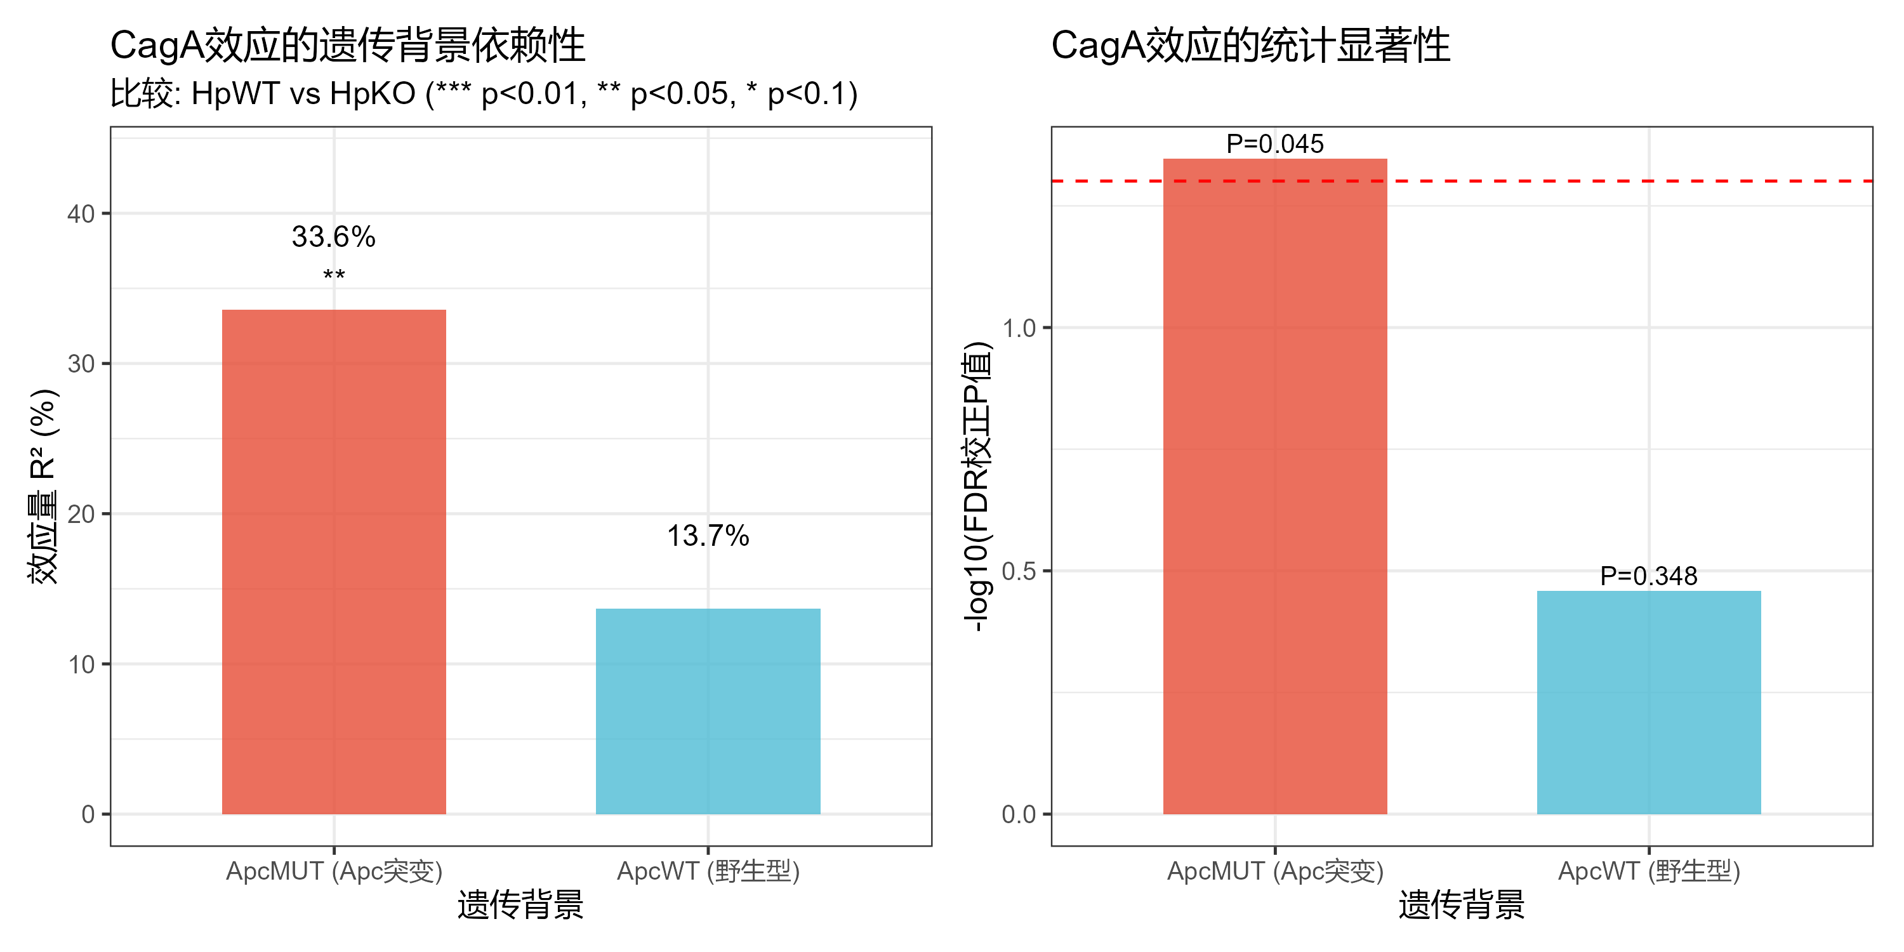
Result 1: CagA Restructures Gut Microbiota
• Beta diversity: P=0.012, R²=33.6%
• Alpha diversity: P=0.73 (no change)
• → Selective restructuring, not destruction
• 29 species significantly associated
6
Notes:
CagA core effect on gut microbiota. (30s)
CagA significantly alters community structure (Beta P=0.012), but does not change overall diversity (Alpha P=0.73). Selective regulation, not destruction. 29 species significantly associated.

Slide 7
Result 2: CagA Targets Bacteria, Not Viruses
Q: What does CagA reshape? Bacteria or Viruses?
Standard (Bacteria)
Virus (Viruses)
9 Pairwise Comparisons:
• FDR Significant: 5/9 (55.6%)
• CagA@ApcMUT: P=0.039 ⭐
• CagA@ApcWT: P=0.387
→ G×E Fully Verified
9 Pairwise Comparisons:
• FDR Significant: 0/9 (0%)
• CagA@ApcMUT: P=0.604
• CagA@ApcWT: P=0.978
→ No Significant Effect
VS
Conclusion: CagA reshapes gut environment mainly via bacteria, not directly via viruses
7
Notes:
What does CagA affect? (30s)
Bacteria: 5/9 significant, core CagA effect P=0.039, G×E verified.
Viruses: 0/9 significant, core comparison P=0.604.
Conclusion: CagA reshapes gut environment mainly via bacteria.

Slide 8
Result 3: Functional Redundancy — All Levels Verified
HUMAnN4 Functional Hierarchy
Silent Shift: Driver Species Change
层级
特征数
P<0.05
FDR<0.05
结论
Total function unchanged, executors changed:
Probiotics ↓
• L. johnsonii: -50%
• F. prausnitzii: ↓
Inflammation-associated ↑
• M. schaedleri: +57%
• Enterocloster: ↑
Pathway
~500
多个
0
✓ 冗余
KO
~6,000
多个
0
✓ 冗余
GO
~13,000
1,577
0
✓ 冗余
PFAM
~7,600
849
0
✓ 冗余
Conclusion: No FDR-significant differences at any level (Pathway→KO→GO→PFAM)
Functional redundancy fully verified, but executors silently shifted
8
Notes:
Functional redundancy at all levels. (45s)
From Pathway to KO to GO to PFAM — no FDR-significant differences at any level. Functional redundancy fully verified.
But stratified analysis reveals "Silent Shift": total function unchanged, executors changed. L. johnsonii -50%, M. schaedleri +57%.
This explains why species change but function remains stable — different species can perform the same functions.

Slide 9
Result 4: Co-occurrence Network — Module Collapse
Network Topology Change (Top 100 Species)
Hub Species (Network Hubs)
HpKO (Control)
HpWT (CagA+)
Top 5 Hub Species (by degree):
• Blautia obeum (d=44)
• Roseburia hominis (d=42)
• Hungatella hathewayi (d=42)
Feature: Mainly anaerobic Clostridia
Function: SCFA producers
Bridge species:
• P. distasonis (btw=402)
Nodes: 80
Edges: 1,280
Modularity: 0.468
→ Clear modules
Nodes: 100
Edges: 2,190 (+71%)
Modularity: 0.177
→ Module collapse
Modularity: 0.468 → 0.177 (-62%)
Conclusion: CagA causes 62% modularity drop, blurred species boundaries
→ Increased niche overlap → Explains functional redundancy mechanism
9
Notes:
Co-occurrence network analysis — module collapse. (45s)
Control HpKO: 80 nodes, 1,280 edges, modularity 0.468, clear functional modules.
CagA+ HpWT: 100 nodes, 2,190 edges (+71%), modularity dropped to 0.177.
62% modularity drop means blurred species boundaries, increased niche overlap. This explains functional redundancy at network level — species that used to specialize now have overlapping functions.
Hub species are mainly SCFA producers; bridge species P. distasonis may be key immune modulation point.

Slide 10
Result 5: Bacteria-Phage Coordination
Phage diversity significantly decreased (P=0.032)
Bacteria-phage highly coordinated:
• Mantel r=0.52, P=0.001
• Procrustes P=0.002
Tripartite network: 17,848 edges
Cascade effect:
CagA → Bacteria → Phage
Cascade Effect
CagA
Infection
Bacteria
Restructured
Phage
Coordinated
CagA affects phage indirectly via bacteria
10
Notes:
Bacteria-phage coordination. (30s)
Although CagA doesn't directly affect viruses, bacterial changes drive phage changes. Phage diversity decreased (P=0.032), bacteria-phage highly coordinated (Mantel P=0.001).
Cascade effect: CagA → bacteria → phage.

Slide 11
Conclusions & Future Directions
1
CagA restructures gut microbiota: Beta P=0.012, selective regulation
2
Functional redundancy at all levels: Pathway→KO→GO→PFAM, no FDR significance
3
Network module collapse: Modularity -62%, explains redundancy mechanism
4
Silent Driver shift: Probiotics↓ Pathobionts↑, altering immune stimulation
5
Bacteria-phage coordination: Mantel P=0.001, cascade effect
11
6
Next: Metabolomics validation + Tumor/T-cell phenotype integration
Notes:
Core conclusions. (45s)
First, CagA restructures microbiota through selective regulation.
Second, functional redundancy verified at all levels — Pathway to PFAM.
Third, network module collapse, modularity -62%, explaining functional redundancy.
Fourth, Driver species silently shifted from probiotics to pathobionts.
Fifth, bacteria-phage highly coordinated with cascade effect.
Next steps: metabolomics validation, tumor/T-cell phenotype integration.
Thank you for your attention!

Slide 12
Thank You
Questions & Discussion
12

