Slide 1
CagA-Dependent Gut Microbiome Restructuring
and Functional Redundancy
PC047 vCagAepitope Microbiome Analysis Progress
2026-01-18
Presenter: Yuhang Gong
1

Slide 2
Background: CagA and Intestinal Tumors
H. pylori CagA Pathogenesis
Key Literature Support
H. pylori
Infection
CagA Injection
into Host Cell
• Jones et al. 2017, PLoS Pathog
Drosophila: CagA alone induces
dysbiosis and epithelial proliferation
Disrupt Wnt/
NF-κB Pathways
Gut Microbiota
Dysbiosis
• Cui et al. 2025, BMC Gastro
Clinical: CagA+ strains affect
colorectal lesions via gut microbiota
Tumor Promotion
• Ding et al. 2025, Cell Host
Phage can eliminate tumor-
promoting bacteria
Central Question: What maintains CD8+ T-cell activation after CagA clearance?
2
Notes:
Let me first introduce the research background.
H. pylori CagA protein is a recognized Class I carcinogen. After being injected into host cells via Type IV secretion system, it disrupts key signaling pathways like Wnt and NF-κB, while causing gut microbiota dysbiosis, ultimately promoting tumor development.
Key literature supporting this mechanism is listed on the right. Notably, Jones et al. 2017 demonstrated in Drosophila that CagA expression alone is sufficient to induce dysbiosis and epithelial hyperproliferation.
This leads to our central question: What maintains CD8+ T-cell activation after CagA clearance?

Slide 3
Background: Apc Mutation and Genetic Susceptibility
Apc Mutation → Constitutive Wnt Activation
G×E Interaction Hypothesis
Normal
ApcWT
ApcMUT
APC
β-catenin
Degradation
Homeostasis
CagA-
Normal
Microbiota
Mild
Dysbiosis
Apc Mutant
APC ✗
β-catenin
Accumulation
Tumor
CagA+
No Effect
P=0.338
Significant
P=0.007
Experimental Design: 2×3 Factorial
→ CagA effect requires Apc-mutant susceptible background
ApcWT
ApcMUT
Ctrl
HpKO
HpWT
Core Comparison
3
Notes:
Now let me introduce Apc mutation and genetic susceptibility.
The left panel shows the Apc-Wnt pathway relationship. Normally, APC protein degrades β-catenin to maintain intestinal homeostasis. When Apc is mutated, β-catenin accumulates, eventually leading to tumor development. This is the classic "gatekeeper" mechanism in colorectal cancer.
The right panel shows our G×E interaction hypothesis. Our preliminary data revealed an interesting phenomenon: CagA infection effects are highly dependent on host genetic background. In wild-type background, CagA has minimal effect; but in Apc-mutant background, CagA significantly restructures gut microbiota.
Therefore, we designed a 2×3 factorial experiment, with the core comparison being CagA+ vs CagA- infection under Apc-mutant background.

Slide 4
Central Hypothesis: Functional Footprint
1
2
3
4
CagA Infection
Restructures Microbiota
Microbiota Produces
Specific Molecules
Persistent CD8+
T-cell Activation
Tumor
Promotion
Scope of This Study
✓ Verified
○ Pending
• Microbiota restructured (P=0.012)
• G×E interaction confirmed (P=0.024)
• Functional redundancy & Driver shift
• Phage coordination (P=0.001)
• Metabolomics: Specific metabolite ID
• Transcriptomics: Gene expression validation
• Integration with tumor/T-cell phenotypes
4
Notes:
This is our central hypothesis — the Functional Footprint hypothesis.
The logical chain is: Step 1, CagA infection restructures gut microbiota; Step 2, altered microbiota produces specific molecules; Step 3, these molecules persistently activate CD8+ T-cells; Step 4, ultimately promoting tumor development.
This presentation covers verification of the first half of the hypothesis. We have confirmed significant microbiota restructuring, discovered G×E interaction, revealed Driver species shifts under functional redundancy, and phage coordination.
The latter half — metabolite identification and correlation with tumor/T-cell phenotypes — requires subsequent metabolomics and phenotype data integration.

Slide 5
Analysis Pipeline Overview
Cecum Samples (n=27)
01 Species Analysis
02 Functional Analysis
03 OTU/Phage Analysis
Kraken2/Bracken
HUMAnN4
SingleM/Lyrebird
Community
G×E Interaction
Pathways
Driver Shift
Phylogeny
Bacteria-Phage
P=0.012
Redundancy
P=0.001
Integration: CagA restructures microbiota via G×E → Functional redundancy with Driver shift → Bacteria-phage coordination
5
Notes:
This slide shows our analysis pipeline.
Starting from 27 cecum samples, we performed three major analyses:
First, species composition analysis using Kraken2 and Bracken for taxonomic classification, focusing on community structure and G×E interaction, with core result of P=0.012.
Second, functional potential analysis using HUMAnN4 for pathway annotation, focusing on functional redundancy and Driver species shift.
Third, OTU and phage analysis using SingleM and Lyrebird, focusing on phylogenetic structure and bacteria-phage coordination, finding strong association at P=0.001.
Integrating all three modules: CagA restructures microbiota via G×E interaction, shows functional redundancy with Driver shift, and bacteria-phage are highly coordinated.

Slide 6
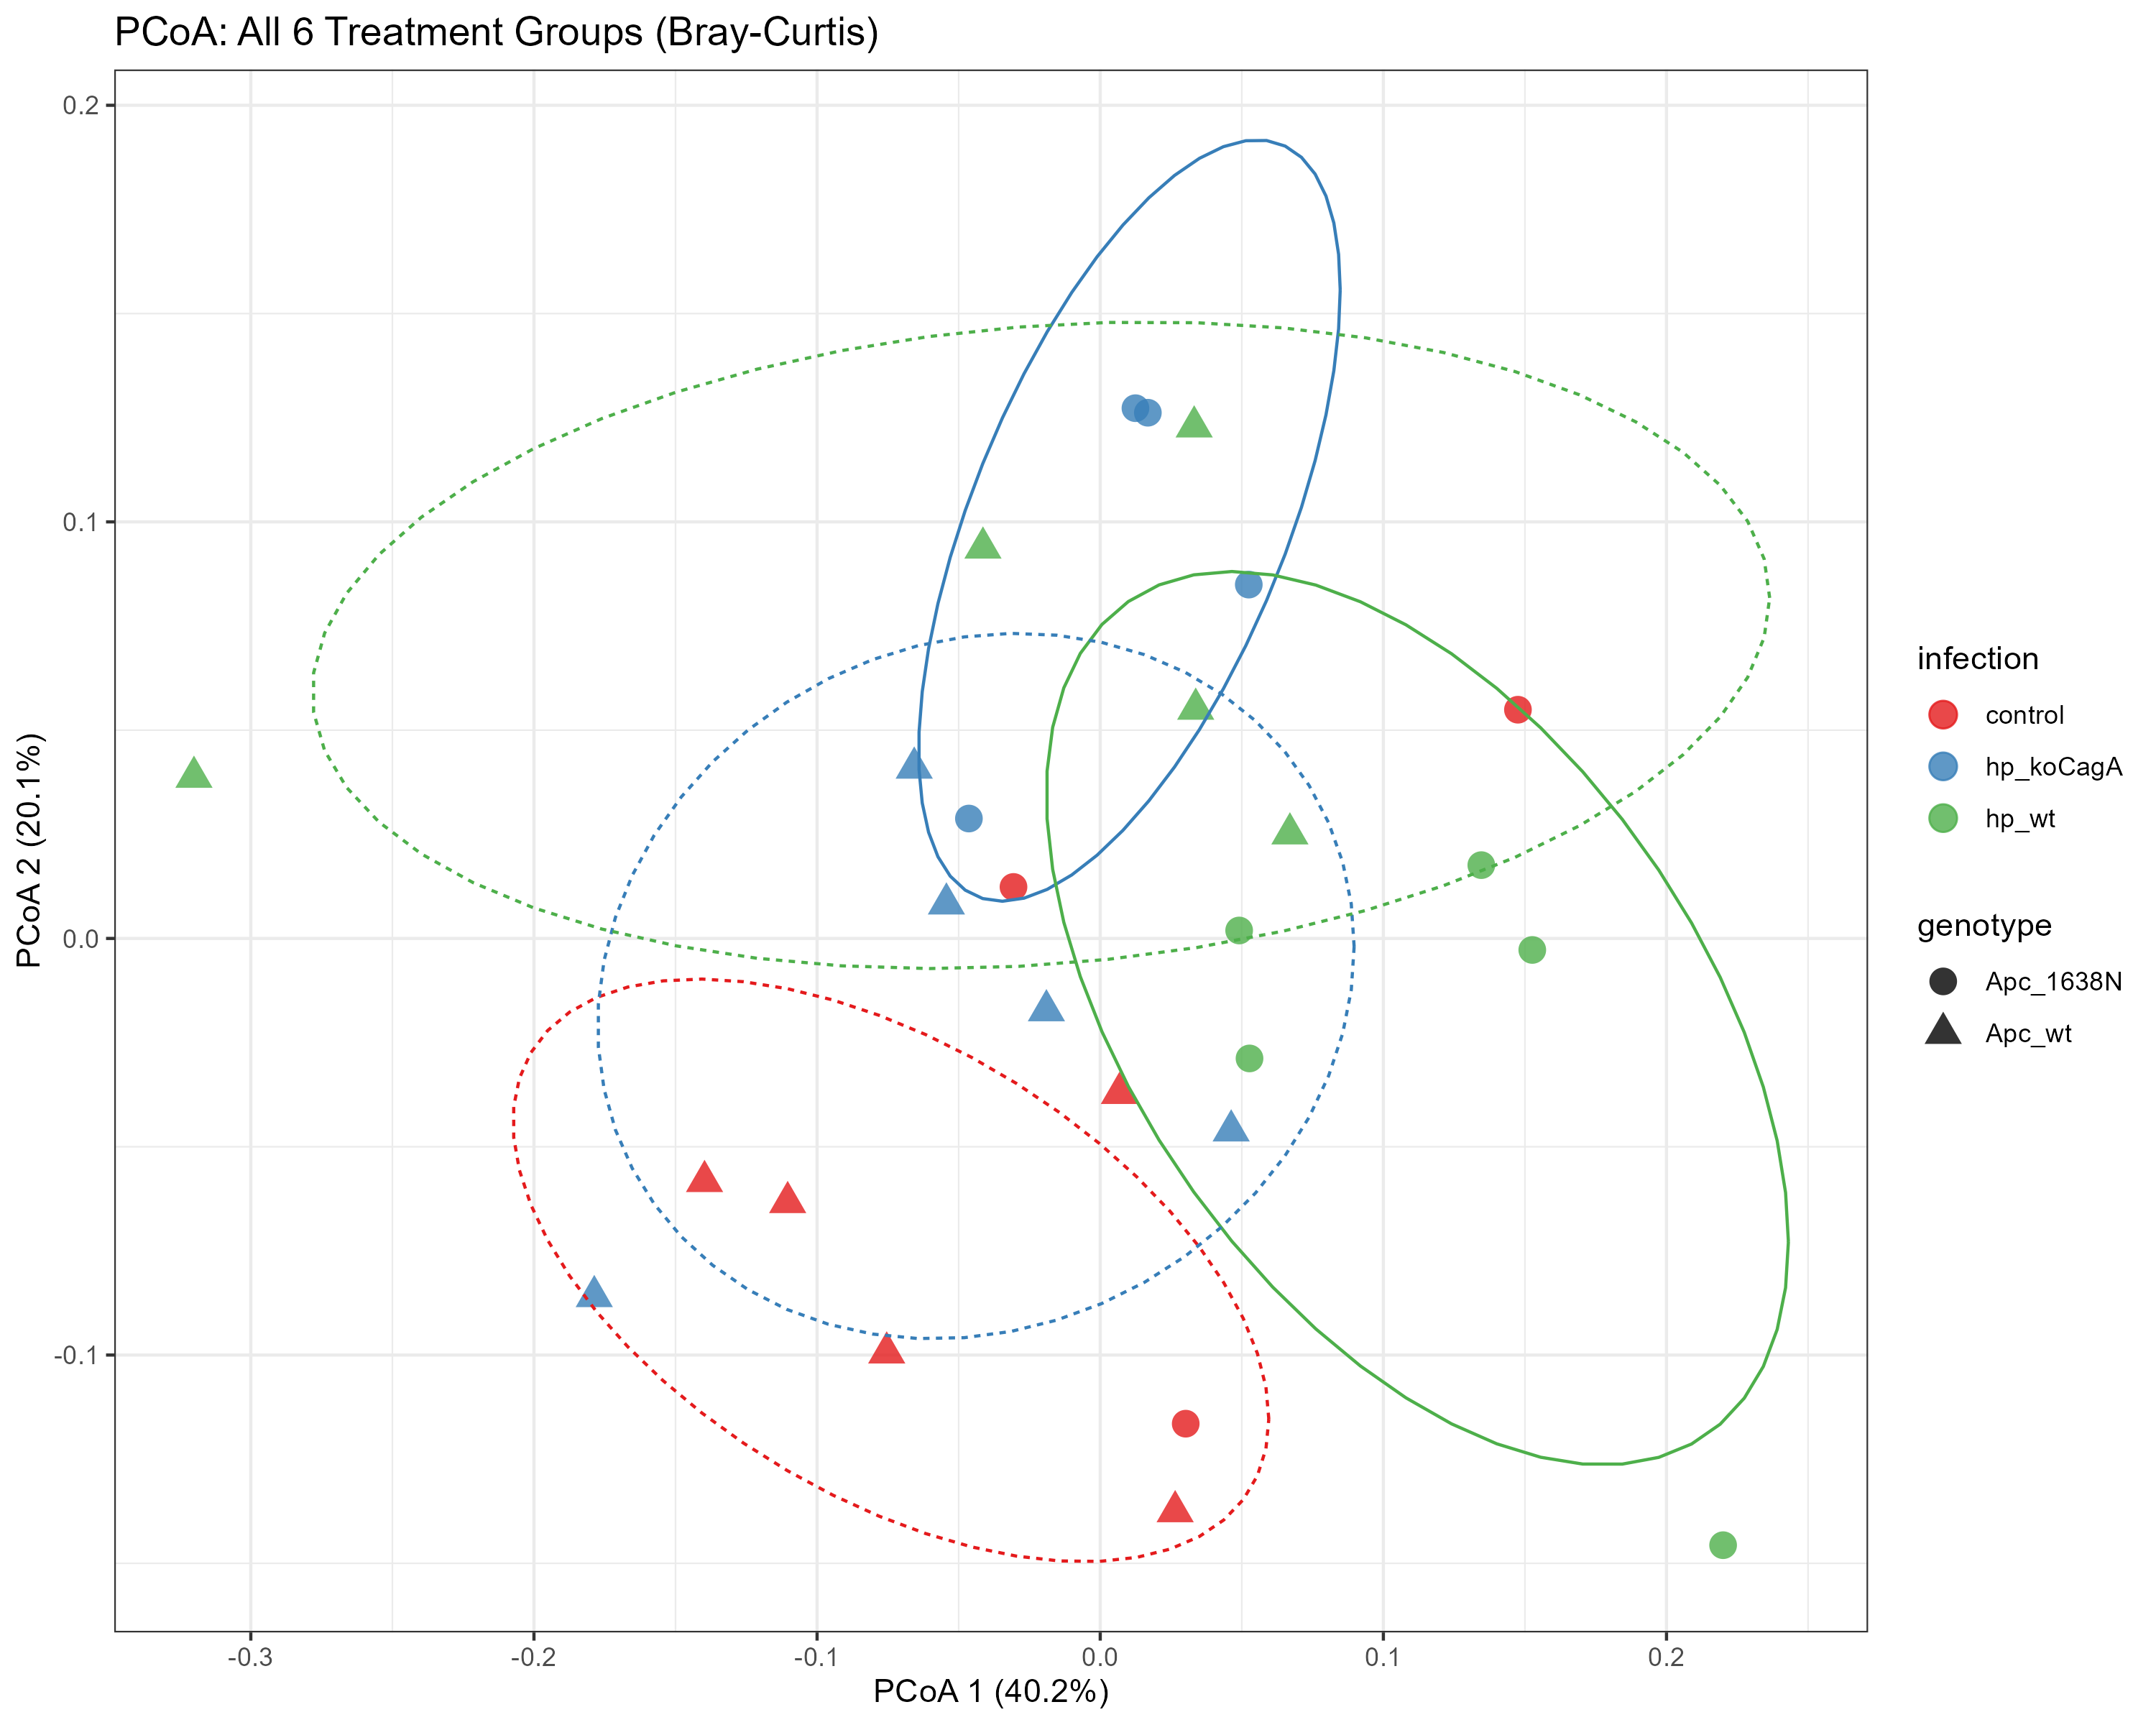
Result 1: Species - G×E Interaction
• Core comparison: Beta diversity P=0.012
• 2×3 factorial: Interaction P=0.024
• ApcMUT: P=0.007, R²=33.6%
• ApcWT: P=0.338, effect absent
• Conclusion: CagA requires Apc-mutant background
6
Notes:
Now let's look at the specific results.
First, species composition analysis. Core comparison shows significant beta diversity difference at P=0.012.
2×3 factorial analysis revealed significant Genotype×Infection interaction at P=0.024.
Key finding: In Apc-mutant background, CagA effect is significant (P=0.007, explaining 33.6% variance); in wild-type background, effect is absent (P=0.338).
This confirms our hypothesis: CagA's microbiota-restructuring effect requires the Apc-mutant susceptible background.

Slide 7

Result 2: Functional Redundancy & Silent Shift
• Species interaction P=0.024 vs Function P=0.223
• Functional redundancy: Species change, function stable
• Silent Shift phenomenon:
- Probiotics↓: L. johnsonii (-50%)
- Pathobionts↑: M. schaedleri (+57%)
• Drivers shifted: Probiotics → Pathobionts
7
Notes:
Second core result is functional redundancy and Silent Shift.
Species-level interaction is significant (P=0.024), but function-level is not (P=0.223) - classic functional redundancy.
Part 9 stratified analysis revealed "Silent Shift": while total function appears unchanged, the species executing these functions have undergone major shifts. Probiotics like L. johnsonii decreased 50%, while inflammation-associated M. schaedleri increased 57%.
This means: beneath the surface of functional stability, drivers have shifted from probiotics to potential pathogens.

Slide 8

Result 3: Phage Coordination
• Phage diversity significantly decreased (P=0.032)
• Bacteria-phage highly coordinated:
- Mantel r=0.52, P=0.001
- Procrustes P=0.002
• Tripartite network: 17,848 edges
• CagA effect transmitted via network
8
Notes:
Third important finding is phage coordination.
First, CagA infection significantly reduced phage alpha diversity at P=0.032.
More importantly, bacteria and phage communities are highly coordinated. Mantel test r=0.52, P=0.001; Procrustes P=0.002.
Our tripartite network contains 17,848 edges, with bacteria-phage being the strongest. This suggests CagA's effect is transmitted and amplified through the bacteria-phage-function network.

Slide 9
Conclusions & Future Directions
1
G×E interaction: CagA effect requires Apc-mutant background (P=0.007 vs P=0.338)
2
Functional redundancy & Silent Shift: Function stable but Drivers changed
3
Phage coordination: CagA reduces phage diversity; Bacteria-phage P=0.001
4
Next: Metabolomics validation + Tumor/T-cell phenotype integration
9
Notes:
Finally, core conclusions.
First, confirmed G×E interaction - CagA effect requires Apc-mutant background.
Second, discovered functional redundancy and Silent Shift - function stable but drivers changed.
Third, revealed phage coordination - bacteria and phage highly associated.
Next steps: metabolomics validation and integration with tumor/T-cell phenotype data.
Thank you for your attention!

Slide 10
Thank You
Questions & Discussion
10

