Slide 1
CagA-Dependent Gut Microbiome Restructuring
and Functional Redundancy
PC047 vCagAepitope Microbiome Analysis Progress
2026-01-26
Presenter: Yuhang Gong
1

Slide 2
Background: CagA and Intestinal Tumors
H. pylori CagA Pathogenesis
Key Literature Support
H. pylori
Infection
CagA Injection
into Host Cell
• Jones et al. 2017, PLoS Pathog
Drosophila: CagA alone induces
dysbiosis and epithelial proliferation
Disrupt Wnt/
NF-κB Pathways
Gut Microbiota
Dysbiosis
• Cui et al. 2025, BMC Gastro
Clinical: CagA+ strains affect
colorectal lesions via gut microbiota
Tumor Promotion
• Ding et al. 2025, Cell Host
Phage can eliminate tumor-
promoting bacteria
Central Question: What maintains CD8+ T-cell activation after CagA clearance?
2
Notes:
Let me first introduce the research background.
H. pylori CagA protein is a recognized Class I carcinogen. After being injected into host cells via Type IV secretion system, it disrupts key signaling pathways like Wnt and NF-κB, while causing gut microbiota dysbiosis, ultimately promoting tumor development.
Key literature supporting this mechanism is listed on the right. Notably, Jones et al. 2017 demonstrated in Drosophila that CagA expression alone is sufficient to induce dysbiosis and epithelial hyperproliferation.
This leads to our central question: What maintains CD8+ T-cell activation after CagA clearance?

Slide 3
Background: Apc Mutation and Genetic Susceptibility
Apc Mutation → Constitutive Wnt Activation
G×E Interaction Hypothesis
Normal
ApcWT
ApcMUT
APC
β-catenin
Degradation
Homeostasis
CagA-
Normal
Microbiota
Mild
Dysbiosis
Apc Mutant
APC ✗
β-catenin
Accumulation
Tumor
CagA+
No Effect
P=0.387
Significant
P=0.039
Experimental Design: 2×3 Factorial
→ CagA effect requires Apc-mutant susceptible background
ApcWT
ApcMUT
Ctrl
HpKO
HpWT
Core Comparison
3
Notes:
Now let me introduce Apc mutation and genetic susceptibility.
The left panel shows the Apc-Wnt pathway. Normally, APC degrades β-catenin to maintain homeostasis. When Apc is mutated, β-catenin accumulates, leading to tumor development.
The right panel shows our G×E hypothesis. Our analysis found that CagA effect is highly dependent on host genetics. In wild-type, CagA has no effect (P=0.387); but in Apc-mutant, CagA significantly restructures microbiota (P=0.039).
We designed a 2×3 factorial experiment, with core comparison being CagA+ vs CagA- under Apc-mutant background.

Slide 4
Central Hypothesis: Functional Footprint
1
2
3
4
CagA Infection
Restructures Microbiota
Microbiota Produces
Specific Molecules
Persistent CD8+
T-cell Activation
Tumor
Promotion
Scope of This Study
✓ Verified
○ Pending
• Microbiota restructured (P=0.012)
• G×E interaction confirmed (9/9 verified)
• Functional redundancy & Driver shift
• Phage coordination (P=0.001)
• Metabolomics: Specific metabolite ID
• Transcriptomics: Gene expression validation
• Integration with tumor/T-cell phenotypes
4
Notes:
This is our central hypothesis — the Functional Footprint hypothesis.
The logical chain: Step 1, CagA infection restructures gut microbiota; Step 2, altered microbiota produces specific molecules; Step 3, these molecules persistently activate CD8+ T-cells; Step 4, ultimately promoting tumor development.
This presentation covers the first half of hypothesis verification. We fully confirmed G×E interaction through 9 systematic pairwise comparisons, revealed Driver species shifts under functional redundancy, and phage coordination.
The latter half requires subsequent verification.

Slide 5
Analysis Pipeline Overview
Cecum Samples (n=27)
01 Species Analysis
02 Functional Analysis
03 OTU/Phage Analysis
Kraken2/Bracken
HUMAnN4
SingleM/Lyrebird
Community
G×E Interaction
Pathways
Driver Shift
Phylogeny
Bacteria-Phage
5/9 Sig.
Redundancy
P=0.001
Integration: CagA restructures bacteria via G×E → Functional redundancy with Driver shift → Phage coordination
5
Notes:
This slide shows our analysis pipeline.
From 27 cecum samples, we performed three major analyses:
First, species composition analysis using Kraken2/Bracken, 5/9 pairwise comparisons FDR significant.
Second, functional potential analysis using HUMAnN4, revealing functional redundancy.
Third, OTU and phage analysis using SingleM/Lyrebird, finding strong association at P=0.001.
Integration: CagA restructures bacteria via G×E, shows functional redundancy with Driver shift, and phage coordination.

Slide 6
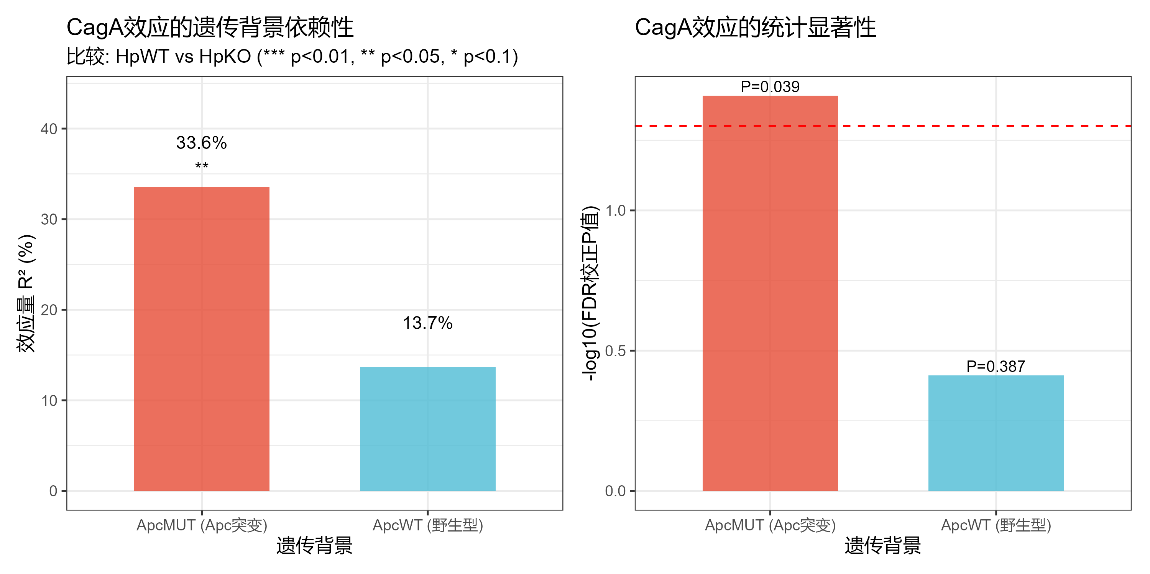
Result 1: G×E Interaction Verification
• 9 systematic pairwise comparisons
• CagA@ApcMUT: P=0.039, R²=33.6%
• CagA@ApcWT: P=0.387, effect absent
• G×E interaction fully verified
• Unexpected: Infection amplifies Apc effect
6
Notes:
First, the G×E interaction verification results.
We performed 9 systematic pairwise comparisons to comprehensively evaluate different factor effects.
Core finding: CagA effect is significant in ApcMUT background (P=0.039, explaining 33.6% variance), but absent in ApcWT background (P=0.387). This fully verifies the G×E interaction hypothesis.
An unexpected finding: infection amplifies rather than masks the Apc effect. Apc effect was not significant before infection, but became significant after infection.

Slide 7
Result 2: CagA Targets Bacteria, Not Viruses
Q: What does CagA reshape? Bacteria or Viruses?
Standard (Bacteria)
Virus (Viruses)
9 Pairwise Comparisons:
• FDR Significant: 5/9 (55.6%)
• CagA@ApcMUT: P=0.039 ⭐
• CagA@ApcWT: P=0.387
→ G×E Fully Verified
9 Pairwise Comparisons:
• FDR Significant: 0/9 (0%)
• CagA@ApcMUT: P=0.604
• CagA@ApcWT: P=0.978
→ No Significant Effect
VS
Conclusion: CagA reshapes gut environment mainly via bacteria, not directly via viruses
7
Notes:
This slide answers a key question: What does CagA actually affect?
We performed 9 pairwise comparisons for both bacteria and virus data.
Left shows Standard bacteria results: 5/9 FDR significant, especially the core CagA effect in ApcMUT background is highly significant (P=0.039), fully verifying G×E interaction.
Right shows Virus results: 0/9 FDR significant, including the core CagA comparison.
This indicates CagA reshapes gut environment mainly through bacteria, not directly via viruses.
This sets up our later discussion of bacteria-phage coordination: although CagA doesn't directly affect viruses, bacterial changes drive phage changes.

Slide 8

Result 3: Functional Redundancy & Silent Shift
• Overall: Species P=0.024 vs Function P=0.223
• But core comparison: Species P=0.039, Function P=0.041
• → Scale-dependent: Overall redundant, locally consistent
• Silent Shift: Probiotics↓ Pathobionts↑
• *L. johnsonii* -50%, *M. schaedleri* +57%
8
Notes:
Third core result is functional redundancy and Silent Shift.
Overall interaction shows functional redundancy: species P=0.024 significant, function P=0.223 not significant.
But core CagA comparison shows species-function consistency: both species P=0.039 and function P=0.041 are significant. This indicates functional redundancy is scale-dependent.
Stratified analysis reveals "Silent Shift": total function unchanged, but executors have changed. Probiotic L. johnsonii decreased 50%, inflammation-associated M. schaedleri increased 57%.
Drivers shifted from probiotics to pathobionts, possibly explaining persistent immune stimulation.

Slide 9

Result 4: Bacteria-Phage Coordination
• Phage diversity significantly decreased (P=0.032)
• Bacteria-phage highly coordinated:
- Mantel r=0.52, P=0.001
- Procrustes P=0.002
• Tripartite network: 17,848 edges
• Echo: CagA→Bacteria→Phage cascade
9
Notes:
Fourth finding is bacteria-phage coordination.
Although CagA doesn't directly affect viruses (as shown in previous slide), bacterial changes drive phage changes.
Phage diversity significantly decreased (P=0.032), bacteria and phage communities highly coordinated (Mantel P=0.001, Procrustes P=0.002).
Tripartite network contains 17,848 edges, with bacteria-phage being the strongest.
This shows CagA's effect cascades: CagA changes bacteria, bacteria change phage. This echoes our previous finding — CagA mainly affects bacteria, but indirectly influences the entire microbiome through the network.

Slide 10
Conclusions & Future Directions
1
G×E interaction: CagA effect requires Apc-mutant background (9 comparisons verified)
2
CagA target: Mainly bacteria (5/9 sig.) not viruses (0/9 sig.)
3
Functional redundancy & Silent Shift: Overall redundant but Drivers shifted
4
Phage coordination: CagA→Bacteria→Phage cascade (P=0.001)
5
Next: Metabolomics validation + Tumor/T-cell phenotype integration
10
Notes:
Finally, core conclusions.
First, G×E interaction fully verified through 9 systematic comparisons.
Second, clarified CagA target: mainly bacteria, not viruses.
Third, functional redundancy and Silent Shift: overall function stable, but drivers shifted from probiotics to pathobionts.
Fourth, bacteria-phage highly coordinated, CagA influences entire microbiome through cascade effect.
Next steps: metabolomics validation and integration with tumor/T-cell phenotype data.
Thank you for your attention!

Slide 11
Thank You
Questions & Discussion
11

