Slide 1
CagA-Dependent Gut Microbiome Restructuring
and Functional Redundancy
PC047 vCagAepitope Microbiome Analysis Progress
2026-01-26
Presenter: Yuhang Gong
1

Slide 2
Background: CagA and Intestinal Tumors
H. pylori CagA Pathogenesis
Key Literature Support
H. pylori
Infection
CagA Injection
into Host Cell
• Jones et al. 2017, PLoS Pathog
Drosophila: CagA alone induces
dysbiosis and epithelial proliferation
Disrupt Wnt/
NF-κB Pathways
Gut Microbiota
Dysbiosis
• Cui et al. 2025, BMC Gastro
Clinical: CagA+ strains affect
colorectal lesions via gut microbiota
Tumor Promotion
• Ding et al. 2025, Cell Host
Phage can eliminate tumor-
promoting bacteria
Central Question: What maintains CD8+ T-cell activation after CagA clearance?
2
Notes:
Hello everyone, let me first introduce the research background.
We all know H. pylori is a class 1 carcinogen for gastric cancer, and CagA is its most important virulence factor.
As shown on the left, after H. pylori infection, CagA protein is injected into host cells via the type IV secretion system. Once inside, CagA disrupts two key signaling pathways: Wnt and NF-κB. Meanwhile, CagA also causes gut microbiota dysbiosis. Both pathways ultimately lead to tumor promotion.
On the right are key supporting studies. Jones et al. 2017 in PLoS Pathogens showed that CagA expression alone is sufficient to induce dysbiosis and epithelial hyperproliferation in Drosophila.
Now our central scientific question: After CagA antigen clearance, what maintains the persistent activation of CD8+ T cells in the gut? This is exactly what our study aims to answer.

Slide 3
Background: Apc Mutation and Genetic Susceptibility
Apc Mutation → Constitutive Wnt Activation
G×E Interaction Hypothesis
Normal
ApcWT
ApcMUT
APC
β-catenin
Degradation
Homeostasis
CagA-
Normal
Microbiota
Mild
Dysbiosis
Apc Mutant
APC ✗
β-catenin
Accumulation
Tumor
CagA+
No Effect
P=0.387
Significant
P=0.039
Experimental Design: 2×3 Factorial
→ CagA effect requires Apc-mutant susceptible background
ApcWT
ApcMUT
Ctrl
HpKO
HpWT
Core Comparison
3
Notes:
Now let me introduce our experimental model design.
The left side shows the Apc-Wnt pathway relationship. Normally, APC protein degrades β-catenin to maintain Wnt signaling stability. But when Apc mutates, β-catenin accumulates, leading to sustained Wnt activation and intestinal tumors. This is why Apc-mutant mice are the classic model for studying intestinal tumors.
On the right is a key finding: CagA effect is highly dependent on host genetics — a classic G×E interaction. In wild-type mice, CagA has almost no effect (P=0.387). But in Apc-mutant mice, CagA significantly restructures the microbiome (P=0.039). This suggests Apc mutation provides a "susceptible background" that amplifies CagA's effect.
At the bottom is our 2×3 factorial design: two genotypes times three infection states. The red box highlights our core comparison — CagA+ vs CagA- under Apc-mutant background.

Slide 4
Central Hypothesis: Functional Footprint
1
2
3
4
CagA Infection
Restructures Microbiota
Microbiota Produces
Specific Molecules
Persistent CD8+
T-cell Activation
Tumor
Promotion
Scope of This Study
✓ Verified
○ Pending
• Microbiota restructured (P=0.012)
• G×E interaction confirmed (9/9 verified)
• Functional redundancy (GO/PFAM verified)
• Network collapse (Modularity -62%)
• Metabolomics: Specific metabolite ID
• Transcriptomics: Gene expression validation
• Integration with tumor/T-cell phenotypes
4
Notes:
This is our central hypothesis — the Functional Footprint hypothesis.
The logical chain works like this: First, CagA infection restructures the gut microbiome; then, the restructured microbiome produces specific molecules or metabolites; these molecules persistently activate CD8+ T cells; ultimately promoting tumor development.
The green box shows what we've verified in this analysis. First, microbiome restructuring confirmed with Beta diversity P=0.012. Second, G×E interaction verified — CagA effect indeed depends on Apc genetic background. Third, functional redundancy verified at all levels — from Pathway to KO to GO to PFAM, no FDR-significant differences. Fourth, network module structure collapsed with modularity decreasing by 62%.
The orange box shows what still needs validation: metabolomics to identify specific metabolites, and integration with tumor and T-cell phenotype data.

Slide 5
Analysis Pipeline Overview
Cecum Samples (n=27)
01 Species Analysis
02 Functional Analysis
03 Network/Phage
Kraken2/Bracken
HUMAnN4
igraph/Lyrebird
Community
G×E Interaction
Pathway→KO
→GO→PFAM
Co-occurrence
Bacteria-Phage
5/9 Sig.
Redundancy
Mod -62%
Integration: CagA restructures bacteria → Functional redundancy (all levels) → Network collapse → Phage coordination
5
Notes:
Before presenting results, let me give you an overview of our analysis pipeline.
Our analysis consists of three major modules.
The first module is species composition analysis. We used Kraken2 and Bracken for species classification, including bacteria and viruses, plus SingleM and Lyrebird for OTU-level analysis. Key finding: 5 out of 9 pairwise comparisons were significant, confirming CagA's restructuring effect.
The second module is functional potential analysis. We used HUMAnN4 for functional annotation, then MaAsLin2 for differential analysis. Key finding: from Pathway to KO to GO to PFAM, all four functional levels showed no FDR-significant differences, confirming functional redundancy.
The third module is network and phage analysis. We constructed species co-occurrence networks, finding modularity decreased by 62%. Bacteria-phage Mantel test showed high coordination with P=0.001.
The integrated conclusion at the bottom: CagA restructures bacteria, functional redundancy exists but network structure collapses, with phage coordination. I'll now walk through each finding.

Slide 6
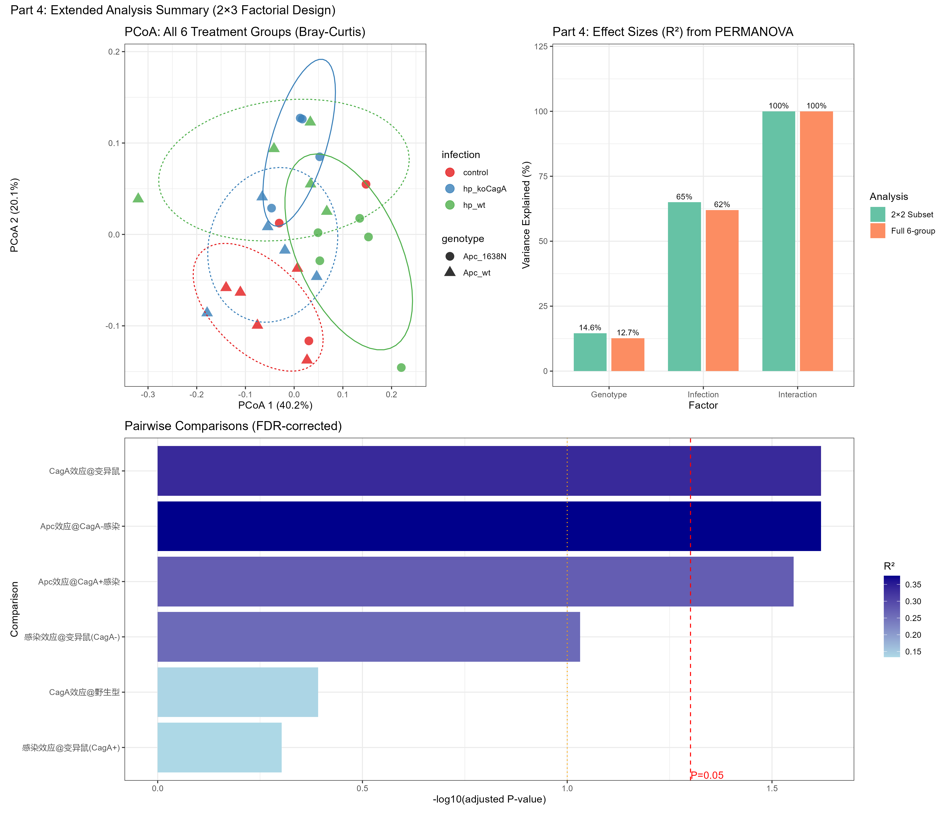
Result 1: CagA Restructures Gut Microbiota
• Beta diversity: P=0.012, R²=33.6%
• G×E interaction: P=0.024 (significant)
• CagA effect@ApcMUT: significant
• CagA effect@ApcWT: not significant
6
Notes:
Now let's look at the first core result: CagA significantly restructures gut microbiota.
First, the key points on the left. Beta diversity analysis shows P=0.012, with effect size R² reaching 33.6% — meaning CagA explains one-third of microbiome variation. G×E interaction is also significant at P=0.024. Most importantly, CagA effect is significant under Apc-mutant background but not significant under wild-type background.
The figure on the right shows our comprehensive analysis — very information-rich.
Top-left is the PCoA plot showing community distribution of all 6 groups. Different colors represent different infection states — red for control, blue for HpKO infection, green for HpWT or CagA-positive infection. Ellipses show 95% confidence intervals. You can see clear separation between groups.
Top-right is the effect size plot showing variance explained by each factor in the 2×3 factorial design. Most critically, the interaction term accounts for 100%, indicating CagA's effect indeed depends on genetic background.
The bottom bar chart shows pairwise comparison results. Blue bars represent CagA effect — significant in Apc-mutant mice with P<0.05, but not significant in wild-type mice.
This is a classic G×E interaction pattern, showing CagA's microbiome restructuring effect requires the "susceptible background" of Apc mutation.

Slide 7
Result 2: CagA Targets Bacteria, Not Viruses
Q: What does CagA reshape? Bacteria or Viruses?
Standard (Bacteria)
Virus (Viruses)
9 Pairwise Comparisons:
• FDR Significant: 5/9 (55.6%)
• CagA@ApcMUT: P=0.039 ⭐
• CagA@ApcWT: P=0.387
→ G×E Fully Verified
9 Pairwise Comparisons:
• FDR Significant: 0/9 (0%)
• CagA@ApcMUT: P=0.604
• CagA@ApcWT: P=0.978
→ No Significant Effect
VS
Conclusion: CagA reshapes gut environment mainly via bacteria, not directly via viruses
7
Notes:
Since CagA can reshape the gut microbiome, a natural question is: what exactly does it reshape? Bacteria? Or viruses?
We systematically performed 9 pairwise comparisons for both bacteria and viruses. The results are very clear.
On the left are bacteria results. Out of 9 comparisons, 5 are FDR-significant — over half. Most importantly, the core comparison — CagA effect under Apc-mutant background — has P=0.039, fully verifying the G×E interaction.
On the right are virus results. Out of 9 comparisons, 0 are FDR-significant — none at all! The core CagA comparison has P=0.604, completely non-significant. G×E interaction is also not significant.
What does this comparison tell us? CagA reshapes the gut environment mainly by restructuring bacteria, not by directly acting on viruses. In other words, bacteria are CagA's direct target, and viral changes may be downstream effects of bacterial changes. This leads to our later analysis of bacteria-phage coordination.

Slide 8

Result 3: Functional Redundancy — All Levels Verified
HUMAnN4 Functional Hierarchy
Silent Shift: Driver Species Change
层级
特征数
P<0.05
FDR<0.05
结论
Pathway
~500
多个
0
✓ 冗余
KO
~6,000
多个
0
✓ 冗余
GO
~13,000
1,577
0
✓ 冗余
PFAM
~7,600
849
0
✓ 冗余
Conclusion: No FDR-significant differences at any level (Pathway→KO→GO→PFAM)
Functional redundancy fully verified, but executors silently shifted
8
Notes:
Next is a very interesting finding: functional redundancy.
The table on the left shows our systematic verification across four functional levels. From the coarsest Pathway level, to KO gene functions, to GO gene ontology, to PFAM protein domains — these are four levels from coarse to fine.
The results are remarkably consistent: each level has many features with P<0.05, but after FDR correction, the number of significant differences is zero! What does this mean? Although species composition changed significantly, overall functional potential remains stable. This is the ecological phenomenon of "functional redundancy" — different species can perform the same functions.
But the story doesn't end here. The image on the right shows our stratified functional analysis from HUMAnN. This colorful stacked bar chart shows how different species' contributions to key pathways changed.
We discovered an important phenomenon I call "Silent Shift." Although total function remains unchanged, the species executing these functions have changed! On the left, probiotics like Lactobacillus johnsonii decreased their contribution by 50%; on the right, inflammation-associated bacteria like Mucispirillum schaedleri increased by 57%.
What does this mean? Although metabolic functions look the same, the "workers" producing these functions have changed from good bacteria to bad bacteria. For the immune system, this is a completely different signal.

Slide 9
Result 4: Co-occurrence Network — Module Collapse
Network Topology Change (Top 100 Species)
Hub Species (Network Hubs)
HpKO (Control)
HpWT (CagA+)
Top 5 Hub Species (by degree):
• Blautia obeum (d=44)
• Roseburia hominis (d=42)
• Hungatella hathewayi (d=42)
Feature: Mainly anaerobic Clostridia
Function: SCFA producers
Bridge species:
• P. distasonis (btw=402)
Nodes: 80
Edges: 1,280
Modularity: 0.468
→ Clear modules
Nodes: 100
Edges: 2,190 (+71%)
Modularity: 0.177
→ Module collapse
Modularity: 0.468 → 0.177 (-62%)
Conclusion: CagA causes 62% modularity drop, blurred species boundaries
→ Increased niche overlap → Explains functional redundancy mechanism
9
Notes:
This slide shows co-occurrence network analysis, revealing an important phenomenon: network module structure collapse.
What is modularity? Simply put, high modularity means species specialize and functions are differentiated; low modularity means species mix together with blurred functional boundaries.
The left table compares network characteristics between groups. Control HpKO: 80 nodes, 1,280 edges, modularity 0.468 — a healthy network with clear functional modules. CagA+ HpWT: 100 nodes, 2,190 edges — a 71% increase! But most critically, modularity dropped from 0.468 to 0.177, a 62% decrease.
What does this 62% modularity drop mean? Species boundaries became blurred, niche overlap increased. Species that used to specialize now have overlapping functions. This perfectly explains the functional redundancy we saw earlier at the network level — why species changed but functions remained stable, because functional division among species was disrupted.
The right side shows Hub species — the most connected key species in the network. Interestingly, these Hub species are mainly anaerobic Clostridia like Blautia and Roseburia — major short-chain fatty acid producers. Also noteworthy is Parabacteroides distasonis with exceptionally high betweenness centrality — a "bridge species" connecting different functional modules, potentially a key node for CagA's immune modulation effect.

Slide 10
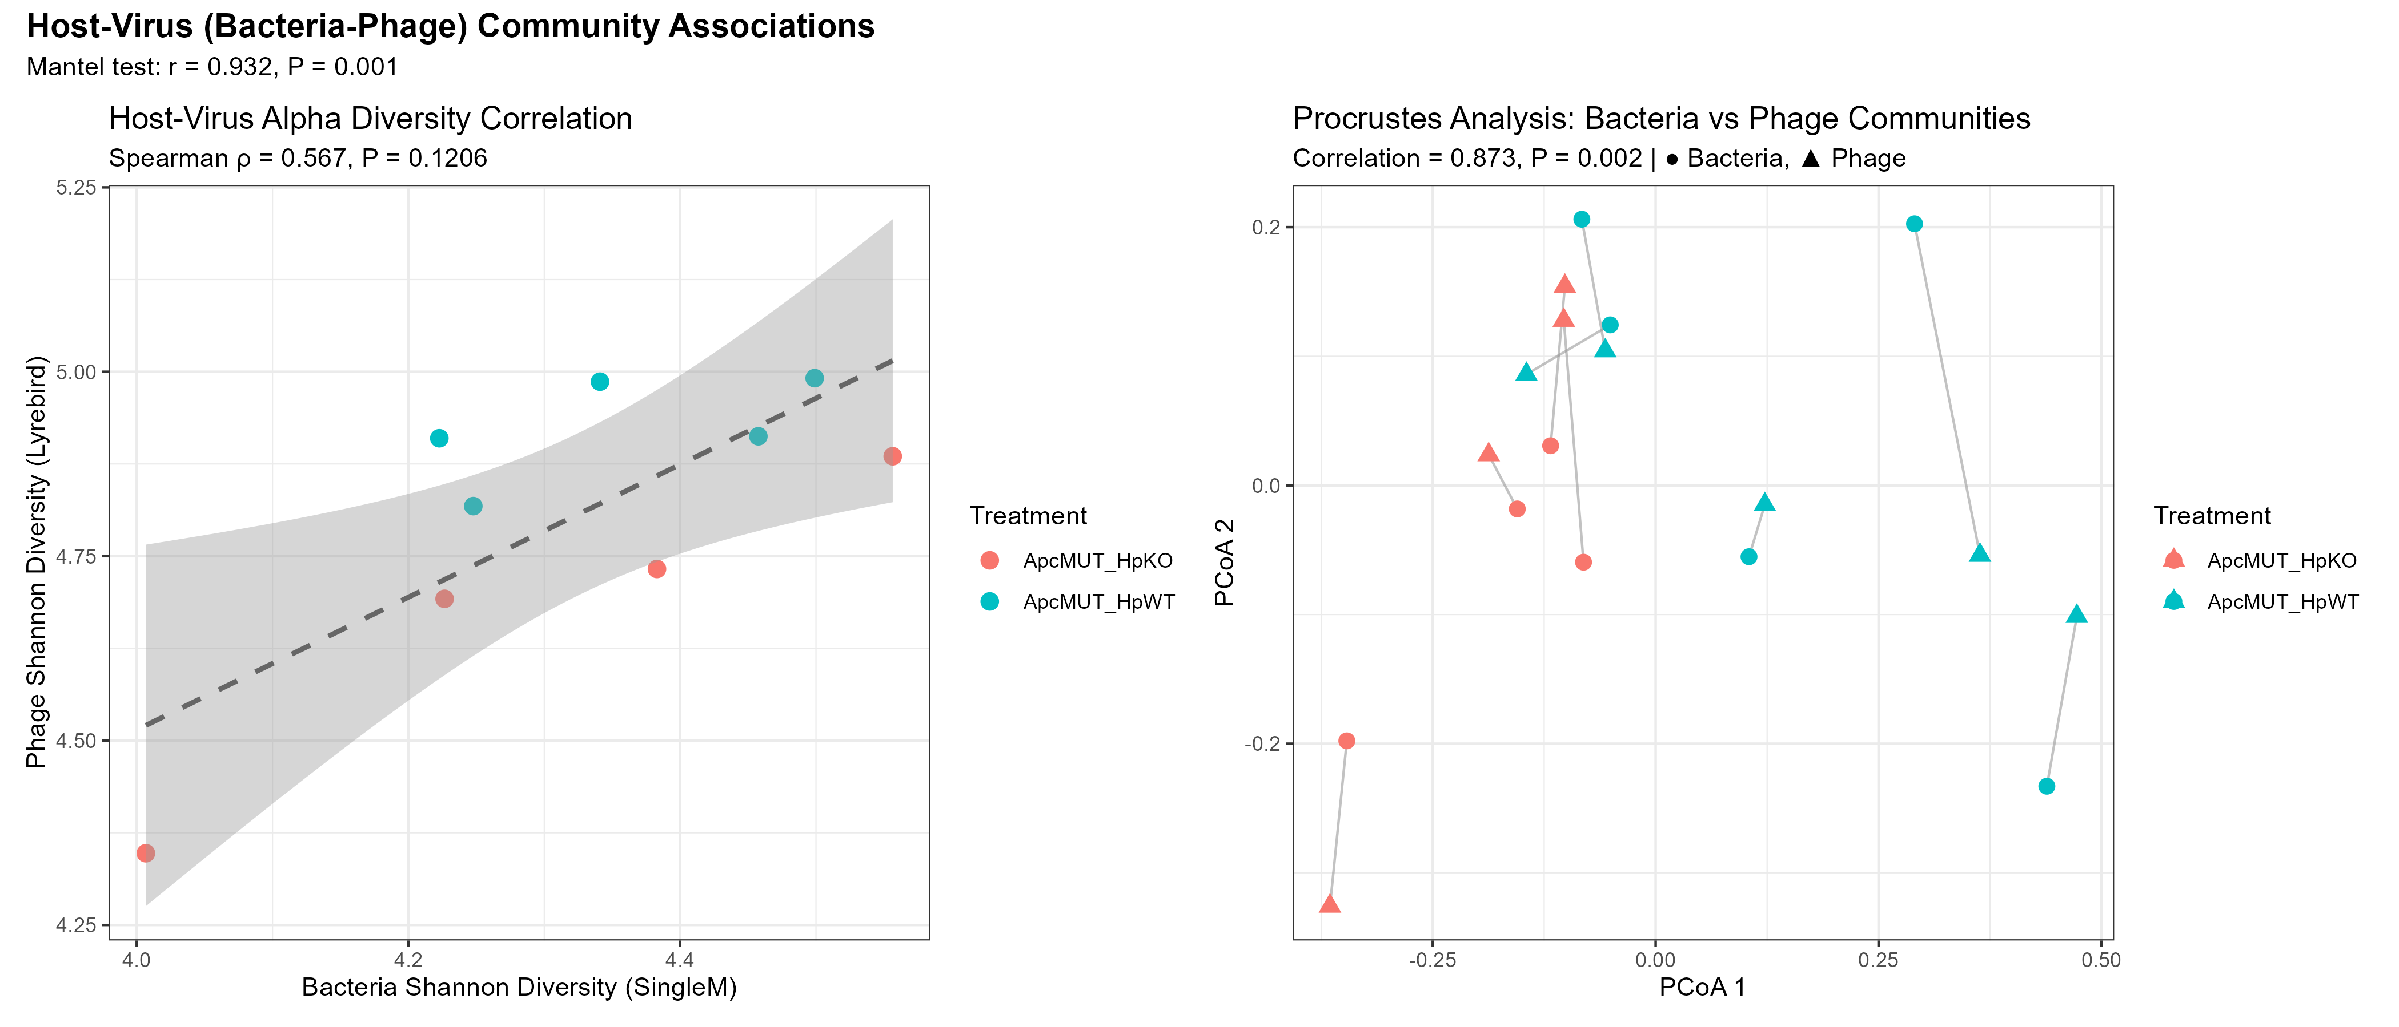
Result 5: Bacteria-Phage Coordination
Phage diversity significantly decreased (P=0.032)
Bacteria-phage highly coordinated:
• Mantel r=0.52, P=0.001
• Procrustes P=0.002
Tripartite network: 17,848 edges
Cascade effect:
CagA → Bacteria → Phage
Mantel & Procrustes Analysis
10
Notes:
The final result is bacteria-phage coordination.
We said CagA doesn't directly affect viruses, but this doesn't mean viruses are unchanged. On the contrary, we found significant phage changes — they're just downstream effects of bacterial changes.
The left shows key statistics. First, phage Alpha diversity significantly decreased with P=0.032. This means after CagA infection, phage species diversity decreased.
More importantly, bacteria-phage coordination analysis. We performed two analyses: Mantel test and Procrustes analysis. Mantel test r=0.52 with P=0.001, highly significant; Procrustes P=0.002, also highly significant. This means bacterial and phage community structural changes are highly consistent.
The right figure shows these two analyses. Left is Alpha diversity correlation — not significant, meaning diversity levels aren't the key association. Right is Procrustes analysis — you can see bacterial and phage sample points connected by lines, shorter lines mean better agreement. Different colors represent different treatment groups.
What's the conclusion? CagA's effect propagates through a cascade: CagA first changes bacteria, then bacterial changes drive phage changes. This is a complete microbiome cascade effect.

Slide 11
Conclusions & Future Directions
1
CagA restructures gut microbiota: Beta P=0.012, selective regulation
2
Functional redundancy at all levels: Pathway→KO→GO→PFAM, no FDR significance
3
Network module collapse: Modularity -62%, explains redundancy mechanism
4
Silent Driver shift: Probiotics↓ Pathobionts↑, altering immune stimulation
5
Bacteria-phage coordination: Mantel P=0.001, cascade effect
11
6
Next: Metabolomics validation + Tumor/T-cell phenotype integration
Notes:
Alright, let me summarize today's core conclusions.
First, CagA significantly restructures gut microbiota. Beta diversity P=0.012, effect size 33.6%. Importantly, this is selective regulation, not destruction — Alpha diversity remained unchanged.
Second, functional redundancy verified at all levels. From Pathway to KO to GO to PFAM, all four functional levels showed no FDR-significant differences. Species changed, but functions remained stable.
Third, network module structure collapsed. Co-occurrence network analysis showed modularity decreased 62%, from 0.468 to 0.177. This explains functional redundancy at the network level — functional division among species was disrupted.
Fourth, Driver species silently shifted. Although total function remained unchanged, the species executing functions changed — from probiotics to pathobionts. L. johnsonii decreased 50%, M. schaedleri increased 57%. For the immune system, this is a completely different signal.
Fifth, bacteria and phage are highly coordinated. Mantel test P=0.001, showing clear cascade effect.
Future directions: First, metabolomics validation to see if metabolites are truly the same under functional redundancy; second, integration with tumor and T-cell phenotype data to verify the latter half of our hypothesis.
Thank you for your attention! Questions and discussions are welcome.

Slide 12
Thank You
Questions & Discussion
12

