Slide 1
I
Interface
Serializable
Abstract Class
Product
Class
Option
*
I
I
*
Class
Util
A
A
A
A
A
1
A
Class
Automobile
Class
EditOptions
1
A
1
A
*
Class
OptionSet
A
*
I
1
I
Class
kbbSystem
Interface
CanModifyAll
I
I
Interface
Find
A
A
A
Interface
CanModifySelf
I
Class
Runner
I
Interface
Runnable
Class
Server
Class
BuildCarModelOptions
A
A
Interface
CanRead
I
Legend
A: associate
I: Implement interface
Class
Strings
Class
Protocol
Server

Slide 2
I
Interface
Serializable
Abstract Class
Product
Class
Option
*
I
I
*
Class
Util
A
A
A
A
A
1
A
Class
Automobile
Class
EditOptions
1
A
1
A
*
Class
OptionSet
*
I
A
I
Class
Client
Class
CarModelOptionsIO
Interface
CanModifyAll
I
A
Interface
Find
Class
Strings
Interface
CanModifySelf
I
Class
Runner
I
Interface
Runnable
Interface
CanRead
I
Legend
A: associate
I: Implement interface
Client

Slide 3
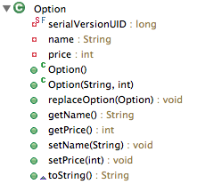
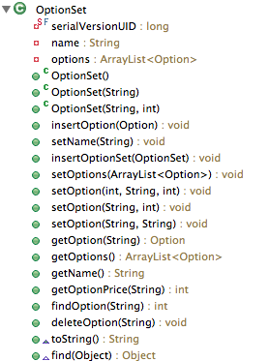
Class: Option
Class: OptionSet

Slide 4
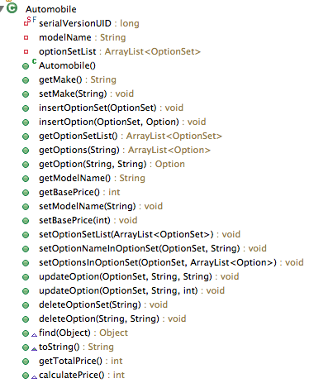
Class: Automobile

Slide 5
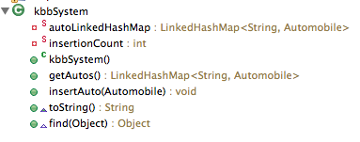
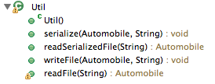
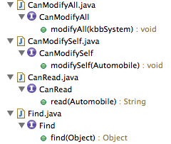

Class: Util
Class: kbbSystem
Abstract Class: Product
Interface:

Slide 6
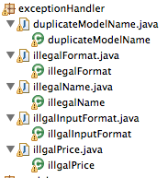
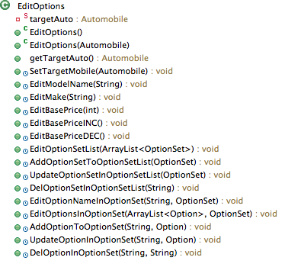
Exception Handler
EditOptions

Slide 7


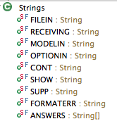
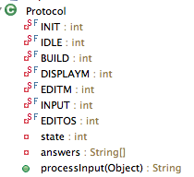


CarModelOptionsIO
BuildCarModelOptions
Strings
Protocol
Client
Server

