Slide 1
I
Interface
Serializable
Abstract Class
Product
Class
Option
*
I
I
*
Class
Util
A
A
A
A
A
1
A
Class
Automobile
Class
EditOptions
1
A
1
A
*
Class
OptionSet
A
*
I
1
I
Class
kbbSystem
Interface
CanModifyAll
I
I
Interface
Find
Interface
CanModifySelf
I
Class
Runner
I
Interface
Runnable
Interface
CanRead
I
Legend
A: associate
I: Implement interface
Class details are described in following pages

Slide 2
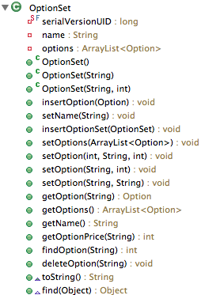
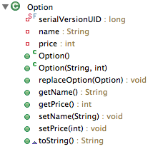
Class: OptionSet
Class: Option

Slide 3
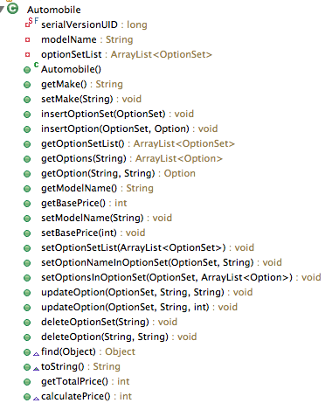
Class: Automobile

Slide 4
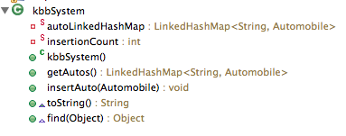
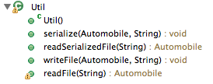
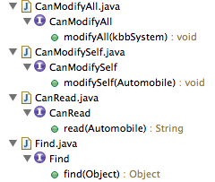

Class: Util
Class: kbbSystem
Abstract Class: Product
Interface:

Slide 5
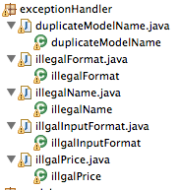
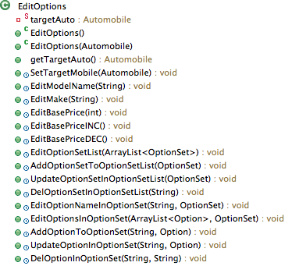
Exception Handler
EditOptions

Slide 6
Unit 3 Changes
Classes in EditOptions are synchronized.
The Runner class generated two threads to change a value in a static Automobile object. The value was increased and decreased by the thread. With the help of synchronization, threads are not racing with each other to get the original value and the write back behavior is stable.

Slide 7
The text file uses <> and </> to separate OptionSet names, uses comma to separate option names and prices.
The program parse the file and construct an Automobile object, serialize and deserialize the data to recreate Automobile object.
Program is implemented to accept extra space at beginning or ending of each line or invalid price (e.g. No price or negative price). Duplicated option will be overwritten by the latest record. Duplicated OptionSet will be merged into one OptionSet.
To run the program, the user need to type in a certain format in car.in and get result from car.out.

