Slide 1

MEMBERS:
Jamal Adams
Kevin Boyd
Zhitao Gong
Jordan Hullett
Tausif Muzaffar
Kelly Perkins
Nathan Plotts
Leo Reyes
Steven Whaley

Slide 2
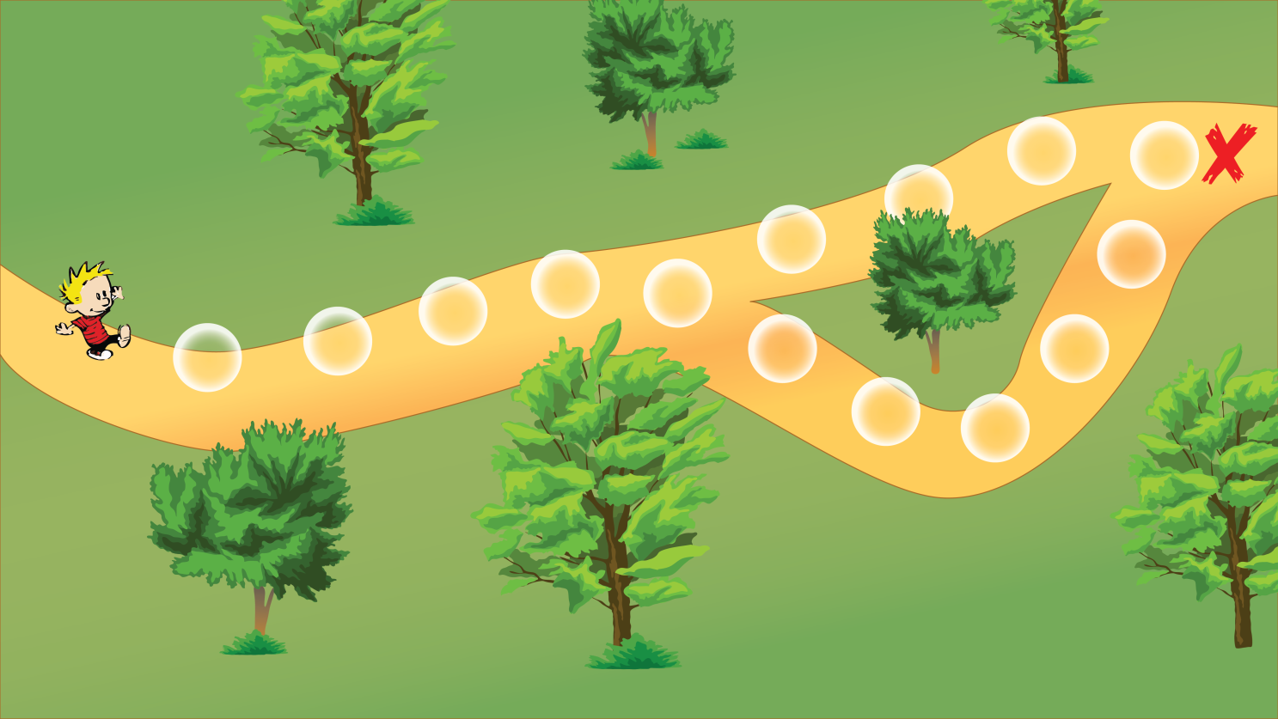
Game Description:
The game will feature a series of mini-games that will represent a character’s travel through a forest. Natural elements will be incorporated as an overlying theme.

Slide 3
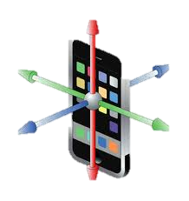

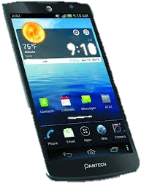
Features:
Mobile Android platform.
Fast and challenging minigames.
Mobile device sensor integration (accelerometer, gyroscope, camera, etc.

Slide 4
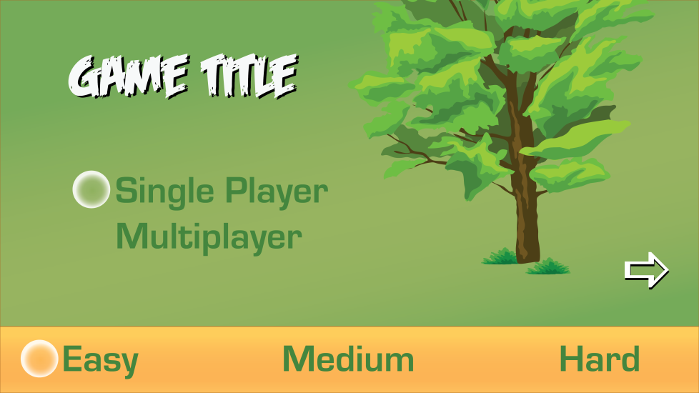

Objectives:
A player will control a character that is lost in the woods. To escape the forest, a series of minigames will need to be completed to progress along the path. Points will be awarded for completing the mingames in the quickest time. A player will strive to earn the title of highest-scorer.
Splash Screen
Sample Minigame

Slide 5



Development Tools:
We plan to use the Eclipse Integrated Development Environment for programming and testing on an emulator.
AndEngine and/or Adobe’s Creative Suite 5 will be used for additional development and graphics for the game.
Final testing will be carried out on multiple Android devices including a Galaxy Nexus, Samsung Galaxy S3 and Galaxy Note 10.1.

Slide 6
Development Schedule:
02/15 – Storyboard game layout
02/20 – Present and discuss all mini-games we want to develop
02/21 – Divide up games and start development
03/18 – Min Target: Create unifying interface
03/25 – Finalize story (text and timing)
03/30 – First set of mini-games must be completed
04/01 – Alpha Testing
04/05 – Second set of mini-games completed
04/09 – Music and interface art work must be completed
04/10 – Beta Testing 04/13 – Finalized interface and story
04/16 – High Target: All mini-games, music, interface has been implemented but still needs stress checks.
04/20 – Delivery Date

