Slide 1

Squirrel Canyon:
Jamal Adams
Kevin Boyd
Zhitao Gong
Jordan Hullett
Tausif Muzaffar
Kelly Perkins
Nathan Plotts
Leo Reyes
Steven Whaley

Slide 2
Strengths of Game:
Unique and cartoony art and music
Mini-game/act variety
Use of accelerometer and mobile phone touch sensors

Slide 3
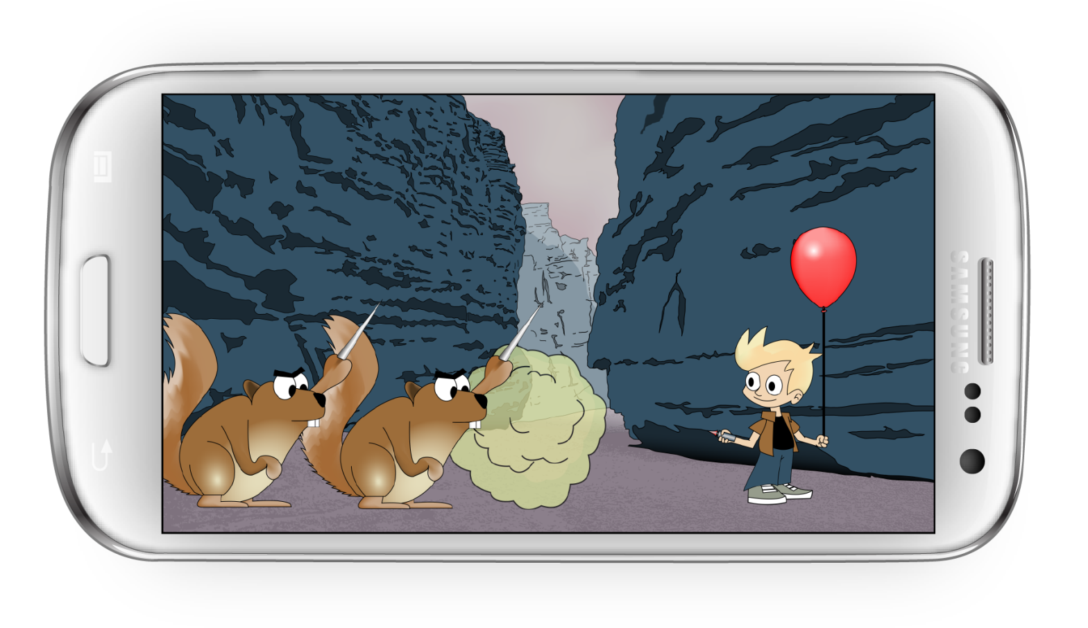
Act 1:
Utilized touch sensors for swiping action
Humor with gas clouds and squirrels
Red eyed squirrels present a greater challenge

Slide 4
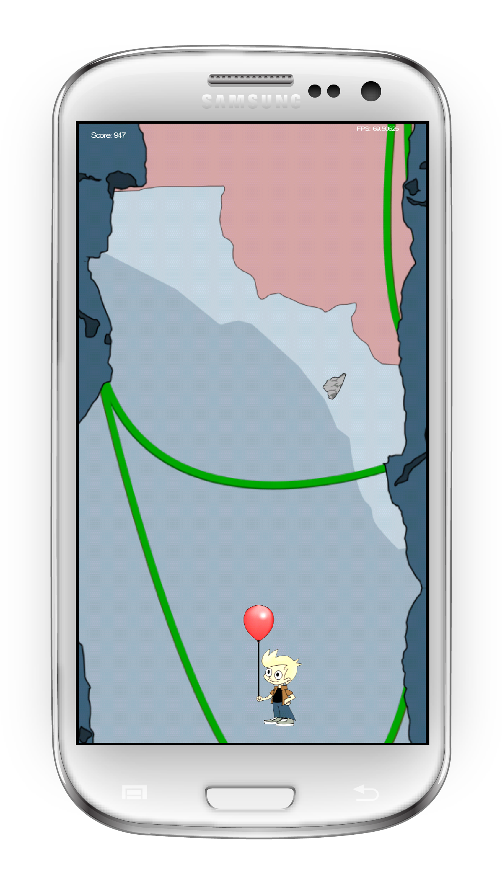
Act 2:
Uses accelerometer for character movement
Must move to avoid randomly generated falling rocks to get to the top of the canyon

Slide 5
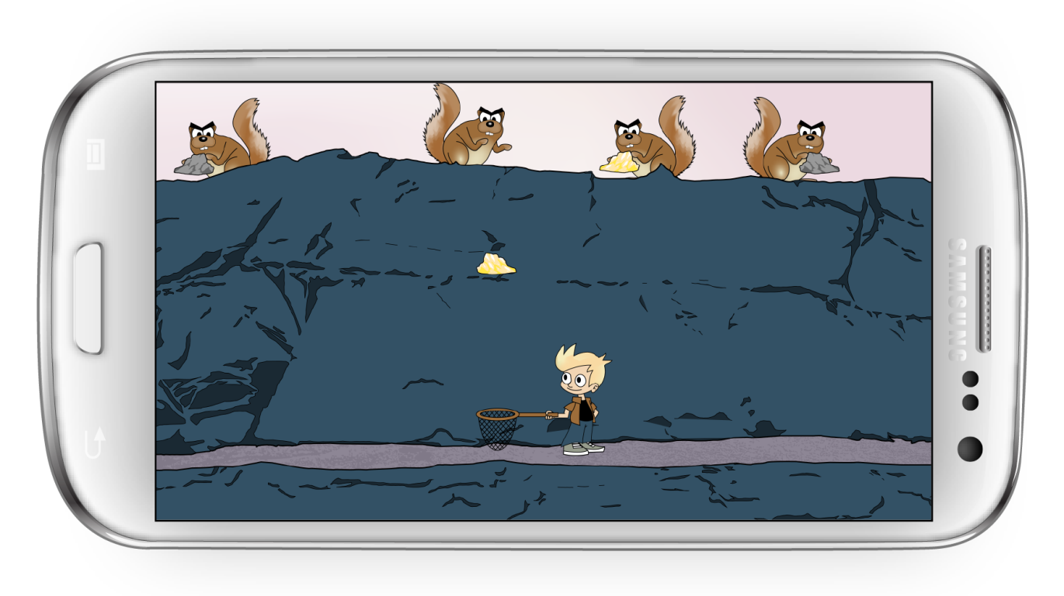
Act3:
Uses accelerometer to move, avoid rocks and catch gold
Randomly generated humorous squirrels attacking character

Slide 6
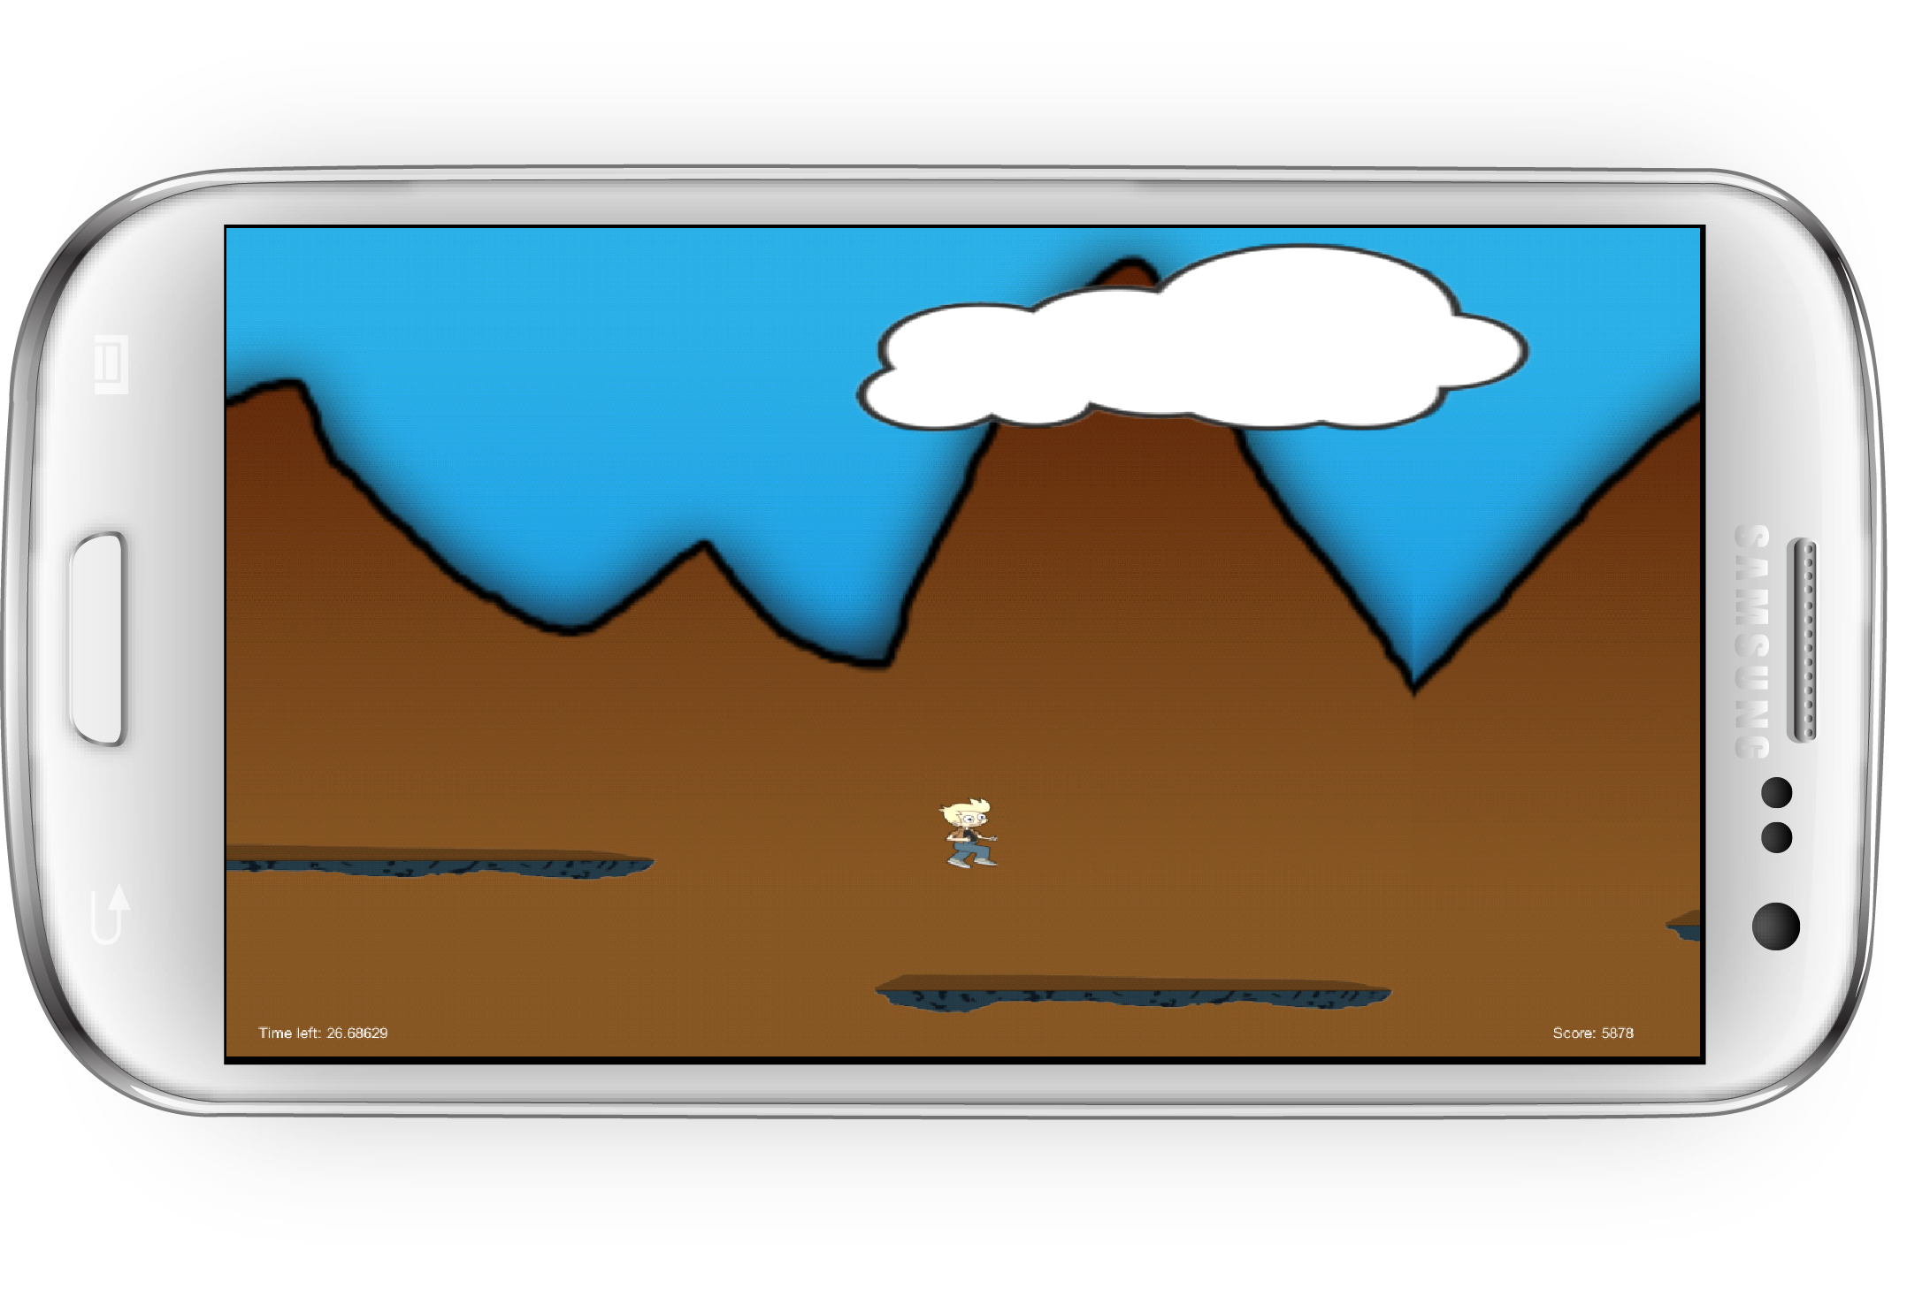
Act 4:
Randomly generated platforms with different lengths
Uses touch sensors for jumping

Slide 7



Game Dev. Platform:
Unity:
Game/physics engine
Android SDK:
Mobile development for Android devices
Adobe Illustrator:
Graphics

Slide 8
Play Testing Short Answer:
Suggestions:
Utilize mobile device sensors more(accelerometer)
Descriptive directions between each level
Slower speeds/add levels of difficulty
Falling rock speeds, attacking squirrels, running on platforms
Likes:
Art and music
Mini-game/act variety
Use of accelerometer
Dislikes:
Unresponsive controls
Getting stuck on one act

Slide 9
Play Testing Results:

Slide 10
If we had more time…
More mini-games/acts
Add levels of difficulty
Adjust sound speed according to difficulty
Further debug levels
Resolve unresponsive functionality
Include small detailed animations
Add instructional menus between levels
Create a credit scene and team logo
Add cut-scene artwork

