Slide 1
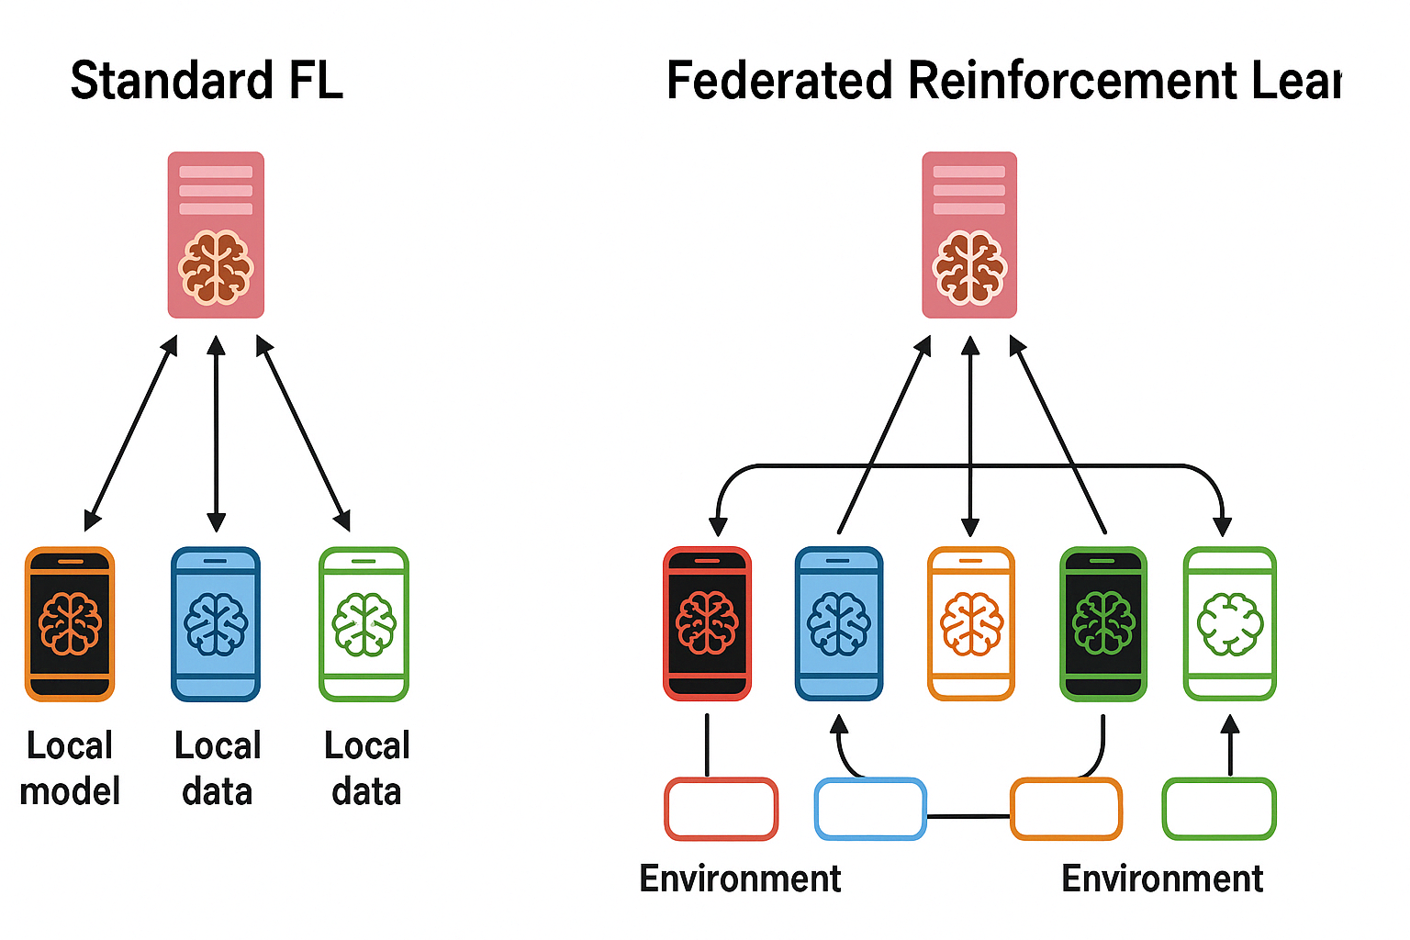

Traditional FL:
Model updates (${\text{ϑ}}^{w}$ - g)
FRL:
Edge rankings R=[2,0,…,1]
VS

Slide 2

Model updates
(${\text{ϑ}}^{w}$ - g)
Edge rankings
R=[2,0,…,1]
VS
Traditional FL FRL

