Slide 1

Axon
Dendrite
# Cells
Polarity
$$φ$$
$$β$$
Capacity = 3 types
s₁₁
$$p(s_{11}, s_{12})$$
s₁₂
Axon
Dendrite
# Cells
Polarity
$$φ$$
$$β$$
Capacity = 3 types
Population
Selection
Crossover
Axon
Dendrite
# Cells
Polarity
$$φ$$
$$β$$
Capacity = 4 types
s₂₁
$$p(s_{21}, s_{22})$$
s₂₂

Slide 2
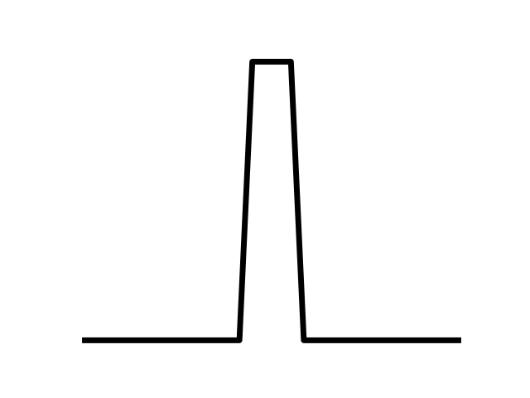


$${Sig}_{ref}$$
$${Sig}_{pert}$$
Photoreceptors
RGCs
Linear Regression
...
Interneuron
Populations

Slide 3
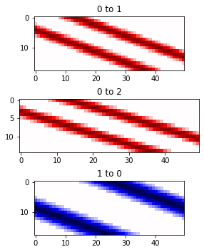
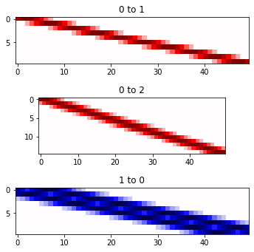
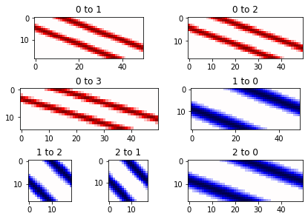

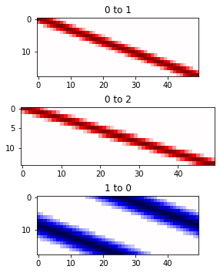
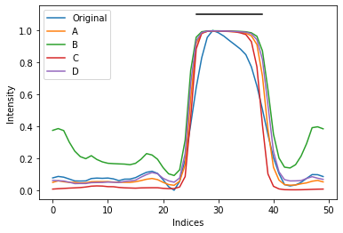
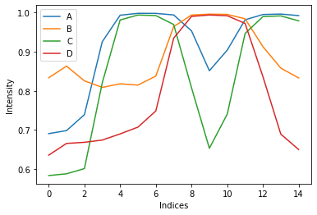
A
B
C
D
E
F

