Slide 1
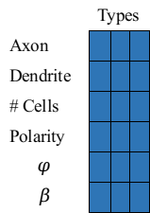
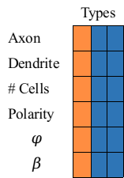
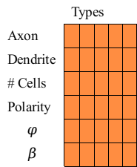








Selection
 | Types
Axon
Dendrite
# Cells
Polarity
$$φ$$
$$β$$
$$11$$
$$p(s_{11}, s_{12})$$
Capacity
(# Types)
$$1$$
$$12$$
Population
$$21$$
$$p(s_{21}, s_{22})$$
$$2$$
$$22$$
 | Types
Axon
Dendrite
# Cells
Polarity
$$φ$$
$$β$$
 | Types
Axon
Dendrite
# Cells
Polarity
$$φ$$
$$β$$
Capacity
(# Types)
Capacity
(# Types)
Crossover

Slide 2
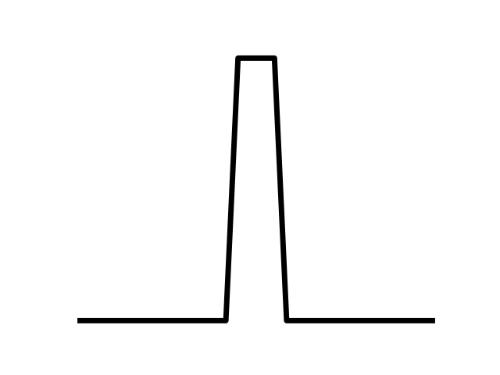
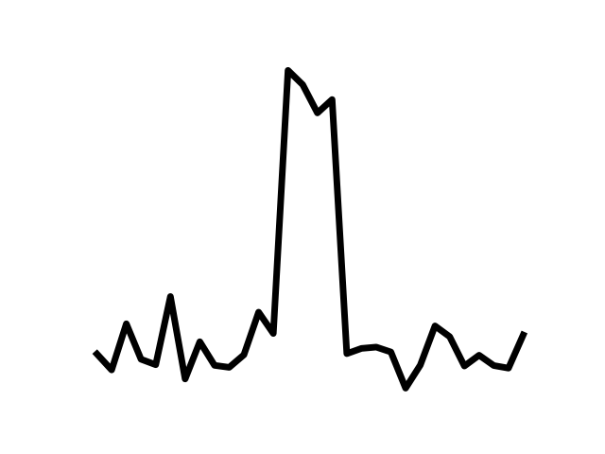


$${Sig}_{ref}$$
$${Sig}_{pert}$$
Photoreceptors
RGC
Discriminator
...
Interneuron
Populations

Slide 3
