Slide 1


Welcome to Software Carpentry!
January 13-16, 2015
Instructors:
Matt Gidden
Steve Goldstein
Lauren Michael
Danielle Nielsen
Cliff Rodgers
Paul Wilson

Slide 2
If You Can’t Reproduce It,
Is It Still Science?
And how long will it take?
Paul Wilson
Inspired by Greg Wilson
Software Carpentry

Slide 3
Reality of Research Computing
Many scientists spend most of their time developing, maintaining, or running software
  Most don’t consider themselves software engineers
  Few have ever been taught how
    Learned on-the-job
    Communal knowledge

Slide 4
So What…
Most results take longer to produce than they need to
  Not because of a lack of computers
Difficult to assess quality
  Often measured by reproducibility
  “System” doesn’t care

Slide 5
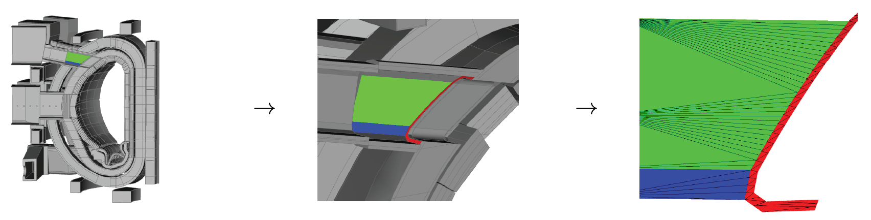
A Recent Story:
Sealing a Faceted Geometry

Slide 6
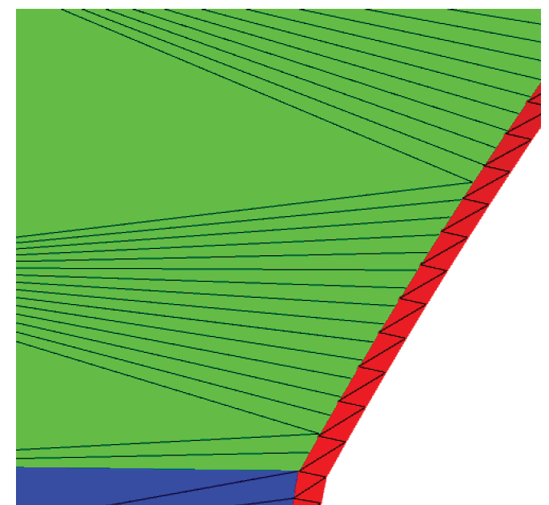
A Recent Story:
Sealing a Faceted Geometry

Slide 7
A Recent Story:
Sealing a Faceted Geometry
Lost particles
through “leaks”
Reduce confidence in
solution

Slide 8
A Recent Story:
Sealing a Faceted Geometry
Model | Particles Simulated [millions] | Lost Particles
 |  | Original | Robust
UW Nuclear Reactor | 41 | 5649 ± 178 | 0
Advanced Test Reactor | 74 | 141 ± 32 | 0
40° ITER Benchmark | 225 | 67 ± 39 | 0
ITER TBM | 205 | 665 ± 184 | 0
ITER Module 4 | 59 | 59 ± 19 | 0
ITER Module 13 | 79 | 450 ± 60 | 0
FNG Benchmark | 1310 | 31273 ± 989 | 0
ARIES First Wall | 4070 | 25 ± 18 | 0
HAPL IFE | 286 | 65 ± 19 | 0
Z-Pinch Fusion | 409 | 2454 ± 317 | 0

Slide 9
Software Carpentry to the Rescue
Best practices used by the best software engineers whose business is development of quality software
  They don’t always have formal training
  They don’t always follow all the practices
  Growing evidence supported by empirical studies

Slide 10
Write software for people, not computers
Automate repetitive tasks
Use the Computer to Record History
Make Incremental Changes
Use Version Control
Don’t Repeat Yourself
Plan for Mistakes
First make it correct, then make it fast
Document Design & Purpose
Conduct Code Reviews

Slide 11
Two Days ≠ Ten Practices
Automate repetitive tasks
Write software for people, not computers
Don’t Repeat Yourself (or Others)
Make Incremental Changes/Use Version Control
Plan for Mistakes
Conduct Code Reviews

Slide 12
Make Incremental Changes Redux
This applies to HOW you work
Choose one practice
  Implement it in your work
  Share it with your lab group
  Allow it to sink in
Repeat

Slide 13
How to Choose Where to Start?
It will depend on the nature of your work
Consider the purpose:
  Improve productivity
  Improve quality

Slide 14
Thoughts on Productivity and Automation
Cumulative Effort
Time

Slide 15
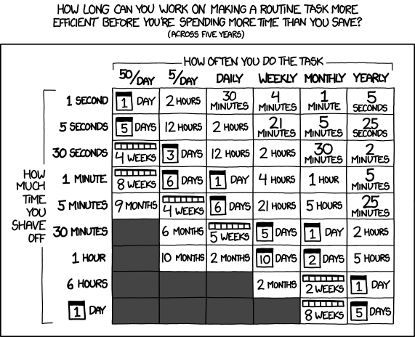
Thoughts on Productivity and Automation

