Slide 1
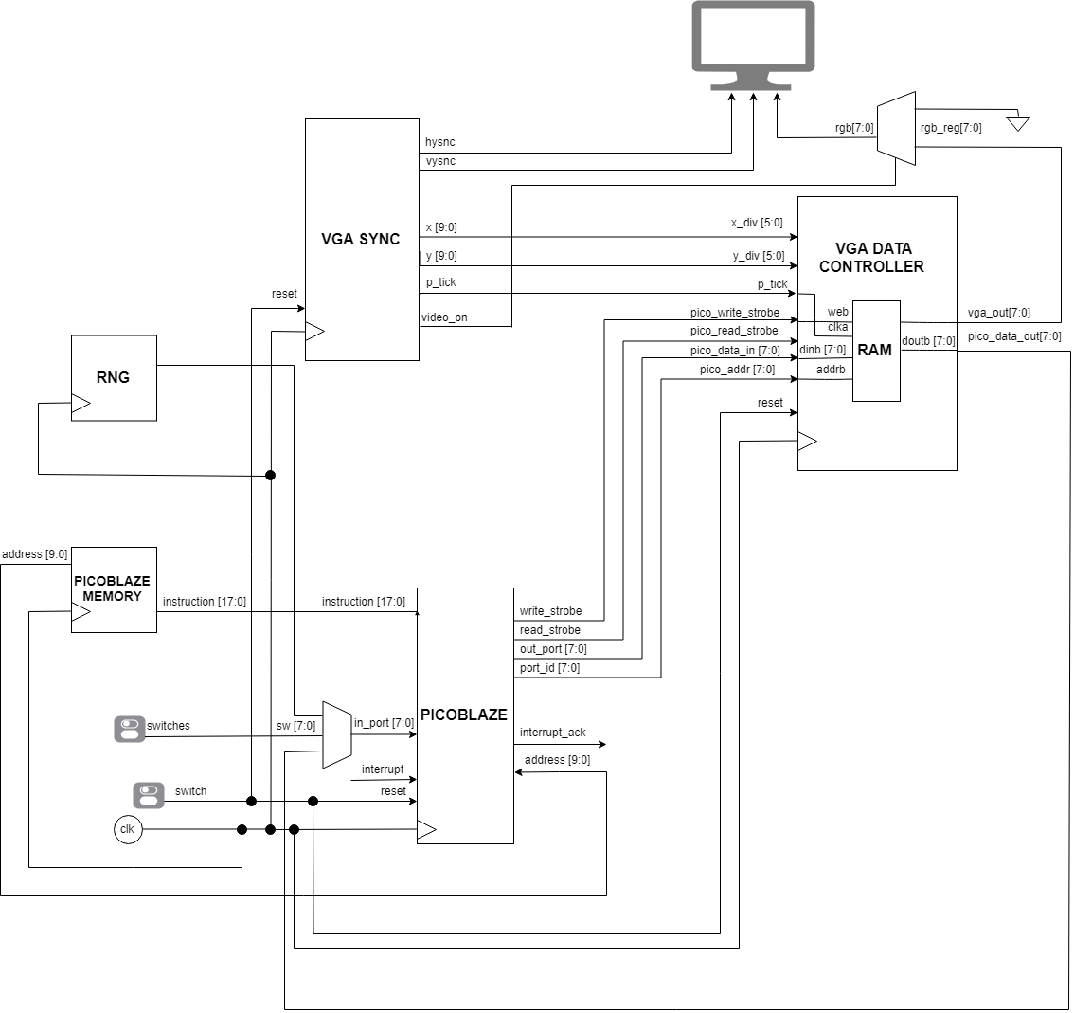
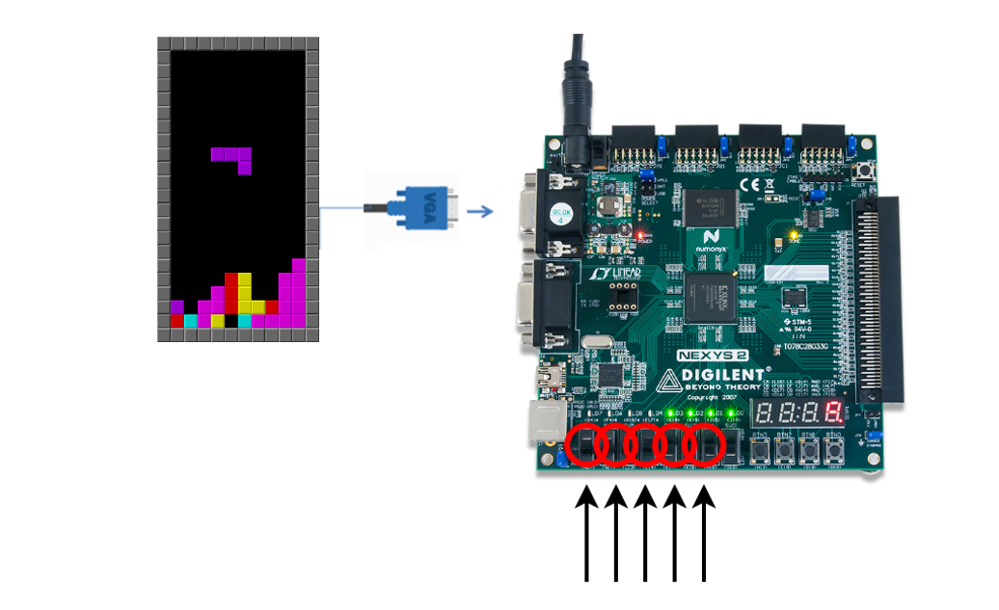
~TALİP Tolga SARI, BURAK Mert GÖnÜltaŞ, İlayda Yaman
EHB432E-Microprocessor System Design Project-2018
TETRIS
GENERAL ARCHITECTURE OF THE SYSTEM
PROJECT OVERVIEW
The purpose of the project is to design and implement a simple platform to play Tetris game on a “Digilent Nexys 2 FPGA” with the help of a soft microprocessor, PicoBlaze, a VGA unit and push buttons which will be used for input types. Except the control of the VGA unit, most of the game rules were controlled by PicoBlaze and push buttons were used for left and right shifts, rotation and speedup.
Implementation of VGA is done to adjust H_synch and V_synch for a static VGA output of a block and a background.
Switch inputs and VGA output modules are combined to deliver a 22x10 block control over a 640x480 resolution monitor.
Blocks are generated with a random generator algorithm.
Game mechanics are added such as game finish, game pause, rotation, collision with right, left and bottom boarders by programming the PicoBlaze.
DATA PATH

