Slide 1
Modeling Homelessness Trends Using Community and Economic Data
Data Science Alliance – Progress Presentation
Gerardo Gonzalez
June 2, 2025

Slide 2
Project Overview
Goal:
Predict homelessness levels and trends using demographic, housing, economic, and climate features at the county level.
Tasks:
Task 1: Exploratory Data Analysis (EDA)
Task 2: Predict annual homelessness rate
Task 3: Predict change in homelessness over time (including binary classification)
The full notebook, all model code, and visualizations are available in the GitHub repo.
Link: https://github.com/gonz-ga-ds/DSA_project.git

Slide 3
Task 1 – Exploratory Data Analysis
Initial EDA (Full Dataset):
Analyzed annual data from 2010–2018 for all CoCs (Continuums of Care)
Focused on understanding distributions, trends, and missing data
1159 entries and 121 predictor variables, 123 unique CoCs, and most frequent CoC is MD-505 (Baltimore, Maryland)
Looked at Correlations and plotted histograms
Filtered EDA (Major City & Largely Urban CoCs):
342 entries, 38 counties, 198 Major City & 144 Urban CoCs
Top CoC by count: AL-501 (Mobile, Alabama)
Missingness patterns examined and visualized
One-hot encoding of CoC category improved sample size

Slide 4
Task 2 – Predicting Homelessness Rate
Target: total_homeless_per_10k
Random split of dataset
Initial Models:
OLS Regression: R² = 0.13, RMSE = 15.6
Random Forest: R² = 0.88, RMSE = 5.9
XGBoost: R² = 0.89, RMSE = 5.6
Takeaway:
Tree-based models outperform linear; all models underpredict high-need counties.

Slide 5
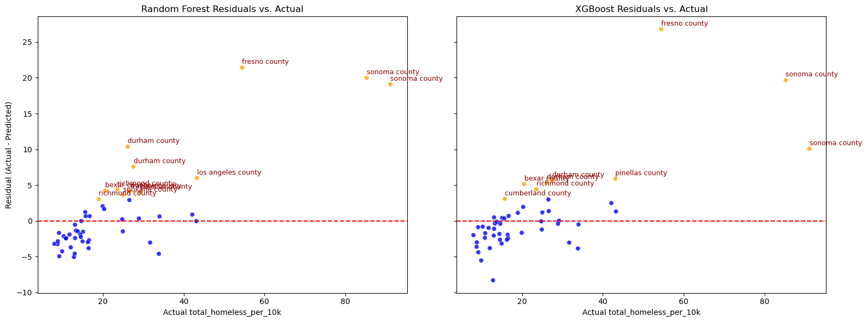
Side by side comparison of Residuals vs. Actuals
Note: Fresno and Sonoma counties are significantly underpredicted

Slide 6
Task 2 – Improving Validation Strategy
Why Update?
Random splits risk overfitting in panel data.
New Approach: Cross-Sectional Temporal Split
Train: 2010–2016, 73 counties
Validate: 2017
Test: 2018: I have not used the test data
Result:
XGBoost (with one-hot CoC): R² = 0.53, RMSE = 6.8
Consistent underprediction in counties like King County

Slide 7
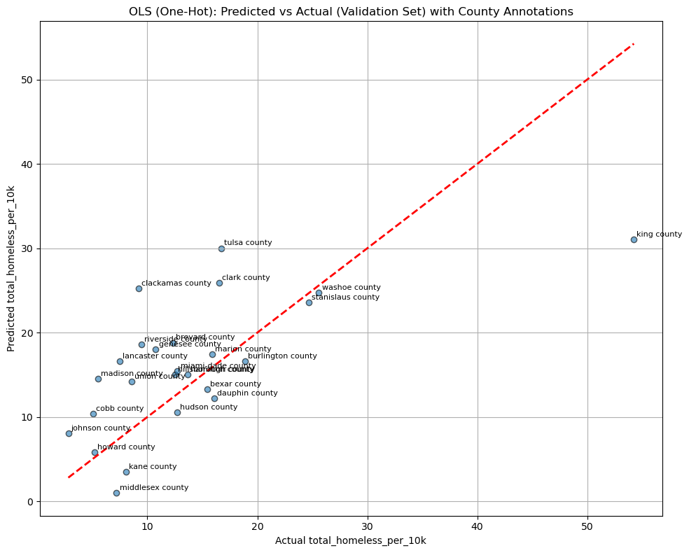
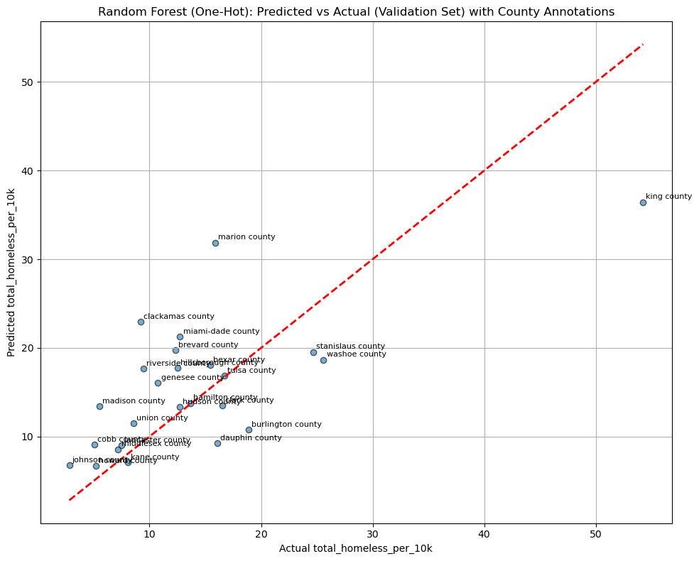
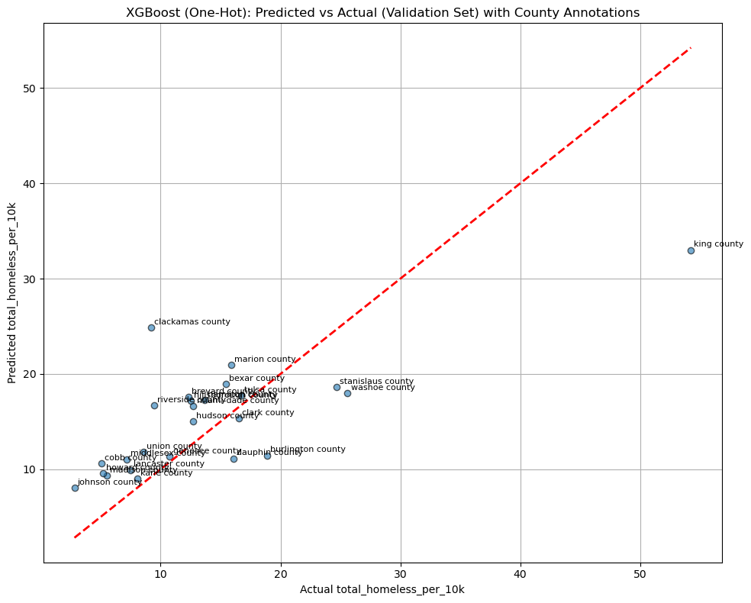
Predicted vs Actual plots With cross-sectional temporal dataset split and one-hot encode CoC category
Note: Counties like King County with extreme homelessness are underpredicted.

Slide 8
Task 3 – Predicting % Change in Homelessness
Target: % change in total_homeless_per_10k
Initial Results (OLS & RF):
R² < 0, RMSE > baseline
Poor generalization
Decided to explore classification instead of regression

Slide 9
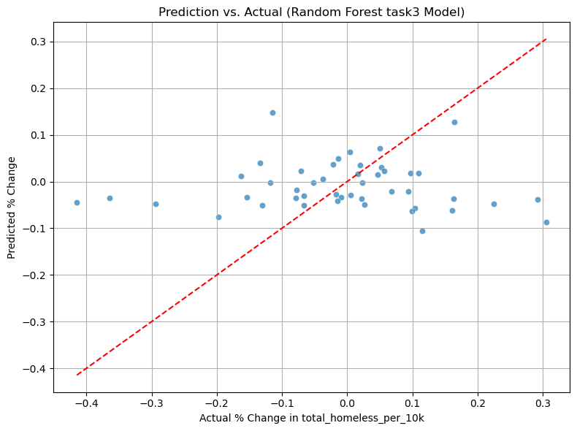
Plot prediction Vs Actual Random forest (regression)
Looks like model is underfitting because most predictions cluster near 0
When actual homelessness increases, the model underestimates how much
There is no strong linear trend between actual and predicted values

Slide 10
Task 3 – Binary Classification Initial attempt
Objective: Classify whether homelessness increased year-over-year
Initial Results:
Accuracy ~ 48–52%
Filtering for Major City and Largely Urban CoCs
Random splitting of the dataset
Class imbalance & small sample size affect performance
All models struggle to capture increases in homelessness

Slide 11
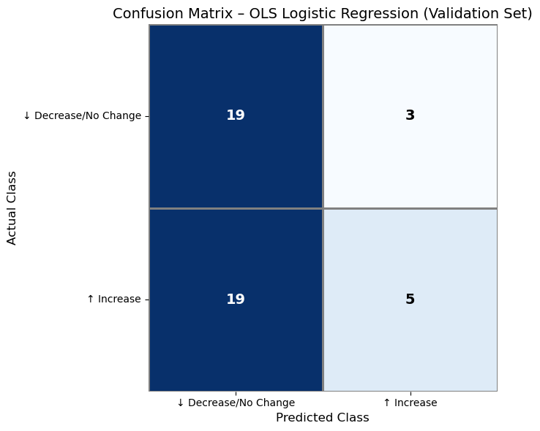
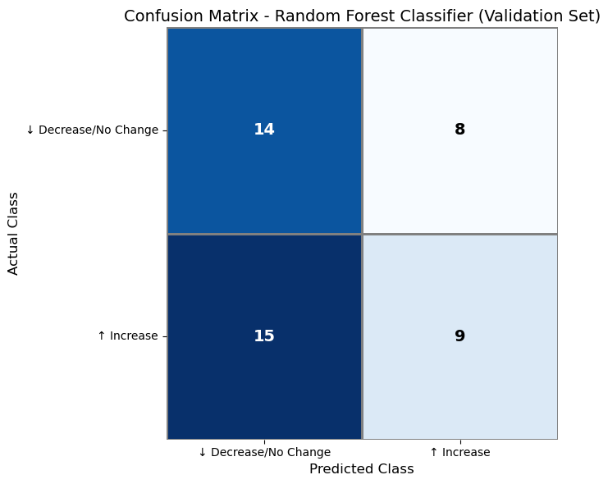
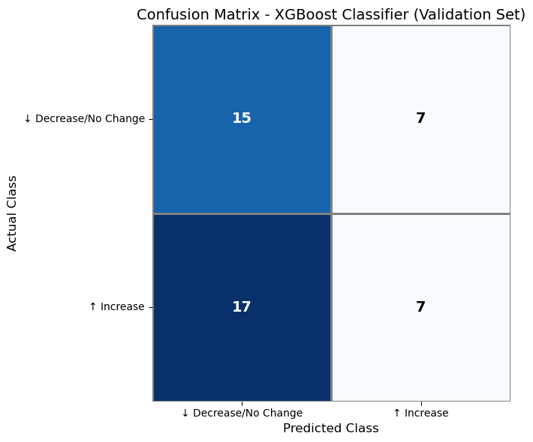
Model confusion matrices
Note: All models struggle to capture increases in homelessness

Slide 12
Task 3 – Lagged Feature Engineering
Why Lag Features?
Homelessness in prior years likely influences current rates.
Features Added:
Prior-year values for homelessness, housing market, economic indicators
Binary Classification
Addressed missingness with custom imputation strategy
Columns with ≤ 20% missingness are median-imputed directly
Columns with > 50% missingness are median-imputed with an additional _missing binary indicator
Columns with 20–50% missingness are left unchanged

Slide 13
Task 3 – Model Evaluation (Lagged + One-Hot + Imputed)
Setup:
Train: 303 rows, 73 counties (2012–2016) | Val: 25 rows, 25 counties (2017) | Test: 26 rows, 25 counties (2018)
CoC one-hot encoded
Results (Top 5 Features):
Logistic Regression: Accuracy = 40%, AUC = 0.44
Random Forest: Accuracy = 40%, AUC = 0.42
XGBoost: Accuracy = 44%, AUC = 0.46

Slide 14
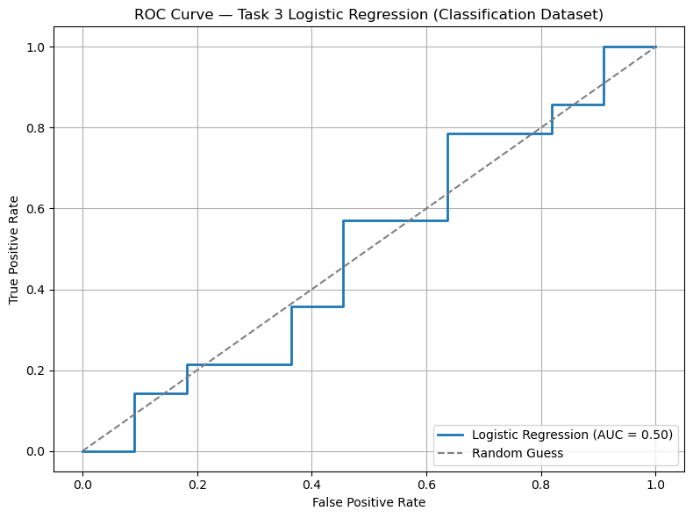
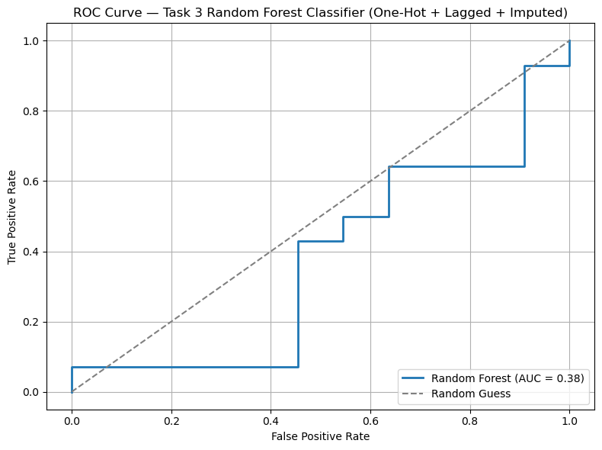
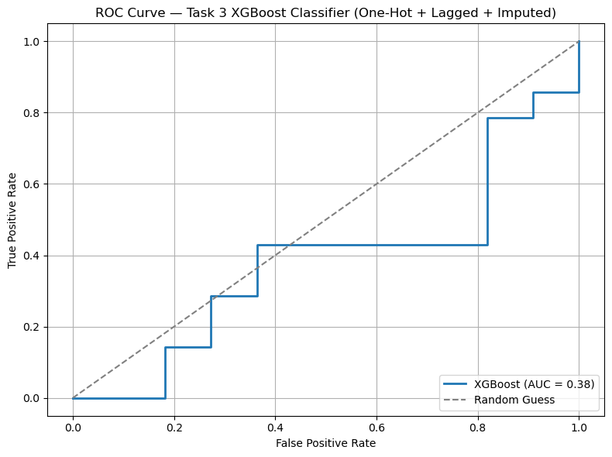
ROC curves: Full dataset
Logistic Regression: The model fails to generalize and performs no better than random guessing.
Random Forest: Performs worse than logistic regression, particularly in identifying increases (recall: .07).
XGBoost: Had best precision (0.50), but recall (0.21) remains low and model struggles with discrimination

Slide 15
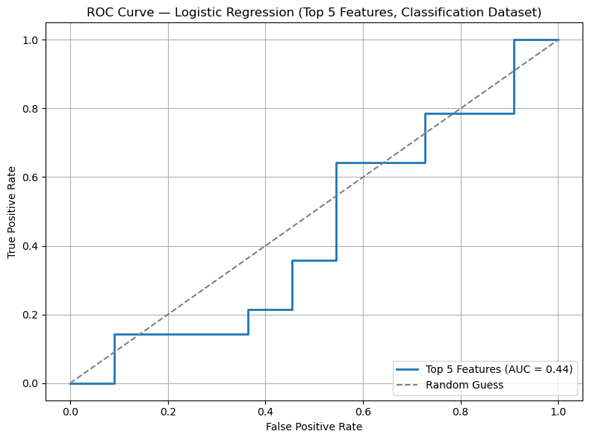
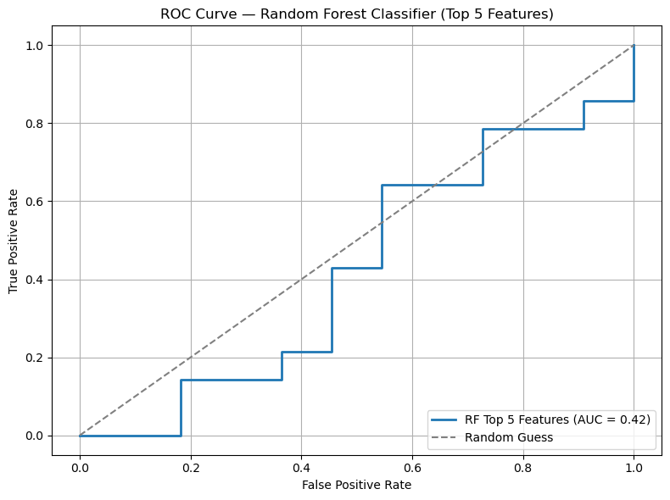
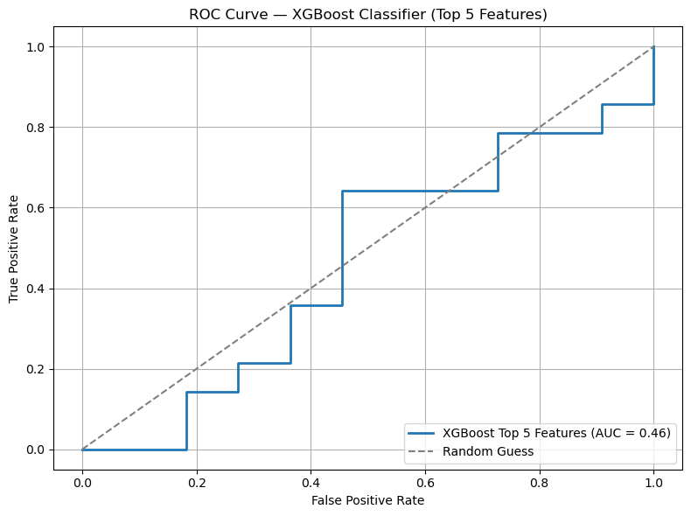
ROC Curves: top 5 features
Logistic Regression: Simpler model performs similarly; top 5 features did not improve generalization.
Random Forest: Substantially more stable than the full model, but still underperforms.
XGBoost: Best balance of performance among all models. Precision (0.50) and F1 (0.42) are highest for the increase class, though AUC remains under 0.50.

Slide 16
Summary of Findings
XGBoost consistently outperforms other models
Underprediction in high-rate counties remains a challenge
Cross-sectional temporal split gives more realistic estimates
Lagged features show some promise, need further refinement

Slide 17
Next Steps
Explore feature selection and model calibration
Look further into the class imbalance in classification
Investigate structural or policy-level features
Refine lagged feature modeling for Task 3

Slide 18
Thank You
Questions or suggestions welcome!
Ready to incorporate feedback and discuss next directions.

