Slide 1
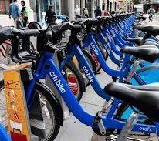
Citybike
By
Alexander Gonzalez
Ahmed mohamed
Abhusan karki

Slide 2
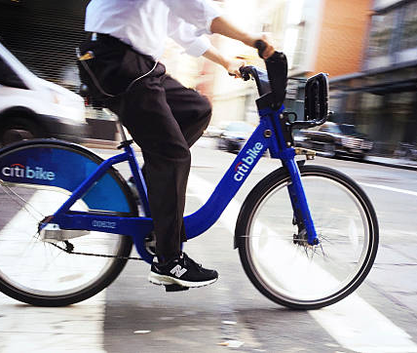
What is citybike
Citi Bike is a privately owned public bicycle sharing system serving the New York City boroughs of the Bronx, Brooklyn, Manhattan, and Queens, as well as Jersey City, New Jersey

Slide 3





How we get our data

Slide 4
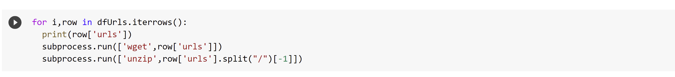
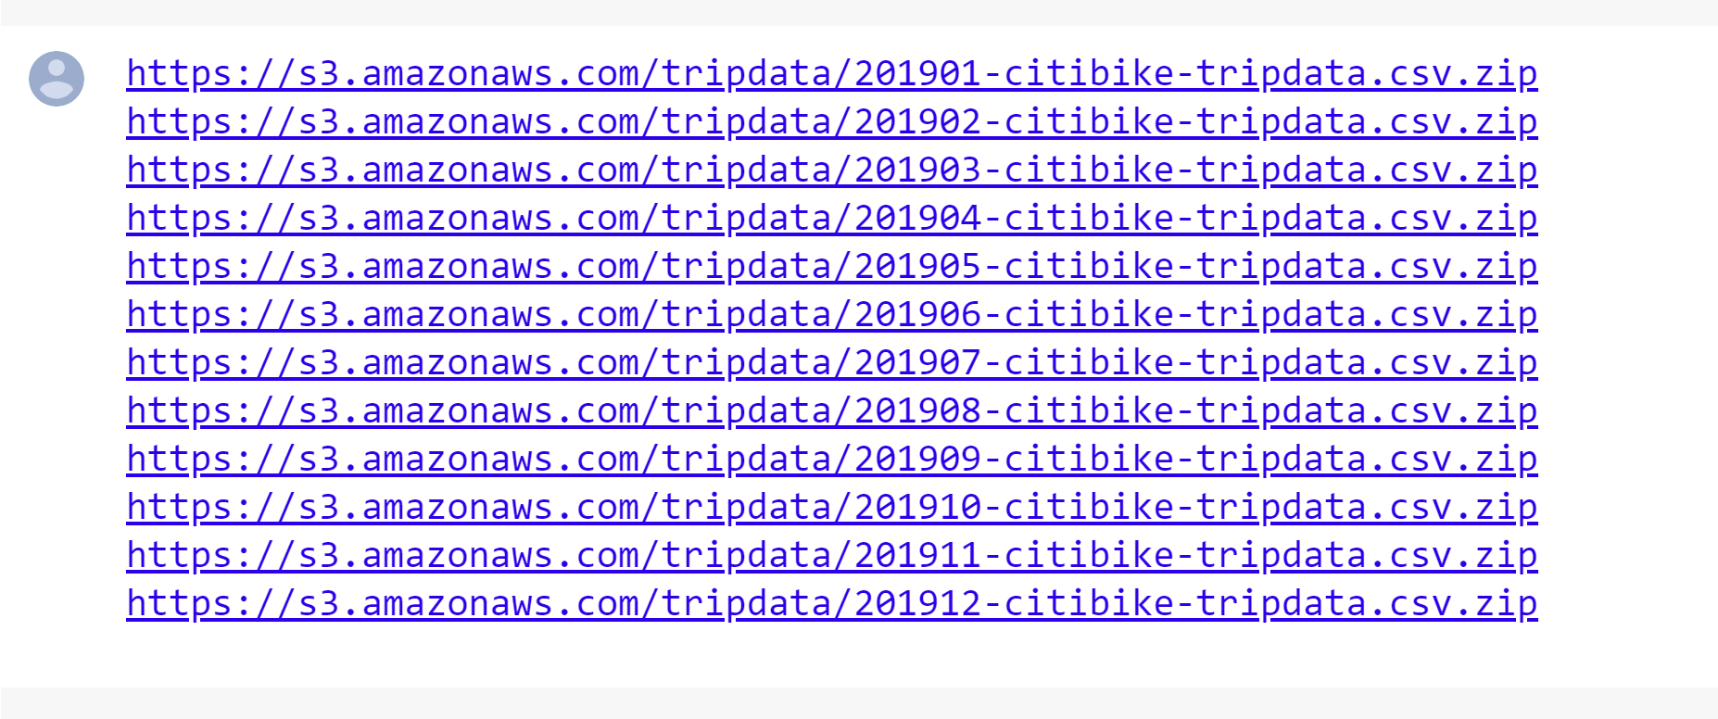
Code

Slide 5
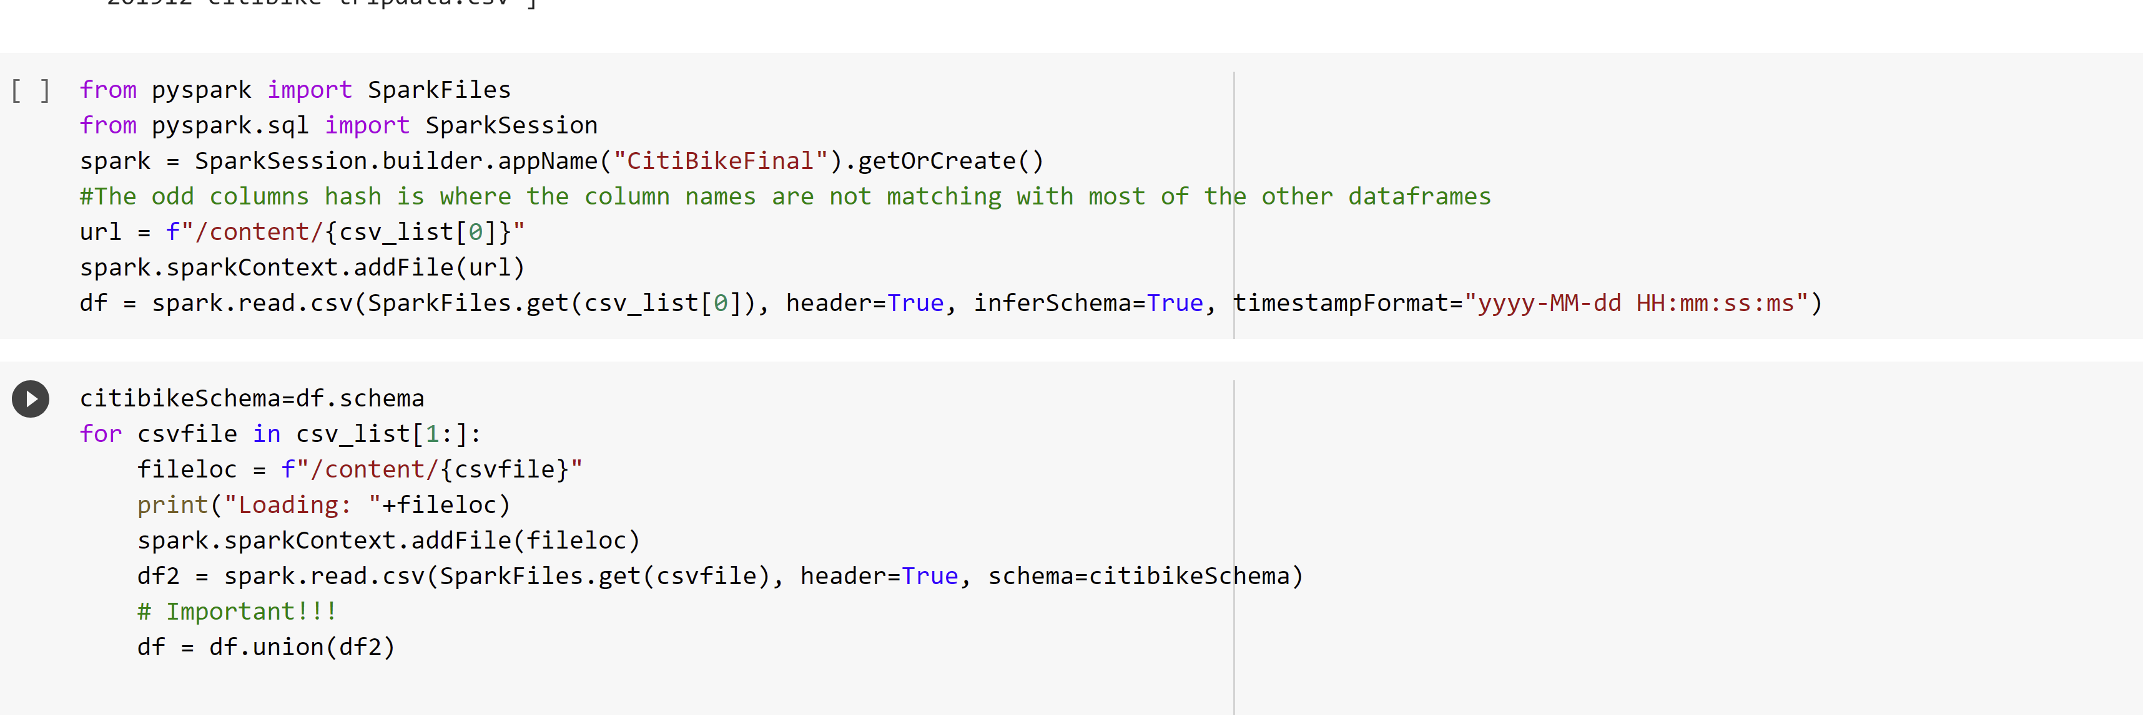
Union of all a data

Slide 6
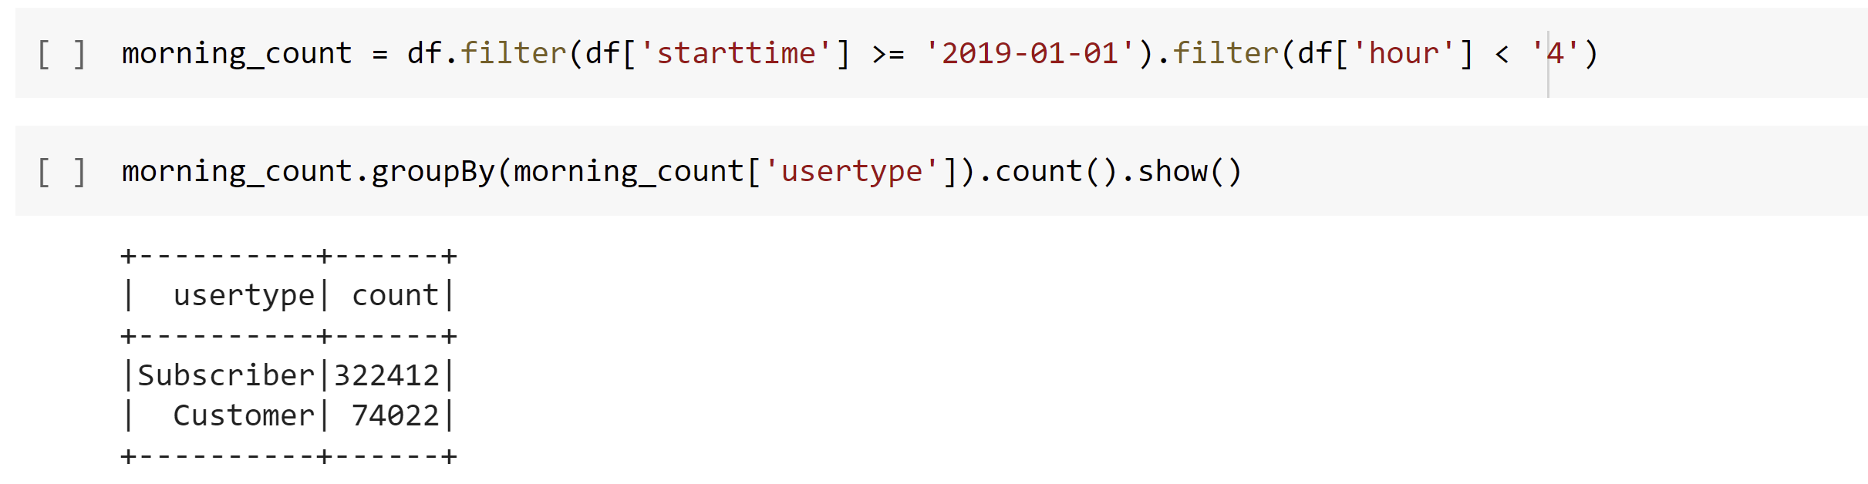
Relation between customer and subs

Slide 7
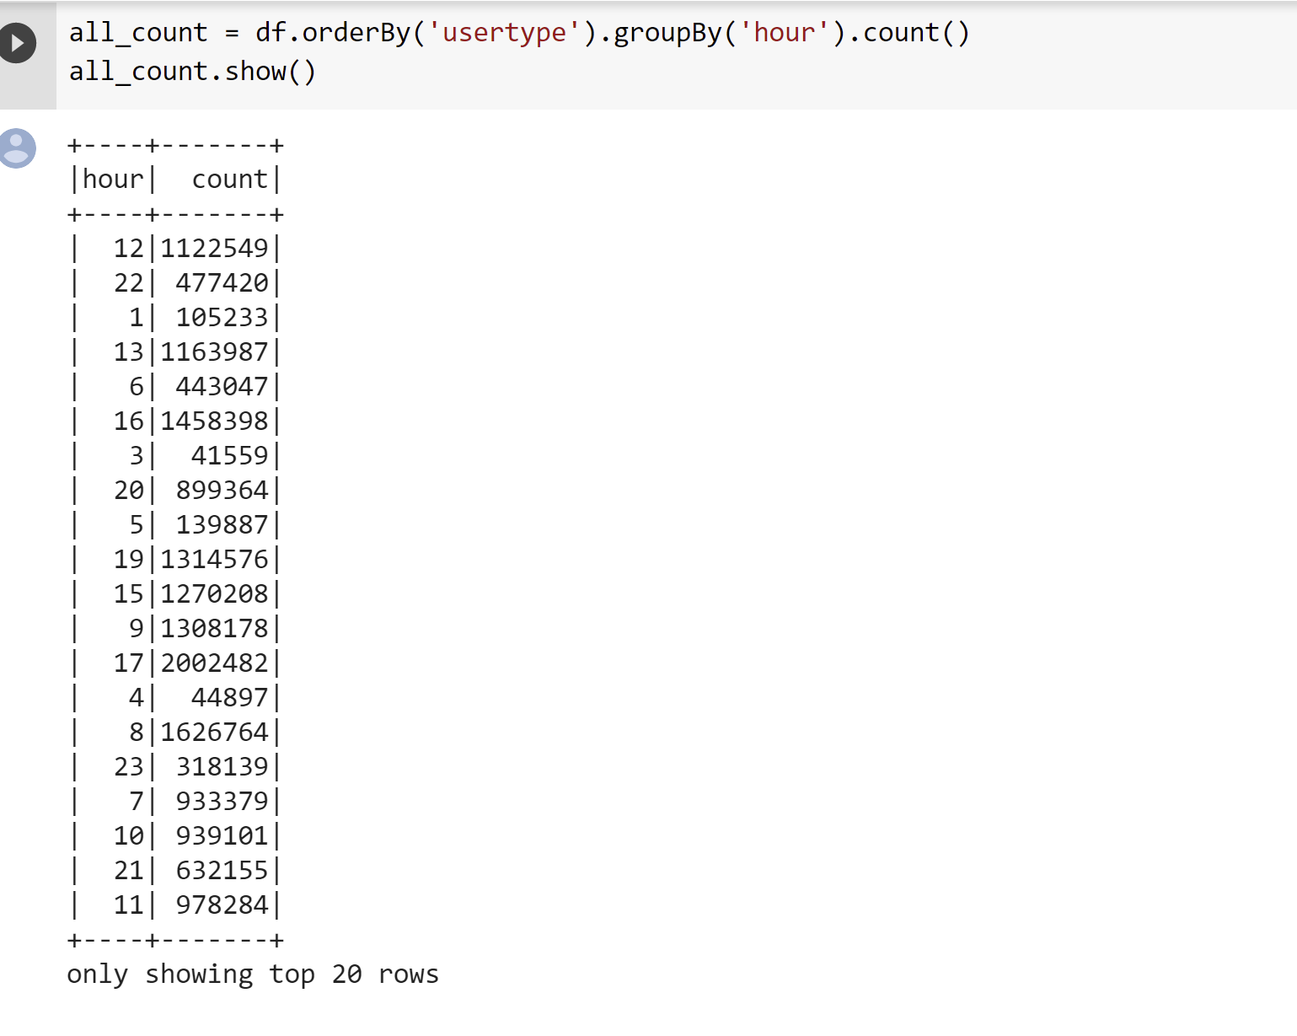
Customer use citybike by hours

Slide 8

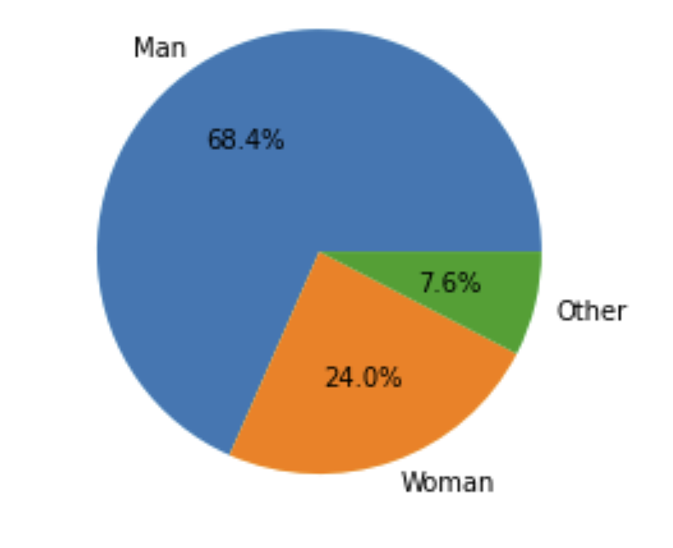
User by gender

Slide 9
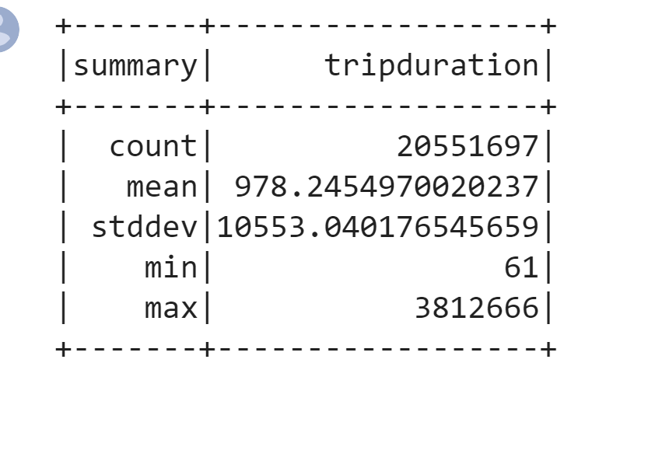
Summary
df.select("tripduration").describe().show()

