Slide 1
Assignment 3 (NLP) Writeup DO NOT TAG
Name: Nicolas Gonzalez
GT Email: ngonzalez62@gatech.edu

Slide 2
Seq2Seq Results – Default configuration Values are for last epoch
RNN
Training Loss: ?
Training Perplexity: ?
Validation Loss: ?
Validation Perplexity: ?
LSTM
Training Loss: ?
Training Perplexity: ?
Validation Loss: ?
Validation Perplexity: ?
RNN-with-Attention
Training Loss: ?
Training Perplexity: ?
Validation Loss: ?
Validation Perplexity: ?
LSTM-with-Attention
Training Loss: ?
Training Perplexity: ?
Validation Loss: ?
Validation Perplexity: ?

Slide 3
Seq2Seq Explanation (RNN vs LSTM)
Compare your RNN result to your LSTM result and explain why they differ.

Slide 4
Seq2Seq Explanation (RNN vs RNN-with-Attention)
Compare your RNN result to your RNN-with-Attention result and explain why they differ.

Slide 5
Seq2Seq Results – Best model Values are for last epoch
Your best model after hyper-parameter tuning
Best model
Training Loss: ?
Training Perplexity: ?
Validation Loss: ?
Validation Perplexity: ?
List your best model hyper-parameter values including model type: ?

Slide 6
Seq2Seq Best model Learning Curves (Perplexity)

Slide 7
Seq2Seq Explanation – Best model
Explain the details of your best model. Explain what you did to improve your model’s performance and why

Slide 8
Transformer Results Values are for last epoch
Default configuration (Encoder Only)
Training Loss: ?
Training Perplexity: ?
Validation Loss: ?
Validation Perplexity: ?
Default configuration (full transformer)
Training Loss: ?
Training Perplexity: ?
Validation Loss: ?
Validation Perplexity: ?
Best model (full transformer)
Training Loss: ?
Training Perplexity: ?
Validation Loss: ?
Validation Perplexity: ?
List your best model hyper-parameter values (full transformer): ?

Slide 9
Full Transformer Best model Learning Curves (Perplexity)

Slide 10
Full Transformer Explanation – Best model
Explain what you did here and why you did it to improve your model performance.

Slide 11
Transformer (Encoder Only) Translation Results (default settings)
Put translation results for your model (1st 9 sentences) here. You may remove duplicate <pad> and <eos> tokens for each sentence.
True Translation | Predicted Translation
‘<sos>'word_1’,’word_2’,….., '<eos>' | ‘<sos>'word_1’,’word_2’,….., '<eos>'
Table 1

Slide 12
Full Transformer Translation Results (best model)
Put translation results for your best model (1st 9 sentences) here. You may remove duplicate <pad> and <eos> tokens for each sentence.
True Translation | Predicted Translation
‘<sos>'word_1’,’word_2’,….., '<eos>' | ‘<sos>'word_1’,’word_2’,….., '<eos>'
Table 2

Slide 13
Seq2Seq (Best model) Translation Results
Put translation results for your best model (1st 9 sentences) here. You may remove duplicate <pad> and <eos> tokens for each sentence.
True Translation | Predicted Translation
‘<sos>'word_1’,’word_2’,….., '<eos>' | ‘<sos>'word_1’,’word_2’,….., '<eos>'
Table 3

Slide 14
Compare Transformer (Encoder Only) to Transformer (Full transformer)
Compare your results for default settings for Encoder Only Transformer vs best model for Full transformer both quantitatively and qualitatively. Explain why you see differences.

Slide 15
Compare Seq2Seq to Transformer (Best models)
Compare your Seq2Seq best model results to your Transformer best model results both quantitatively and qualitatively and explain the differences.

Slide 16
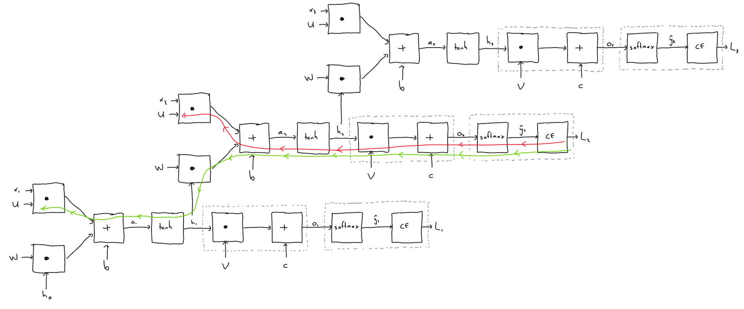
Theory question

Slide 17
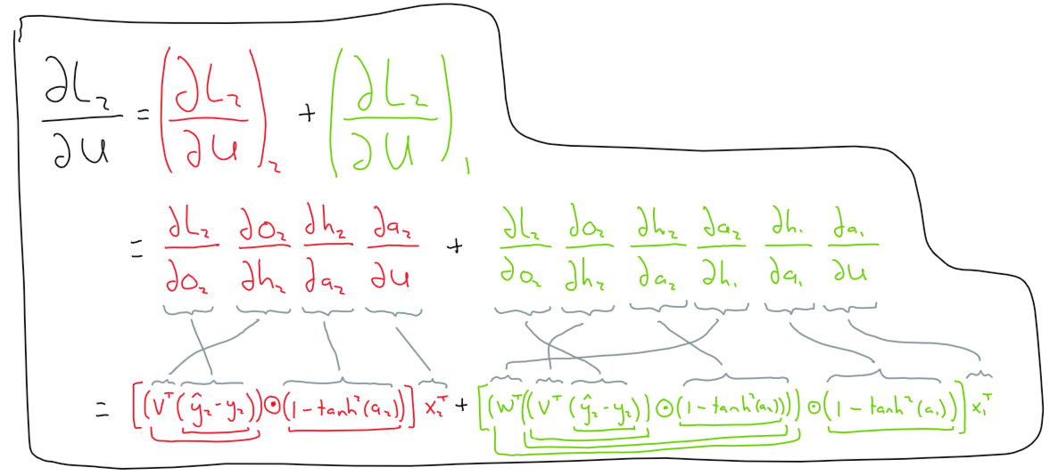

Slide 18
Paper discussion
Name the paper you chose and answer the questions related to it. Add additional slides as necessary

