Slide 1
Chapter 4: Threads

Slide 2
Chapter 4: Threads
Overview
Multicore Programming
Multithreading Models
Thread Libraries
Implicit Threading
Threading Issues
Operating System Examples

Slide 3
Objectives
Introduce notion of thread
  Fundamental unit of CPU utilization
  Forms basis of multithreaded computer systems
Discuss APIs for Pthreads library
Explore several strategies for implicit threading
Examine issues related to multithreading
Cover OS support for threads in Linux

Slide 4
Motivation
Most modern applications are multithreaded
Threads run within single application
Multiple tasks implemented by separate threads
  Update display
  Fetch data
  Spell checking
  Answer network request

Slide 5
Motivation
Process creation is heavy-weight
Thread creation is light-weight
Can simplify code, increase efficiency
Kernels generally multithreaded

Slide 6

Multithreaded Server Architecture

Slide 7
Benefits
Responsiveness - allows continued execution if part of process is blocked
  Especially important for user interfaces
Resource Sharing - threads share process resources
  Easier than shared memory or message passing

Slide 8
Benefits
Economy - cheaper than process creation
  Thread switching has lower overhead than context switching
Scalability – process can take advantage of multiprocessor architectures

Slide 9
Multicore Programming
Multicore or multiprocessor systems put pressure on programmers, challenges include:
  Dividing activities
  Balance
  Data splitting
  Data dependency
  Testing and debugging

Slide 10
Multicore Programming
Parallelism: system can perform more than one task simultaneously
Concurrency: more than one task makes progress
  Single core, scheduler provides concurrency

Slide 11
Multicore Programming (Cont.)
Types of parallelism
  Data parallelism: distributes subsets the same data across multiple cores
    Same operations on each subset
  Task parallelism: distributes threads across cores
    Each thread performs unique operation

Slide 12
Multicore Programming (Cont.)
Architectural support for threads growing
  CPUs have cores as well as hardware threads
  E.g., Oracle SPARC T4
    8 cores
    8 hardware threads per core

Slide 13


Concurrency vs. Parallelism
Concurrent execution on single-core system:
Parallelism on multi-core system:

Slide 14

Single and Multithreaded Processes

Slide 15
User Threads and Kernel Threads
User threads: managed by user-level threads library
Three primary thread libraries:
  POSIX Pthreads
  Windows threads
  Java threads

Slide 16
User Threads and Kernel Threads
Kernel threads: supported by Kernel
E.g., virtually all general purpose OSs, including:
  Windows
  Solaris
  Linux
  Tru64 UNIX
  Mac OS X

Slide 17
Multithreading Models
Many-to-One
One-to-One
Many-to-Many

Slide 18

Many-to-One
Many user-level threads mapped to single kernel thread
One blocking thread causes all to block
Multiple threads may not run in parallel on multicore system
  => only one thread in kernel at a time
Few systems currently use this model

Slide 19
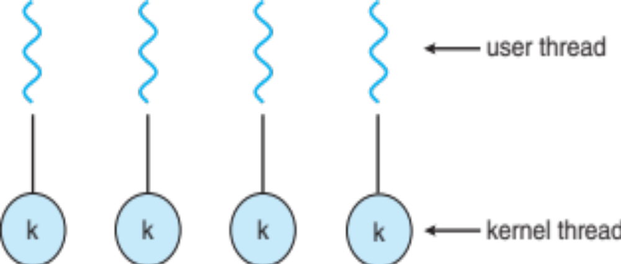
One-to-One
Each user-level thread maps to a kernel thread
Creating user-level thread creates kernel thread
More concurrency than many-to-one
Number of threads per process sometimes restricted
Examples
  Windows
  Linux

Slide 20

Many-to-Many Model
Many user-level threads mapped to many kernel threads
Allows OS to create sufficient number of kernel threads
Solaris prior to version 9

Slide 21

Two-level Model
Similar to many-to-many except allows user thread to be bound to kernel thread
Examples
  IRIX
  HP-UX
  Tru64 UNIX
  Solaris 8 and earlier

Slide 22
Thread Libraries
Thread library provides programmer with API for creating and managing threads
Two primary implementations
  Library entirely in user space
  Kernel-level library supported by OS

Slide 23
Pthreads
Provided either as user-level or kernel-level
POSIX standard (IEEE 1003.1c) API for thread creation and synchronization
Specification, not implementation
API specifies behavior of thread library, implementation up to development of library
Common in UNIX operating systems
  e.g., Solaris, Linux, Mac OS X

Slide 24

Pthreads Example

Slide 25
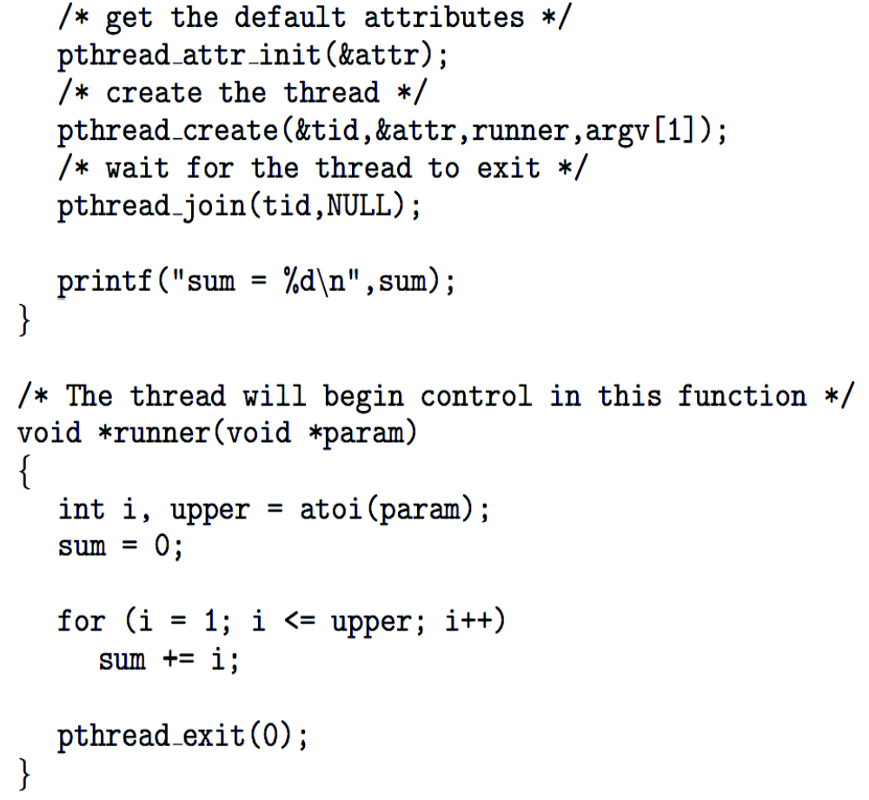
Pthreads Example (Cont.)

Slide 26
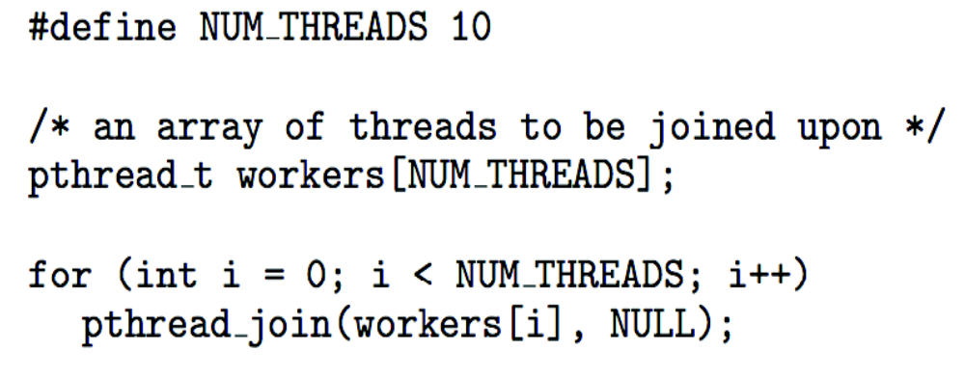
Pthreads Code for Joining 10 Threads

Slide 27
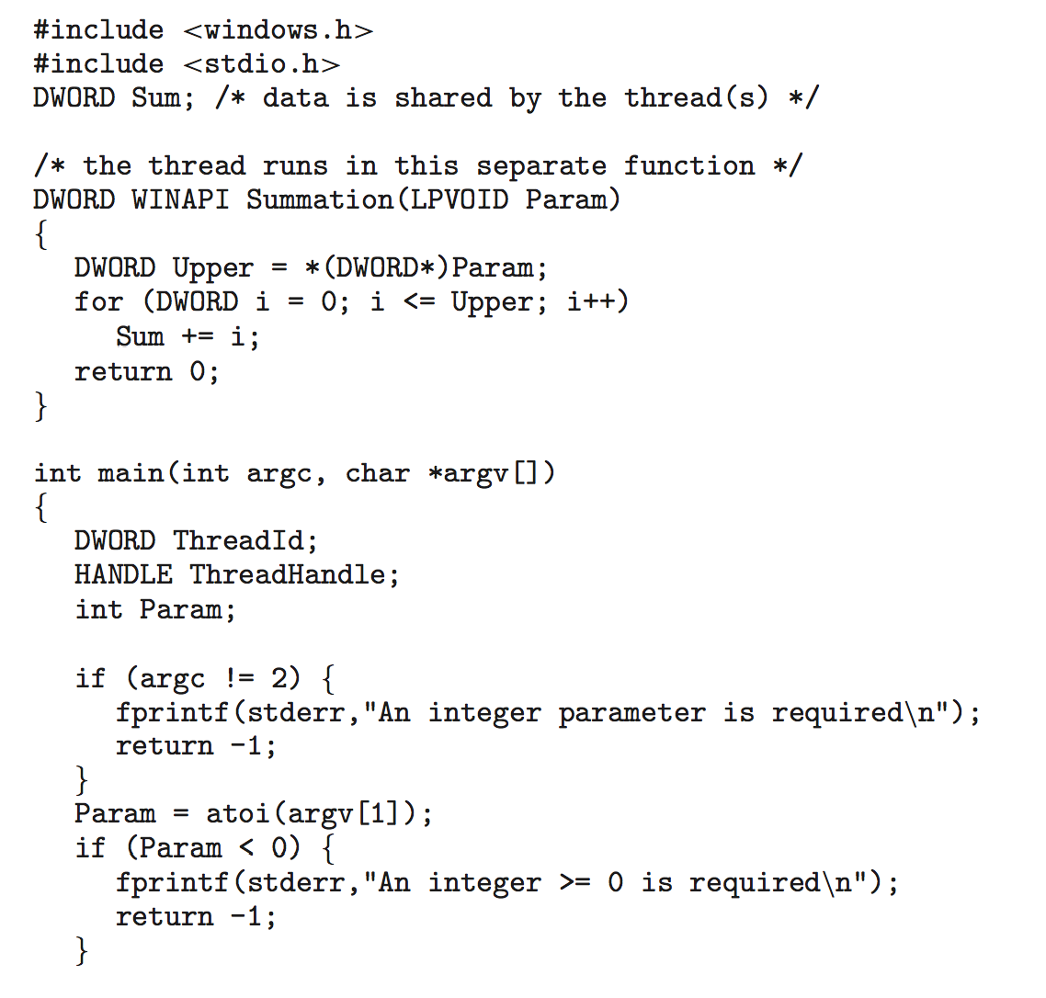
Windows Multithreaded C Program
continued on next slide...

Slide 28
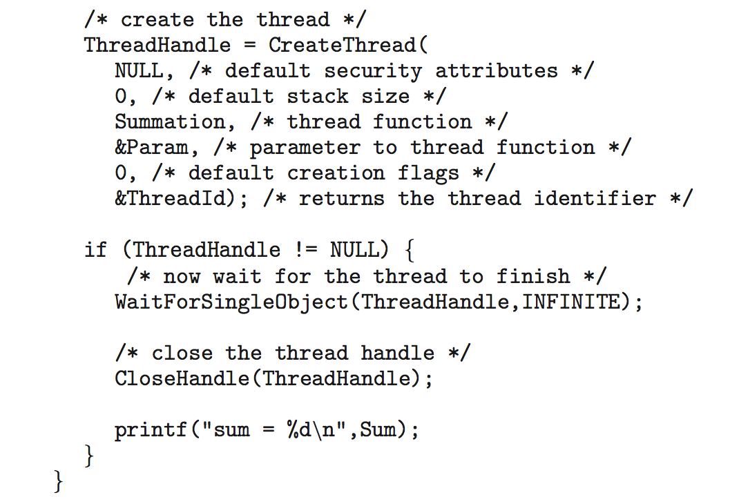
Windows Multithreaded C Program (Cont.)
gross!!!

Slide 29

Java Threads
Java threads managed by JVM
Typically implemented using thread model provided by underlying OS
Java threads created by:
  Extending Thread class
  Implementing Runnable interface

Slide 30

Java Multithreaded Program

Slide 31

Java Multithreaded Program (Cont.)

Slide 32
Implicit Threading
Growing in popularity...
  As numbers of threads increase, program correctness more difficult with explicit threads
Creation and management of threads done by compilers and run-time libraries
  Rather than programmers

Slide 33
Implicit Threading
Three methods explored
  Thread Pools
  OpenMP
  Grand Central Dispatch
Other methods include Microsoft Threading Building Blocks (TBB), java.util.concurrent package

Slide 34
Thread Pools
Create number of threads, put in pool where they await work
Advantages:
  Usually slightly faster to service a request
  Allows bound number of threads in application
  Separates tasks from mechanics of creating task
  Allows different strategies for running task
Windows API supports thread pools...

Slide 35
OpenMP
Set of compiler directives and API for C/C++, and FORTRAN
Provides support for parallel programming in shared-memory environments
Identifies parallel regions: blocks of code that can run in parallel

Slide 36

OpenMP
#pragma omp parallel
Create as many threads as cores
#pragma omp parallel for for(i=0;i<N;i++) {
c[i] = a[i] + b[i];
}
Run for loop in parallel

Slide 37
Grand Central Dispatch
Apple technology for Mac OS X and iOS
Extensions for C, C++ languages
API and run-time library
Allows identification of parallel section

Slide 38
Grand Central Dispatch
Manages most threading details
Parallel block in “^{ }” e.g.,
  ˆ{ printf("I am a block"); }
Blocks placed in dispatch queue
  Assigned to available thread in thread pool

Slide 39
Threading Issues
Semantics of fork() and exec() system calls
Signal handling
  Synchronous and asynchronous
Thread cancellation of target thread
  Asynchronous or deferred
Thread-local storage
Scheduler Activations

Slide 40
Semantics of fork() and exec()
Does fork()duplicate only calling thread or all threads?
  Some UNIXes have two versions of fork
exec()- replaces running process including all threads

Slide 41
Signal Handling
Signals used in UNIX systems to notify a process
Signal handler used to process signals
  Signal generated by particular event
  Signal delivered to process
  Signal handled by one of two signal handlers:
    default
    user-defined

Slide 42
Signal Handling
Every signal has default handler
  User-defined signal handler can override default
  For single-threaded, signal delivered to process

Slide 43
Signal Handling (Cont.)
In multithreaded program, where should signal be delivered?
  Deliver signal to thread to which signal applies
  Deliver signal to every thread in process
  Deliver signal to certain threads in process
  Assign specific thread to receive all signals

Slide 44
Thread Cancellation
Terminating thread before it finishes
Thread to be canceled: target thread
Two general approaches:
  Asynchronous: terminate target thread immediately
  Deferred: allow target thread to periodically check

Slide 45

Thread Cancellation
Pthread code to create and cancel a thread:

Slide 46

Thread Cancellation (Cont.)
Actual cancellation depends on thread state
If thread has cancellation disabled, cancellation remains pending until thread enables it

Slide 47
Thread Cancellation (Cont.)
Default type is deferred
  Cancellation occurs when thread reaches cancellation point
    I.e. pthread_testcancel()
    Then cleanup handler is invoked
In Linux, thread cancellation handled through signals

Slide 48

Scheduler Activations
Many-to-many and two-level models require communication to maintain appropriate number of allocated kernel threads
Use intermediate data structure between user and kernel threads – lightweight process (LWP)
  Appears as virtual processor on which process can schedule user thread to run
  Each LWP attached to kernel thread
  How many LWPs to create?

Slide 49
Scheduler Activations
Scheduler activations provide upcalls
  A communication mechanism from kernel to upcall handler in thread library
This allows application to maintain correct number kernel threads

