Slide 1
Chapter 1: Introduction

Slide 2
Chapter 1: Introduction
What Operating Systems Do
Computer-System Organization
Operating-System Structure
Process, Memory, Storage Management
Protection and Security
Computing Environments

Slide 3
Objectives
Describe basic organization of computer systems
Provide grand tour of major OS components
Give overview of types of computing environments
Explore several open-source operating systems

Slide 4
What is an Operating System?
Intermediary between user and hardware
Operating system goals:
  Execute user programs
  Make solving user problems easier
  Make computer system convenient to use
  Use computer hardware in efficient manner

Slide 5
Computer System Structure
Hardware – provides basic computing resources
Operating system - coordinates use of hardware among various applications and users
Application programs – define how system resources used to solve computing problems
Users - People, machines, other computers

Slide 6

Four Components of a Computer System

Slide 7
What Operating Systems Do
Users want convenience, ease of use and good performance
  Don’t care about resource utilization
Shared computers (e.g., mainframe) must keep all users happy
Users of workstations frequently use shared resources from servers

Slide 8
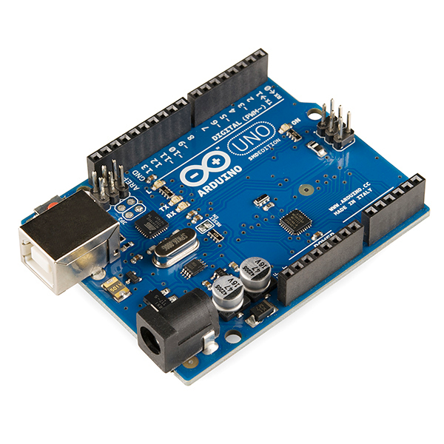
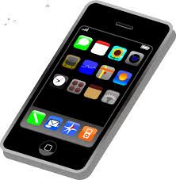
What Operating Systems Do
Handheld computers are resource poor
  Optimized for usability and battery life
Some computers have little or no user interface
  E.g., embedded devices

Slide 9
Operating System Definition
OS is resource allocator
  Manages all resources
  Decides between conflicting requests
  Ensures efficient and fair resource use
OS is control program
  Controls execution of programs
  Prevent errors and improper use

Slide 10
Operating System Definition (Cont.)
No universally accepted definition
“Everything a vendor ships when you order an operating system” is good approximation
  Varies wildly

Slide 11
Operating System Definition (Cont.)
No universally accepted definition
“The one program running at all times on the computer” is the kernel.
Everything else is either
  system program (ships with operating system)
  application program

Slide 12
Computer Startup
Bootstrap program is loaded at power-up or reboot
  Typically stored in ROM or EPROM
    Generally known as firmware
  Initializes all aspects of system
  Loads operating system kernel
  Starts kernel execution

Slide 13

Computer System Organization
CPUs and device controllers connected through common bus (w/ access to shared memory)
Concurrent execution of CPUs and devices compete for memory cycles

Slide 14
Computer-System Operation
I/O devices and CPU execute concurrently
Each device controller in charge of particular device
Each device controller has local buffer
CPU moves data from/to main memory to/from local buffers
I/O from device to local buffer of controller
Device controller informs CPU via interrupt

Slide 15
Common Functions of Interrupts
Interrupt transfers control to interrupt service routine
  Generally, through interrupt vector
    Contains addresses of all service routines
Must save address of interrupted instruction
A trap or exception is software-generated interrupt
  Caused by error or user request

Slide 16
Interrupt Handling
OS preserves state of CPU by storing registers and program counter
Operating system is interrupt driven

Slide 17

Interrupt Timeline

Slide 18
I/O Structure
After I/O starts, control returns to user program only upon I/O completion
  Wait instruction idles CPU until next interrupt
  Wait loop (contention for memory access)
  At most one I/O request at a time
    No simultaneous I/O processing

Slide 19
I/O Structure
After I/O starts, control returns to user program without waiting for I/O completion
  System call – request to OS to allow user to wait for I/O completion
  Device-status table contains entry for each I/O device indicating its type, address, and state
  OS indexes into I/O device table to determine device status and modify table entry to include interrupt

Slide 20
Storage Structure
Main memory – only storage media that CPU can access directly
  Random access
  Typically volatile
Secondary storage – extension of main memory
  Provides large nonvolatile storage

Slide 21
Storage Structure
Hard disks – rigid metal or glass platters covered with magnetic recording material
  Disk surface logically divided into tracks
  Tracks subdivided into sectors
  Disk controller determines logical interaction between device and computer
Solid-state disks – faster than hard disks, nonvolatile
  Various technologies
  Becoming more popular

Slide 22
Storage Hierarchy
Storage systems organized in hierarchy
  Speed
  Cost
  Volatility
Caching – copy information into faster storage
  Main memory = cache for secondary storage
Device Driver for each device manages I/O
  Provides uniform interface to kernel

Slide 23

Storage-Device Hierarchy

Slide 24
Caching
Performed at many levels in computer
  Hardware, operating system, software
Information copied from slower to faster storage
  Temporary

Slide 25
Caching
Faster storage (cache) checked first
  If there, information used directly (fast)
  If not, data copied to cache and then used
Cache often smaller than storage being cached
  Cache management important design problem
  Cache size and replacement policy (e.g., Paging...)

Slide 26
Direct Memory Access Structure
Used for high-speed I/O devices
  Transmit information close to memory speeds
Device controller transfers blocks of data from buffer storage directly to main memory
  No CPU intervention!
Only one interrupt generated per block, rather than one interrupt per byte

Slide 27

How a Modern Computer Works
A von Neumann architecture

Slide 28
Computer-System Architecture
Most systems use single general-purpose processor
  Most systems have special-purpose processors as well
Multiprocessors systems increasingly popular
  Also known as parallel systems
  Advantages:
    Increased throughput
    Economy of scale
    Increased reliability – fault tolerance

Slide 29
Computer-System Architecture
Two types of multiprocessing:
  Asymmetric – each processor assigned specific task
  Symmetric – each processor performs all tasks

Slide 30

Symmetric Multiprocessing Architecture

Slide 31

A Dual-Core Design
Multi-chip and multicore
Systems containing all chips
  Chassis containing multiple separate systems

Slide 32
Clustered Systems
Like multiprocessor systems, but multiple systems working together
  Usually shares storage via storage-area network (SAN)
  Provides high-availability service which survives failures
  Some clusters used for high-performance computing
    Applications must be written to use parallelization

Slide 33
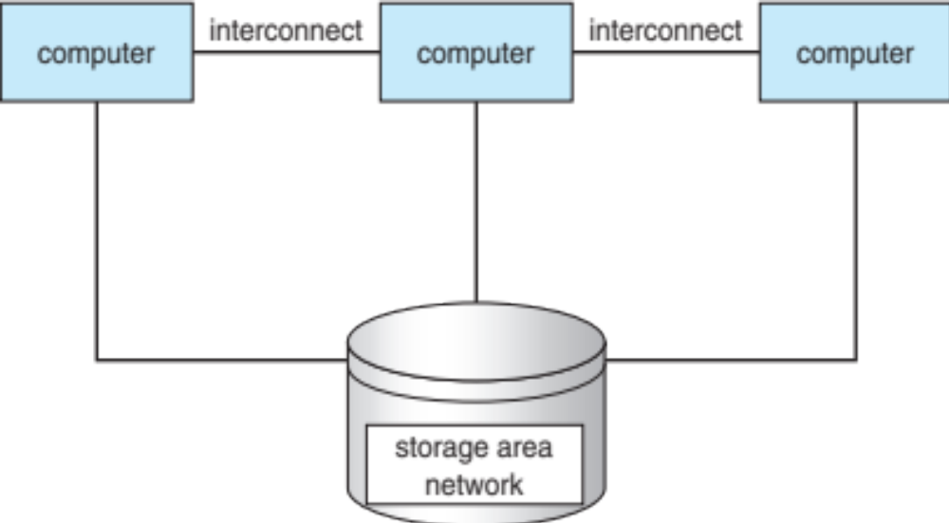
Clustered Systems

Slide 34
Operating System Structure
Multiprogramming
  User cannot keep CPU and devices busy at all times
  Multiprogramming organizes jobs so CPU always busy
  A subset of jobs is kept in memory
  One job selected and run via scheduling
  When job has to wait, OS switches to another job

Slide 35
Operating System Structure
Timesharing (multitasking)
  CPU switches jobs so frequently that users can interact with each job while it is running
  If several jobs ready to run  scheduling
  If processes don’t fit in memory, swapping moves them
  Virtual memory allows execution of processes not completely in memory

Slide 36

Memory Layout for Multiprogrammed System

Slide 37
Operating-System Operations
Interrupt driven (hardware and software)
  Hardware interrupt caused by devices
  Software interrupt (exception or trap):
    Software error (e.g., division by zero)
    Request for operating system service
    Invalid memory access

Slide 38
Operating-System Operations (cont.)
Dual-mode operation allows OS to protect itself and other system components
  User mode vs. kernel mode
  Mode bit provided by hardware
    Provides ability to distinguish b/t user & kernel
    Some instructions are privileged, only executable in kernel mode
    System call changes mode to kernel, return from call resets it to user

Slide 39
Transition from User to Kernel Mode
Timer prevents process from hogging resources
  Timer interrupts after some time period
  Counter decremented by physical clock
  Operating system sets counter (privileged instruction)
  Interrupt generated when counter = 0
  Timer set before process scheduling...

Slide 40

Transition from User to Kernel Mode

Slide 41
Process Management
Process = program in execution
  Unit of work within system
  Program is passive entity
  Process is active entity
Process needs resources to accomplish task
  CPU, memory, I/O, files
Process termination reclaims any reusable resources

Slide 42
Process Management
Single-threaded process has one program counter
  Specifies location of next instruction
  Process executes instructions sequentially
Multi-threaded process has one PC per thread
Typical system has many processes running concurrently on one or more CPUs
  Concurrency sharing CPUs among processes / threads

Slide 43
Process Management Activities
Creates / deletes user and system processes
Suspends / resumes processes
Provides mechanisms for process synchronization
Provides mechanisms for process communication
Provides mechanisms for deadlock handling

Slide 44
Memory Management
To execute a program, all (or part) of the:
  Instructions must be in memory
  Data must be in memory
OS determines what is in memory and when
  Optimizes CPU utilization and computer response

Slide 45
Memory Management
Memory management activities
  Keep track of memory usage and owners
  Decide which processes to move into and out of memory
  Allocate and deallocate memory space as needed

Slide 46
Storage Management
OS provides logical view of information storage
  Abstracts physical properties to logical storage unit
  Each medium is controlled by device
    (i.e., disk drive, tape drive)
    Varying properties include:
      Access speed
      Capacity
      Data-transfer rate
      Access method (sequential or random)

Slide 47
Storage Management
File-System management
  Files usually organized into directories
  Access control (who can access what)
  OS activities include:
    Creating and deleting files and directories
    Primitives to manipulate files and directories
    Mapping files onto secondary storage
    Backup files onto stable (non-volatile) storage media

Slide 48
Mass-Storage Management
Disk used to store data that doesn’t fit in main memory
  Or data that must be kept for a “long” period of time
Proper management is of central importance
Speed of computer operation hinges on disk subsystem and algorithms

Slide 49
Mass-Storage Management
OS activities:
  Free-space management
  Storage allocation
  Disk scheduling
Some storage need not be fast
  Tertiary storage includes optical storage, tape
  Still must be managed – by OS or applications
  Varies between WORM (write-once, read-many-times) and RW (read-write)

Slide 50

Performance of Various Levels of Storage

Slide 51

Migration of data “A” from Disk to Register
Multitasking environments must use most recent value, no matter where stored in hierarchy
Multiprocessor environment must provide cache coherency in hardware
  All CPUs have most recent value in cache

Slide 52
I/O Subsystem
OS hides peculiarities of hardware devices
I/O subsystem responsible for
  Memory management of I/O including:
    buffering
    caching
    spooling (overlap output of one job with input of others)
  General device-driver interface
  Drivers for specific hardware devices

Slide 53
Protection and Security
Protection –mechanism for controlling access to resources defined by OS
Security – defense of system against internal and external attacks
  Huge range, including denial-of-service, worms, viruses, identity theft, theft of service

Slide 54
Computing Environments - Traditional
Stand-alone general purpose machines
Portals provide web access to internal systems
Network computers are like Web terminals
Mobile computers interconnect via wireless networks
Networking becoming ubiquitous

Slide 55
Computing Environments - Mobile
Handheld smartphones, tablets, etc.
Extra features (e.g., GPS, gyroscope)
Allows new types of apps
Use 802.11 wireless or cellular data networks for connectivity
Leaders are Apple iOS and Google Android

Slide 56
Computing Environments – Distributed
Distributed computing
  Collection of separate, possibly heterogeneous, systems networked together
    Network is communications path, TCP/IP most common
      Local Area Network (LAN)
      Wide Area Network (WAN)
      Metropolitan Area Network (MAN)
      Personal Area Network (PAN)

Slide 57
Computing Environments – Distributed
Network Operating System provides features between systems across network
  Communication allows systems to exchange messages
  Illusion of single system

Slide 58

Computing Environments – Client-Server
Compute-server system interface for client to request services
File-server system interface for clients to store and retrieve files

Slide 59
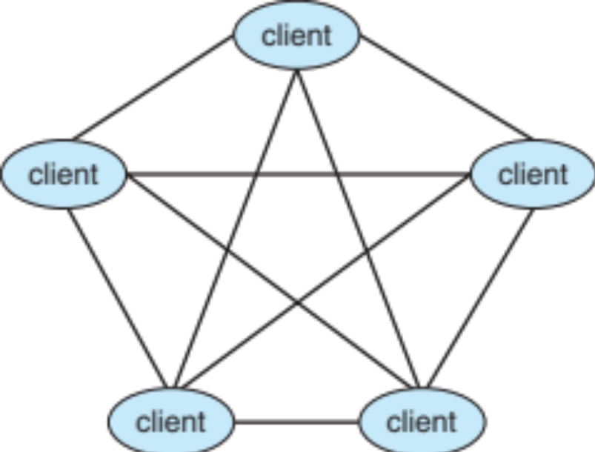
Computing Environments - Peer-to-Peer
P2P does not distinguish clients and servers
  All nodes considered peers
  May act as client, server, or both
  E.g., Napster, Skype, Torrent

Slide 60
Computing Environments - Virtualization
Allows operating systems to run within other OS
  Vast and growing industry
Emulation used when source CPU different from target (e.g., PowerPC to Intel x86)
  Generally slowest method

Slide 61
Computing Environments - Virtualization
Virtualization – OS natively compiled for CPU, running guest OS also natively compiled
  VMM (virtual machine Manager) provides virtualization services

Slide 62

Computing Environments - Virtualization

Slide 63
Computing Environments – Cloud Computing
Computing, storage, app as service across network
  Software as a Service (SaaS) –applications available via the Internet (e.g., word processor)
  Platform as a Service (PaaS) – software stack ready for application use via the Internet (e.g., a database server)
  Infrastructure as a Service (IaaS) – servers or storage available over Internet (e.g., storage available for backup use)

Slide 64
Computing Environments – Cloud Computing
Cloud computing environments composed of traditional OS, VMMs, and cloud management tools
  Internet connectivity requires security like firewalls
  Load balancers spread traffic across multiple applications

Slide 65

Computing Environments – Cloud Computing

Slide 66
Computing Environments – Real-Time Embedded Systems
Real-time embedded systems most prevalent
  Vary considerable, special purpose, real-time OS
  Use expanding
Many other special computing environments as well
  Some have OS, some perform tasks without OS

Slide 67
Computing Environments – Real-Time Embedded Systems
Real-time OS has well-defined fixed time constraints
  Processing must be done within constraint
  Correct operation only if constraints met

