Slide 1
Chapter 7: Main Memory

Slide 2
Chapter 7: Memory Management
Background
Swapping
Contiguous Memory Allocation
Segmentation
Paging
Page Table Structure

Slide 3
Objectives
Describe various ways to organize memory hardware
Discuss various memory-management techniques
  Segmentation
  Paging

Slide 4
Background
Program brought from disk into memory
  Placed within process to run
CPU can only access main memory and registers
Memory unit only sees:
  Stream of addresses + read requests
  Stream of addresses + write requests

Slide 5
Background
Register access takes one CPU clock (or less)
Main memory can take many cycles, causes stall
Cache between main memory and CPU registers
Memory protection required for correct operation

Slide 6

Base and Limit Registers
Logical address spaced defined by base and limit registers
CPU checks every memory access
  Must be between base and limit for user

Slide 7

Hardware Address Protection

Slide 8
Address Binding
Programs on disk, ready to be brought into memory
  Forms input queue
  Without support, process loaded into address 0000
Inconvenient to have first user process occupy physical address 0000
  How can it not be?

Slide 9
Address Binding
Addresses may change throughout program’s life
  Source code uses symbolic addresses
  Compiler binds addresses to relocatable addresses
    E.g., “14 bytes from beginning of module”
  Linker or loader binds relocatable addresses to absolute addresses
    E.g., 74014
  Each binding maps one address space to another

Slide 10

Binding of Instructions and Data to Memory
Address binding occur during either:
  Compile time
  Load time
  Execution time

Slide 11
Binding of Instructions and Data to Memory
Compile time address binding:
  Memory location known a priori
  Absolute code can be generated
  Must recompile if location changes

Slide 12
Binding of Instructions and Data to Memory
Load time address binding:
  Generate relocatable code if memory location not known at compile time

Slide 13
Binding of Instructions and Data to Memory
Execution time address binding:
  Binding delayed until run time
  Process can be moved in memory during execution
  Need hardware support for address maps
    (e.g., base and limit registers)

Slide 14
Logical vs. Physical Address Space
Binding logical address space to separate physical address space is central to memory management
  Logical address – generated by CPU
    Also referred to as virtual address
  Physical address – address seen by memory unit

Slide 15
Logical vs. Physical Address Space
In compile-time and load-time address binding
  Logical and physical addresses are the same
In run-time address binding
  Logical and physical addresses differ

Slide 16
Logical vs. Physical Address Space
Logical address space - set of all logical addresses generated by program
Physical address space - set of all physical addresses generated by program

Slide 17
Memory-Management Unit (MMU)
Hardware device that maps virtual to physical addresses at run-time
  Many mapping methods possible...
E.g., Value in relocation register added to every address generated by a user process
  Base register now called relocation register
  MS-DOS on Intel 80x86 used 4 relocation registers

Slide 18

Dynamic relocation using a relocation register

Slide 19
Memory-Management Unit (MMU)
User programs deal with logical addresses
... never see real physical addresses
  Execution-time binding occurs when reference is made to memory location
  Logical address bound to physical addresses

Slide 20
Dynamic Loading
Routine not loaded until called
  Better memory-space utilization
  Unused routine never loaded
All routines kept on disk in relocatable load format

Slide 21
Dynamic Loading
Useful when large procedures called infrequently
  E.g., error handling
No special support from OS required
  Implemented through program design
  OS can provide libraries for dynamic loading

Slide 22
Dynamic Linking
Static linking – system libraries and program code combined by loader into binary program image
Dynamic linking – linking postponed until run-time
Stub (small piece of code) used to locate appropriate library routine in memory
  Stub replaces itself with address of routine
  Executes routine

Slide 23
Dynamic Linking
OS checks if routine in processes‘memory address
  If not, add to address space
Dynamic linking useful for libraries
  Also known as shared libraries

Slide 24
Chapter 7: Memory Management
Background
Swapping
Contiguous Memory Allocation
Segmentation
Paging
Page Table Structure

Slide 25
Swapping
Processes can be swapped out of memory to a backing store
  Then brought back into memory for continued execution
  Total physical memory space of processes can exceed physical memory
Backing store – fast, large disk
  Big enough to hold copies of all memory images
  Must provide direct access to memory images

Slide 26
Swapping
Roll out, roll in – swapping variant used for priority-based scheduling algorithms
  Lower-priority process swapped out for higher-priority process
Transfer time is major concern
  Transfer time proportional to amount of memory swapped
System maintains ready queue of ready-to-run processes
  Memory images on disk

Slide 27

Schematic View of Swapping

Slide 28
Context Switch Time including Swapping
Context switch time between swapped processes can be high
E.g.,
  100MB process swapping to hard disk with transfer rate of 50MB/sec
    Swap out time = 2000 ms
    Swap in time = 2000 ms (same sized process)
  Total context switch time of 4000ms (4 seconds)

Slide 29
Context Switch Time and Swapping (Cont.)
Other constraints on swapping
  Pending I/O – can’t swap process
    I/O would occur to wrong process
  Or always transfer I/O to kernel space, then I/O device
    Known as double buffering, adds overhead
Standard swapping not used in modern OSs
  Modified version common
    Swap only when free memory extremely low

Slide 30
Swapping on Mobile Systems
Not typically supported
  Flash memory based
    Small amount of space
    Limited number of write cycles
    Poor throughput between flash memory and CPU

Slide 31
Swapping on Mobile Systems
If free memory space is low:
  iOS asks apps to voluntarily relinquish memory
    Read-only data thrown out, reloaded if needed
    Failure to free can result in termination
  Android terminates apps if low free memory
    First writes application state to flash for fast restart
  Both iOS and Android support paging...

Slide 32
Chapter 7: Memory Management
Background
Swapping
Contiguous Memory Allocation
Segmentation
Paging
Page Table Structure

Slide 33
Contiguous Allocation
Main memory must support both OS, user processes
  Limited resource, must allocate efficiently
Contiguous allocation is one method
Main memory in two partitions:
  Resident OS, usually held in low memory
  User processes held in high memory
    Each process contained in single contiguous region

Slide 34
Contiguous Allocation
Relocation registers used to protect:
  User processes from each other
  Users from changing OS code and data
Base register contains smallest physical address
  Limit register contains range of logical addresses
    Each logical address must be less than limit register
  MMU maps logical address dynamically
  Allows for transient kernel code (and kernel size)

Slide 35

Hardware Support for Relocation and Limit Registers

Slide 36
Multiple-partition allocation
Multiprogramming limited by number of partitions
Variable-partition sizes for efficiency
  Size based on process’ needs
Hole – block of available memory
  Holes of various size scattered throughout memory

Slide 37
Multiple-partition allocation
When process arrives, allocated memory from hole large enough to accommodate
Terminating process frees its partition
  Adjacent holes combined
Operating system maintains information about:
  Allocated partitions
  Free partitions (holes)

Slide 38

Multiple-partition allocation

Slide 39
Dynamic Storage-Allocation Problem
First-fit: Allocate first hole that’s big enough
Best-fit: Allocate smallest hole that’s big enough
  Must search entire list (unless ordered by size)
  Produces smallest leftover hole
Worst-fit: Allocate largest hole
  Must search entire list
  Produces largest leftover hole

Slide 40
Fragmentation
External fragmentation-
  Processes loaded / removed from memory
  Free memory broken into little, non-contiguous pieces
  Unusable
50-percent rule-
  Given N blocks in memory, 0.5N blocks lost to frag
    Based on analysis of first-fit algorithm
  1/3 of memory unusable

Slide 41
Fragmentation
Internal Fragmentation –
  Allocated memory slightly larger than requested
  Size difference internal to partition
    Memory not used

Slide 42
Fragmentation
Reduce external fragmentation by compaction
  Place all free memory together in one large block
Compaction only possible if relocation is dynamic,
  Done at execution time

Slide 43
Chapter 7: Memory Management
Background
Swapping
Contiguous Memory Allocation
Segmentation
Paging
Page Table Structure

Slide 44
Segmentation
Memory-management scheme that supports user view of memory
Program is collection of segments, e.g.,
  Main program
  Procedure
  Function
  Method
  Objects
  Local variables, global variables
  ...

Slide 45

User’s View of a Program

Slide 46
Logical View of Segmentation
1
1
4
2
3
4
2
3
user space
physical memory space

Slide 47
Segmentation Architecture
Logical address is tuple
  <segment-number, offset>
Segment table – maps segments to physical memory
  Each entry contains:
    base – starting physical address where segments resides
    limit – length of segment

Slide 48
Segmentation Architecture
Segment-table base register (STBR) points to segment table in memory
Segment-table length register (STLR) indicates number of segments used by a program
  Segment s is legal if s < STLR

Slide 49
Segmentation Architecture (Cont.)
Protection
  Each entry in segment table has:
    validation bit = 0 ⇒ illegal segment
    read/write/execute privileges
Protection bits associated with segments
  Code sharing occurs at segment level

Slide 50

Segmentation Hardware

Slide 51
Chapter 7: Memory Management
Background
Swapping
Contiguous Memory Allocation
Segmentation
Paging
Page Table Structure

Slide 52
Paging
Process’ physical address space can be noncontiguous
  Process allocated physical memory whenever space is available
  Avoids external fragmentation
  Avoids problem of varying sized memory chunks

Slide 53
Paging
Divide physical memory into fixed-sized blocks (frames)
  Size is power of 2
  Typically between 512 bytes - 16 MB
Divide logical memory into blocks of same size (pages)

Slide 54
Paging
Keep track of all free frames
To run program of size N pages, need N free frames
Page table translates logical to physical addresses
Backing store also split into pages
Still have Internal fragmentation

Slide 55
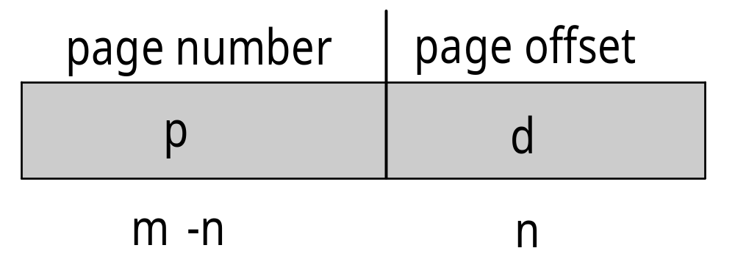
Address Translation Scheme
Address generated by CPU divided into:
  Page number (p)
    Used as index into page table
      Contains base address of page in physical memory
  Page offset (d)
    Combined with base address to define physical address sent to memory unit
  For given logical address space 2^{m} and page size 2^{n}

Slide 56

Paging Hardware

Slide 57

Paging Model of Logical and Physical Memory

Slide 58

Paging Example
n=2 ; m=4
32-byte memory
4-byte pages

Slide 59
Paging (Cont.)
Calculating internal fragmentation, e.g.,
  Page size = 2,048 bytes
  Process size = 72,766 bytes
  35 pages + 1,086 bytes
  Internal fragmentation of 2,048 - 1,086 = 962 bytes
  Worst case fragmentation = 1 frame – 1 byte

Slide 60

Free Frames
Before allocation
After allocation

Slide 61
Implementation of Page Table
Page table kept in main memory
Page-table base register (PTBR) points to page table
Page-table length register (PTLR) indicates size of page table

Slide 62
Implementation of Page Table
In this scheme, every data/instruction access requires two memory accesses
  One for page table
  One for data / instruction
Two memory access problem solved using special fast-lookup hardware cache called
  Associative memory
  or
  Translation look-aside buffers (TLBs)

Slide 63
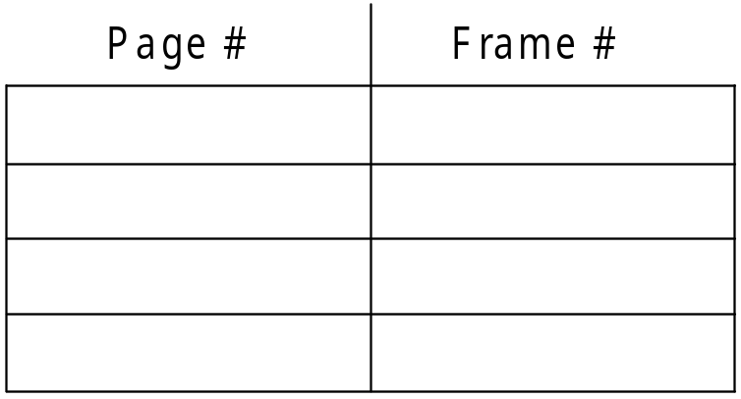
Associative Memory
Associative memory – parallel search
Address translation (p, d)
  If p is in associative register, get frame #
  Otherwise get frame # from page table in memory

Slide 64

Paging Hardware With TLB

Slide 65
Memory Protection
Implemented by associating protection bit w/ each frame
  Indicates if read-only or read-write access is allowed
  Can also add more bits to indicate page permissions
    E.g., execution

Slide 66
Memory Protection
Valid-invalid bit attached to each entry in page table
  Valid- associated page is in process’ logical address space, => legal page
  Invalid- page is not in process’ logical address space
  Or use page-table length register (PTLR)

Slide 67

Valid (v) or Invalid (i) Bit In A Page Table

Slide 68
Shared Pages
Shared code
  One copy of read-only (reentrant) code shared among processes
    E.g., text editors, compilers, window systems
  Similar to multiple threads sharing same process space
  Also useful for interprocess communication

Slide 69
Shared Pages
Private code and data
  Each process keeps separate copy of code and data
  Pages for private code and data can appear anywhere in logical address space

Slide 70

Shared Pages Example
Editor program
  => 3 pages of shared code (ed 1-3)
Each user process:
  Executes editor code (shared)
  Has own data

Slide 71
Chapter 7: Memory Management
Background
Swapping
Contiguous Memory Allocation
Segmentation
Paging
Page Table Structure

Slide 72
Structure of the Page Table
Paging memory structures can be very large, e.g.,
  32-bit logical address space
  Page size of 4 KB (2¹²)
  Page table would have 1 million entries (2³² / 2¹²)
  If each entry is 4 bytes
  => 4 MB of physical address for page table

Slide 73
Hierarchical Page Tables
Break up logical address space into multiple page tables
Simple technique: two-level page table

Slide 74

Two-Level Page-Table Scheme

Slide 75
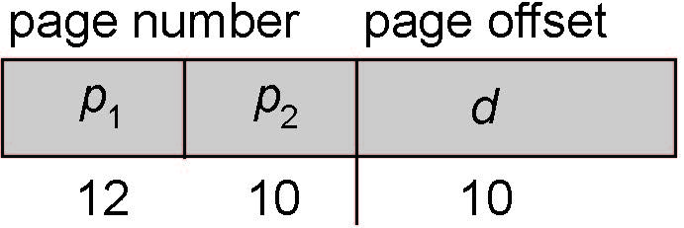
Two-Level Paging Example
AKA: forward-mapped page table
Logical address on 32-bit machine with 1K page size:
  22-bit page number
  10-bit page offset (2^10 = 1024)
Page table is paged => page number divided into:
  12-bit page number
  10-bit page offset

Slide 76

Address-Translation Scheme

Slide 77
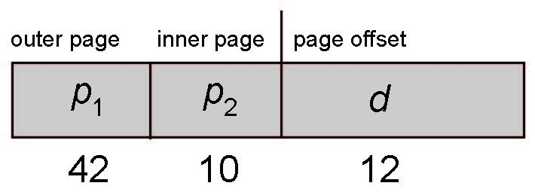
64-bit Logical Address Space
Two-level paging insufficient for 64-bit address space
E.g., page size 4 KB (2¹²)
  Page table has 2⁵² entries
If two level scheme:
  Inner page tables could be 2¹⁰ 4-byte entries
  Outer page table has 2⁴² entries or 2⁴⁴ bytes

Slide 78


Three-level Paging Scheme
One solution: add 2nd outer page table
  But... 2nd outer page table is 2³⁴ bytes in size

Slide 79
Hashed Page Tables
Common in address spaces > 32 bits
Virtual page number hashed into page table
  Page table contains chain of elements that hash to same location
Each element contains:
  Virtual page number
  Value of mapped page frame
  Pointer to next element

Slide 80
Hashed Page Tables
Virtual page numbers searched for in chain
  If match found, corresponding physical frame extracted
Variation for 64-bit addresses: clustered page tables
  Similar to hashed, but each entry refers to several pages
    E.g., 16 rather than 1
  Especially useful for sparse address spaces
    Memory references are non-contiguous and scattered

Slide 81

Hashed Page Table

Slide 82
Inverted Page Table
Instead of one page table per process, track all physical pages
  One entry for each real page of memory
Entry consists of virtual address of page stored in that real memory location
  With information about owning process

Slide 83
Inverted Page Table
Uses hash table to reduce search time
  TLB can accelerate access
Decreases memory needed to store each page table
  Increases time needed to search table when page reference occurs

Slide 84

Inverted Page Table Architecture

