Slide 1
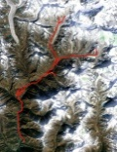

Client Designs
Terrain Server
HGT
Map Server
MapBox
4.b
.jpeg/.x3d
Shapeways
MB.API
3.b
.jpeg
GPSWikiLoc
2.a
.tilesid
2.b
.bin
0
.gpx
4.a
.jpeg/x3d
+ ids_style
+id_gps
3.a
.mapid
.loc
.gjson
Core function
5
Card_id
Shipping_ac
1.a
.gpx
1.b
.tilesid
GPS data
Online Design Tool
(Mapbox-Leaflet & 3JS)
Order

