Slide 1
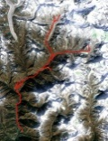
Client Designs
Terrain Server
Cesium
7
ZIP . jpeg/.x3d)
Map Server
MapBox
2
.tiles
4
.styles
[mapids]
Shapeways
MB.API
6.b
.jpeg
GPSWikiLoc
0
.gpx
6.a
.mapid
.loc
.gjson
Core function
1
.gpx
2
.tiles
6.c
.jpeg/x3d
8
Zip .jpeg/.x3d
6
.x3d
GPS data
Online Design Tool
(Mapbox-Leaflet & 3JS)
Order

