Slide 1
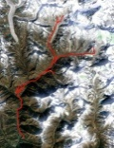
Client Designs
6.b
ZIP . jpeg/.x3d)
Map Server
MapBox
Terrain Server
Cesium
MB.API
Shapeways
2
.styles
[mapids]
3.b
.jpeg
4.b
.tiles
GPSWikiLoc
0
.gpx
6.a
.jpeg/x3d
Core function
3.a
.mapid
.loc
.gjson
Core function
1.a
.gpx
1.b
.gpx
4.a
.gpx
5.a
.tiles
5.b
.x3d
7
Zip .jpeg/.x3d
GPS data
Online Design Tool
(Mapbox-Leaflet & 3JS)
Order

