Slide 1

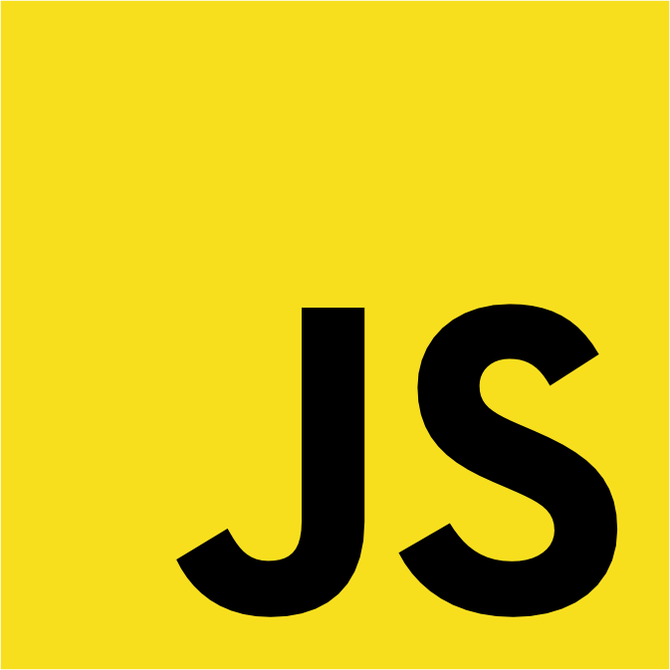
Dredd::Rack
♥

Slide 2
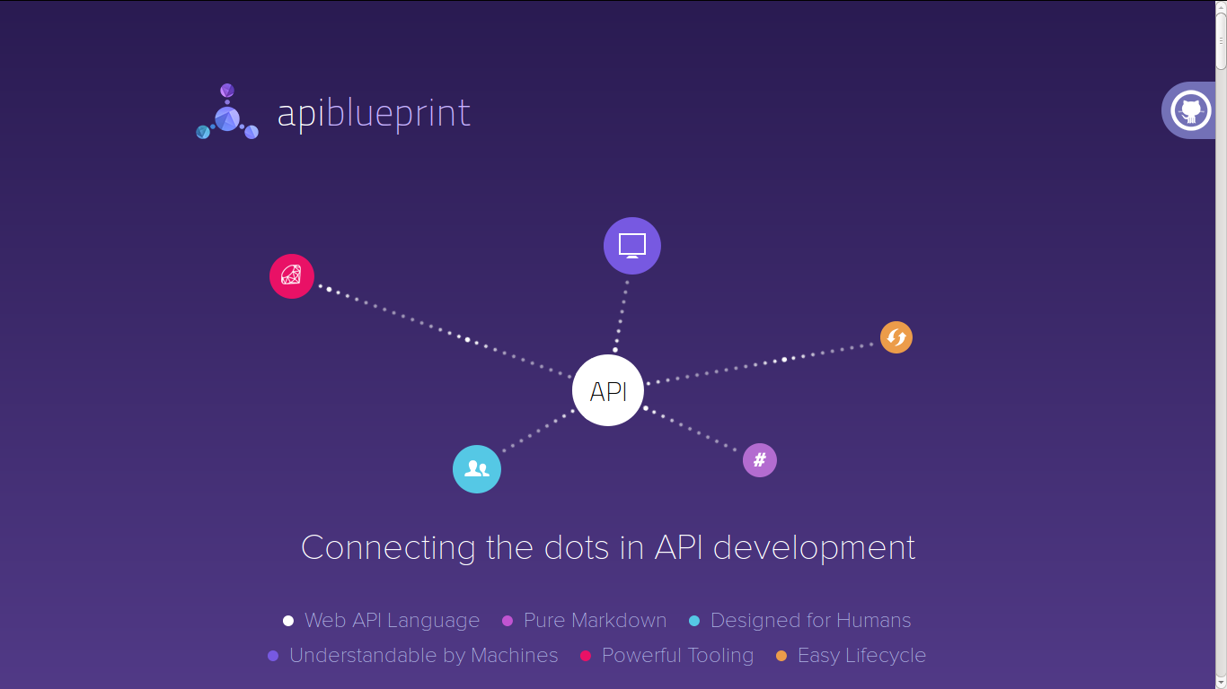


Slide 3
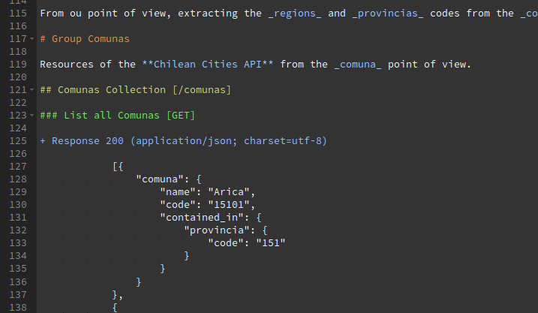
apiblueprint.org
Markdown
with great tooling!

Slide 4
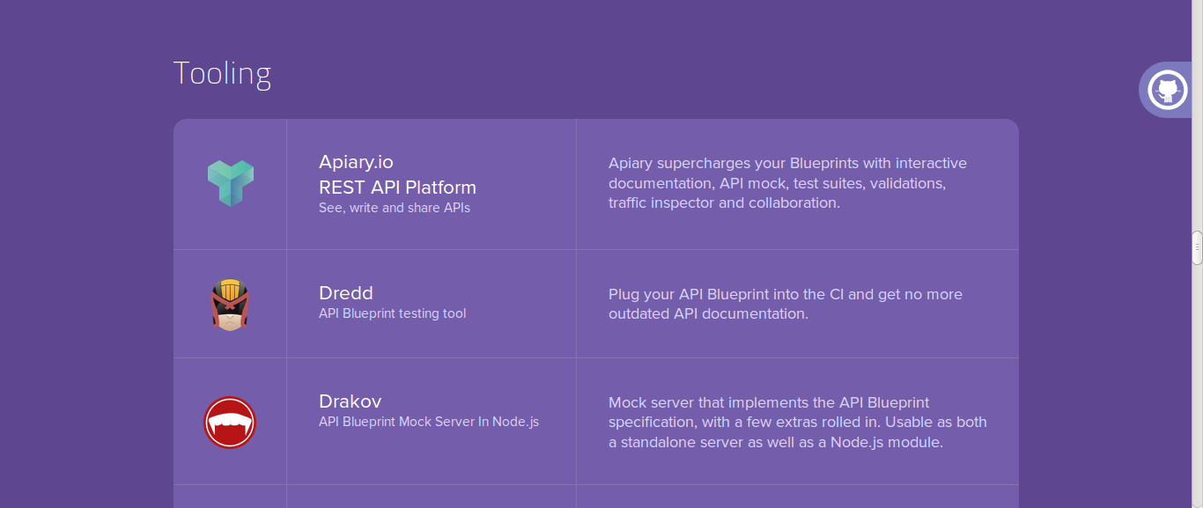
apiblueprint.org

Slide 5
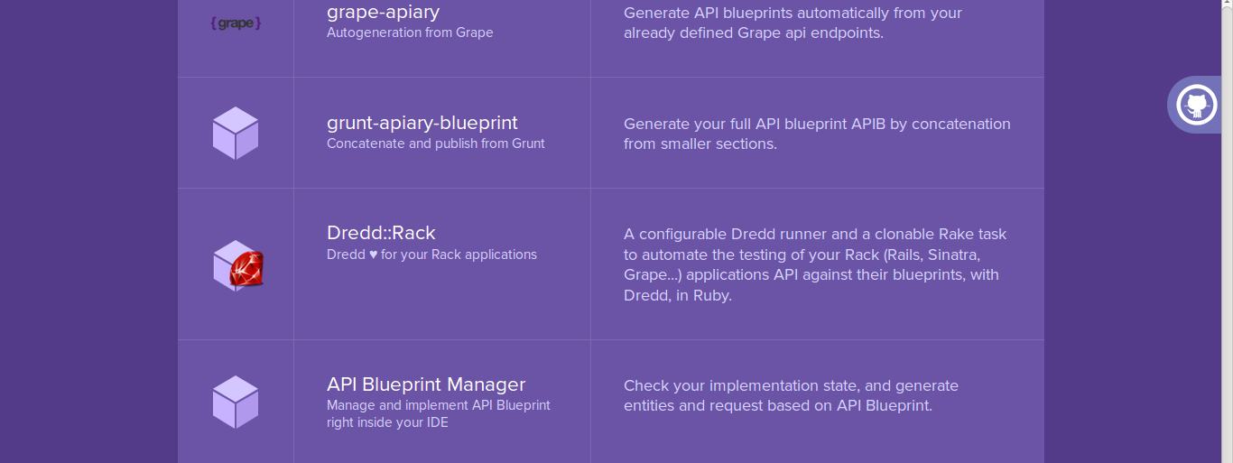
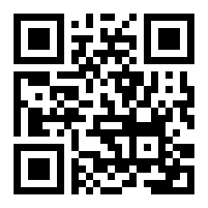
apiblueprint.org

Slide 6

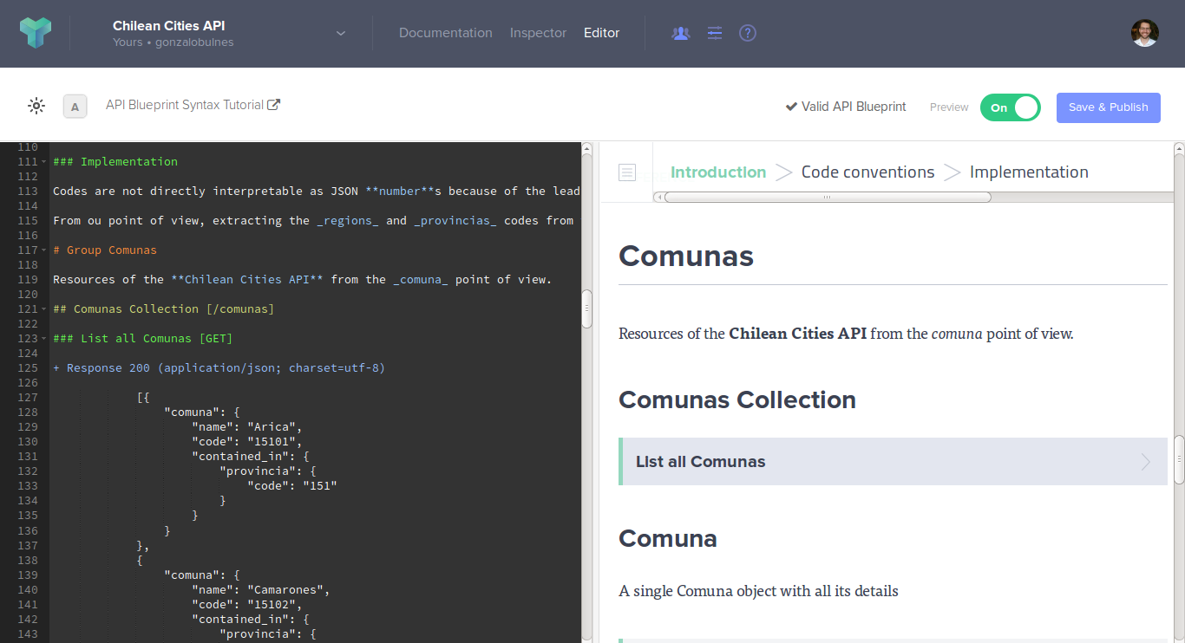
Mock server
based on your API blueprint examples

Slide 7
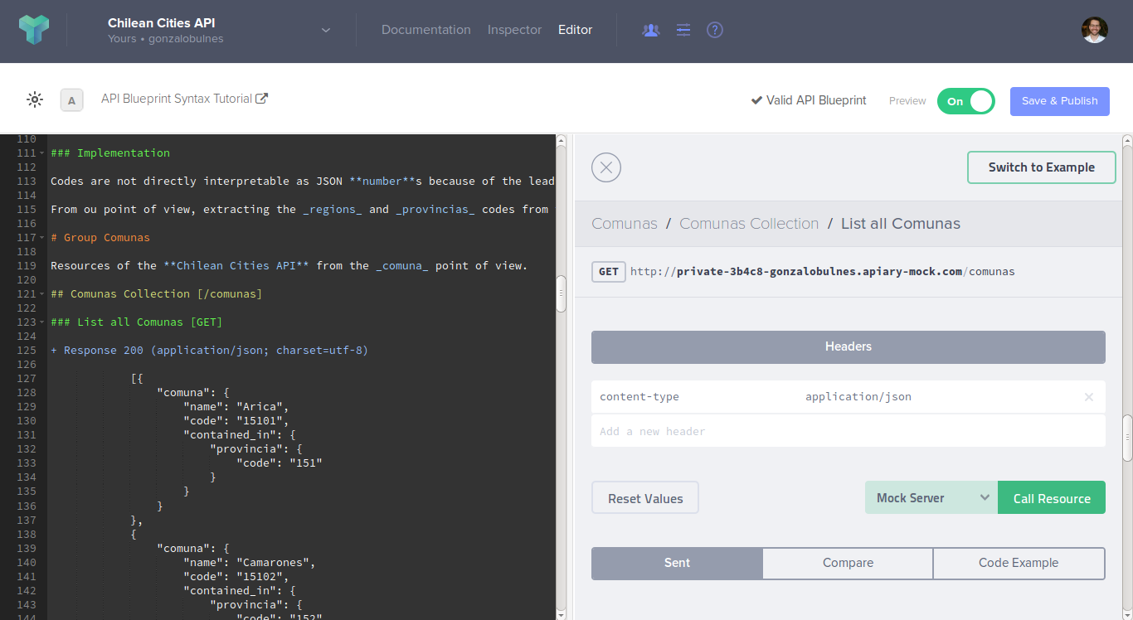
Mock server
based on your API blueprint examples

Slide 8
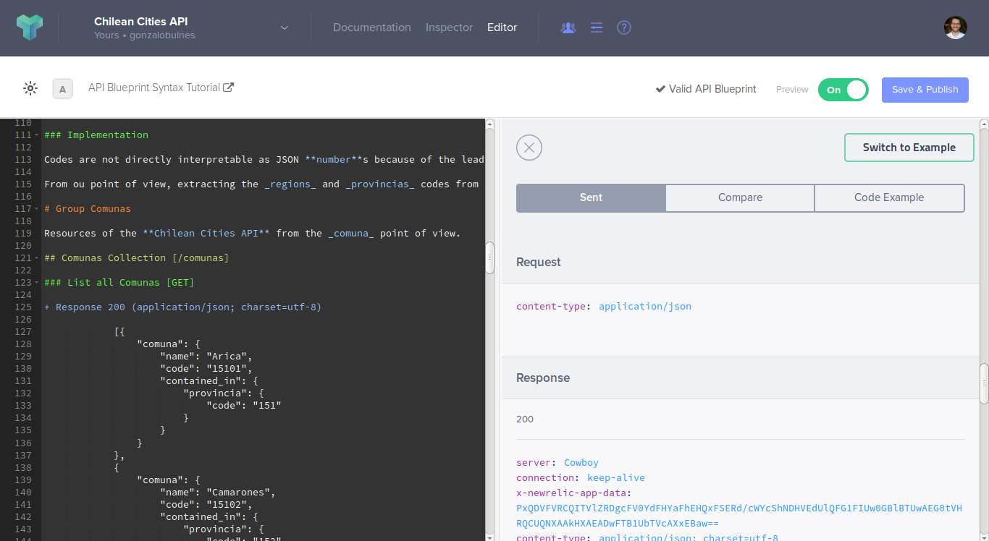
Mock server
based on your API blueprint examples

Slide 9
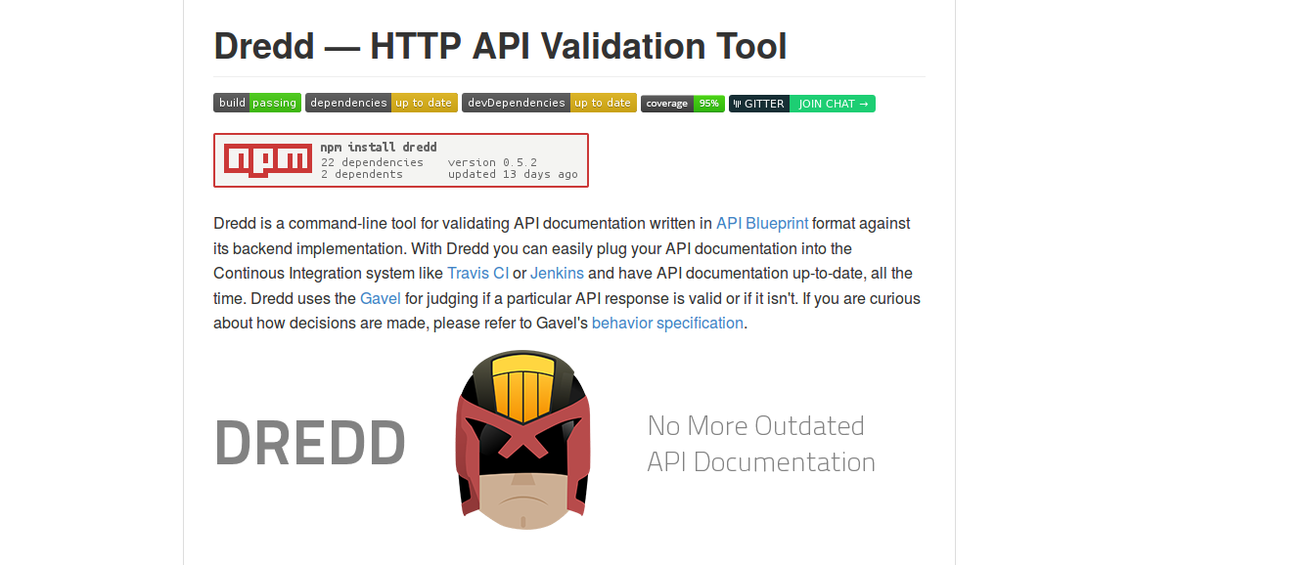
github.com/apiaryio/dredd

Slide 10
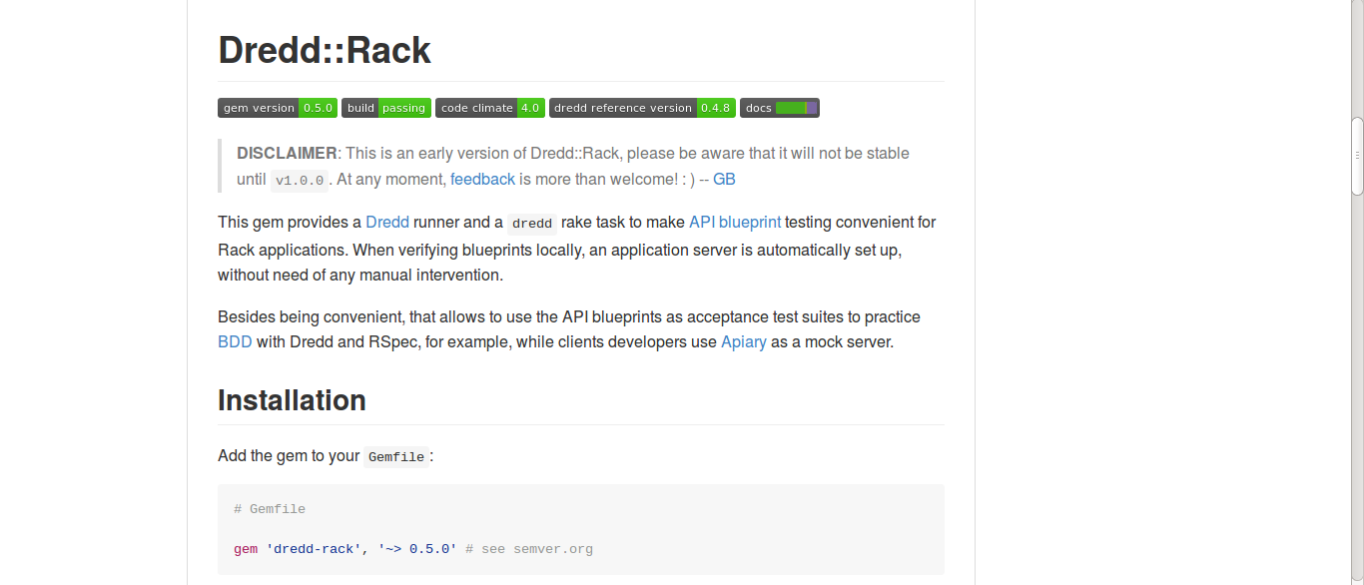
github.com/gonzalo-bulnes/dredd-rack

Slide 11
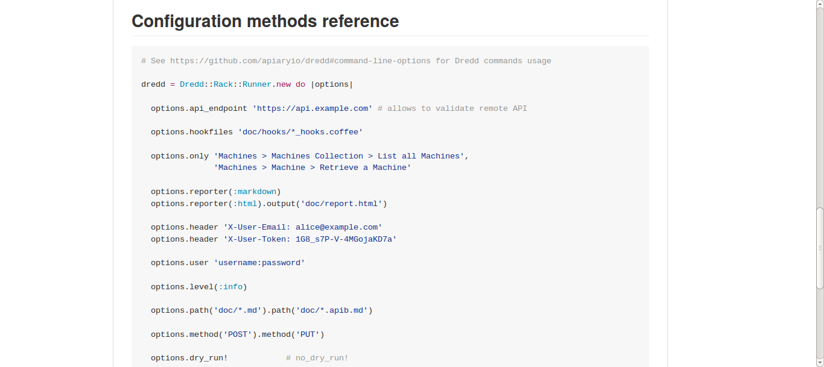
Write Ruby, execute Javascript!
Dredd::Rack is a thin wrapper around the Dredd coffeescript.

Slide 12
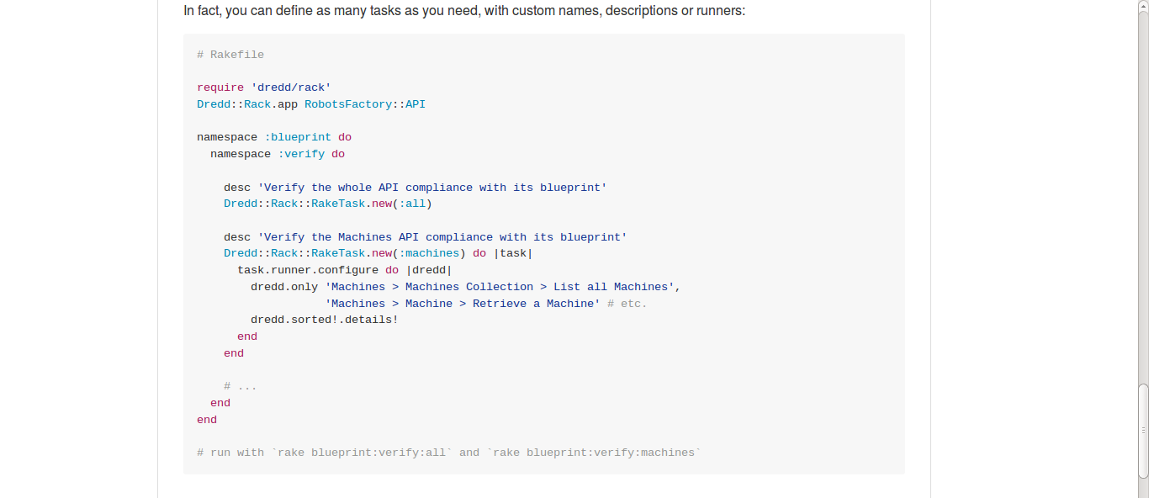
Practice BDD with your API blueprints!
Lovely Rake task

Slide 13
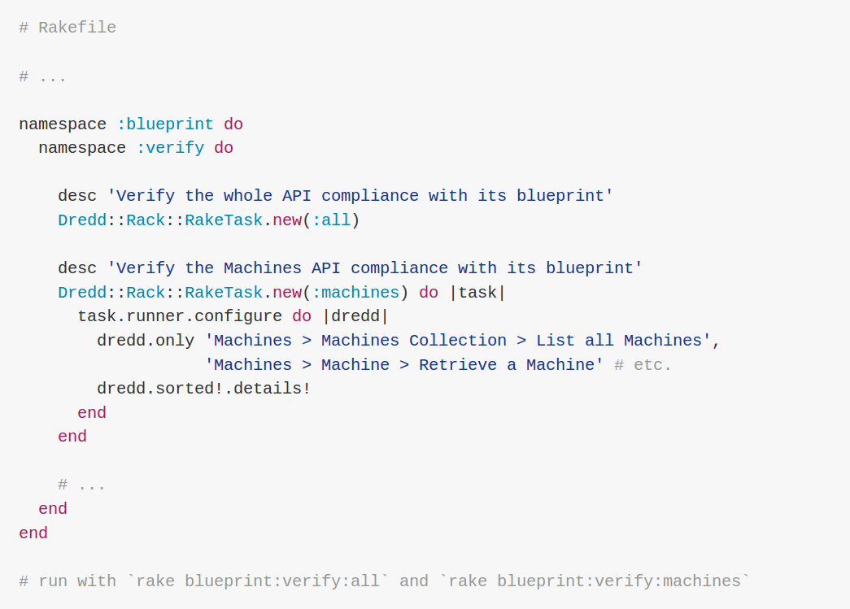
Practice BDD with your API blueprints!
Lovely Rake task

Slide 14
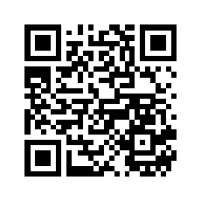
Dredd::Rack
♥
Thanks!

Slide 15
License
Copyright © 2015 Gonzalo Bulnes Guilpain
Except otherwise stated (see creditsbelow):
Permission is granted to copy, distribute and/or modify this document under
the terms of the GNU Free Documentation License, Version 1.3 or any later version
published by the Free Software Foundation; with no Invariant Sections,
no Front-Cover Texts, and no Back-Cover Texts.
A copy of the license can be found at http://www.gnu.org/copyleft/fdl.html.
Credits
https://apiblueprint.org
https://apiary.io
https://commons.wikimedia.org/wiki/Category:Ruby_programming_language#/media/File:Ruby_logo.svg
https://commons.wikimedia.org/wiki/File:JavaScript.svg

