Slide 1

https://www.w3.org/Consortium/mission
The social value of the Web is that it enables human communication, commerce, and opportunities to share knowledge.
One of W3C's primary goals is to make these benefits available to all people, whatever their hardware, software, network infrastructure, native language, culture, geographical location, or physical or mental ability.

Slide 2
Easy Accessibility improvements using React:
Your everyday ESLint can help you!
evcohen/eslint-plugin-jsx-a11y
included in Airbnb ESLint default config
airbnb/javascript/eslint-config-airbnb
Just add it to your ESLint config...

Slide 3
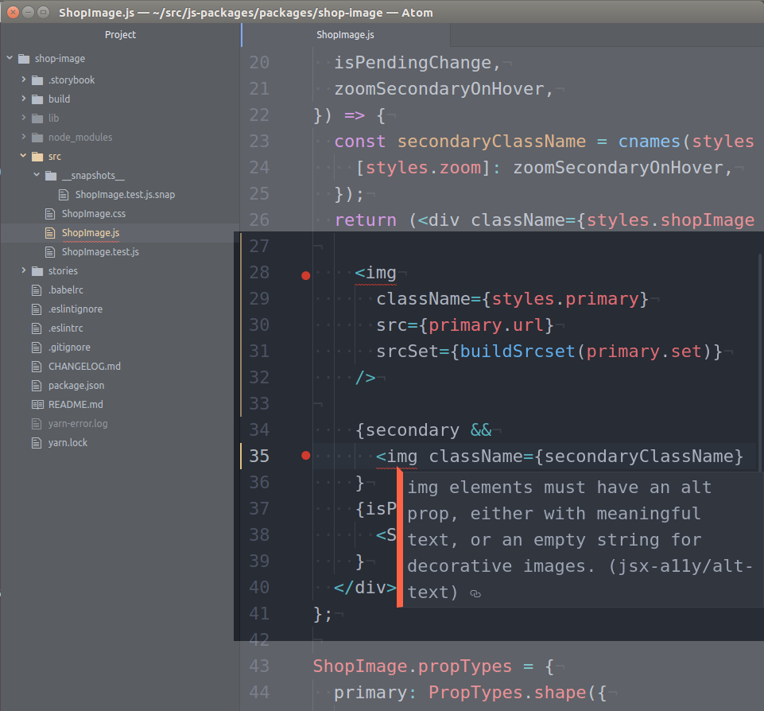
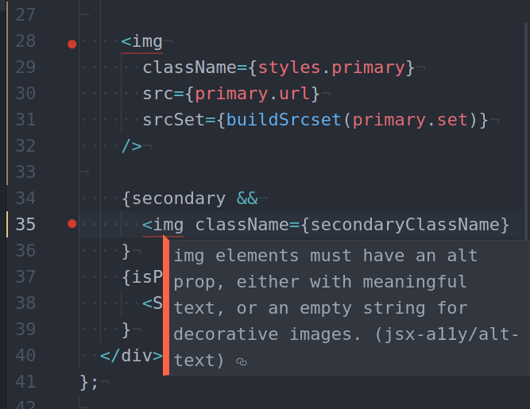
and get help!
right in your editor
🙃

Slide 4

Redbubble
That’s all! That’s easy.
It’s what I did this week-end : )
and it’s my first contribution to accessibility at
I hope it can be yours too,
whatever project you contribute to!

Slide 5
CampJS VIII - A JavaScript Hacker Retreat - Lord Somers Camp, Melbourne, August 4th - 7th 2017
Credits: https://github.com/gonzalo-bulnes/getting-started-with-accessibility-using-react
evcohen/eslint-plugin-jsx-a11y
included in Airbnb ESLint default config
airbnb/javascript/eslint-config-airbnb

