Slide 1
Symbiodiniaceae
Pocillopora cf. verrucosa

Slide 2
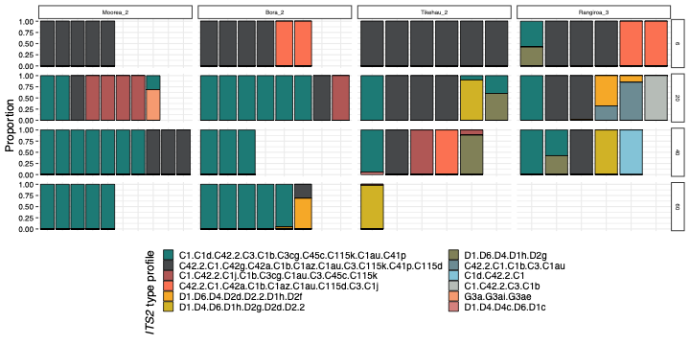

Slide 3
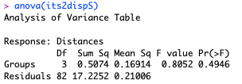
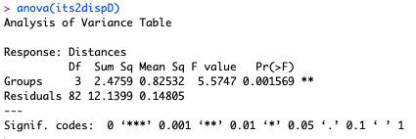
Using ```betadisper()``` in *vegan* to look at multivariate homogeneity of dispersion (PERMDISP) between sites and depths. This is using Bray-Curtis dissimilarity.
No significant effect of the site
Significant effect of the depth

Slide 4
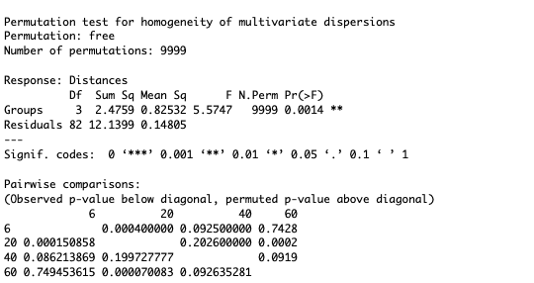
Permutation test for pairwise comparisons
6m different from 20 m depth only
20m and 60m different

Slide 5
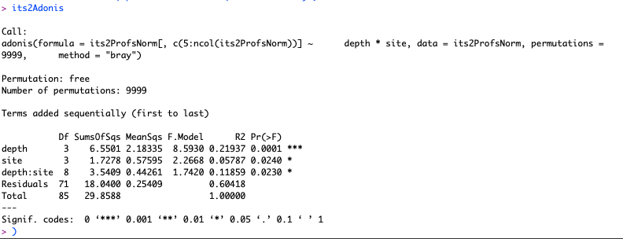
PERMANOVA bray-curtis similiraty
We will use Bray-Curtis similarity for our distance matrix and run a total 0f 9,999 permutations, and test the effects of Site, Depth, and the interaction between Site and Depth. Dispersion is heteroschedastic, but PERMANOVA is robust to deviations in
homgeneity of variance ( [Anderson and Walsh, 2013]

Slide 6
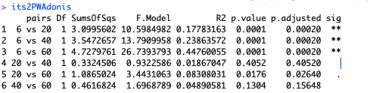
Pairwise PERMANOVA for multiple comparisons
depth
6m different with all
20 m different of 60

Slide 7
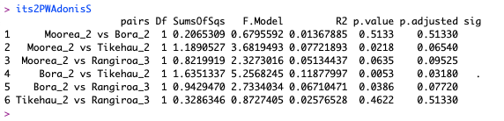
Pairwise PERMANOVA for multiple comparisons
site

Slide 8
Symbiodiniaceae
Pachyseris cf. speciosa

Slide 9
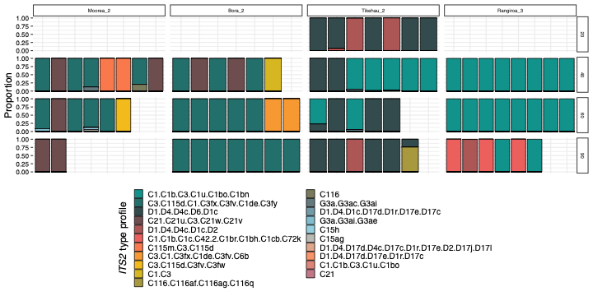

Slide 10
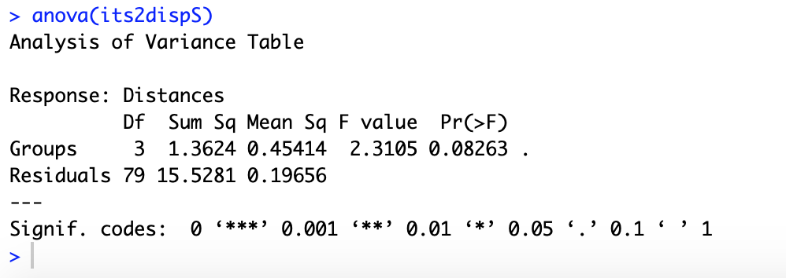
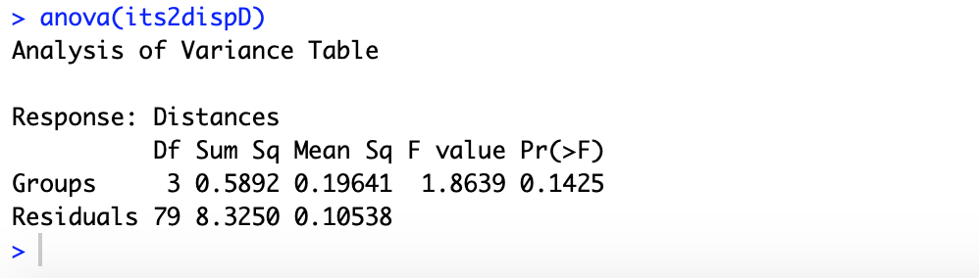
Using ```betadisper()``` in *vegan* to look at multivariate homogeneity of dispersion (PERMDISP) between sites and depths. This is using Bray-Curtis dissimilarity.
no significant effect of the site
no significant effect of the depth

Slide 11
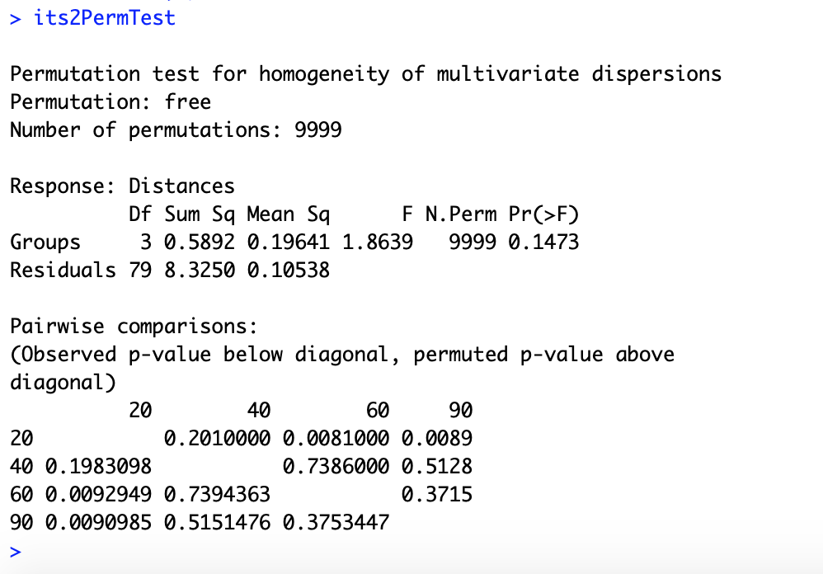
Permutation test for pairwise comparisons
20m different from 60m and 90m

Slide 12
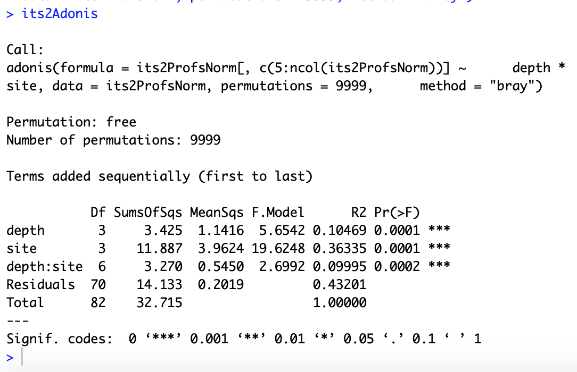
PERMANOVA bray-curtis similiraty
We will use Bray-Curtis similarity for our distance matrix and run a total 0f 9,999 permutations, and test the effects of Site, Depth, and the interaction between Site and Depth. Dispersion is heteroschedastic, but PERMANOVA is robust to deviations in
homgeneity of variance ( [Anderson and Walsh, 2013]

Slide 13
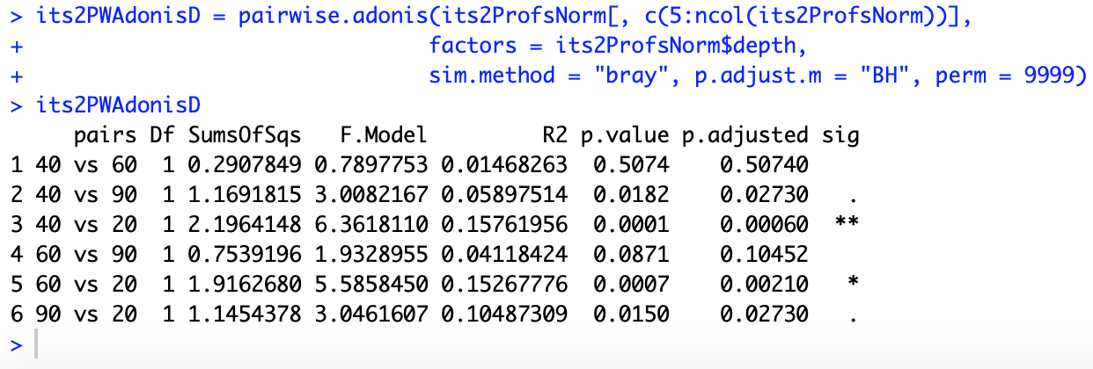
Pairwise PERMANOVA for multiple comparisons
depth
20m different with all
40 m different of 90

Slide 14
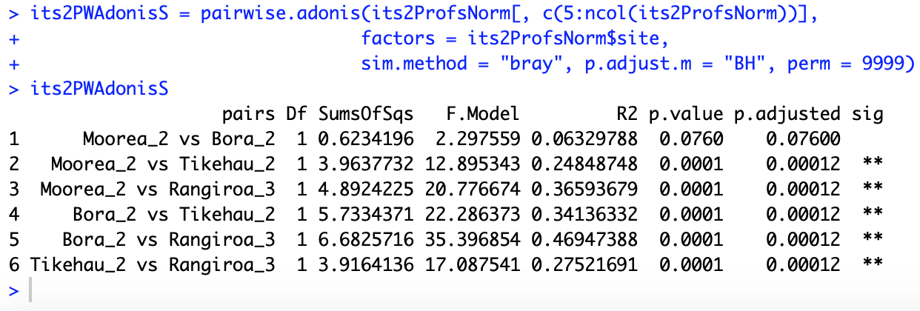
Pairwise PERMANOVA for multiple comparisons
site

