Slide 1


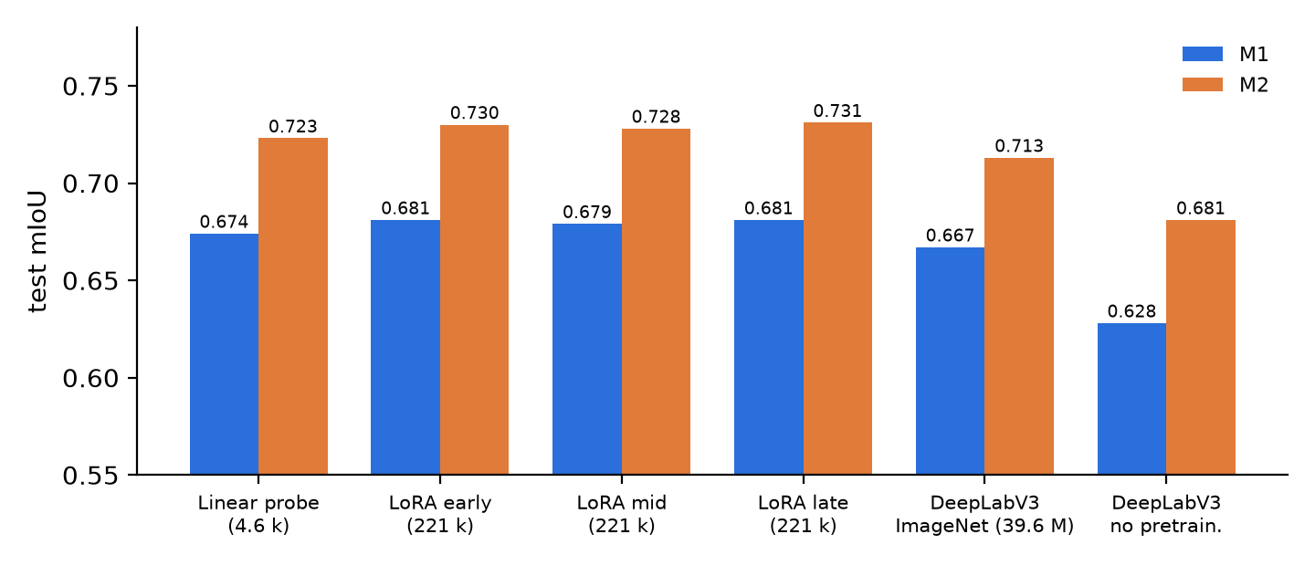
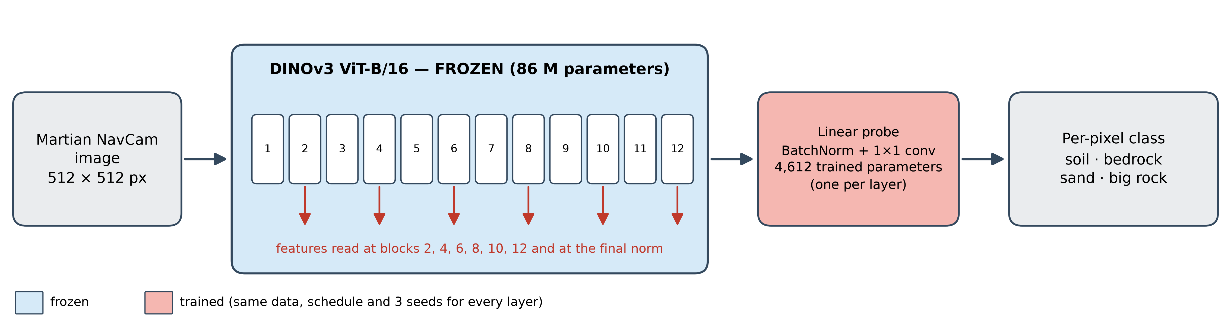
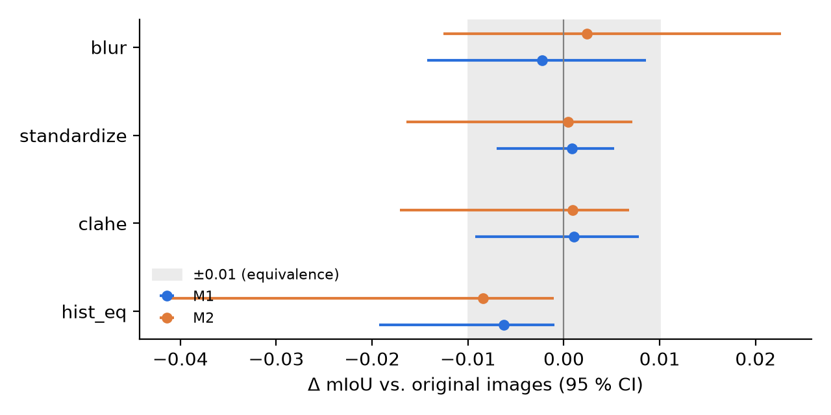
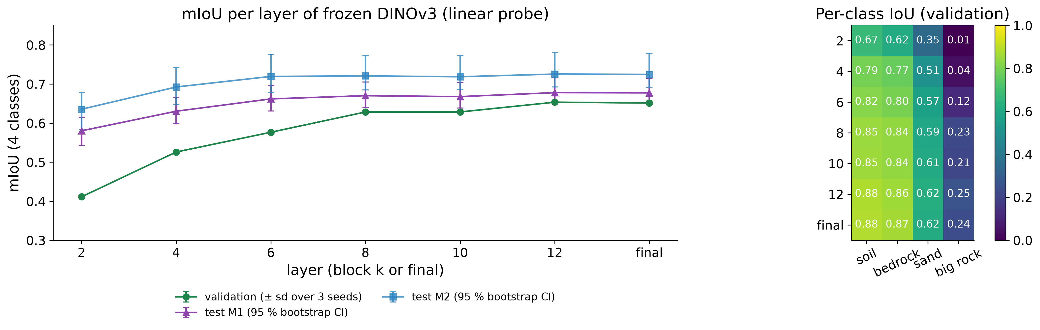
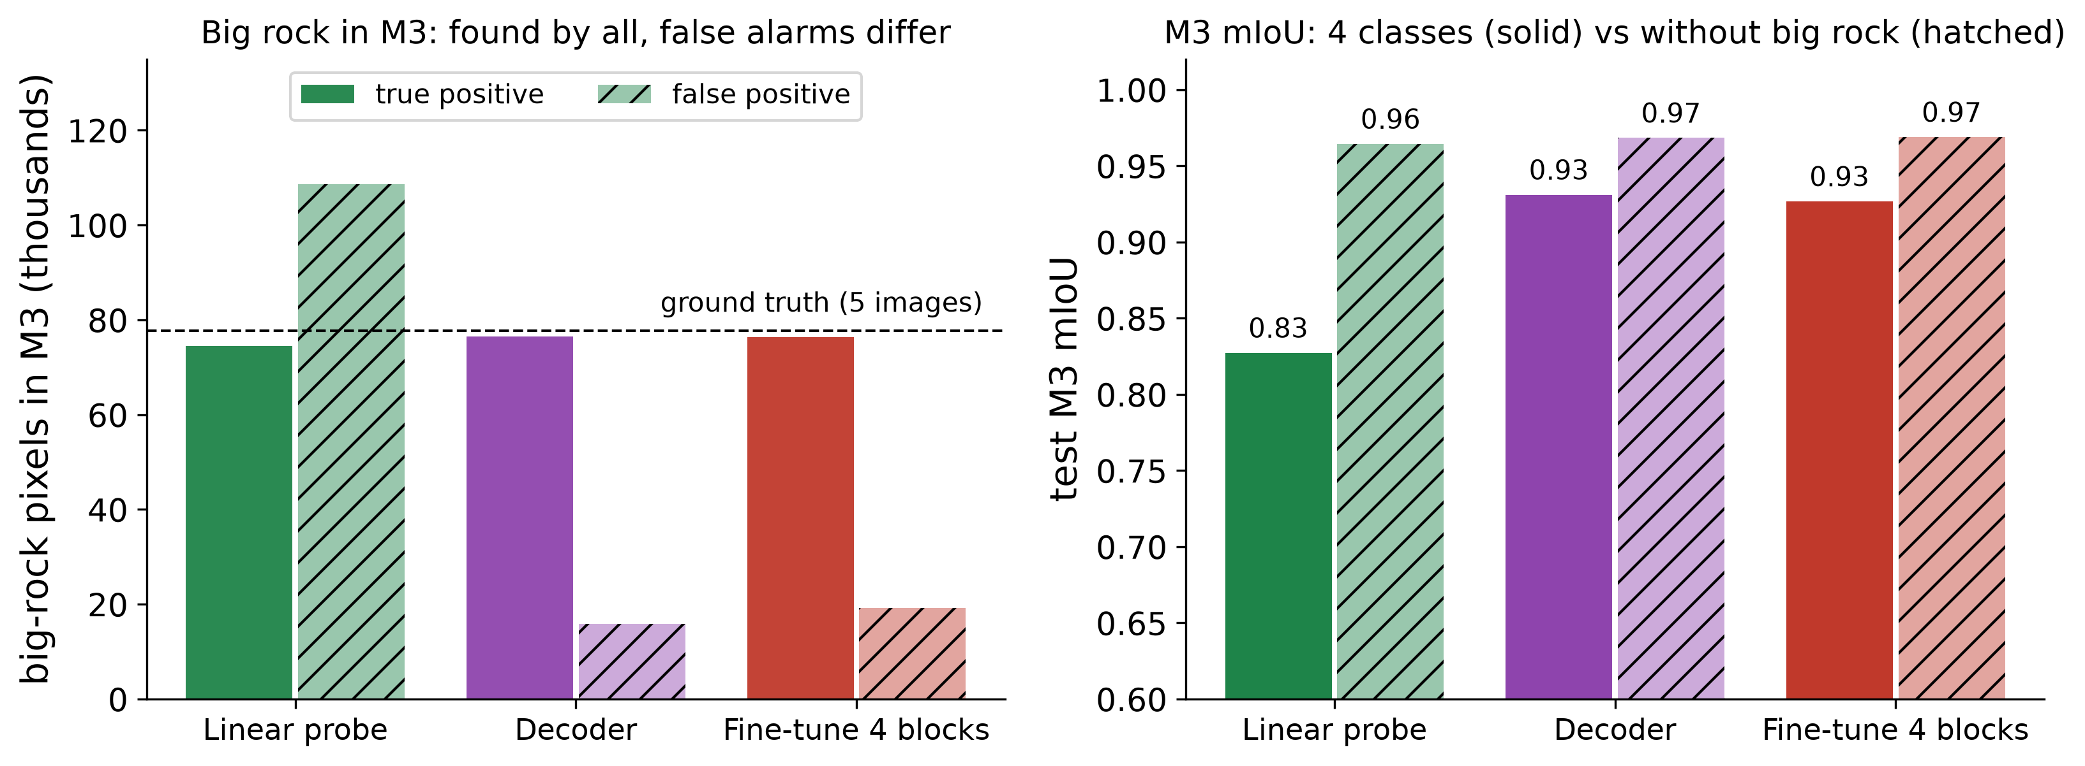
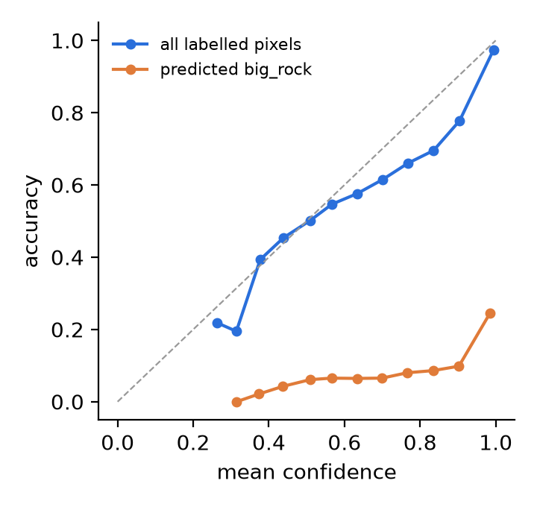
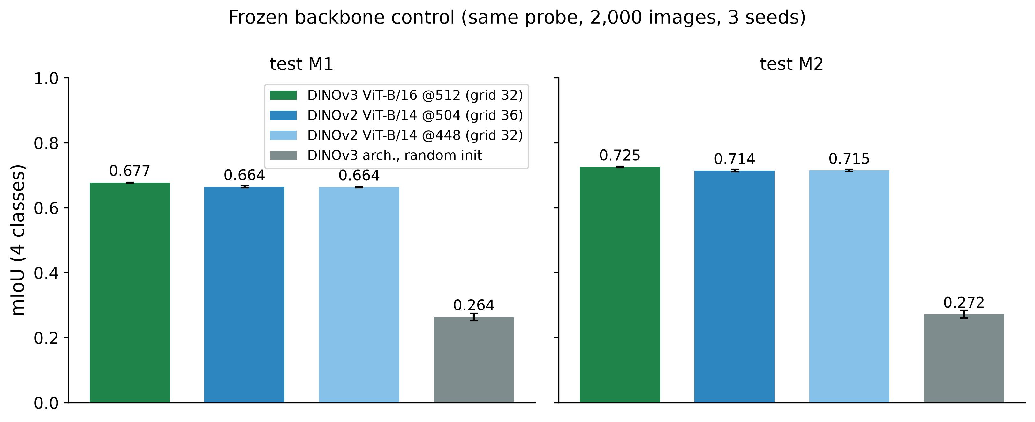
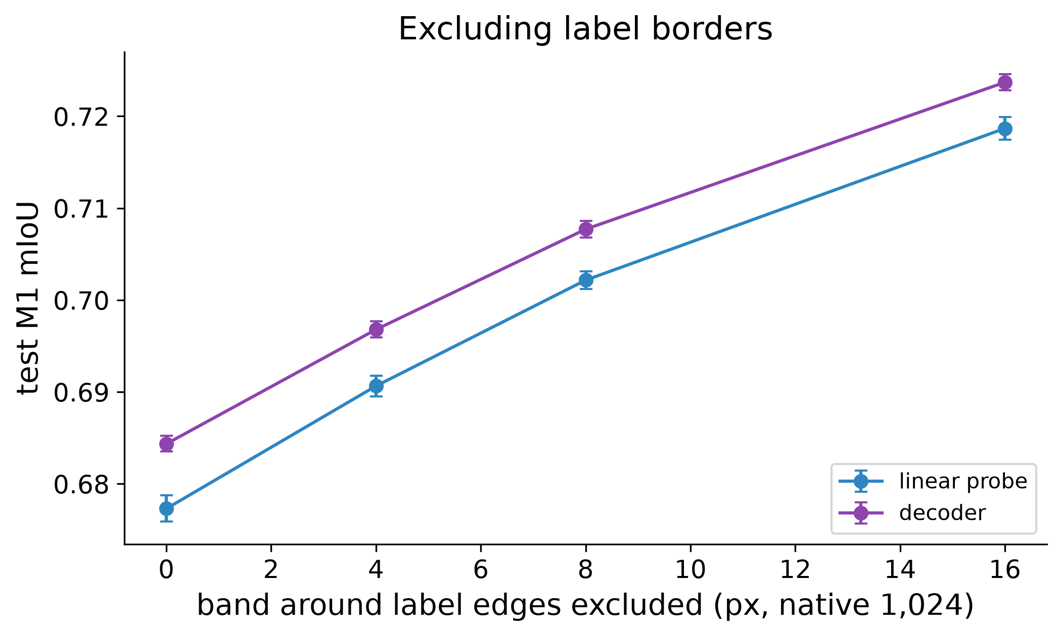
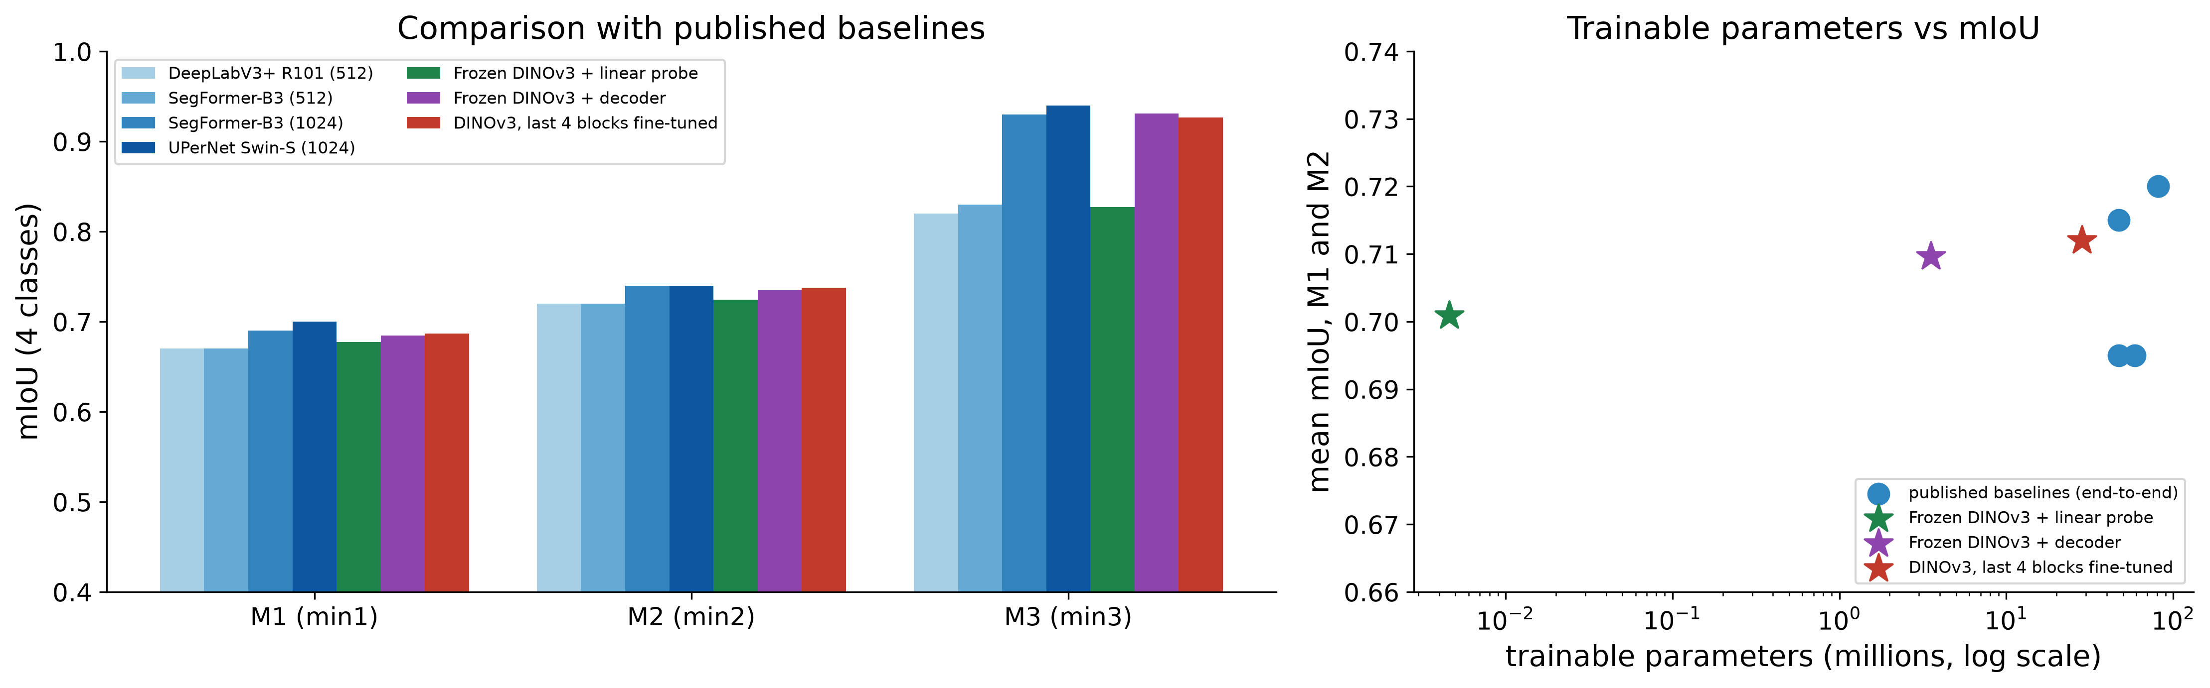
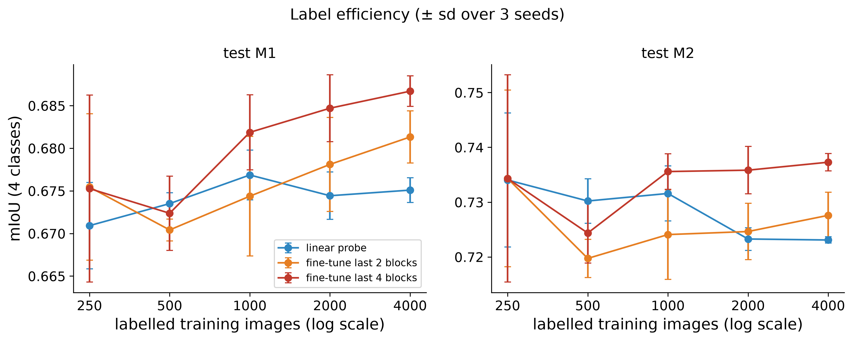
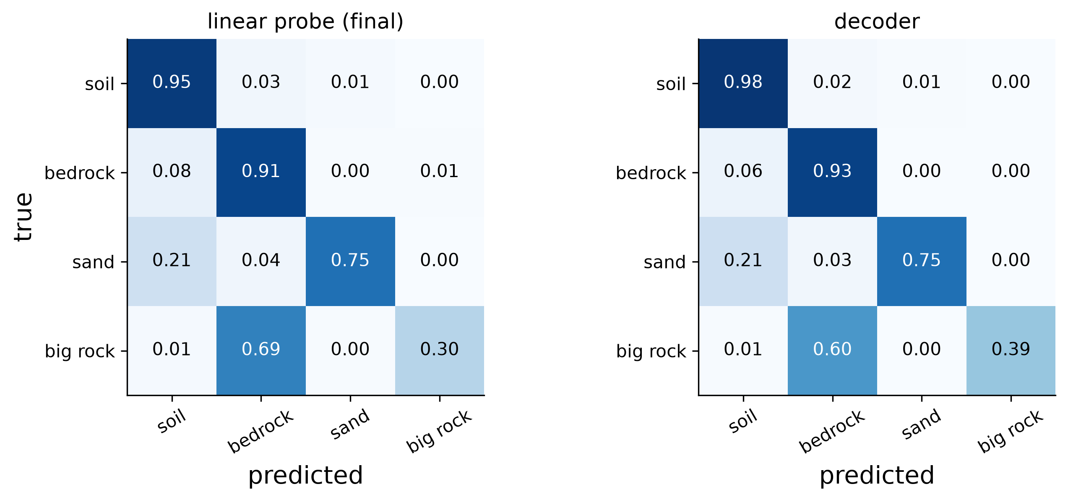

Workshop on Artificial Intelligence and Machine Learning Applications
How Do Web-Pretrained DINOv3 Features Extend to Martian Terrain? A Study on AI4Mars
Gonzalo Quispe¹ • Gustavo Meza¹ • David Rodríguez¹
¹Pontificia Universidad Católica del Perú, Lima, Peru · gquispeo@pucp.edu.pe · meza.gustavo@pucp.edu.pe · david.rodriguezc@pucp.edu.pe
MOTIVATION & RESEARCH PROBLEM
RESEARCH QUESTIONS
• Foundation vision models are pretrained on web images, yet they are used on scenes that look nothing like the web, such as the surface of Mars.
• Rovers must tell soil, bedrock, sand and big rock apart; expert labels are scarce and ambiguous.
• Question: how do the features of a DINOv3 pretrained on web images extend to the Martian domain (AI4Mars)?
• Layers: how far does a frozen DINOv3 go, layer by layer, and what do a decoder and fine-tuning add?
• P1, data: is the gap one of image appearance?
• P2, model: where is it worth adapting, with the same LoRA budget on early, middle or late blocks?
• P3, errors: where does it fail and does it know? Expert agreement and calibration.
• Closest work uses frozen DINOv2 on other Mars data and tasks [5]; we found no controlled study of adaptation depth or calibration on AI4Mars.
METHODOLOGY
RESULTS 2 · APPEARANCE AND ADAPTATION
• Data: AI4Mars, Curiosity NavCam, 512 px, 4 classes. 15,564 training images, 500 validation (temporal hold-out), 322 expert test images in three sets M1 / M2 / M3 (labels agreed by at least 1 / 2 / 3 experts).
• Backbone: DINOv3 ViT-B/16, frozen (85.7 M parameters, 215 GFLOPs per image, 12 identical blocks). Probe: BatchNorm + 1×1 convolution on one layer's tokens (4.6 k parameters).
• Heads: decoder over blocks 3, 6, 9, 12 (3.5 M); last 2 or 4 blocks fine-tuned (14 M / 28 M); LoRA rank 8 on two blocks, early (1–2), middle (6–7) or late (11–12), 221 k parameters.
• Appearance (P1): histogram equalisation, CLAHE, per-image standardisation, Gaussian blur.
• Errors (P3): mIoU where three experts agree vs where one labelled; calibration (ECE).
• Statistics: 3 seeds (2 for LoRA, 1 for the DeepLabV3 baseline); paired bootstrap 95 % CI over blocks of 10 consecutive images; a difference is real if the CI excludes 0 and |Δ| ≥ 0.01, equivalent if inside ±0.01. Hypotheses and rules written before the runs.
• Reference: the probe reaches 0.674 / 0.723 on M1 / M2, level with DeepLabV3-R50 trained end to end (0.667 / 0.713; M1 difference −0.007, 95 % CI [−0.025, +0.008]), with about 8,600 times fewer trainable parameters. Without pretraining the baseline is clearly behind (0.628).
• P1, appearance: CLAHE and standardisation are equivalent to the original images on M1 (+0.001); equalisation is slightly lower (−0.006); blur does not hurt (−0.002). The gap does not look photometric.
• P2, where to adapt: LoRA adds +0.005 to +0.007 in every zone, and the zones do not differ (late − early −0.000, [−0.006, +0.015]).
Fig. 5. Test mIoU: probe, LoRA by zone and DeepLabV3 baselines (LoRA 2 seeds; baselines 1 seed, 3 epochs).
Fig. 1. Frozen DINOv3 ViT-B/16 with one linear probe per tapped layer.
RESULTS 1 · TRANSFER AND LAYERS
• Transfer: a linear probe on the final layer reaches mIoU 0.677 / 0.725 on test M1 / M2 (0.125 for always predicting the majority class).
• Heavier heads add little: decoder 0.684 / 0.735 and last 4 blocks fine-tuned 0.687 / 0.737, at most +0.012 over the probe.
• No intermediate layer beats the last; block 6 already gives 98 % of the final M1 value.
• Pretraining matters: a random-init ViT gets 0.264 on M1; DINOv3 is +0.013 [+0.002, +0.025] over DINOv2 on M1, and matching the token grid leaves the gap unchanged.
Fig. 6. P1: change in probe mIoU under each appearance transform (grey band: ±0.01).
RESULTS 3 · WHERE IT FAILS
• Labels: where three experts agree mIoU is 0.862, where only one labelled it is 0.546 (+0.315 [+0.180, +0.413]). 250 labelled images give 99 % of the 4,000-image probe mIoU, and excluding label borders raises every head by about 0.025.
• Calibration: ECE 0.029 overall, but on pixels predicted big rock confidence exceeds accuracy by 0.674 [+0.435, +0.762]; 45 % of big-rock pixels are missed. M3 holds big rock in only 5 images, so it cannot rank models on that class.
Fig. 2. mIoU per layer of frozen DINOv3 (validation ± sd over 3 seeds; test sets with 95 % bootstrap CI) and per-class IoU.
Fig. 7. Big rock in test M3: true and false positives (left); mIoU with and without that class (right).
Fig. 8. Calibration of the probe.
Fig. 3. Frozen backbones, same probe.
Fig. 4. Excluding label borders (M1).
CONCLUSIONS
• Web-pretrained DINOv3 features already work on Mars with almost no adaptation: a 4.6 k-parameter probe is about 0.02 mIoU below the best published end-to-end models and matches a DeepLabV3 trained here, within the statistical margin.
• Neither the appearance of the images nor the depth at which the backbone is adapted moves the score by more than about 0.01 mIoU.
• What limits it is label ambiguity and the rare big-rock class, where the model is confidently wrong. Better labels and class-aware losses come before a heavier model.
• Limits: one backbone, one rover, 322 test images (appearance and adaptation depth cannot be decided); LoRA 2 seeds and 2 epochs; DeepLabV3 baseline 1 seed and 3 epochs; M3 holds big rock in only 5 images.
• Ethics: public NASA data, noisy crowd-sourced labels; not to be used alone for hazard detection.
Fig. 9. Comparison with published baselines (M1–M3) and trainable parameters.
LABEL EFFICIENCY AND CONFUSIONS
Fig. 10. Label efficiency: probe vs fine-tuning.
Fig. 11. Row-normalised confusion matrices: probe (left) and decoder (right).
KEY REFERENCES
CONTINUE THE CONVERSATION
[1] O. Siméoni et al., “DINOv3,” arXiv:2508.10104, 2025.
[2] R. M. Swan et al., “AI4MARS: A dataset for terrain-aware autonomous driving on Mars,” CVPR Workshops, 2021.
[3] F. Mohammad, Y. Li, Y. Gao, “Transformers vs CNNs: Enhancing semantic segmentation for Martian terrain classification,” iSpaRo, 2025.
[4] F. Mohammad et al., “Deep learning based semantic segmentation for Mars rover terrain classification,” iSpaRo, 2024.
[5] P. Durai, G. Doran, “MANTLE: a framework for adaptive in-situ planetary perception using a modular uplink principle,” arXiv:2608.28724, 2026.
[6] E. J. Hu et al., “LoRA: Low-rank adaptation of large language models,” ICLR, 2022.
Code, notebook and results: https://github.com/gonzaquis29/DinoV3-AI4Mars
Contact: gquispeo@pucp.edu.pe · meza.gustavo@pucp.edu.pe · david.rodriguezc@pucp.edu.pe
Data and model: AI4Mars (NASA/JPL), DINOv3 (Meta AI). Compute: free-tier Kaggle GPU.
BRING YOUR RESEARCH. SHARE YOUR IDEAS. JOIN THE CONVERSATION.
WAIMLAp 2026 • November 18–20, 2026 • Lima, Peru • waimlap.org

