Slide 1


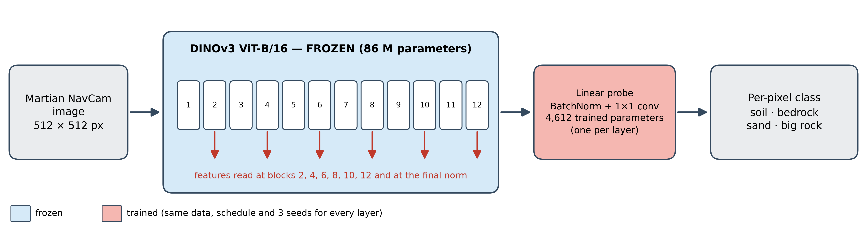
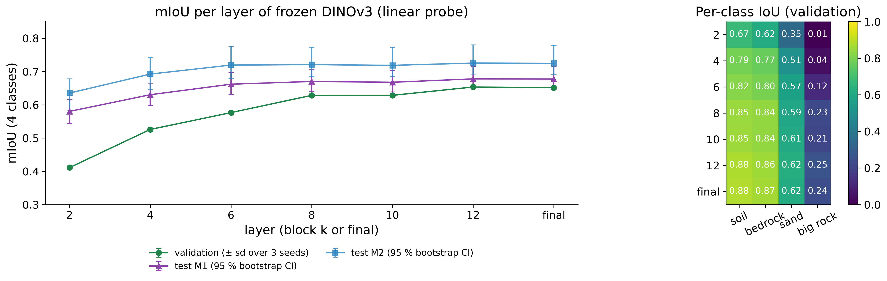
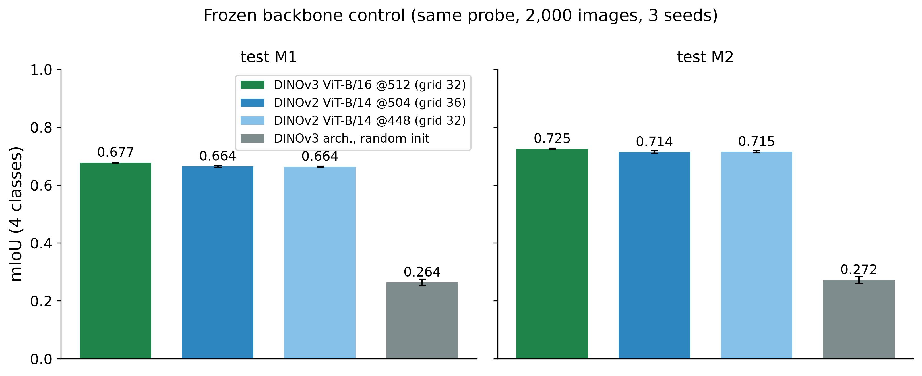
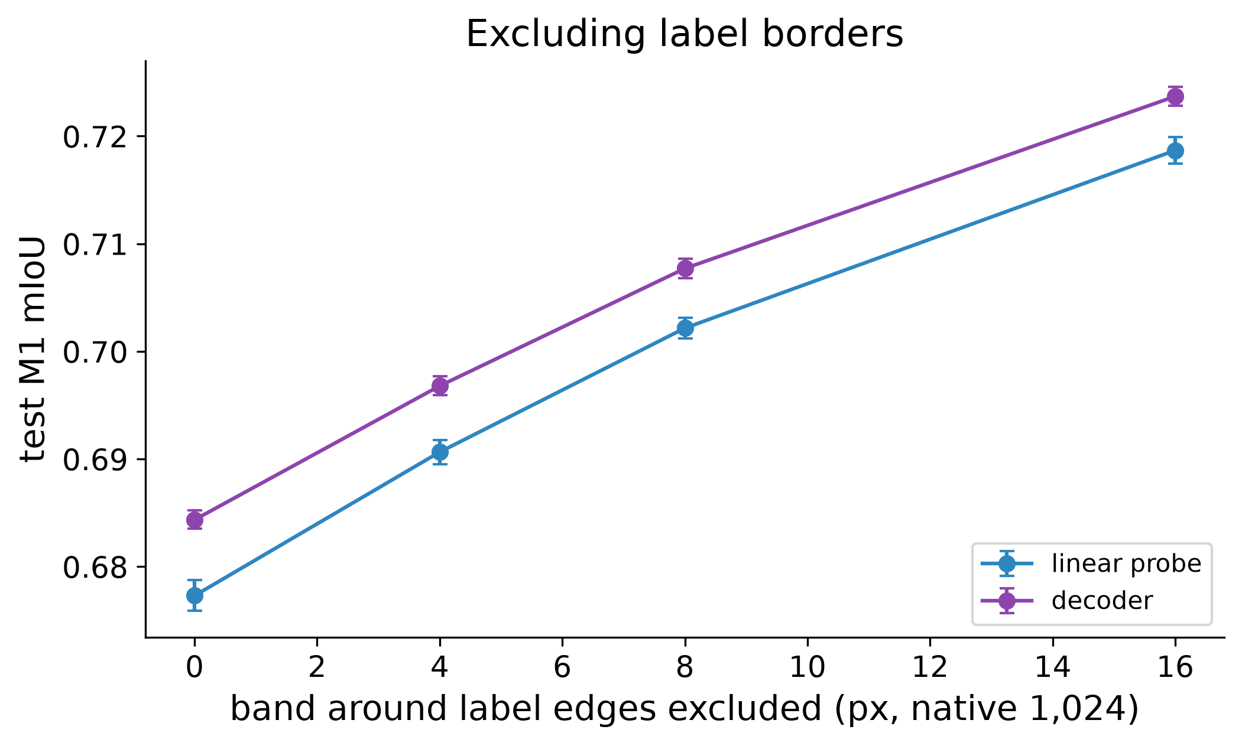
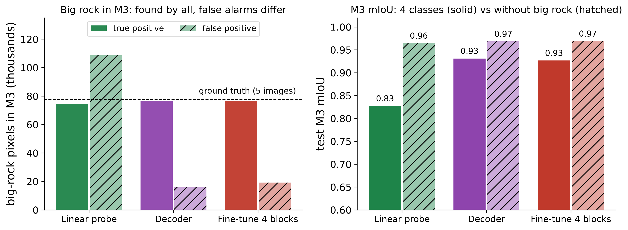
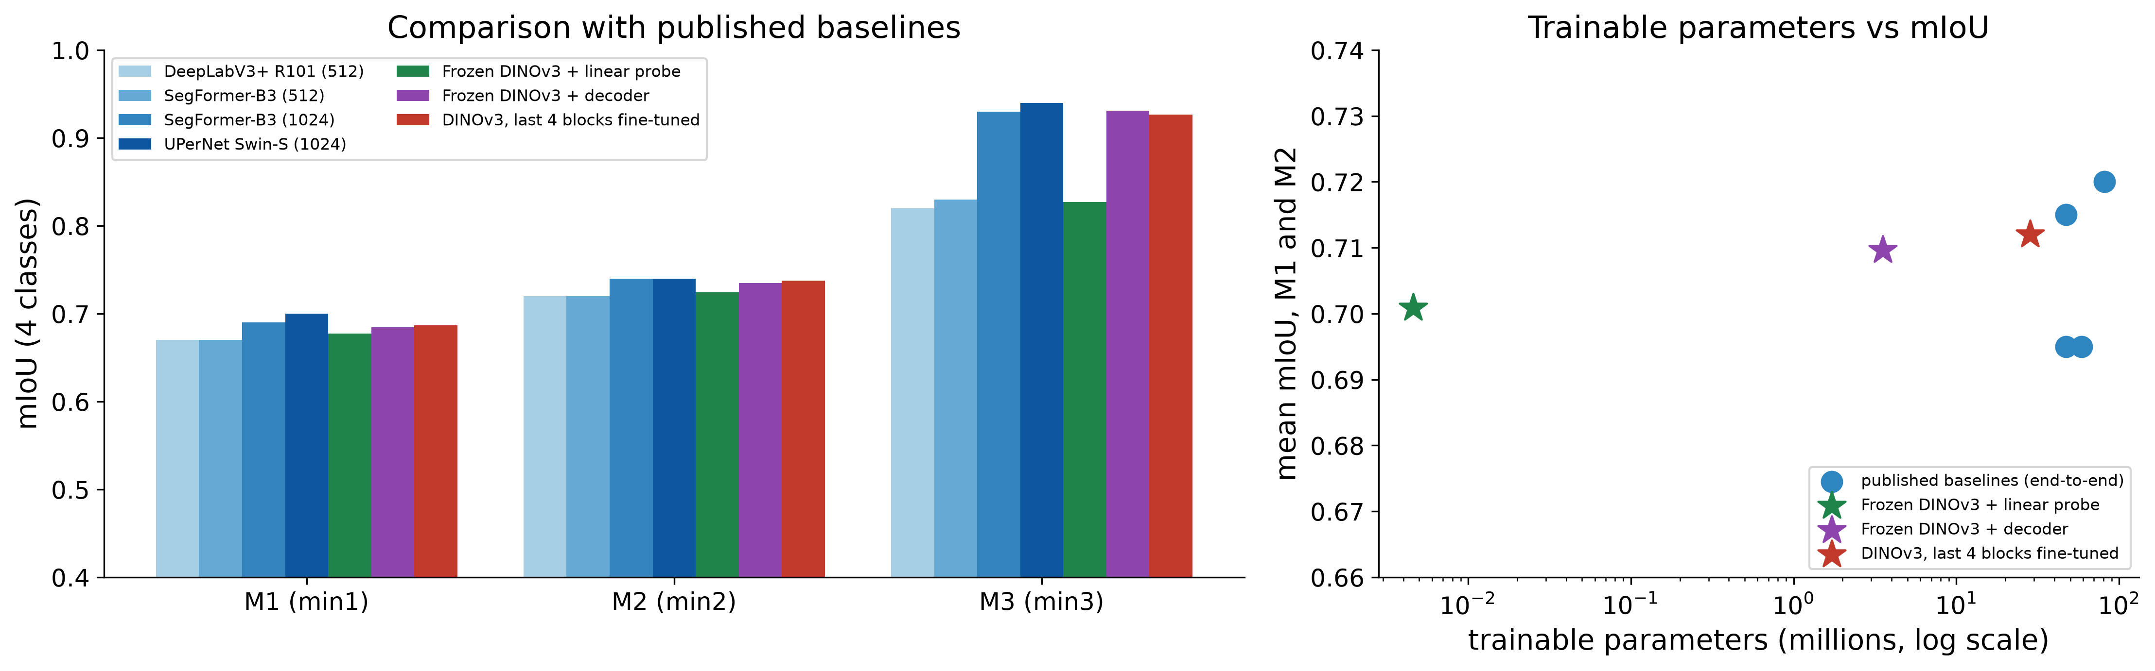
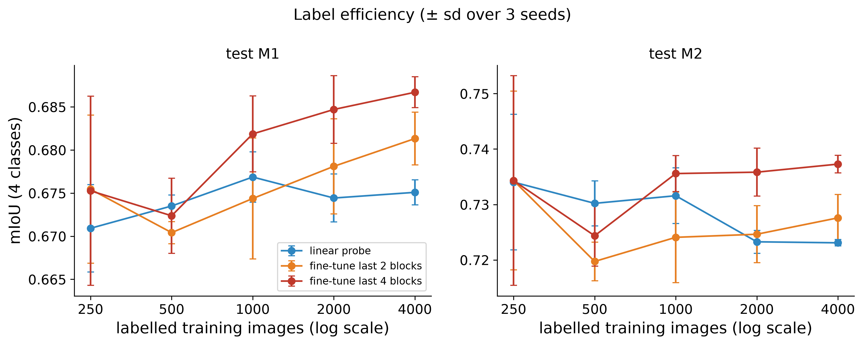
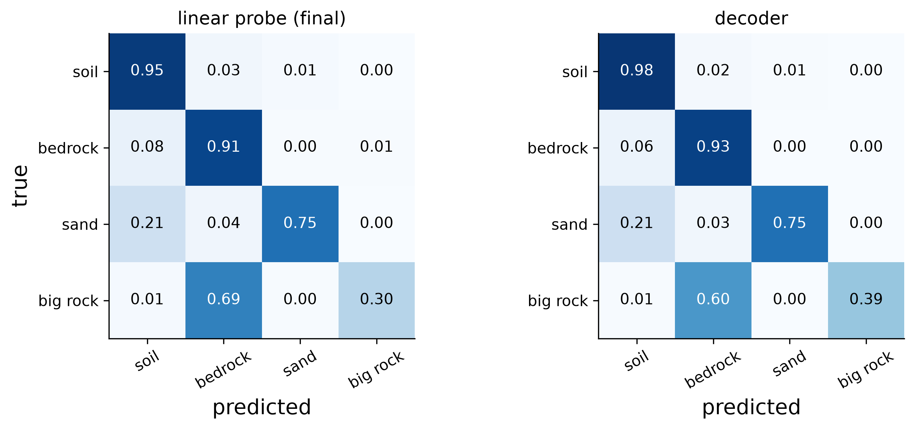

Workshop on Artificial Intelligence and Machine Learning Applications
Frozen DINOv3 Features for Martian Terrain Segmentation: Layer-wise Linear Probing on AI4Mars
Gonzalo Quispe¹ • Gustavo Meza¹ • David Rodríguez¹
¹Pontificia Universidad Católica del Perú, Lima, Peru · gquispeo@pucp.edu.pe · meza.gustavo@pucp.edu.pe · david.rodriguezc@pucp.edu.pe
MOTIVATION & RESEARCH PROBLEM
OBJECTIVES / CONTRIBUTION
• Rovers need to recognize the terrain they drive on (soil, bedrock, sand, big rock); expert labels of Mars are scarce and costly.
• DINOv3 is pretrained on web images, far from Mars: grayscale, repetitive textures, unusual illumination.
• Question: how well do frozen DINOv3 features transfer to Martian terrain, and which layers carry the useful information?
• Study: off-the-shelf frozen DINOv3 ViT-B/16 on AI4Mars (Curiosity), 4 terrain classes.
• Approach: one linear probe per layer (4.6 k parameters), then a decoder and partial fine-tuning; 3 seeds, bootstrap CIs.
• Related: Goh et al. [6] pretrain their own backbone with few labels; MANTLE [7] freezes one for binary boulders. We freeze a web-pretrained backbone for 4 terrain classes.
METHODOLOGY
RESULTS & DISCUSSION
• Transfer: final-layer probe reaches mIoU 0.677 / 0.725 on test M1 / M2 (majority class: 0.115 / 0.123).
• Heavier heads add little: decoder 0.684 / 0.735, last 4 blocks 0.687 / 0.737 (≤ +0.012).
• Pretraining: a frozen random ViT gets 0.264, only a lower bound (no from-scratch control). DINOv3 beats DINOv2 by +0.013 on M1 (both at N = 2,000), also at a matched token grid.
• Baselines: 0.023 / 0.015 below the best end-to-end model (indicative only), with 4.6 k instead of 58.8–81.2 M parameters.
• Layers and labels: no intermediate layer beats the last; 250 images give 99 % of the probe's mIoU.
• Data: AI4Mars, 512 px; 15,564 train, 500 validation (temporal hold-out), 322 expert test images (M1, M2, M3).
• Model: frozen DINOv3 ViT-B/16; probe per layer (4.6 k), decoder (3.5 M), last 2 / 4 blocks fine-tuned (14 M / 28 M).
• Evaluation: mIoU; layers chosen on validation; a gap is real if its 95 % bootstrap CI excludes 0 and |Δ| ≥ 0.01.
WHERE IT FAILS
• Big rock is the hardest class: IoU 0.24 on validation (others 0.62–0.88); 69 % of it is predicted as bedrock.
• M3 hides this: only 5 of its 322 images contain big rock. Models differ in false alarms (probe 109 k px, decoder 16 k px), which drives the M3 gap (0.83 vs 0.93).
• Size alone does not explain misses (inconclusive).
Fig. 1. mIoU per layer of frozen DINOv3 (validation ± sd over 3 seeds; test sets with 95 % bootstrap CI) and per-class IoU on validation.
Fig. 2. Frozen backbones, same probe (DINOv3, DINOv2 at two input sizes, random init).
Fig. 3. Excluding label borders (M1).
Fig. 7. Big rock in test M3 (mean of 3 seeds): true and false positives (left); mIoU with and without that class (right).
Fig. 4. Comparison with published baselines (M1–M3; M3 is dominated by big-rock false alarms) and trainable parameters.
CONCLUSIONS
• Frozen DINOv3 transfers to Mars: a 4.6 k-parameter probe is within 0.025 mIoU of the best published end-to-end model on M1 / M2; heavier heads add ≤ 0.012.
• Pretrained features matter (+0.41 over a frozen random ViT, +0.013 over DINOv2); no intermediate layer helps.
• Limits: one backbone, one rover, 3 seeds; only 1 of 6 hypotheses supported (H4: a decoder does not beat the probe); no from-scratch control; M3 cannot rank models on big rock.
• Next: same-protocol baseline, from-scratch control, other rovers.
Fig. 5. Label efficiency: linear probe vs fine-tuning the last 2 or 4 blocks (± sd over 3 seeds).
Main confusions (validation, row-normalised, probe / decoder):
big rock → bedrock 68.6 % / 60.0 %
sand → soil 20.5 % / 21.3 %
sand → bedrock 4.2 % / 3.4 %
Fig. 6. Row-normalised confusion matrices on validation: linear probe on the final layer (left) and decoder (right).
KEY REFERENCES
CONTINUE THE CONVERSATION
[1] O. Siméoni et al., “DINOv3,” arXiv:2508.10104, 2025.
[2] R. M. Swan et al., “AI4MARS: A dataset for terrain-aware autonomous driving on Mars,” CVPR Workshops, 2021.
[3] F. Mohammad, Y. Li, Y. Gao, “Transformers vs CNNs: Enhancing semantic segmentation for Martian terrain classification,” iSpaRo, 2025.
[4] F. Mohammad et al., “Deep learning based semantic segmentation for Mars rover terrain classification,” iSpaRo, 2024.
[5] G. Alain, Y. Bengio, “Understanding intermediate layers using linear classifier probes,” arXiv:1610.01644, 2016.
[6] E. Goh, J. Chen, B. Wilson, “Mars terrain segmentation with less labels,” arXiv:2202.00791, 2022.
[7] P. Durai, G. Doran, “MANTLE: a framework for adaptive in-situ planetary perception using a modular uplink principle,” arXiv:2608.28724, 2026.
Code, notebook and results: https://github.com/gonzaquis29/DinoV3-AI4Mars
Contact: gquispeo@pucp.edu.pe · meza.gustavo@pucp.edu.pe · david.rodriguezc@pucp.edu.pe
Data and model: AI4Mars (NASA/JPL), DINOv3 (Meta AI). Compute: free-tier Kaggle GPU.
BRING YOUR RESEARCH. SHARE YOUR IDEAS. JOIN THE CONVERSATION.
WAIMLAp 2026 • November 18–20, 2026 • Lima, Peru • waimlap.org

