Slide 1
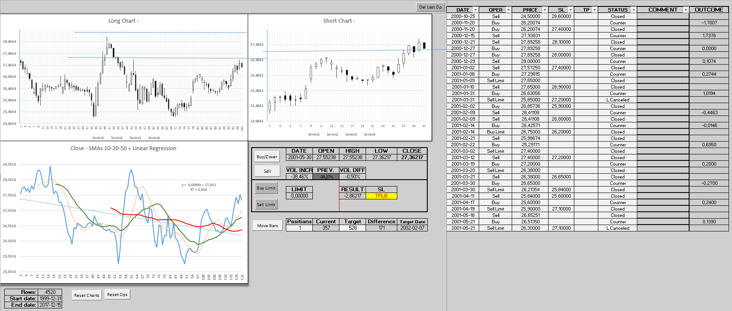
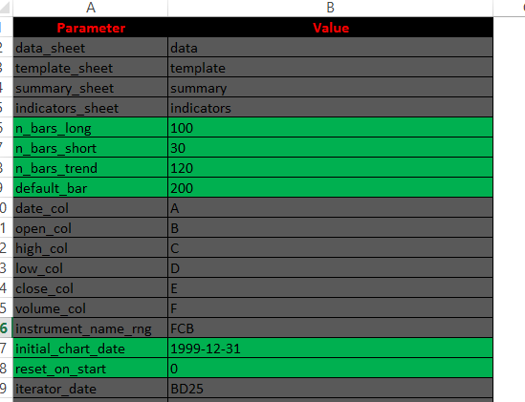
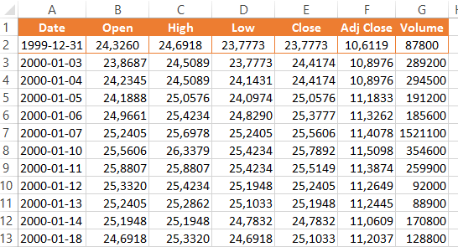
Notes:
Slide to explain the three main sections of the tool: Data, Iterator and Configuration.

Slide 2
Charts Area
Operations Area
Controls Area
Info/Reset Area
Notes:
Different panels of the Iterator tool

Slide 3
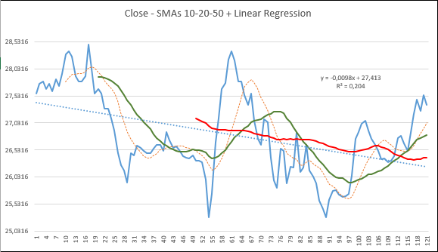
SMA10 Line
Linear Regression
SMA20Line
SMA10 Line
Close Line

Slide 4
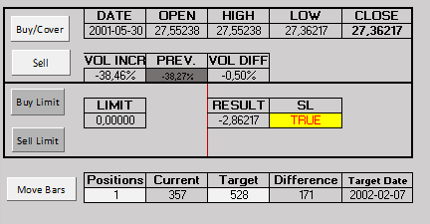
Buy/Cover button
Sell button
Move bars button
Positions cell
Target cell

Slide 5
