Slide 1
Causal-VAE World Model for the Joung TF Atlas
Developmental annotation (human fetal atlas) · singles-only training & architectures ·
held-out singles/combo results · epistasis · next-step architectures
scCausalRL | exp17_joung_tfatlas + exp19_nonlinear_compose

Slide 2
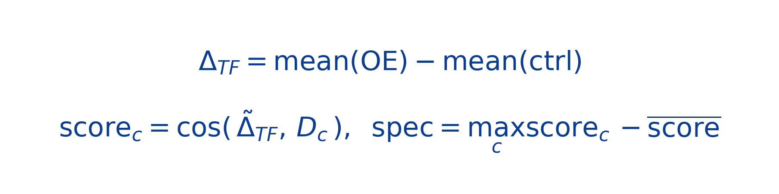
1 · Annotating the Joung TF Atlas with the Human Fetal Cell Atlas
Approach — shift alignment
Method shoot-out (chosen: cosine)
• Per TF: induced shift Δ = mean(OE cells) − mean(hESC control) — not the absolute profile (shared pluripotency baseline hides identity).
• Reference: Cao 2020 human fetal atlas (GSE156793) — 172 organ-cell-type expression signatures Dc = mean(type c) − mean over types.
• Score = alignment(Δ, Dc) after stripping the shared OE nuisance axes (top-4 SVD of the centred TF-shift matrix).
• Human reference ⇒ NO mouse→human orthology step: direct symbol match keeps ~all 9,923 Joung HVGs (vs the ~15k mouse-ortholog subset).
method | #conf(>0.12) | #conf(>0.05) | med spec | agree↔cos
cosine | 73 | 949 | 0.067 | 1.00
nnls | 0 | 0 | 0.020 | 0.02
ols | 0 | 0 | 0.000 | 0.02
ridge | 0 | 0 | 0.000 | 0.02
• TFs scored (n≥50 cells): 1084 | cell types: 172
• shared genes used: 6557 (discriminative half: 3278)
• cosine specificity: median 0.067, q90 0.109, max 0.394
• confidently annotated (spec>0.12): 73 TFs — vs only 13 with the mouse MOCA reference.
• cond(DᵀD)=1.1e+17 → collinear signatures, so unconstrained OLS/NNLS are ill-conditioned; cosine is the stable choice (README finding, re-confirmed).
Chosen: cosine alignment + specificity gate. The human reference is the same family the Joung paper used; the upgrade vs mouse is gene retention (no orthology loss) → more confident calls.

Slide 3
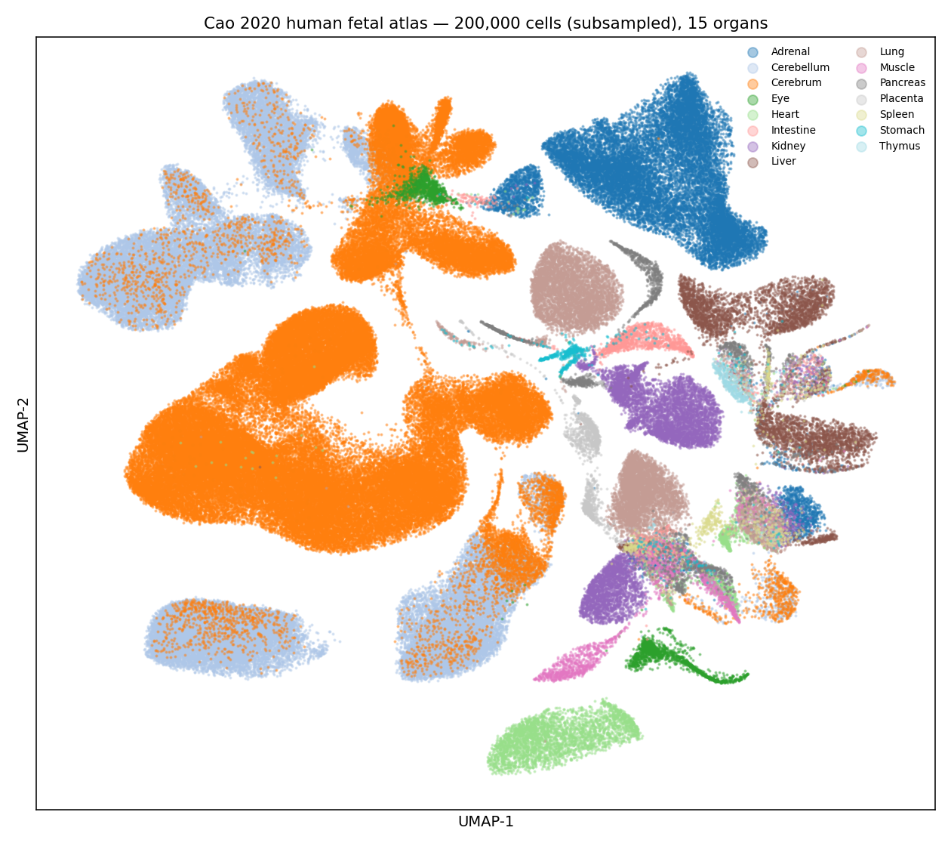
1 · The Human Fetal Reference (Cao 2020 / Descartes, GSE156793)
Why this reference
• ~4M cells, 121 fetal tissues, 15 organs (sci-RNA-seq3).
• 172 organ-cell-type signatures = the targets Δ_TF is aligned to.
• Human → direct symbol match to the Joung 9,923-HVG axis (no mouse orthology loss).
• Same reference family the Joung 2023 paper used to map TF profiles to fates → our annotation is comparable to the publication.
• Caveat: midgestation fetal is slightly LATER than the early-progenitor states 7-day hESC OE reaches; trajectory tiers differ from MOCA.
experiments/figures/joung/human_fetal_atlas_umap.png

Slide 4
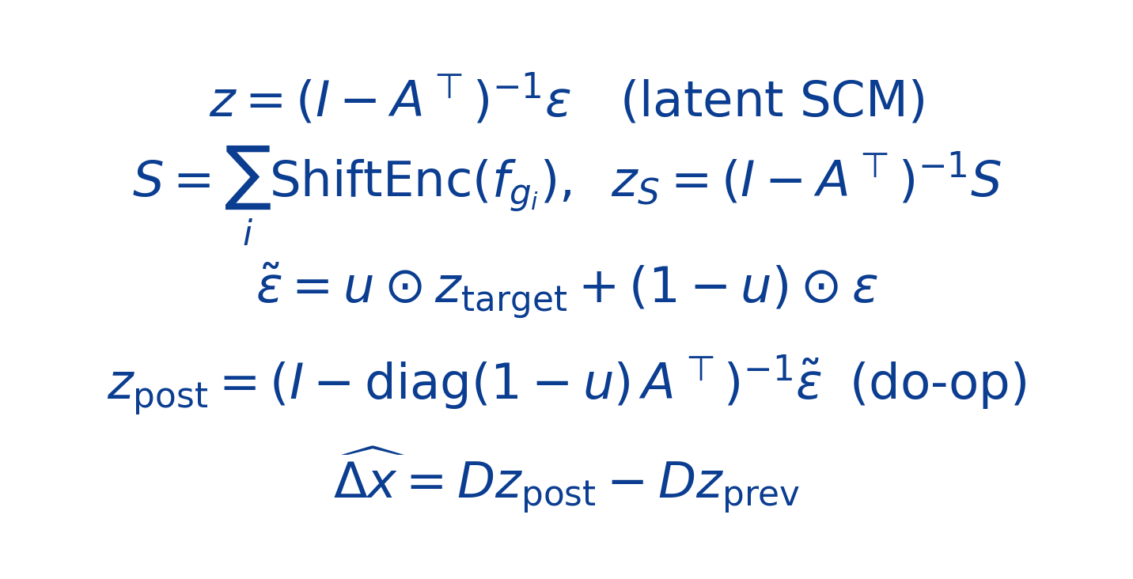
2 · Training: Singles-Only on the Joung TF Atlas
Data & vocabulary
The world model (shift-encoder + SCM do-operator)
• Raw atlas dense 1.15M × 37,528 (≈172 GB) → chunk-preprocessed to a compact 9,923-gene axis.
• Vocabulary (9,923 genes) = 8,506 combinatorial-screen genes ∪ 1,769 TF genes (the on-axis perturbable set).
• Full training set: 1,144,579 cells × 9,923 genes; controls = GFP/mCherry cells (~127,813).
• Trains on SINGLE TF over-expressions only; combos/triples fully held out for compositional eval.
• MLP encoder → linear-Gaussian SCM on latents → LINEAR decoder (kept linear for the GRN + CollecTRI prior).
• A held-out TF is predicted zero-shot from its feature (control-PCA or ESM embedding) via the learned shift encoder.
Splits (gene-level, seed 42)
split | # TFs | use
train | 1,351 | fit the world model
val | 169 | early-stop / selection
test | 169 | held-out single-TF zero-shot
combos | 44 pairs + 3 triples | held-out composition

Slide 5
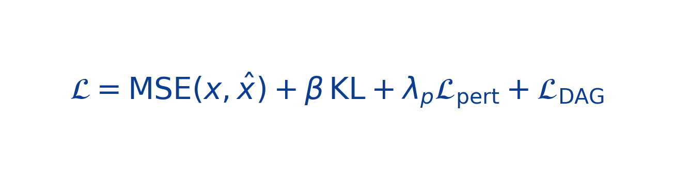
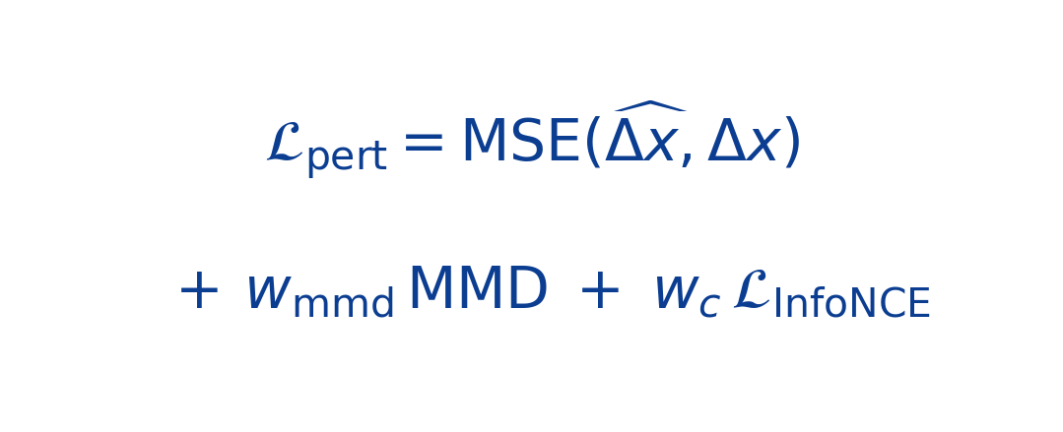
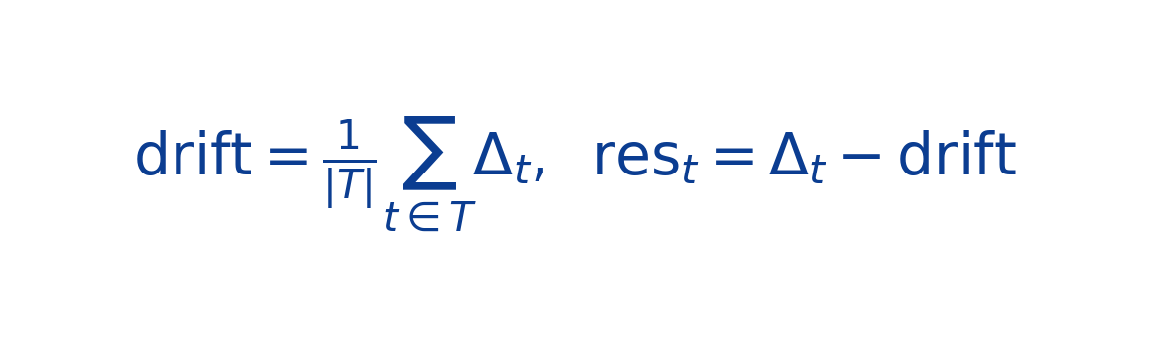
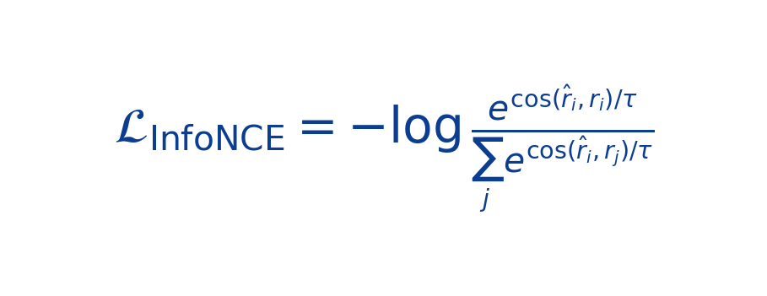
2 · Architectures Tried & Loss Functions
Ablation grid (shift input × residual target × contrastive × latent)
Losses
variant | input | resid-MSE | contrastive | note
orig | ctrl-PCA | ✗ | ✗ | baseline
esm | ESM-2 | ✗ | ✗ | input swap
esm_resid | ESM-2 | ✓ | ✗ | collapsed
esm_resid_con | ESM-2 | ✓ | ✓ | collapsed
esm_con ★ | ESM-2 | ✗ | ✓ | winner
+MMD / +sep-head | ESM-2 | — | — | exp17 (running)
u_gate / eps_mix | ESM-2 | ✗ | ✓ | exp19 (running)
Perturbation (cascade) loss:
Drift-removed residual (specificity):
Contrastive (InfoNCE, drift-removed):
Non-learned baselines
• context_mean (Δ=0), perturb_mean (drift), additive_obs (Σ observed singles; combos),
• corr (gene–gene control correlation), coexp (k-NN of training-TF Δ in control-feature space).
InfoNCE makes each TF's predicted shift retrieve its OWN observed (drift-removed) shift — the specificity baselines cannot fake.

Slide 6
3 · Results — Held-out Single TFs (zero-shot)
Takeaways
• Raw Pearson / Spearman / DEG-AUROC are SATURATED by perturb_mean (drift) and coexp — not where the model adds value.
• Model wins only on DRIFT-REMOVED Pearson + discrimination (the load-bearing, baseline-uncheatable metrics).
• esm_con (ESM input + contrastive) is the winner: disc-resid 0.615 vs 0.50 chance; beats even the coexpression prior.
• Residual-TARGET runs collapse (decoder conflict).
[ FIGURE PLACEHOLDER ]
experiments/figures/joung/exp17_singles_panels.png

Slide 7
3 · Results — Combo / Triple Composition
[ FIGURE PLACEHOLDER ]
[ FIGURE PLACEHOLDER ]
experiments/figures/joung/exp17_combos_panels.png
experiments/figures/joung/exp17_pairs_vs_triples.png
Takeaways
• do-op (mutilation) beats zero-shot additive by a small margin — but LOSES to the additive_obs oracle (Σ observed singles): 0.25 vs 0.13.
• Only the contrastive models clear the perturb_mean floor on combos; no model achieves combo-level discrimination (≈ chance).

Slide 8
4 · Epistasis — Is the do-operator Capturing Synergy?
Verdict: epistasis-neutral
• vs the model's OWN additive, the do-op adds only ≤0.05 Pearson — and that edge does NOT grow with epistasis (shrinks for esm_con).
• The apparent "gap closes on epistatic combos vs additive_obs" is the ORACLE degrading, not the model improving.
• Consistent with exp14 (Norman): the operator is epistasis-NEUTRAL, not epistasis-capturing.
• Singles-only training cannot learn interaction — needs combo data + interaction capacity.
[ FIGURE PLACEHOLDER ]
experiments/figures/joung/exp17_epistasis_quartiles.png

Slide 9
5 · Next Steps — Architectures We're Pursuing
Singles-trainable non-additivity (decoder stays linear → GRN/CollecTRI intact)
direction | what it changes | why / hypothesis | status
u_gate = MLP(S) | cross-program nonlinear gate on the do-op strength u | only singles-trainable non-additivity; gate sees multi-program single shifts | exp19 — training
nonlinear ε-mix | nonlinear cross-program exogenous mixing | same goal via the ε-combination; zero-init → starts at linear baseline | exp19 — training
u_gate + ε-mix | both | max singles-only non-additivity capacity | exp19 — training
separate residual head | decouple a pert decoder from the GRN decoder | test residual target without the decoder conflict; A still gets gradients | exp17 — training
re-add MMD | distributional set-matching term (exp14 recipe) | exp17 dropped MMD; restores perturbed-distribution shape | exp17 — training
human-fetal annotation | swap mouse→human reference | more confident fate labels → enable fate-reward / RL identifiability | done (this deck)
combo-training | train on a subset of combos (Norman has ~107; Joung only 44) | the ONLY lever that truly unlocks epistasis | planned (Norman)
RL readiness: clears the discrimination gate over trivial baselines (single-step RL OK); combinatorial planning needs epistasis → combo data + interaction capacity. additive_obs is an oracle ceiling, not a gate.

