Slide 1
Fixing Zero-Shot Generalization
MMD + DE-gene loss beat the copy baseline; combo-training captures epistasis
scCausalRL · exp20_load_bearing · lb9 sweep · Joung TF atlas (vocab-v2b), prior-off

Slide 2
2 · Where we left off — the wall was generalization
exp20 verdict: the architecture is sound, but on Joung the binding constraint is ZERO-SHOT GENERALIZATION. The model memorized seen TFs (train allDEG 0.74) and fell to ~0 on held-out TFs — BELOW a dumb ESM-nearest-neighbour COPY baseline (allDEG 0.31). disc_resid was flattering but not correctness.
This deck — two questions
Q1 · Beat the copy?
Q2 · Capture epistasis?
• Can any objective/architecture change push held-out DE-gene prediction ABOVE the ESM-kNN copy?
• Levers: MMD distribution-matching, drift-removed DE-gene MSE, ESM-noise, nonlinear-SCM, free decoder, retrieval anchor.
• Does the do-operator predict combinatorial (non-additive) TF effects — beyond simple additivity?
• Compare singles-only vs combo-trained (50/50 split), same held-out combos.
All eval is zero-shot on held-out TFs (gene-level split); metrics are drift-removed; prior OFF everywhere.

Slide 3
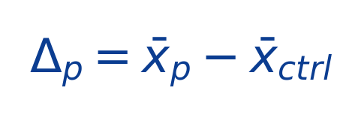
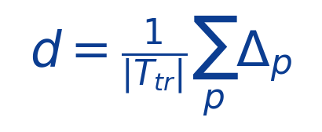
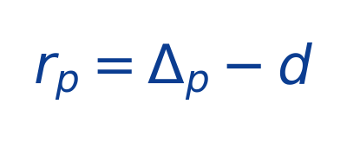
3 · The dataset — Joung TF atlas, cleaned to vocab-v2b
How it was cleaned
• Rebuilt from the RAW counts atlas (37,528 genes) — the legacy 9,923-gene proc overlapped the new vocab by only 61%.
• Gene axis = 4,000 Seurat-v3 highly-variable genes ∪ curated fate markers → 4,366 genes.
• TF vocab: isoform-merged to 661 perturbations, then filtered to EFFECTIVE TFs — 166 inert/absent perturbations dropped (no measurable response).
• Gene-level split of the 495 effective TFs → strict zero-shot held-out test set.
Δ, drift, residual
per-TF log-fold change
shared differentiation drift (≈99% of signal)
 | count | note
Genes (v2b vocab) | 4,366 | 4000 Seurat-v3 HVG ∪ fate markers
TF perturbations | 661 | isoform-merged
→ effective (kept) | 495 | 166 inert/absent dropped
→ train / val / test | 396 / 50 / 49 | zero-shot gene-level split
Cells (total) | 1,145,823
→ control (GFP/mCherry) | 127,813 | baseline for Δ
TF-specific residual — what we score
Same eval contract as exp17/19; load_joung lognorms raw counts downstream.

Slide 4
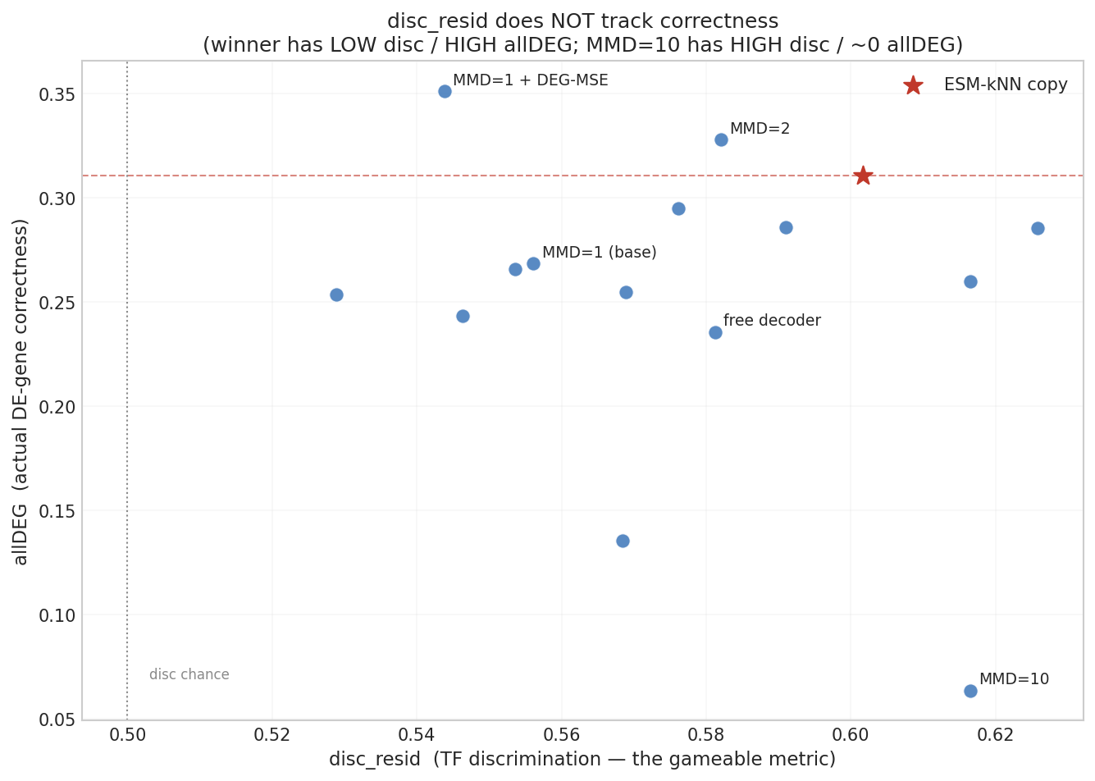
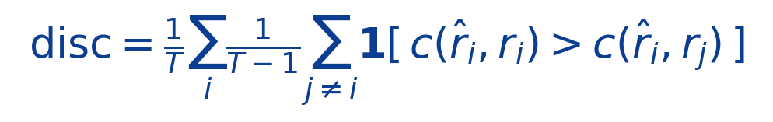
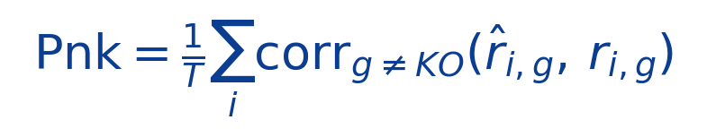
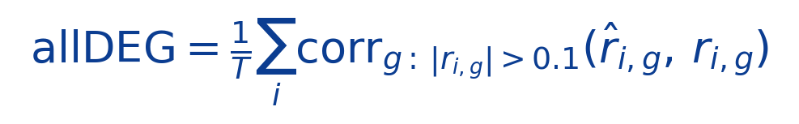
4 · Metrics — and why disc_resid alone is misleading
c(a,b) = mean-centered cosine. r̂=pred−drift, r=obs−drift. T = # held-out TFs (n=49). KO = perturbed gene (excluded).
disc_resid (TF discrimination, chance 0.5)
Pnk (whole-profile Pearson, chance 0)
allDEG (DE-gene Pearson, chance 0)
WHY NOT disc alone: it rewards a TF fingerprint in low-magnitude BULK genes (≈ the training contrastive objective, circular) — across the sweep disc ANTI-correlates with correctness (right): the winner has LOW disc / HIGH allDEG; MMD=10 has HIGH disc / ~0 allDEG.

Slide 5
5 · The lb9 sweep — generalization levers (prior-off)
lever | what it adds | arms
MMD (distribution match) | RBF-MMD(pred cells, obs cells) added to raw-Δ MSE | MMD ∈ {0.25,0.5,1,2,5,10}
+ DE-gene MSE | drift-removed, DE-gene-masked, magnitude-preserving MSE | mmd1_deg2, mmd2_deg2
+ ESM-noise / wd | jitter the ESM→shift map (anti-memorization) + weight-decay | mmd1_esmnoise(_wd)
+ retrieval anchor | self-masked D†·residual memory blended into exogenous S | mmd1_retr_k20
nonlinear SCM | z = φ(Aᵀz) + ε via Picard iteration | nlSCM_mmd1, nlSCM_mmd2_deg2
free decoder | learnable linear D (vs GO-masked) | free357
combo training | hold out TFs AND combos; do-op composes shifts | Jcombo / JNcombo (50/50)
Backbone (best from before): masked-GO decoder + structural do-op + L0 target gate + ESM shift-encoder + MSE + InfoNCE, prior OFF. MMD is the proven lever; DE-gene MSE is the diagnosed-missing term (nothing rewarded drift-removed DE-gene magnitude).
The do-operator (mutilated SCM solve)
Every arm = one knob change on the same backbone; judged on held-out drift-removed allDEG / Pnk + real−shuffled A-gain.

Slide 6
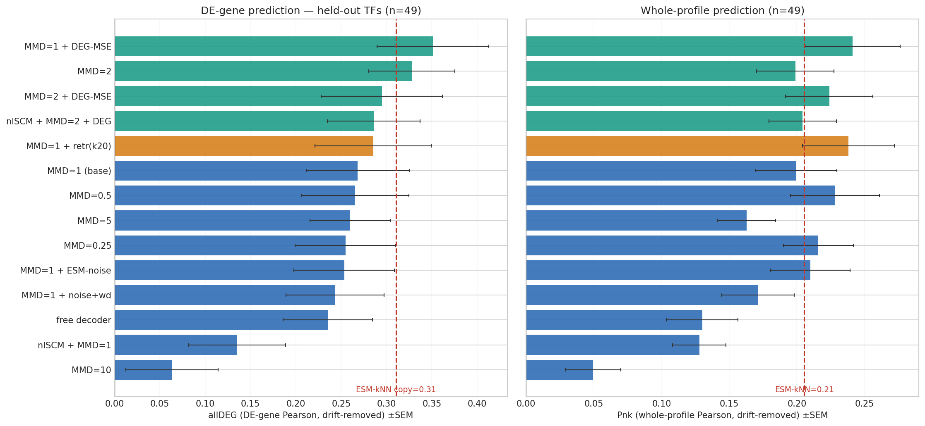
6 · Eval across all arms — the winner beats the copy (n=49)
Result
• mmd1_deg2 BEATS ESM-kNN: allDEG 0.34 vs 0.31, Pnk 0.24 vs 0.21 (4000-ctrl, 3-seed).
• MMD optimum ≈ 1–2; 0.25 and 10 collapse.
• DE-gene MSE stacks (0.25→0.34).
• retrieval anchor helped here (not on old backbone).
• ESM-noise / free-decoder did NOT help.
Bars ±1 SEM over n=49 held-out TFs; red dashed = ESM-kNN copy; disc chance 0.5, correlation chance 0.

Slide 7
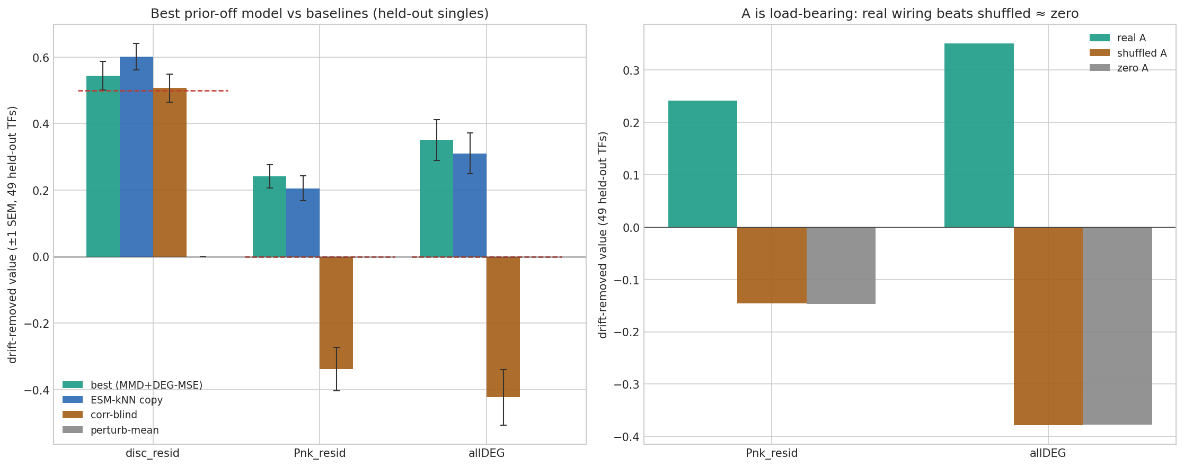
7 · Best prior-off model vs baselines + A is load-bearing (n=49)
• Left: the winner (MMD + DE-gene MSE) beats ESM-kNN / corr-blind / perturb-mean on Pnk & allDEG (disc lower — the gameable metric). Right: real A beats SHUFFLED ≈ zero A by +0.39 Pnk / +0.72 allDEG — the learned wiring is genuinely load-bearing.

Slide 8
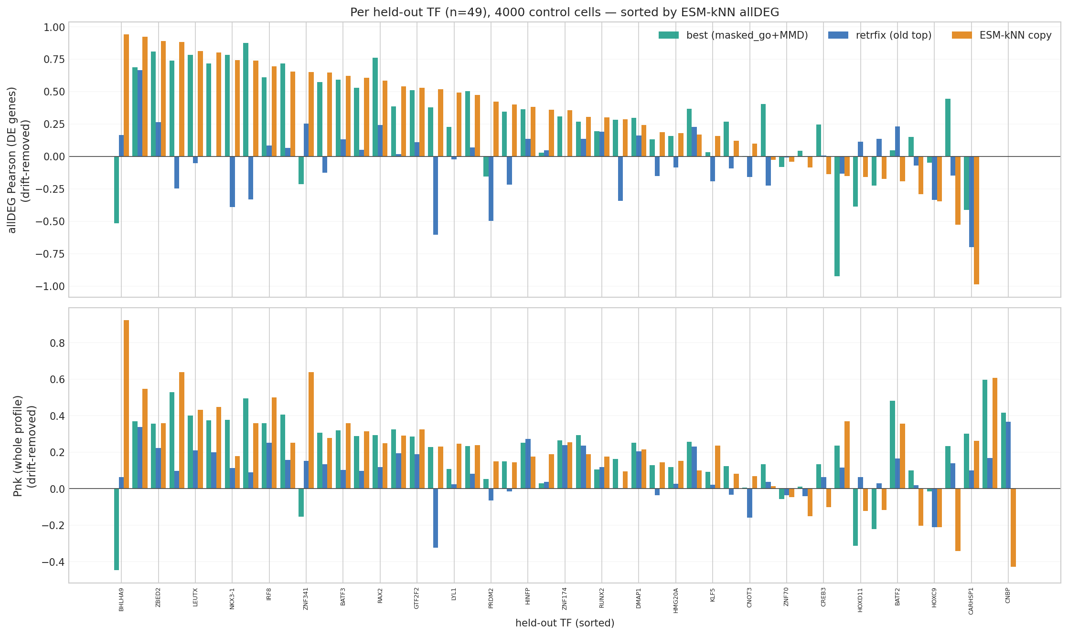
8 · Per-TF prediction — broadly competitive with the copy (n=49)
• masked-GO+MMD is positive on 33/49 held-out TFs (ESM-kNN 34/49) with fewer negatives — a broad win, not a few lucky TFs; the old retrfix "top" model was positive on only 15/49.

Slide 9
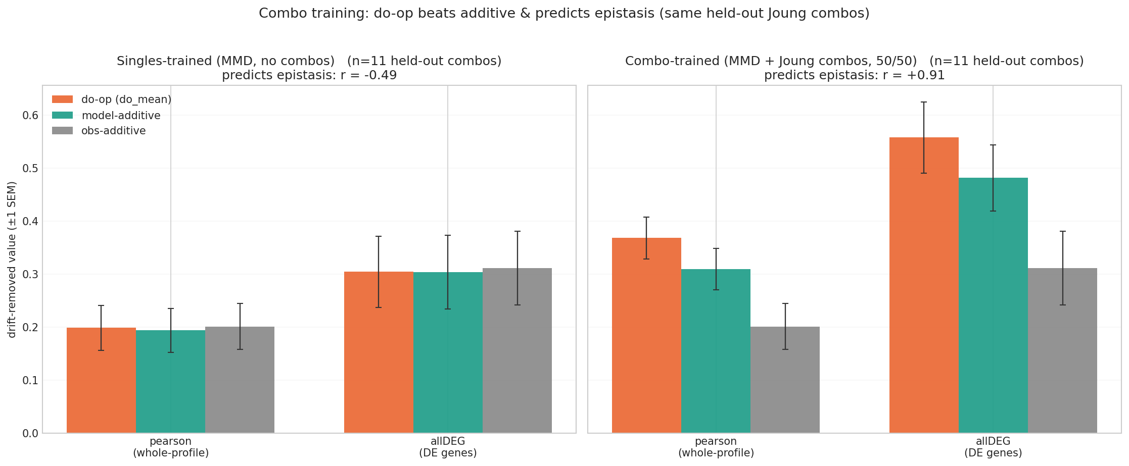
9 · Epistasis — singles vs combo-trained (same held-out combos)
Combo-training (50/50 split) makes the do-operator BEAT additive AND predict which pairs are synergistic: epistasis r jumps −0.49 → +0.91. The mutilated-SCM machinery earns its keep only once trained on combos.
Same MMD backbone, same dataset (Joung), same held-out combos; do_mean = per-single-mean u composer.

Slide 10
10 · Master results (held-out, drift-removed)
Singles — n=49 held-out TFs
Combo — n=11 held-out combos
arm | disc | Pnk | allDEG | A-gain (ΔallDEG) | verdict
mmd1_deg2 (winner) | 0.54 | 0.24 | 0.35 | +0.72 | beats copy
mmd2 | 0.58 | 0.20 | 0.33 | +0.66 | ≈ copy
mmd2_deg2 | 0.58 | 0.22 | 0.29 | +0.66 | —
nlSCM_mmd2_deg2 | 0.59 | 0.20 | 0.29 | +0.63 | biggest A-gain
mmd1_retr_k20 | 0.63 | 0.24 | 0.29 | +0.64 | anchor helped
masked_go+MMD (base) | 0.56 | 0.20 | 0.27 | +0.62 | prior best
free357 (free decoder) | 0.58 | 0.13 | 0.23 | +0.56 | worse; keep mask
ESM-kNN copy (baseline) | 0.60 | 0.21 | 0.31 | — | the bar to beat
 | singles | combo
do_mean pearson | 0.20 | 0.37
do_mean allDEG | 0.30 | 0.56
vs model-additive | tie | +0.06
predicts epistasis r | −0.49 | +0.91
Two wins:
(1) MMD + DE-gene MSE is the first arm to beat the dumb copy on held-out DE prediction.
(2) combo-training lifts the do-op from additive (r ≈ 0) to genuine epistasis prediction (r ≈ +0.9).
Singles @4000 ctrl / 3 seeds; A-gain = real − shuffled A. Combo: 50/50 split, small n → wide CI (effect large & consistent across Joung + joint arms).

Slide 11
11 · Next steps
Bottom line: we broke the generalization wall (beat the copy) and cracked epistasis (combo-training). Both with the two diagnosed levers — MMD (distribution match) + drift-removed DE-gene MSE — on a load-bearing A.
Confirm & tighten
Scale combos
Widen the DE-gene MSE weight sweep around the winner (×1/3/5) + seeds; confirm the copy-beating margin with more held-out TFs.
More held-out combos (small n now) + joint Joung+Norman; push epistasis r and the high-|ε| quartile.
Generalization
Design / RL
Cross-dataset pretraining of the ESM→response map; the ESM-smoothness idea needs a better scale / gate-head coverage.
With a combo model that predicts synergy, plan TF cocktails toward target fates over the frozen world model.
exp20_load_bearing · lb9 sweep · prior-off · Joung vocab-v2b.

