Slide 1
Perturbation Eval — Methodology
How DEGs are called, how the correlation and GRN baselines work,
and exactly what the additive combo baseline computes.
CausalBioRL | evaluation/run_perturbation_eval.py + eval_combinatorial.py

Slide 2
Step 1 — Build the DEG ground truth (one example: DONSON in Replogle)
Per perturbation g — what we do:
Cohort sizes after filtering
• 1. Find pert cells: indices where obs.gene == g. For DONSON: 688 cells.
• 2. Compare to ALL control cells (obs.gene == "non-targeting"): 10,691 cells in Replogle K562, 11,183 in Norman.
• 3. Per gene g′ in the 2,000-HVG axis, compute lfc: mean(pert) − mean(ctrl). Signed.
• 4. Per gene g′, run Mann–Whitney U (rank-sum test on pert vs ctrl distributions) to get a p-value. Vectorised across all 2,000 genes.
• 5. A gene is a DEG of pert g iff its p-value < 0.05. For DONSON: 892 of 2,000 HVGs flagged.
• 6. Pooled effect size = |lfc| / sqrt((σ²_ctrl + σ²_pert) / 2). Used for ranking metrics that need a non-negative magnitude.
• 7. Perturbations with fewer than MIN_CELLS = 5 pert cells are dropped.
Replogle K562 (train_v5.h5ad, CRISPRi)
• 186,807 cells after cell_line == "k562" filter
• 10,691 non-targeting control cells
• 1,371 perturbed genes (≥ 5 cells each)
• Gene split: 1,097 train / 137 val / 137 test (seed 42)
• On test split: 40 of 137 have ≥ 3 DEGs (AUROC computable)
Norman (MTX, K562 CRISPRa)
• 111,668 raw barcodes → 104,507 after good_coverage filter
• 11,183 non-targeting control cells
• 105 single-pert genes, 131 combos
• On Replogle 2,000-HVG axis: 19 / 105 singles, 4 / 131 combos are evaluable (the rest have target gene outside the HVG axis)
• K562 essential unfiltered (8,563 genes) would lift coverage to ~54 / 105
The DEG mask is the SAME ground truth for the model, correlation baseline, GRN baseline, and additive baseline.

Slide 3
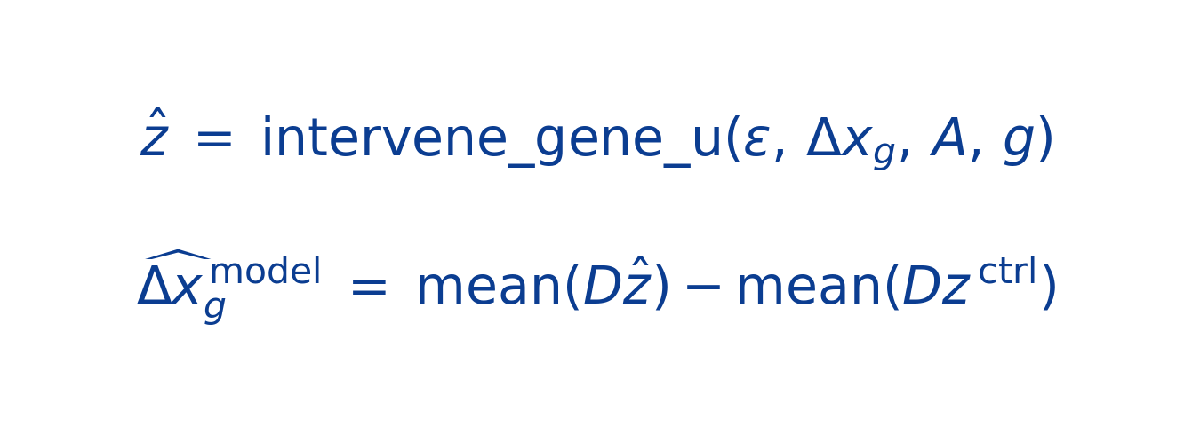
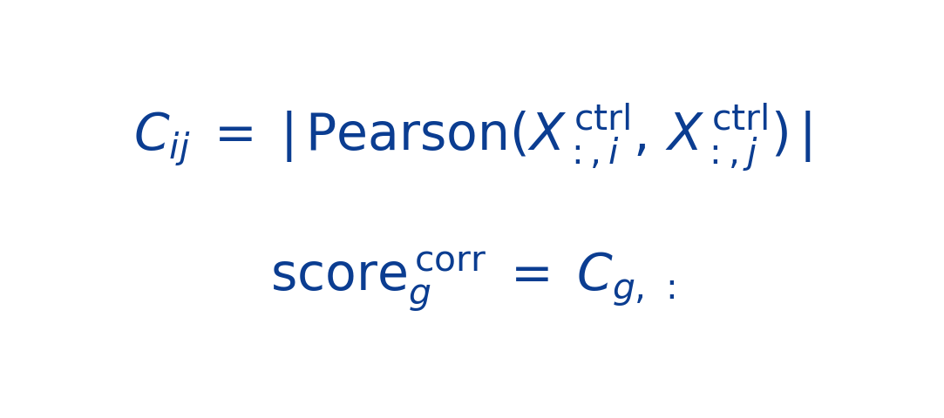
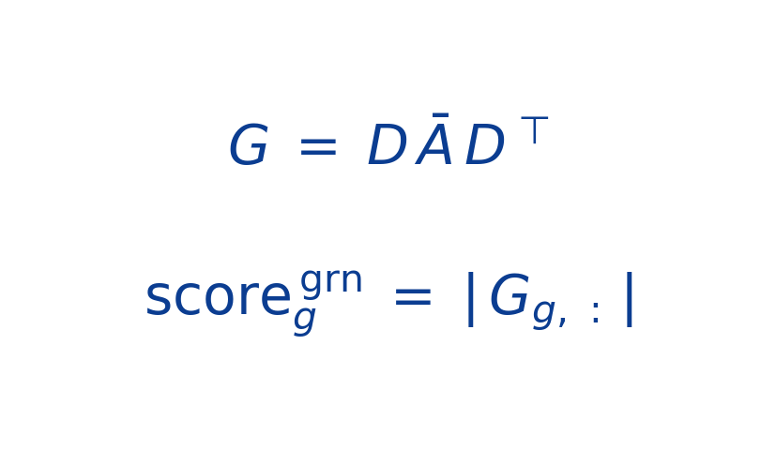
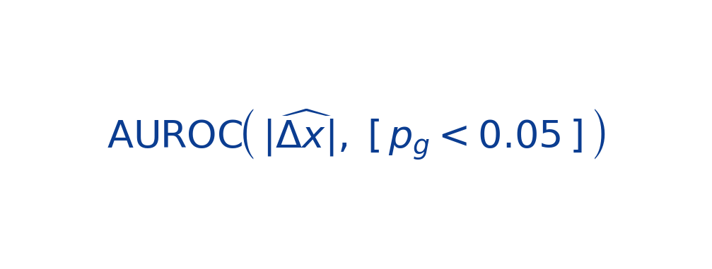
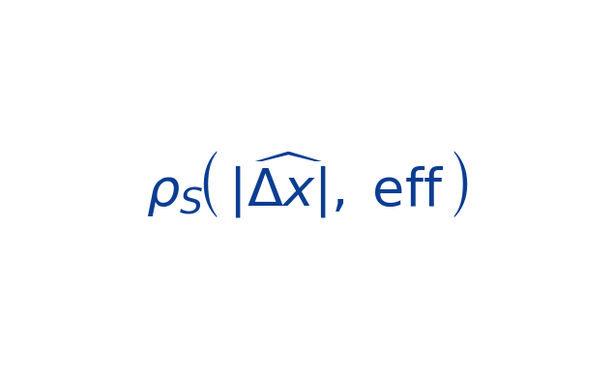
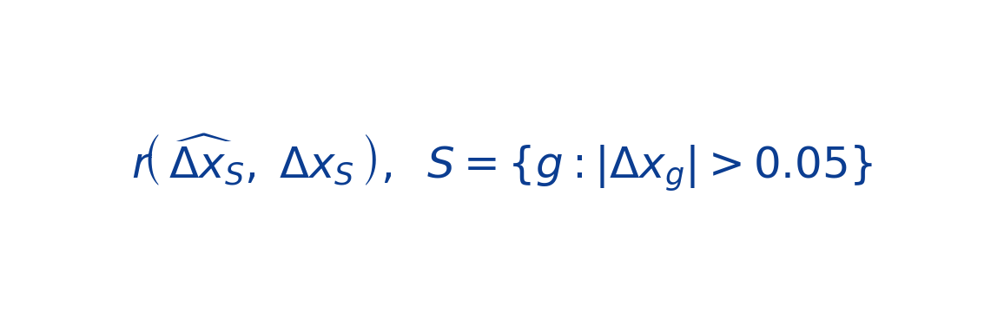
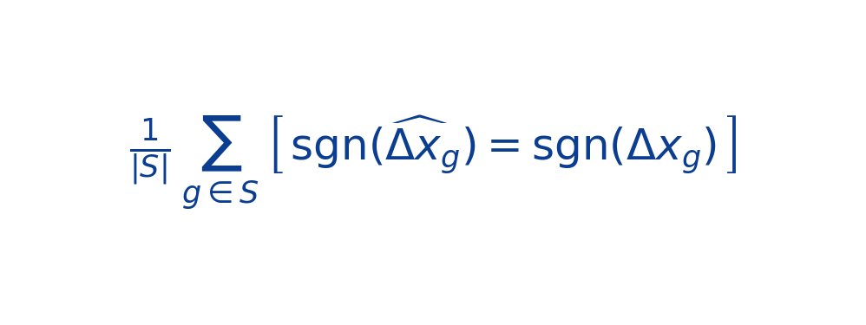
Step 2 — Single-pert: Model vs. Correlation vs. GRN Baselines
Causal VAE (D†)
Correlation baseline
Learned GRN (D · A · Dᵀ)
Sample 50 random ctrl cells (seed=42), encode → ε, draw ONE A sample (n_dag_samples=1 deterministic at eval), apply u-score do(g), decode, average the 50 cell predictions.
C built from ALL ctrl cells (Replogle 10,691 or Norman 11,183). Score row g excluded self. No causal claim — purely co-variation.
Uses the model parameters directly: D and the mean edge prob A from dag.get_edge_probs(). One static G — no per-cell sampling.
Metrics computed per perturbation, then averaged:
AUROC (DEG detection)
Spearman ρ on |effect|
Pearson on DEGs
Direction acc. (DEGs)
Can the score rank true DEGs above non-DEGs? 0.5 = random.
How well the score RANKS genes by effect-size magnitude. Signed variant uses lfc instead.
Linear correlation of predicted vs observed lfc, computed only on genes with |Δx| > 0.05 (DEGs).
Fraction of DEGs with correct sign (up vs down). S = sig set.

Slide 4
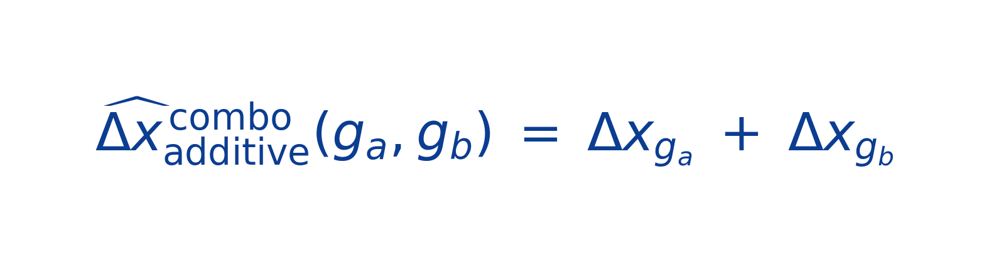
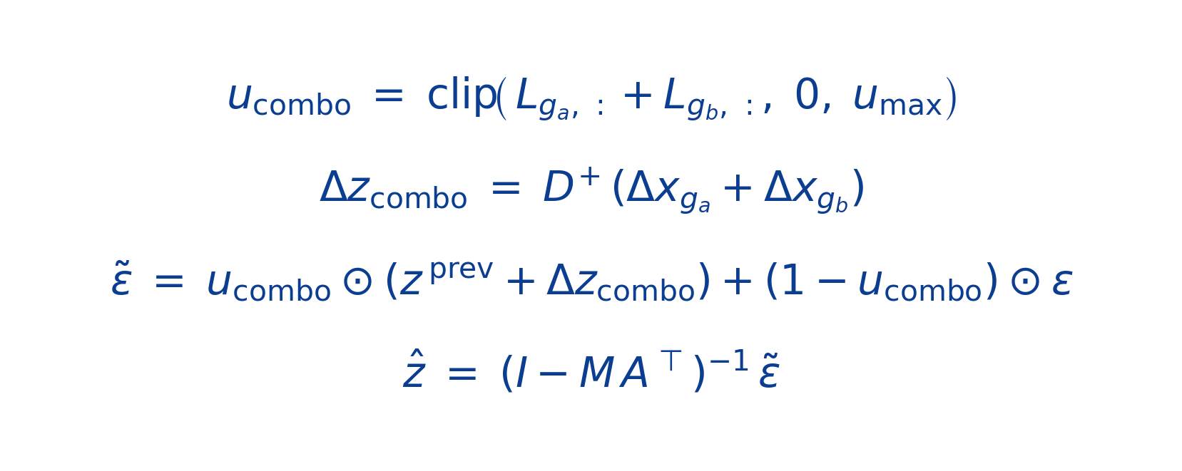
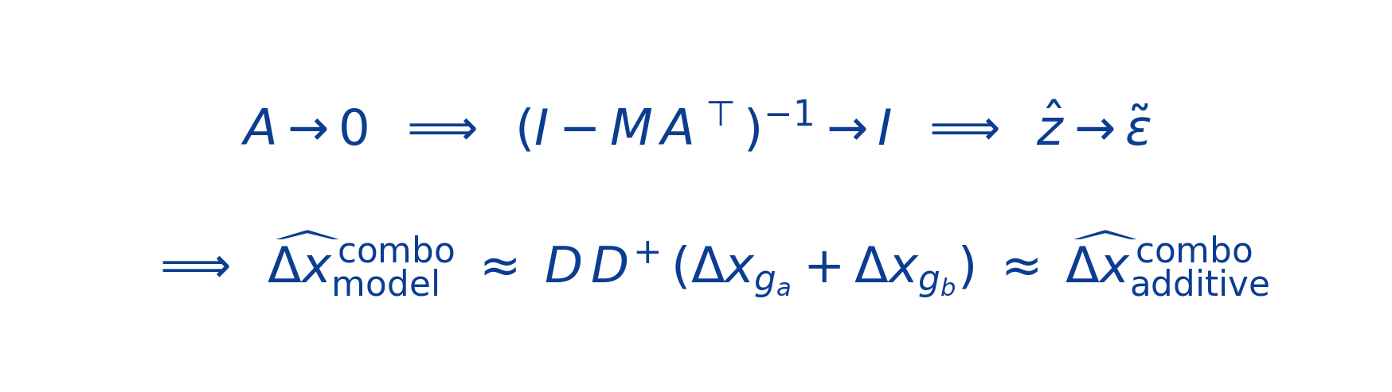
Step 3 — Combo (Norman only): Additive Baseline & Parallel u-score Combo
Additive baseline
Causal VAE (parallel u-score)
where each Δx_{g} is the OBSERVED single-pert delta from Norman cells.
• Δx_{g_a}, Δx_{g_b} come from Norman OBSERVED single-pert lfc (de_single dict, full single-pert cells, not held out).
• No epistasis, no saturation — pure linear superposition.
• Strong because ~70% of combo effects are near-additive (Norman 2019).
• Combo cells held out for eval: 20 ctrl cells (seed=42) used for the model pipeline; additive uses ALL ctrl_mean.
Order-invariant (AB ≡ BA by construction). M = diag(1−u_combo).
Why the additive baseline is hard to beat:

