Slide 1
Is the Latent DAG Load-Bearing?
An architectural + objective + identifiability investigation on the Joung TF atlas
scCausalRL · exp20_load_bearing · shift-encoder causal-VAE world model

Slide 2
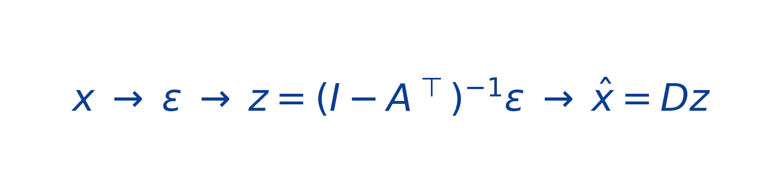
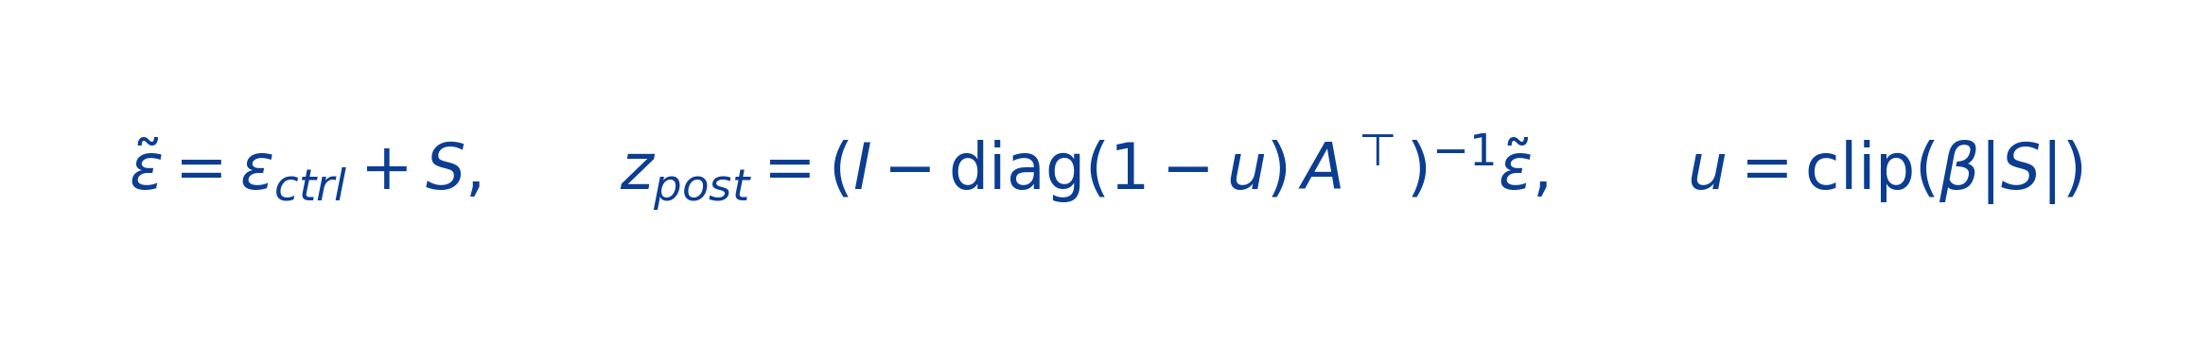
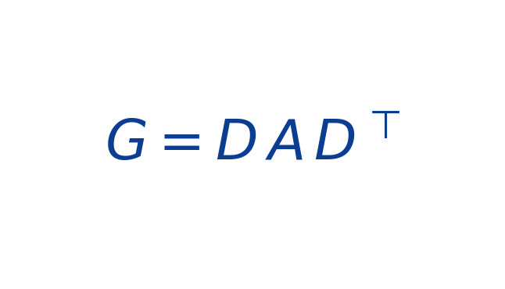
2 · The model & the two questions
Shift-encoder causal-VAE (per-cell) + do-operator
Q1 — Causality
(encoder) (linear-Gaussian SCM) (linear decoder)
Is A load-bearing? Does the learned latent DAG carry prediction, and is the projected GRN biologically real?
Perturbation = mutilated do-operator (shift S from a per-TF ESM descriptor)
Q2 — Prediction
GRN read out from the latent DAG
Can it predict a HELD-OUT TF’s effect zero-shot (unseen perturbation), from protein sequence alone?
Prior finding (27-run exp19 sweep): A is INERT and discrimination is WEAK. exp20 attacks both at the ARCHITECTURE + OBJECTIVE level (not loss tuning), retires the CollecTRI prior, and closes with a synthetic ground-truth identifiability test.
Eval is always ZERO-SHOT on held-out TF genes (gene-level split); metrics are drift-removed.

Slide 3
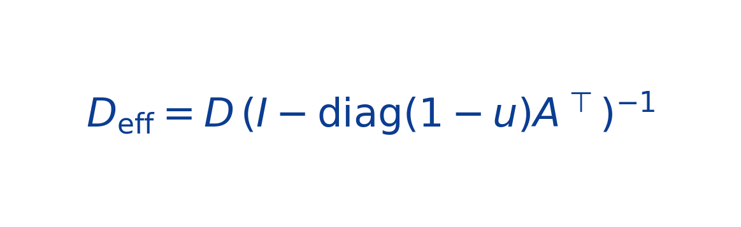
3 · Two failure modes — and the escape hatches that cause them
A inert (identifiability)
Discrimination weak (mode collapse)
• A=0 stays optimal: a per-cell ε reconstructs each cell, so A carries nothing.
• DECODER ABSORPTION — the linear decoder can absorb the SCM operator:
(see equation) → for ANY A there is a D giving identical predictions.
• A dense learned shift reproduces the propagated effect directly ⇒ A never needed.
• Consequence: A_gap ≈ 0; the "GRN" is decoder co-expression, not causal.
• Joung Δ is ~99% a shared differentiation program (one dominant mode).
• The model predicts that shared program scaled by a single magnitude scalar.
• Per-TF predictions become ~identical → crossTF_div ≈ 0.02.
• Zero-shot on unseen TFs: the ESM→effect map does not transfer at ~5% SNR.
• Consequence: discrimination pinned near chance (0.5).
These are SEPARATE problems: #1 is architecture/identifiability; #2 is objective + data SNR.

Slide 4
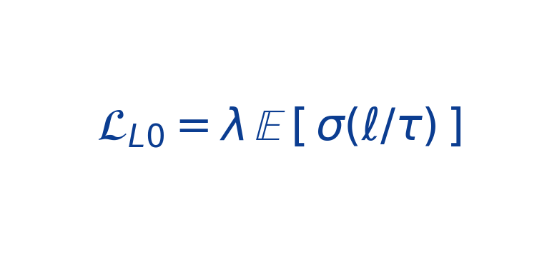
4 · What we changed — the ablation catalog
Fix / arm | What it changes | Targets
Fix 1 · structural do-op | single mutilated solve, S into exogenous noise (no z-target leak) | A inert
Fix 2 · sparse L0 gate | 2nd ESM head gates programs; L0 on gate existence (soft→hard) | A inert
prior OFF | remove CollecTRI margin loss (was memorized into G) | honest GRN
frozen GO+PCA decoder | D fixed to GO:BP membership + PCA cols (requires_grad=False) | absorption
whitened pert target | MSE on drift-removed + per-gene z-scored residual | mode collapse
staged 3-phase L0 | decouple gate-closing from A-learning (A competent first) | gate-vs-A race
nonlinear SCM | z=tanh(Aᵀz)+ε via Picard; Jacobian GRN | A expressiveness
hard self-gate | shift restricted to gene g’s own top-k decoder programs | localization
multi-context (+Norman) | 2nd cell context via modality token; ESM bridge; shared held-out | generalization
— penalize gate EXISTENCE (L0), not magnitude (L1)
~30 arms across grids x20 (prior-on), x20po (prior-off), x20arch, x20R (objective), x20frz (frozen), + synthetic.

Slide 5
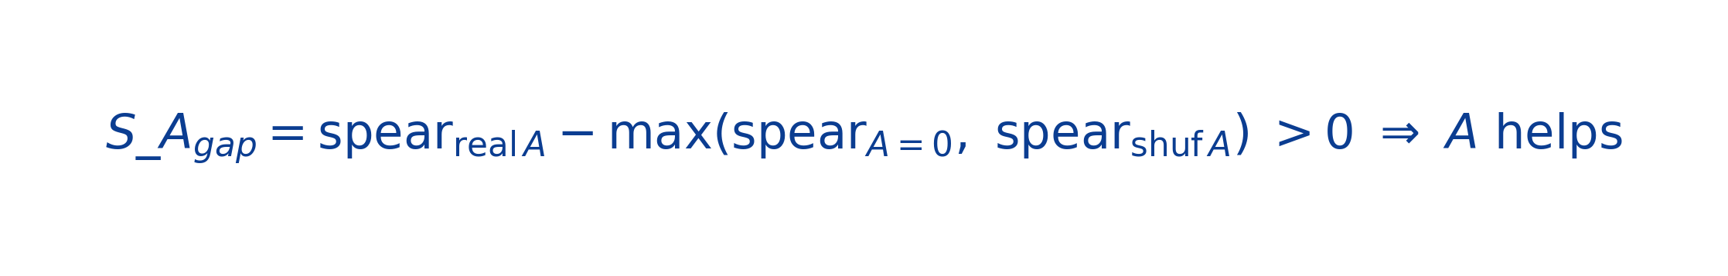
5 · Metrics & methodology (one eval script for every arm)
Prediction — zero-shot held-out TFs, drift-removed
• disc_resid = drift-removed discrimination_cos (does pred_i retrieve obs_i vs other TFs; chance 0.5)
• train vs held-out disc = overfitting / generalization gap
Causality — A load-bearing (real vs zero vs shuffled A)
• probe_A = 1−cos(Δ, Δ|A=0) — does removing A change the output (A used?)
• probe_Dperm = 1−cos(Δ, Δ|D shuffled) — decoder dominance; crossTF_div — pred diversity (mode collapse)
Biology (prior-free) — projected GRN vs known networks, with shuffle-A / random-D controls
• CollecTRI / DoRothEA AUROC + fetal-atlas fate-hierarchy AUROC (same-fate TF pairs)
All arms evaluated on the FINAL epoch-60 checkpoint (not best-by-val-loss).

Slide 6
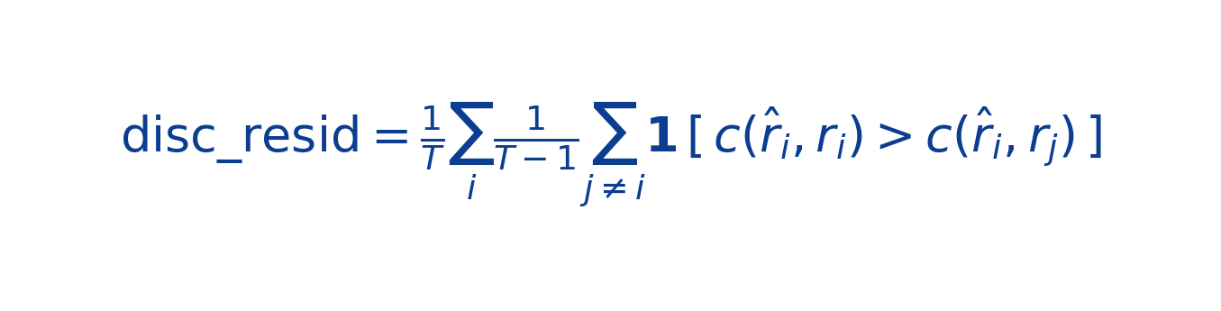
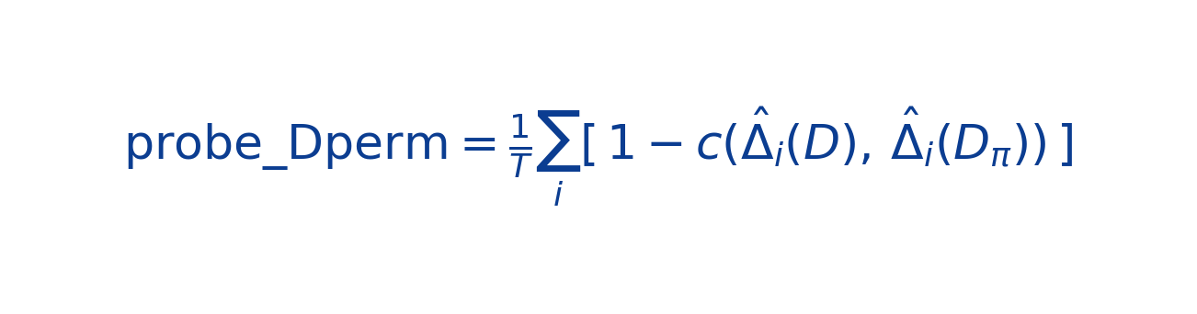
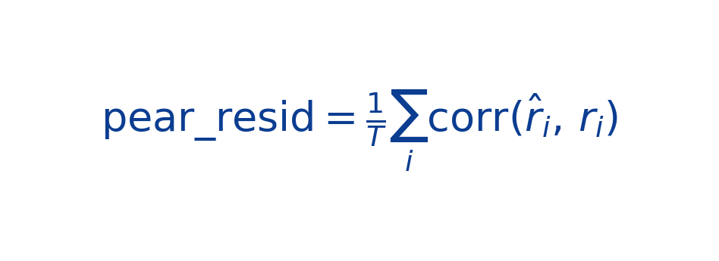
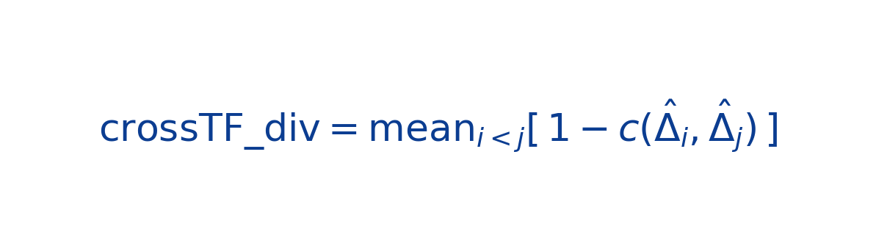
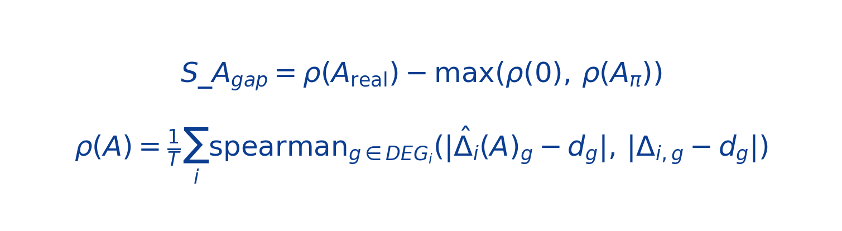
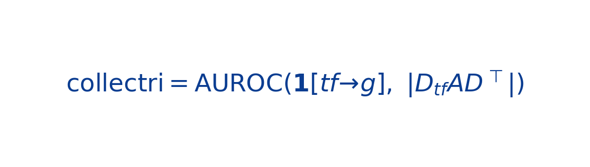
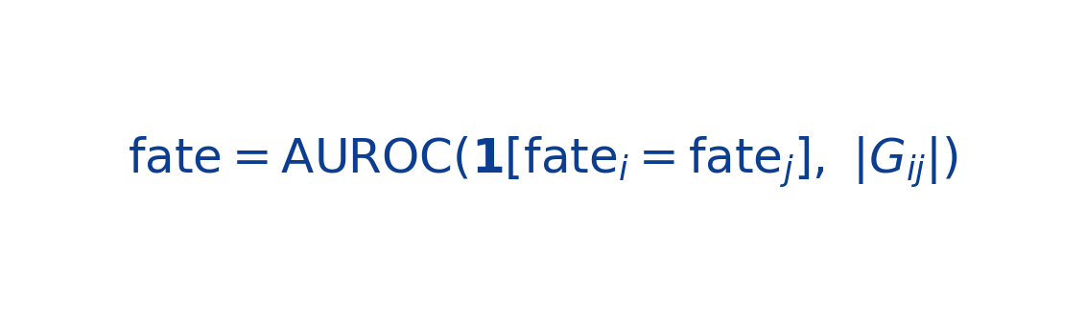
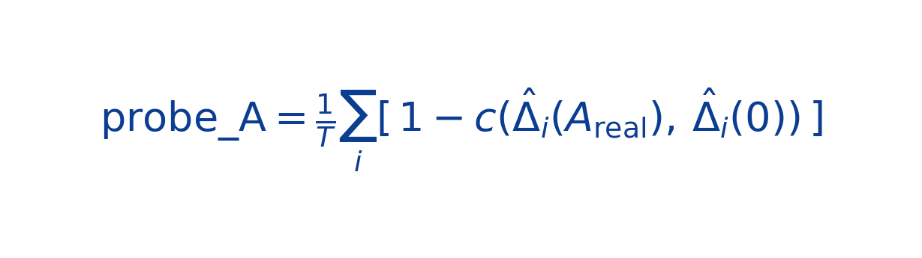
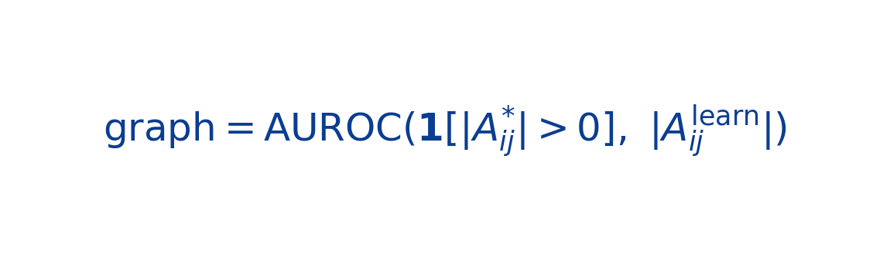
6 · Metric definitions & chance levels
c(a,b) = mean-centered cosine. r̂=pred−drift, r=obs−drift. Δ̂(A)=do-op prediction under adjacency A (A=0 zeroed, Aπ column-shuffled).
Prediction (chance 0.5)
Mechanism
Causality — is A load-bearing?
Biology (AUROC, prior-free)
KEY DISTINCTION: probe_A = “A is USED” (output changes if A removed); S_Agap = “A is USEFUL” (drift-removed prediction improves). Finding: probe_A can be 0.8 while S_Agap≈0 — used, not useful. Note: grn_dag_sweep’s “disc” column = retrieval-top-1 (chance 1/T≈0.006), NOT disc_resid (chance 0.5).

Slide 7
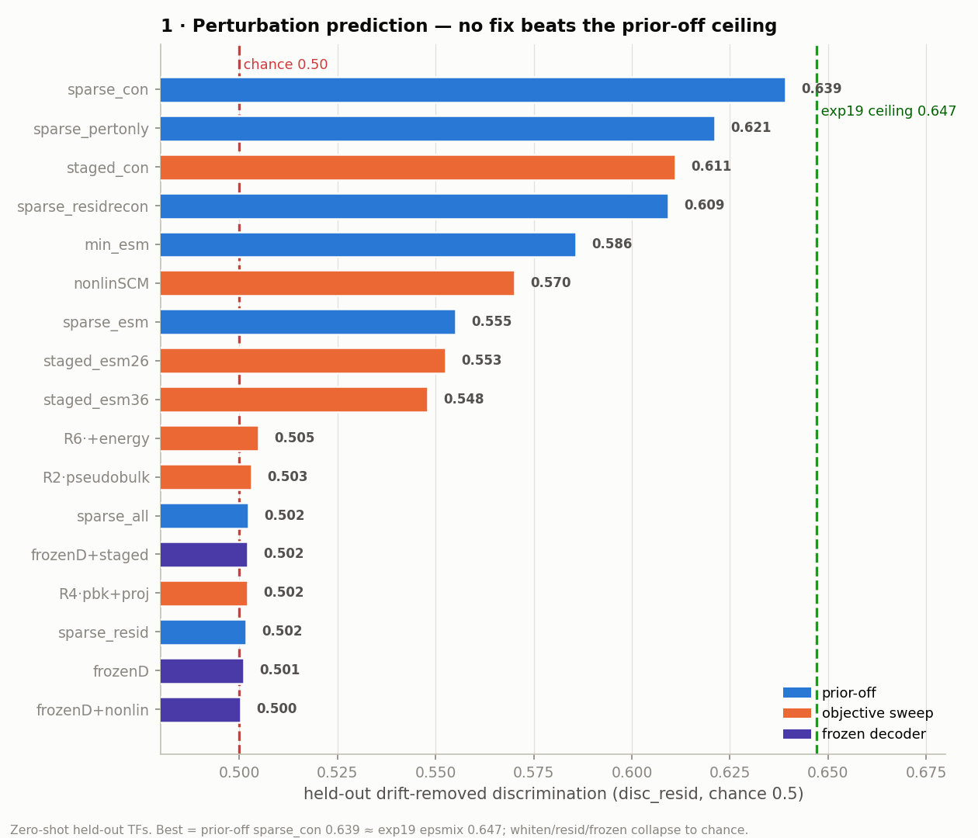
7 · Perturbation prediction — nothing beats the prior-off ceiling
• Best = prior-off sparse_con 0.639 ≈ exp19 epsmix ceiling 0.647.
• Turning the CollecTRI PRIOR OFF is the only change that helped (+0.05).
• whiten / resid / all / frozen arms COLLAPSE to chance (0.50).
• staged-L0 and nonlinear-SCM are flat-to-worse.
• Net: no architectural/objective fix beat a simple prior-off shift+decoder.
Held-out zero-shot TFs; disc_resid, chance 0.5, exp19 ceiling 0.647.

Slide 8
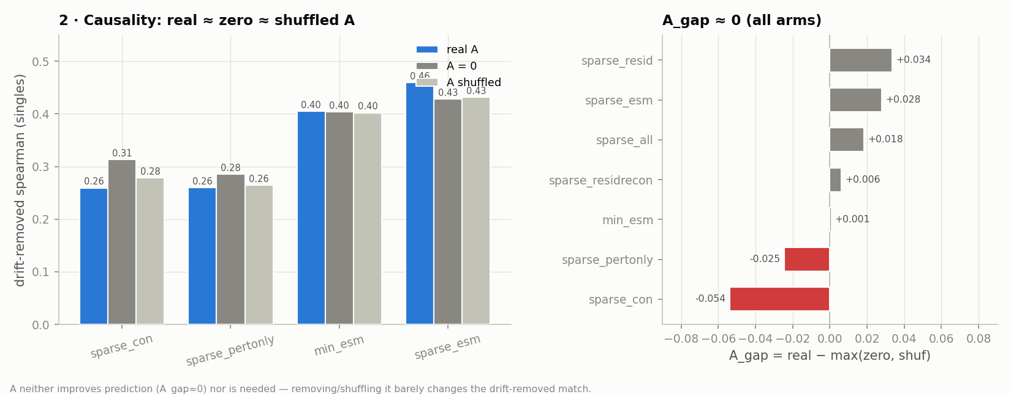
8 · Causality — A is not load-bearing
• real-A ≈ zero-A ≈ shuffled-A on drift-removed prediction; A_gap ≈ 0 for every prior-off arm (±0.05). Removing or shuffling A barely changes the match — A carries no predictive causal structure.

Slide 9
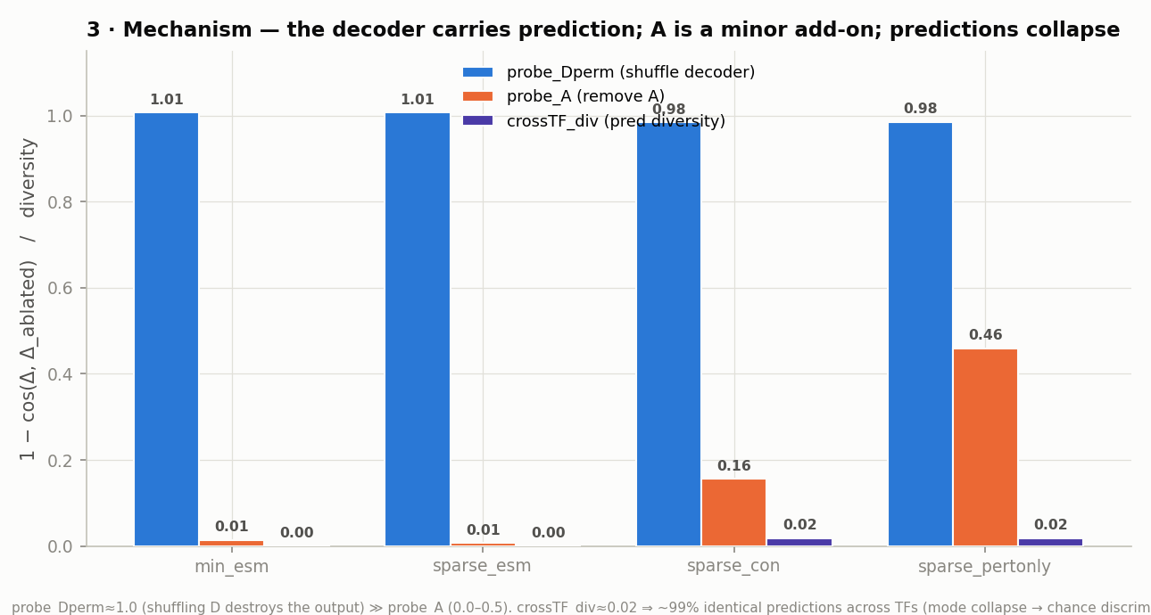
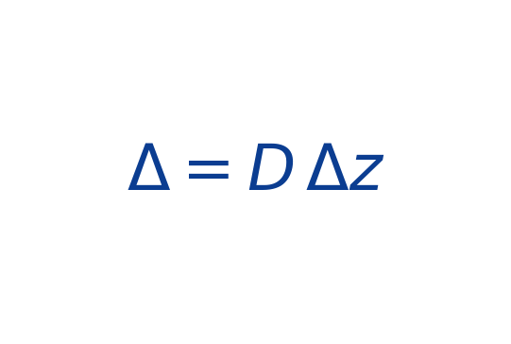
9 · Mechanism — decoder absorbs the operator; predictions collapse
Why A is redundant
• probe_Dperm ≈ 1.0: shuffling D destroys the output → D carries the gene pattern.
• probe_A ≤ 0.16 (soft gate): A a minor add-on.
• crossTF_div ≈ 0.02: ~99% identical predictions across TFs = mode collapse.
• A single scalar shift_scale absorbs 27–47% of the pert-loss gradient.
The shift is load-bearing for MAGNITUDE, not identity; the decoder carries the gene-space pattern.

Slide 10
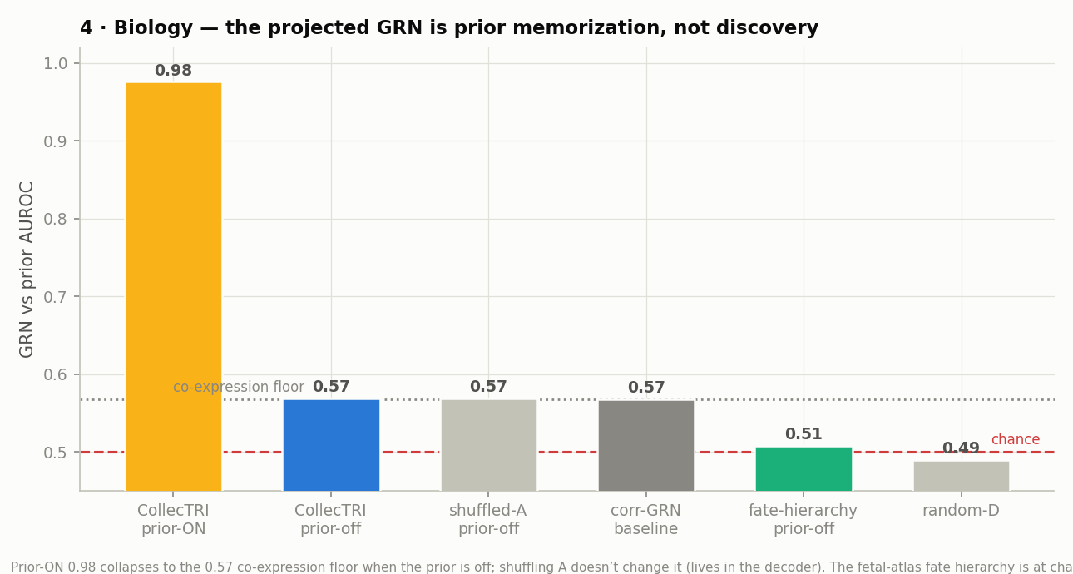
10 · Biology — the projected GRN is prior memorization
• CollecTRI AUROC 0.98 (prior ON) → 0.57 (prior OFF) = co-expression floor.
• Shuffling A does NOT drop it → the signal lives in the decoder (D·Dᵀ), not A.
• Fetal-atlas FATE hierarchy: AUROC 0.51 = chance → no developmental structure.
• random-D → chance confirms D carries the (co-expression) signal.
Prior-free GRN validation: neither TF→target edges nor developmental hierarchy are recovered from data.

Slide 11
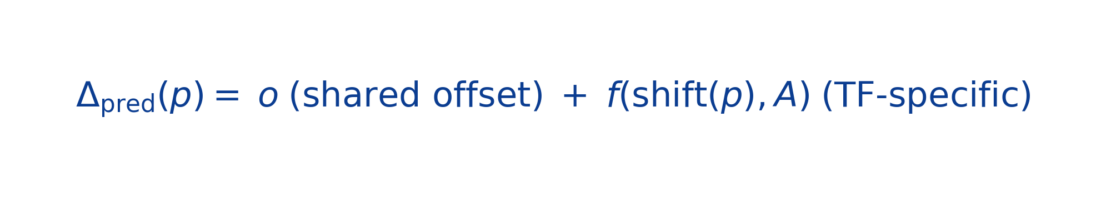
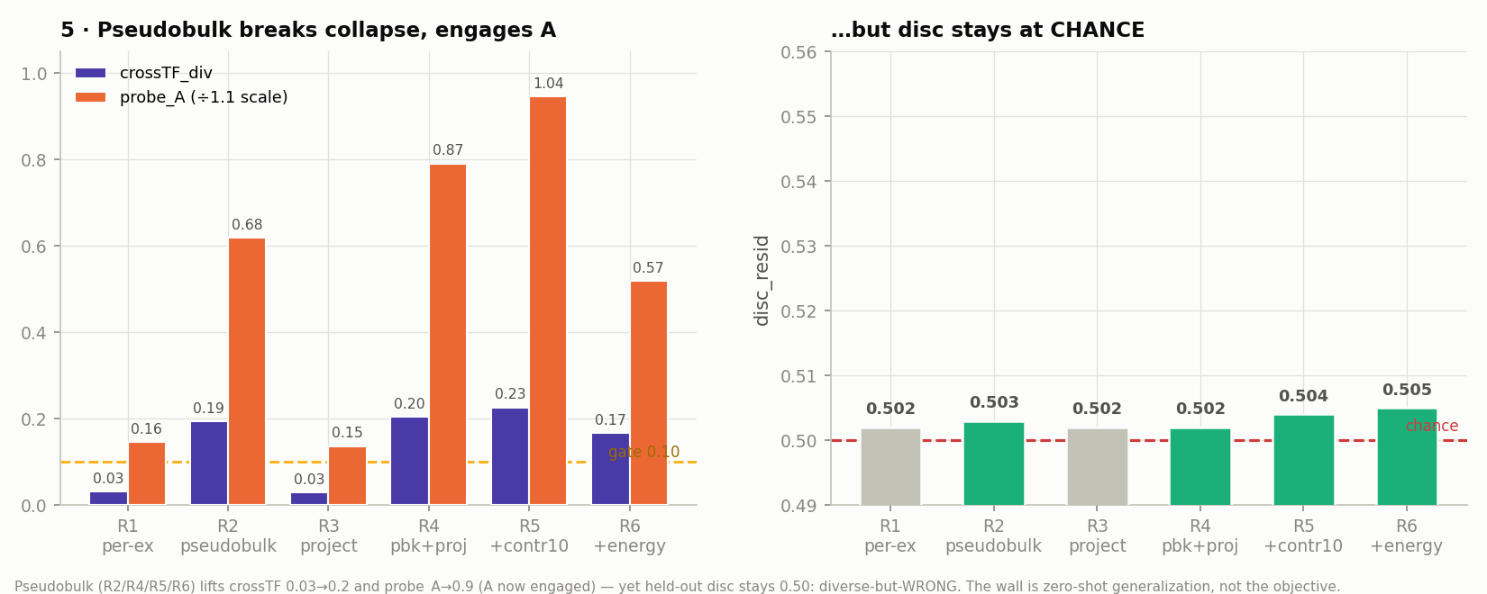
11 · Objective sweep — break mode collapse, but not generalization
Lever A: pseudobulk per-TF target (SNR). Lever B: project the shared direction out of the loss.
• Pseudobulk (Lever A) lifts crossTF_div 0.03→0.2 and probe_A→0.9 (A engaged) — but disc stays at chance: diverse-but-WRONG. Project-out alone (R3) does nothing. The binding constraint is zero-shot generalization.

Slide 12
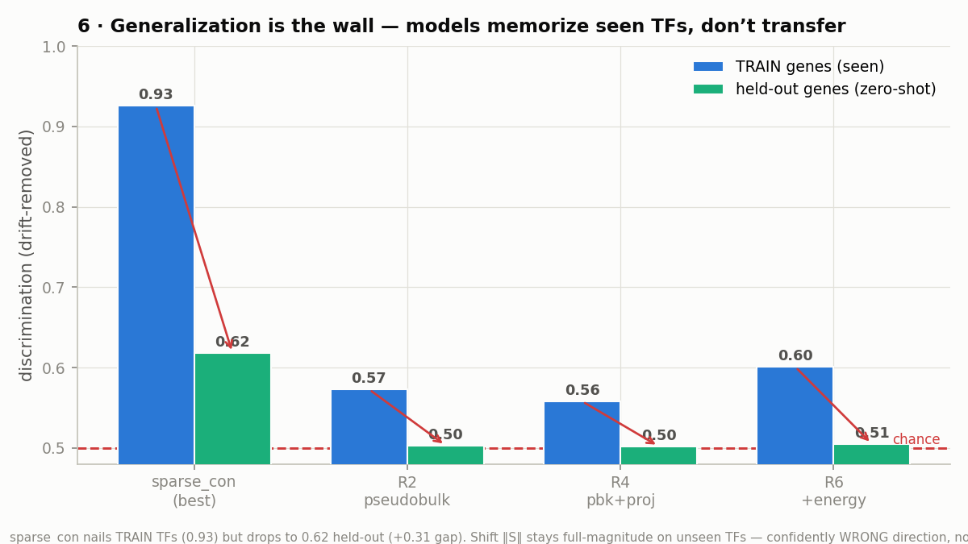
12 · Generalization is the wall — memorize seen, fail unseen
• sparse_con: TRAIN disc 0.93 → held-out 0.62 (+0.31 gap).
• On seen TFs the model discriminates almost perfectly; it just does not transfer.
• Shift ‖S‖ stays full-magnitude on unseen TFs → confidently WRONG direction (not mean-regression).
• pseudobulk arms fit train worse (0.56) and still fail held-out.
The failure is zero-shot generalization of the TF→effect map — not fitting capacity.

Slide 13
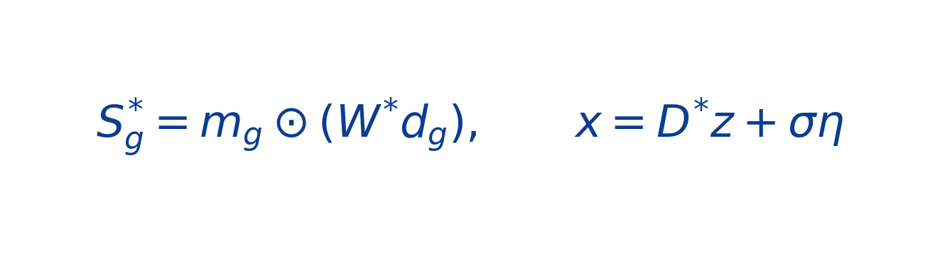
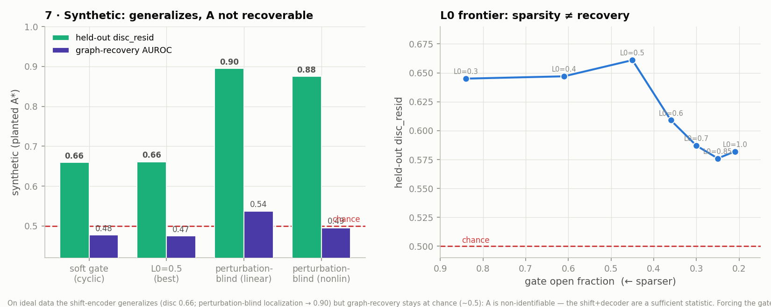
13 · Synthetic control — method sound, A non-identifiable
planted A*, sparse shift LINEAR in the descriptor (generalizable)
• Planted A*/D*/generalizable shift: the shift-encoder GENERALIZES (disc 0.66; perturbation-blind localization → 0.90) but graph-recovery AUROC stays at CHANCE (~0.5) — A is non-identifiable (shift+decoder are a sufficient statistic).

Slide 14
14 · Master results (representative arms, prior-off)
arm | fix | disc_resid | S_Agap | crossTF | verdict
sparse_con | baseline (best) | 0.639 | −0.05 | 0.02 | ceiling; A idle
sparse_pertonly | baseline | 0.621 | −0.03 | 0.02 | —
staged_con | staged L0 | 0.611 | −0.05 | — | no gain
nonlinSCM | nonlinear SCM | 0.570 | −0.08 | — | worse; A anti-useful
staged_esm | staged L0 (no-con) | 0.553 | +0.05 | — | no rescue
R4 | pseudobulk+proj | 0.502 | +0.03 | 0.20 | collapse; crossTF↑ probeA↑
whiten | whitened target | 0.500 | +0.06 | — | collapse to chance
frozenD64 | frozen decoder | 0.501 | +0.00 | 0.02 | collapse (basis span)
frozenD64_nonlin | frozen + nonlinear | 0.500 | +0.01 | 0.00 | collapse
Reference: exp19 best (epsmix, prior-on) disc_resid 0.647 · Joung split-half discriminability ceiling ≈ 5% · CollecTRI prior-on 0.97 → prior-off 0.57 (memorization). A is used-but-not-useful wherever the gate opens; no arm both discriminates AND uses A.
Full 22-arm table in docs/MASTER_ALL.md; figures in docs/figures/.

Slide 15
15 · Verdict & the two real levers
CONCLUSION — The architecture is sound (it generalizes on ideal synthetic data). On Joung the binding constraint is ZERO-SHOT GENERALIZATION of the TF→effect map (models memorize seen TFs, disc 0.93→0.62). And A is NON-IDENTIFIABLE / redundant in this shift-based class — even with a planted graph — because the shift + decoder are a sufficient statistic.
Two levers (neither is "more SCM machinery on Joung")
A · Multi-context (Norman)
B · Different identification
• Add K562 CRISPRa as a 2nd context (modality token + ESM bridge).
• Lets the model separate context-shared from TF-specific signal.
• Directly targets the generalization ceiling. (JN0/JN1 in flight.)
• Load-bearing A needs a setup where the shift CANNOT express propagation.
• e.g. fit A to the interventional DISTRIBUTION (discrepancy-VAE).
• Hard self-gate localization + frozen decoder tested; still redundant.
In flight: J1/J2 (hard self-gate localization) + JN0/JN1 (Joung+Norman multi-context, 43 shared TFs).

